Slide 1
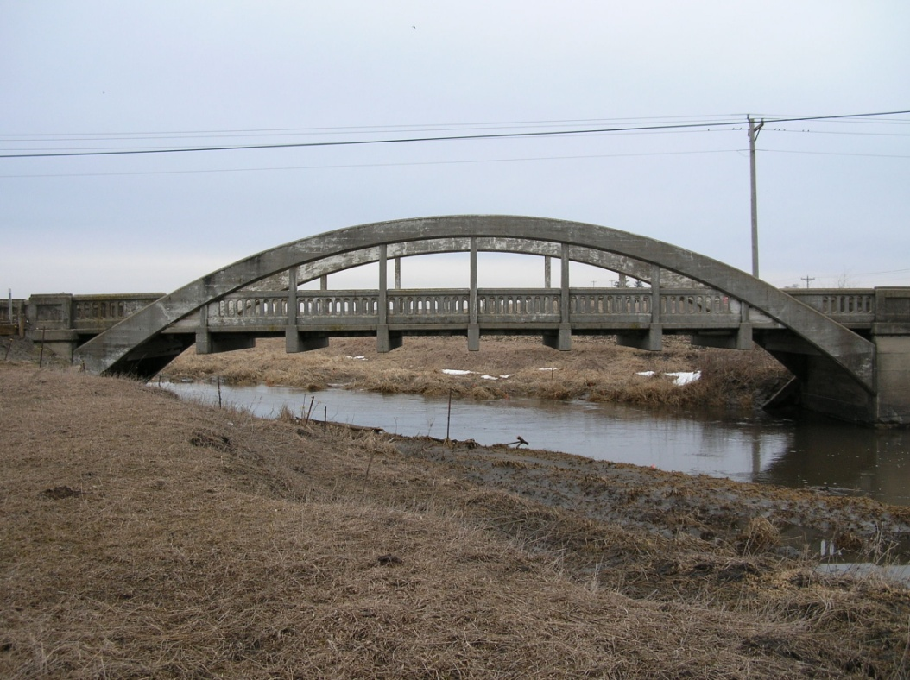
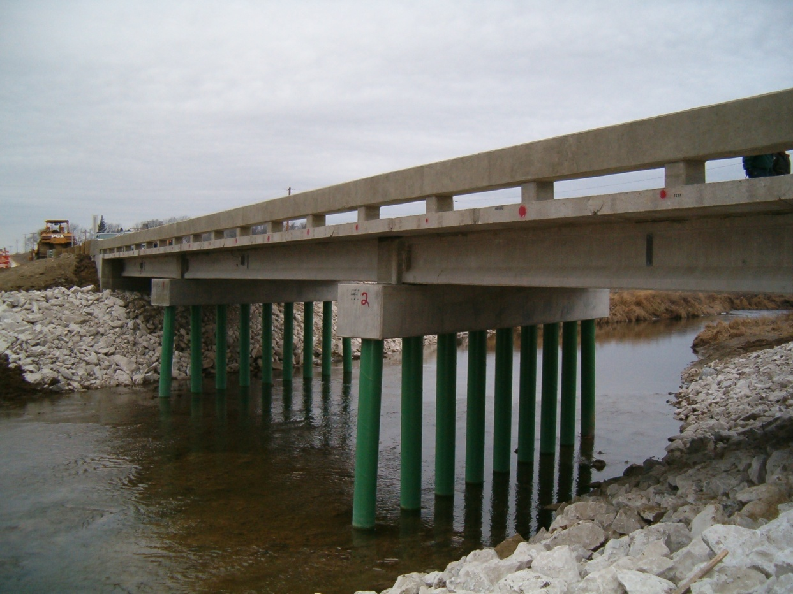
Boone County Mackey Bridge

Slide 2
Overview
Design by Iowa DOT
First ABC concept in Iowa
3 span pre-stressed girder
47’-5, 56’-6, 47’-5 Spans
151’ long x 33’ wide
Precast substructure and superstructure elements
Winning Bid Total $737,098
Bridge Bid $509,173
Bridge Unit Cost $90/SF
Notes:
Panels 8 ft? long (in long. Direction) with 60 deg skew…..

Slide 3
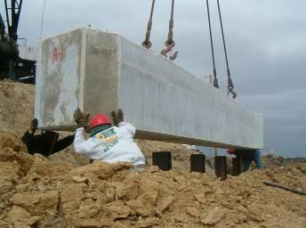
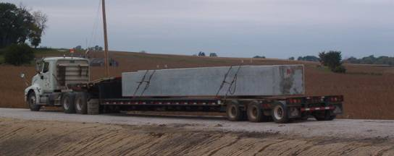
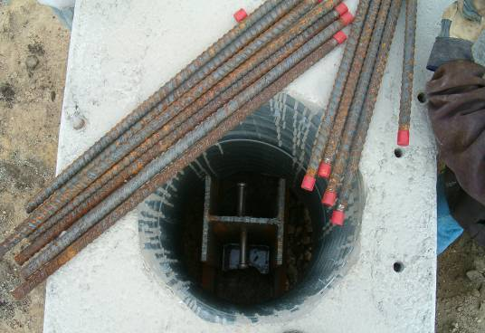
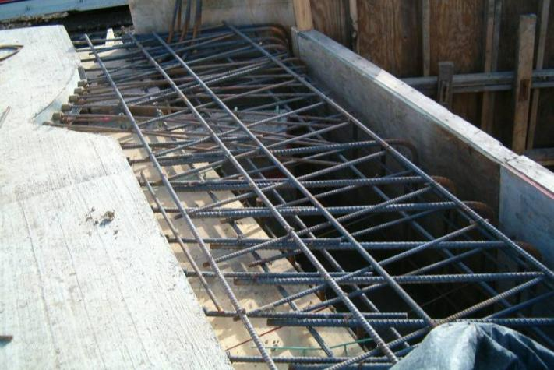
Substructure
Notes:
Integral abutment casts in place…another step on critical path
High early strength concrete mix in blockouts

Slide 4
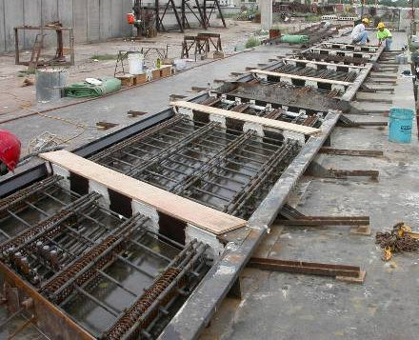
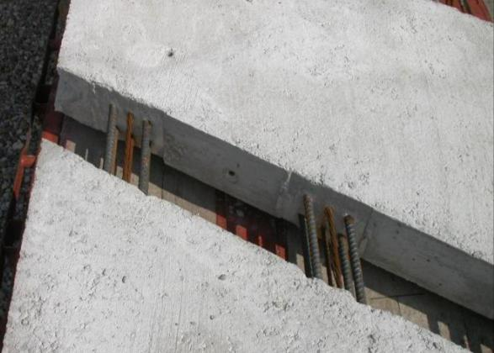
Superstructure
32 Interior deck panels
Each ½ bridge width
4 End panels with PT
anchorage zones
Pretensioned transversely
Post-tensioned longitudinally
Notes:
8 ft 1 by 16 ft 1 and 8 ¼ in deep with female to female transverse joints and diamond plates

Slide 5
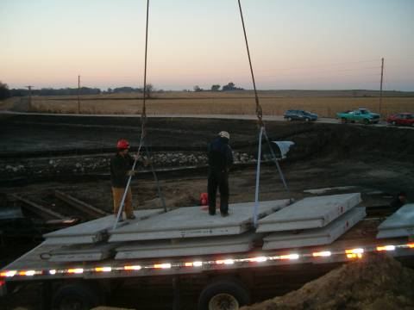
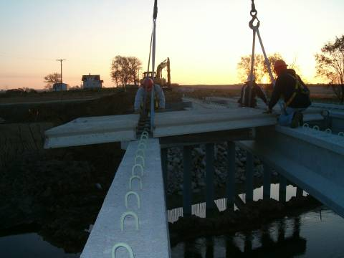
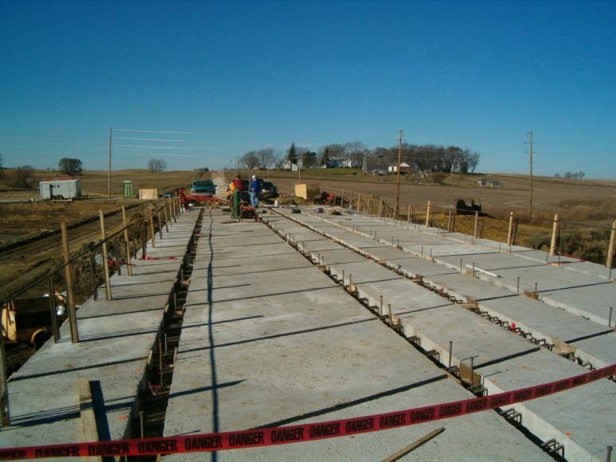
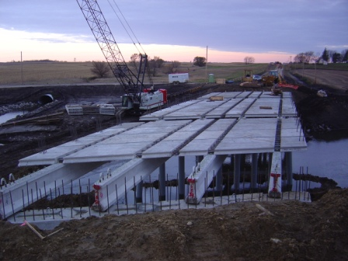
Notes:
Modified LXA beams - spacing 8’-4
Setting Panels
Leveling Panels
Casting Transverse Joints
Post-Tensioning
Casting Longitudinal Joints and Abutment Diaphragms

Slide 6
Monitoring Program
Evaluate
Structural performance of precast concrete bridge elements in the laboratory
Constructability of connections
Handling of components
Monitor and evaluate structural performance of bridge during and after construction
Notes:
Technical part is obj 1
Important nontechnical issue is to request supplemental funding to produce a better product from work research already initiated and funded by others

Slide 7
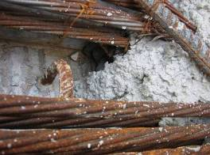
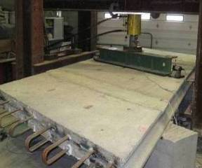
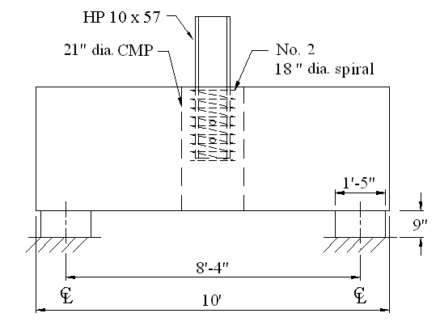
Laboratory Tests

