Slide 1
Freight Advisory Council
Role & Input

Slide 2
Question
How does the input that the FAC provides ultimately inform the Iowa Transportation Commission?

Slide 3
Generalized process and roles
step2
DOT staff
develops recommendations
Various planning and programming items
step1
FAC
step3
Transportation Commission
advises DOT staff
acts on staff recommendations
General freight issues
Planning priorities
Funding programs
State Long-Range Transportation Plan
Grant Programs
Five Year Program

Slide 4
What does effective input look like?
Examples from Iowa DOT perspective
Continuous staff learning
State Freight Plan/Rail Plan development
LIFTS program development
Project Prioritization tool refinement

Slide 5
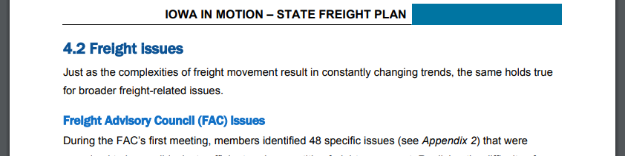
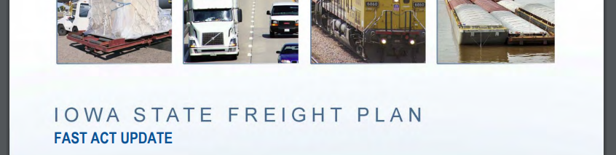
State Freight Plan development
Freight issues identification
Freight bottleneck evaluation
Plan document
review & comment

Slide 6
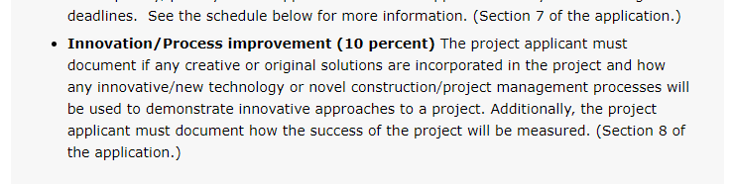
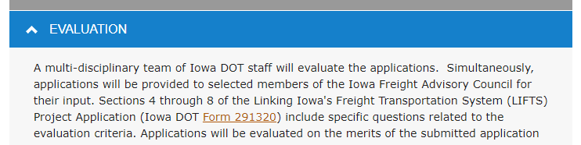
LIFTS Program development
Evaluation criteria
Criteria weighting
Application
review & comment

Slide 7
Project Prioritization tool refinement
Evaluation criteria
Criteria weighting
Project Prioritization tool update:
Freight factor being modified based on FAC input (freight utilization and value)
Previously based on proximity to freight generating facilities
Modified focus on truck traffic and bottlenecks (value to freight efficiency)

Slide 8
Simplified process
step2
DOT staff
develops recommendations
Various planning and programming items
step1
FAC
step3
Transportation Commission
advises DOT staff
acts on staff recommendations
General freight issues
Planning priorities
Funding programs
State Transportation Plan
Grant Programs
Five Year Program

Slide 9
What should effective input look like?
FAC discussion

Slide 10
THANK YOU FOR YOUR TIME AND ATTENTION

