Slide 1



Iowa Contractors:
Obtaining Your Railroad Crossing Information February 18, 2016

Slide 2
Iowa Contractors: Obtaining Your Railroad Crossing Information
Bidding Documents can be found at
https://www.bidx.com
or at
http://www.iowadot.gov/contracts/lettings.html
01
All information needed to bid on an Iowa DOT Highway Project Proposal/Bid Order with Railroad Involvement is available from the Iowa DOT Contract Documents and the Federal Railroad Administration (FRA) Crossing Database Website
Plan Set Title Sheet
Railroad Specification (DS/SP) Document
http://safetydata.fra.dot.gov/OfficeofSafety/PublicSite/Crossing/Crossing.aspx

Slide 3
Data Sheet Background
The current process, using a Railroad Data Sheet, is being eliminated with May 17, 2016 Letting
02
Datasheets were developed many years ago to aid in the determination of railroad protective insurance policies for projects with railroad involvement and to indicate the point of contact at the Railroad.
* Train Volume, Speed, Number of Tracks
1
Railroads report train information directly to the Federal Railroad Administration (FRA). FRA maintains a database of the crossing information and it is available to the public.
2
Iowa DOT has been using the FRA Database Website to provide the railroad crossing information in the railroad data sheet.
3
Effective March 2016 the railroads will be required to report to FRA train changes no later than 6 months after the change. If no changes occur the railroad will be required to report at least once every three years to the FRA. The FRA is the official source via the FRA crossing inventory website.
4

Slide 4
Iowa Contractors: Obtaining Your Railroad Crossing Information
03
Railroad Data Sheet
Information currently provided on railroad Data Sheet:
Project information
Railroad Contact
Train Data at Project Railroad Crossing

Slide 5
Iowa Contractors: Obtaining Your Railroad Crossing Information
03
Railroad Data Sheet
Information currently provided on railroad Data Sheet:
Project information
Railroad Contact
Train Data at Project Railroad Crossing

Slide 6
Iowa Contractors: Obtaining Your Railroad Crossing Information
03
Railroad Data Sheet
Information currently provided on railroad Data Sheet:
Project information
Railroad Contact
Train Data at Project Railroad Crossing

Slide 7
Iowa Contractors: Obtaining Your Railroad Crossing Information
03
Railroad Data Sheet
Information currently provided on railroad Data Sheet:
Project information
Railroad Contact
Train Data at Project Railroad Crossing
The datasheet does NOT provide the type of Railroad Protective Insurance coverage or limits needed for each railroad or project.

Slide 8
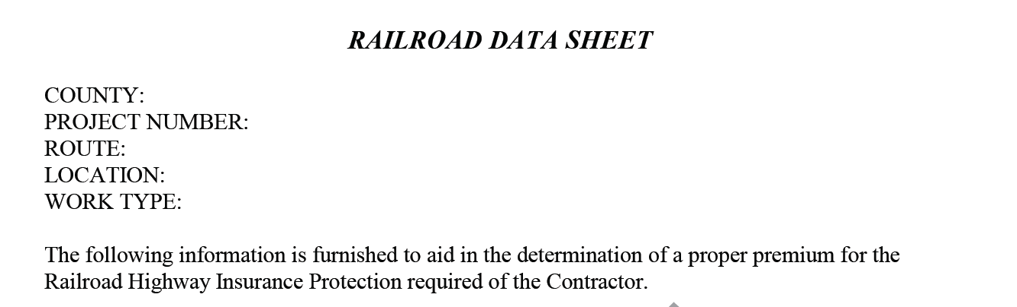
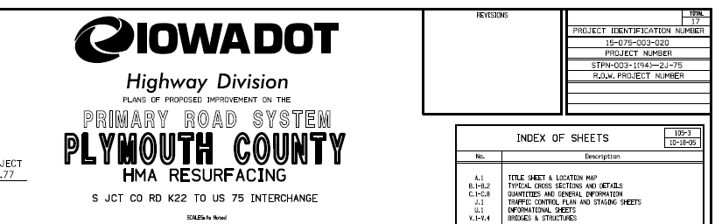
Iowa Contractors: Obtaining Your Railroad Crossing Information
Project Information
04
Plan Set Title Sheet or Proposal

Slide 9
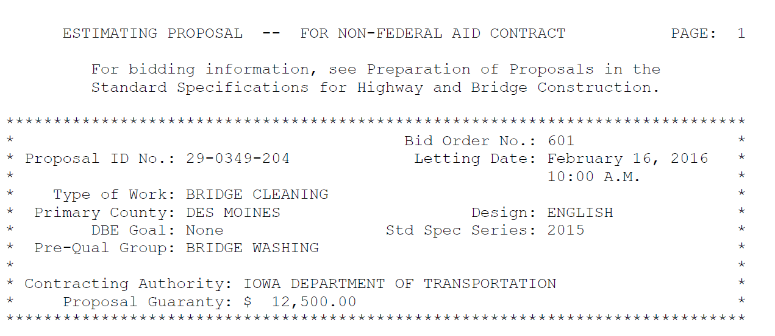
Iowa Contractors: Obtaining Your Railroad Crossing Information
Project Information
04
Plan Set Title Sheet or Proposal

Slide 10
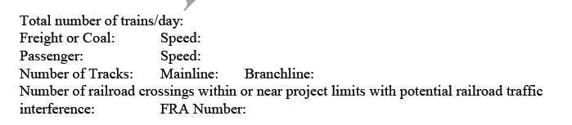
Iowa Contractors: Obtaining Your Railroad Crossing Information
05
Railroad Crossing Data:
FRA Number on Plan Set Title Sheet

Slide 11
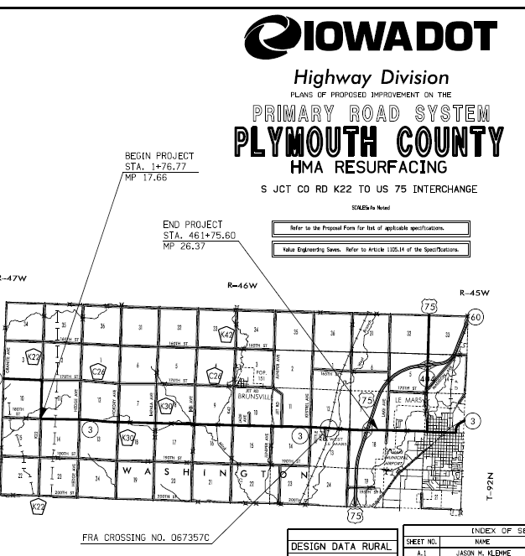
Iowa Contractors: Obtaining Your Railroad Crossing Information
05
Railroad Crossing Data:
FRA Number on Plan Set Title Sheet

Slide 12
Iowa Contractors: Obtaining Your Railroad Crossing Information
05
Railroad Crossing Data:
FRA Number on Plan Set Title Sheet
FRA Crossing No. 067357C will be entered at the FRA Website from the link provided in the Railroad specification document.

Slide 13
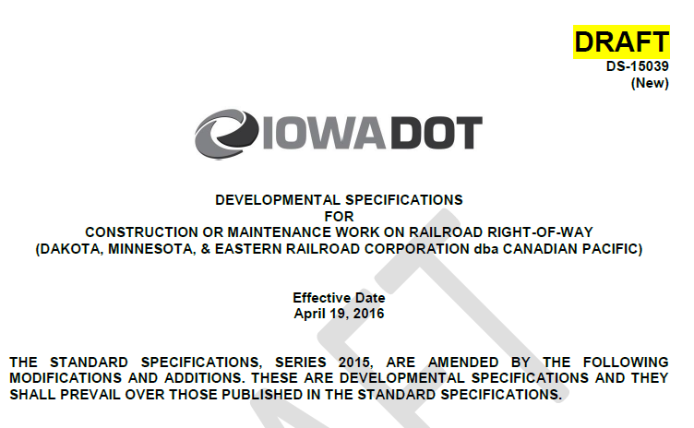
Railroad Specification Document (DS or SP)
06
FRA Website Link
Railroad Contact Information
All Railroads have an individual specification document either as a Developmental Specification or a Special Provision with the required insurance coverage and limits.

Slide 14
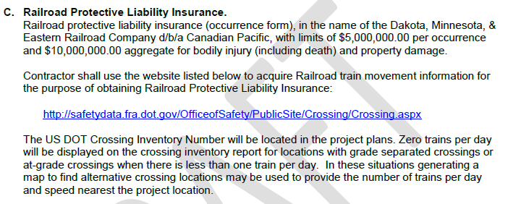
Railroad Specification Document (DS or SP)
06
FRA Website Link
Railroad Contact Information
All Railroads have an individual specification document either as a Developmental Specification or a Special Provision with the required insurance coverage and limits.

Slide 15
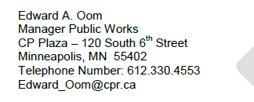
Railroad Specification Document (DS or SP)
06
FRA Website Link
Railroad Contact Information
All Railroads have an individual specification document either as a Developmental Specification or a Special Provision with the required insurance coverage and limits.

Slide 16
http://safetydata.fra.dot.gov/OfficeofSafety/PublicSite/Crossing/Crossing.aspx
07

Slide 17
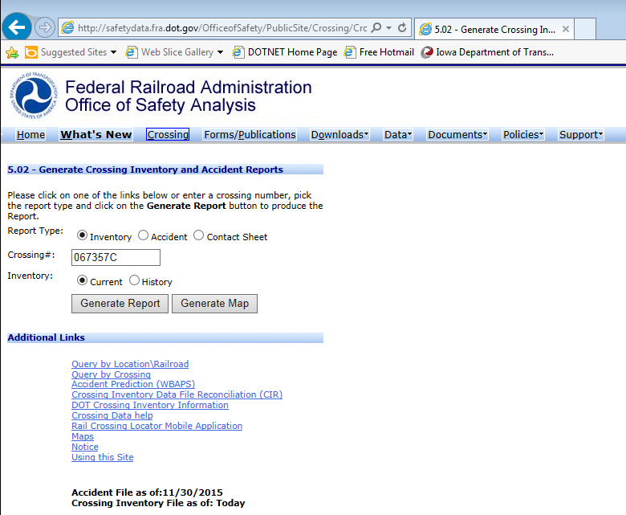
http://safetydata.fra.dot.gov/OfficeofSafety/PublicSite/Crossing/Crossing.aspx
07

Slide 18
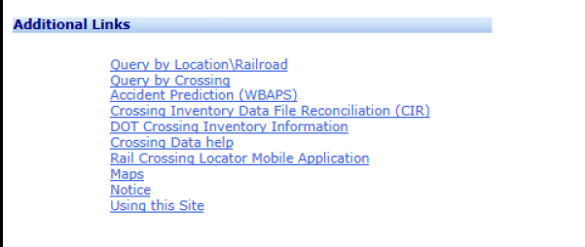
http://safetydata.fra.dot.gov/OfficeofSafety/PublicSite/Crossing/Crossing.aspx
07

Slide 19
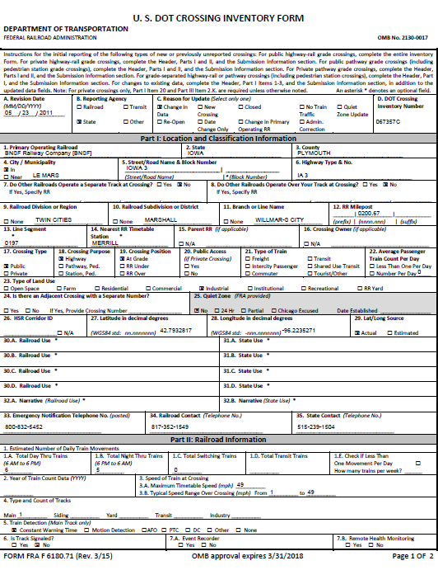
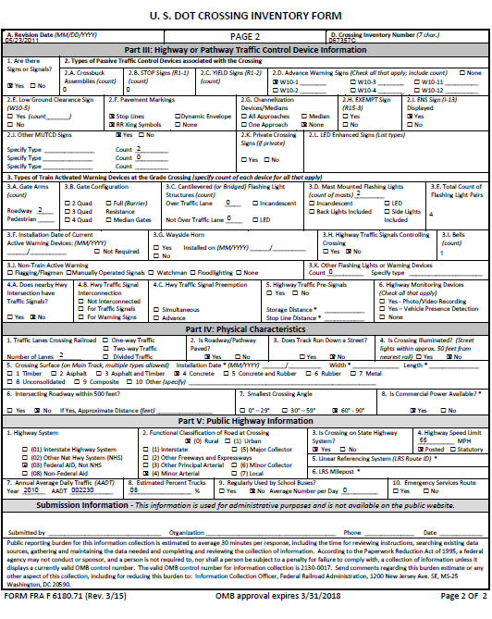
FRA Crossing Inventory Report

Slide 20
FRA Crossing Inventory Report

Slide 21
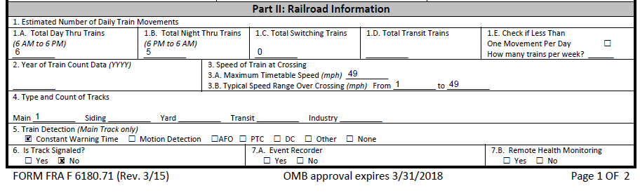
FRA Crossing Inventory Report

Slide 22
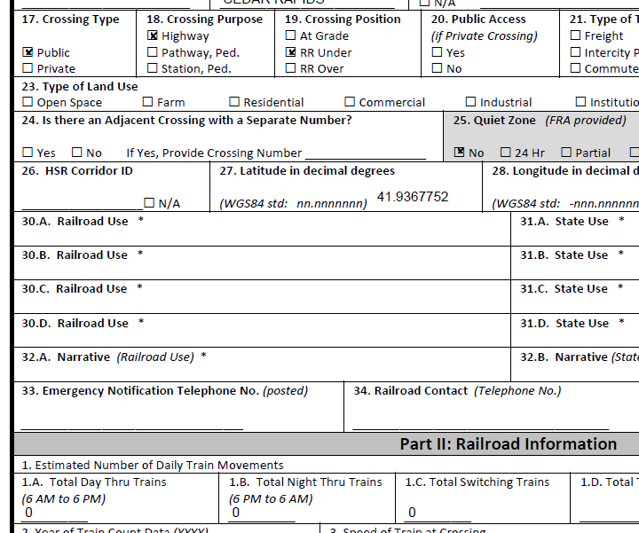
FRA Report indicates zero (0) trains per day at a crossing location.
09

Slide 23
FRA Report indicates zero (0) trains per day at a crossing location.
09
Grade Separated Crossings will display zero “0” for the number of trains per day.

Slide 24
FRA Report indicates zero (0) trains per day at a crossing location.
09
Grade Separated Crossings will display zero “0” for the number of trains per day.
Crossings with less than one (1) train per day will display zero “0” on the report.

Slide 25
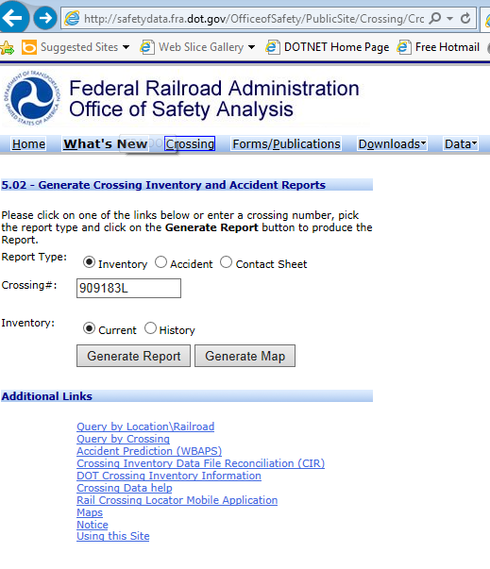
What do you do when the FRA Report indicates zero (0) trains per day at a crossing location?
10
The FRA Database website can be used to find an alternate crossing by using the “Generate Map” or “Query by Location” search options

Slide 26
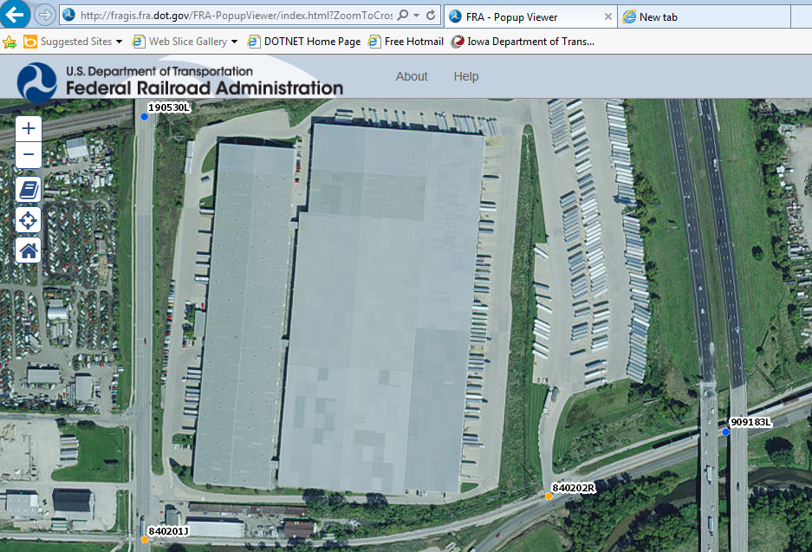
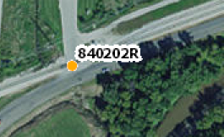
Use the FRA Database to “Generate Map” and use the next closest crossing number instead

Slide 27
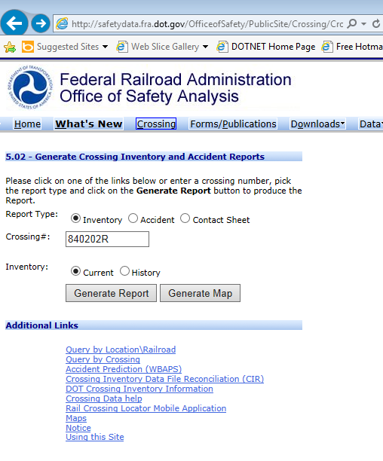
Use the FRA Database to “Generate Report of next crossing number and use the data
12

Slide 28
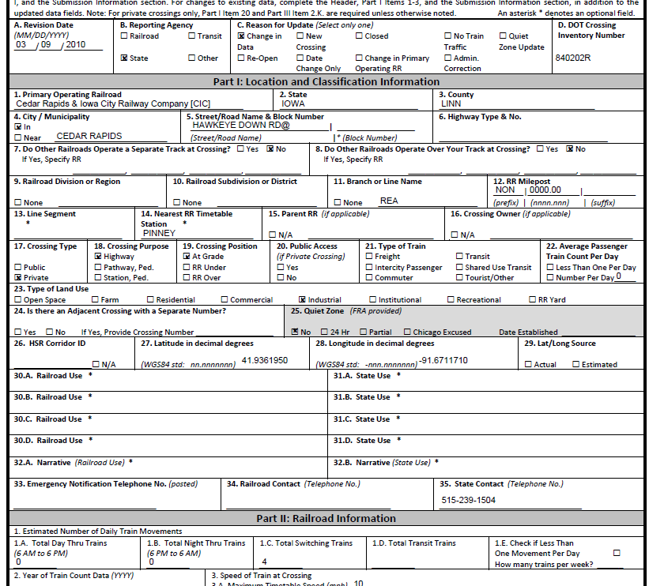
Use the FRA Database to “Generate Report of next crossing number and use the data
12

Slide 29
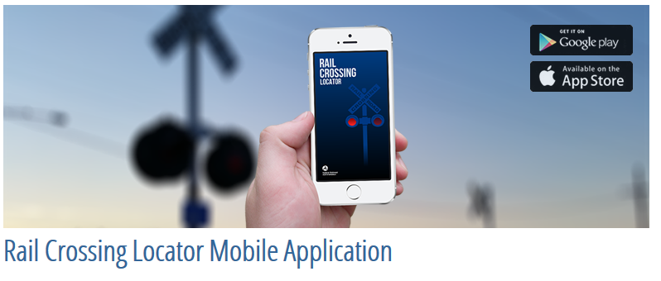
Iowa Contractors: Obtaining Your Railroad Crossing Information
Rail Crossing Locator Mobile Application
13
With location services turned on it will find the crossings that you are near on the map!

Slide 30
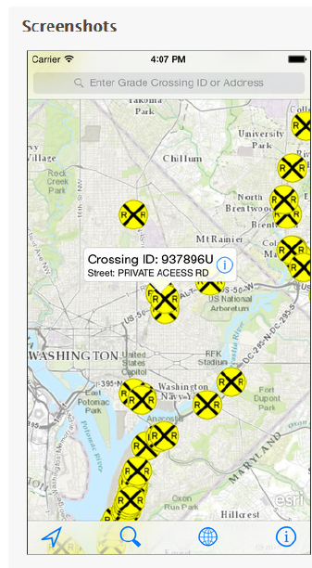
Iowa Contractors: Obtaining Your Railroad Crossing Information
Rail Crossing Locator Mobile Application
13
With location services turned on it will find the crossings that you are near on the map!

Slide 31
Conclusion
The Plan Set Title Page will provide you the FRA Crossing Number
  Each railroad will have an individual DS or SP for their company
The Railroad Specification will provide:
    FRA Database Website to generate a railroad crossing inventory report
    will provide you the railroad contact name
    required railroad protective insurance policy coverage and limits. *Each railroad can request different coverage
    Track Protection, Contractor Safety Training Requirements, Notification period prior to starting work, other important information.
  Chicago, Central & Pacific/Cedar River Railroad/ CN: DS
  Union Pacific Railroad Company: DS-Construction and DS- Maintenance
  Canadian Pacific/ DM & E/CP: Just finalized DS
  An SP Document exists for all other railroads
    Contact Information:
  Maria Hobbs, Office of Rail, 515-239-1088, maria.hobbs@dot.iowa.gov
14

