Slide 1

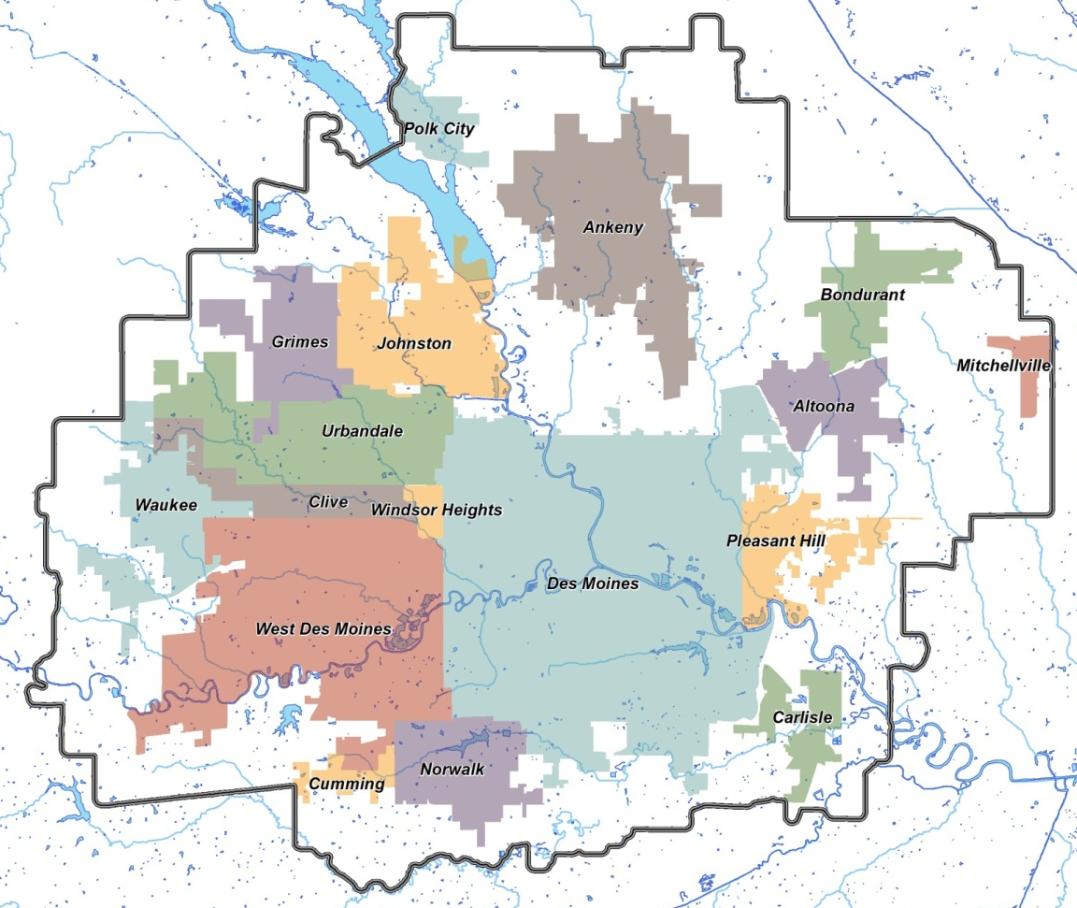
ADDITIONAL MEMBERS:
Dallas County
DART
Polk County
Warren County
EXECUTIVE COMMITTEE
BOB ANDEWEG (Chair)
Mayor, Urbandale
STEPHANIE RIVA (Vice Chair) Council, Norwalk
TED WEAVER (Secretary/Treasurer)
Council, Clive
MARK HOLM
Mayor, Ankeny
JEFF WALTERS
Council Polk City
RUTH RANDLEMAN
Council, Carlisle
FRANK COWNIE
Mayor, Des Moines
JOE GATTO
Council, Des Moines
RUSH TRIMBLE
Mayor, West Des Moines
ELIZABETH BURNS-THOMPSON Council, Altoona
TOM HOCKENSMITH
Supervisor, Polk County
Members
Altoona • Ankeny • Bondurant • Carlisle • Clive • Dallas County • Des Moines • DART • Grimes • Johnston • Mitchellville • Norwalk • Pleasant Hill • Polk City • Polk County • Urbandale • Warren County • Waukee • West Des Moines • Windsor Heights
CONTACT
TODD ASHBY
CEO and Executive Director
420 Watson Powell Jr. Pkwy Suite 200
Des Moines, IA 50309
515-334-0075
www.dmampo.org
CONTACT
About the Des Moines Area MPO:
The Des Moines Area MPO is a federally required organization (23 CFR § 450.310) that provides a regional forum to assure local, state, and federal agencies and the public coordinate on transportation and regional planning issues, prepare plans and programs, and allocate federal transportation funding. The Des Moines Area MPO develops both long-range and short-range multimodal transportation plans, selects and approves projects for federal funding based on regional priorities, and develops ways to manage traffic congestion. Its members include 16 cities, 3 counties, and DART.

Slide 2
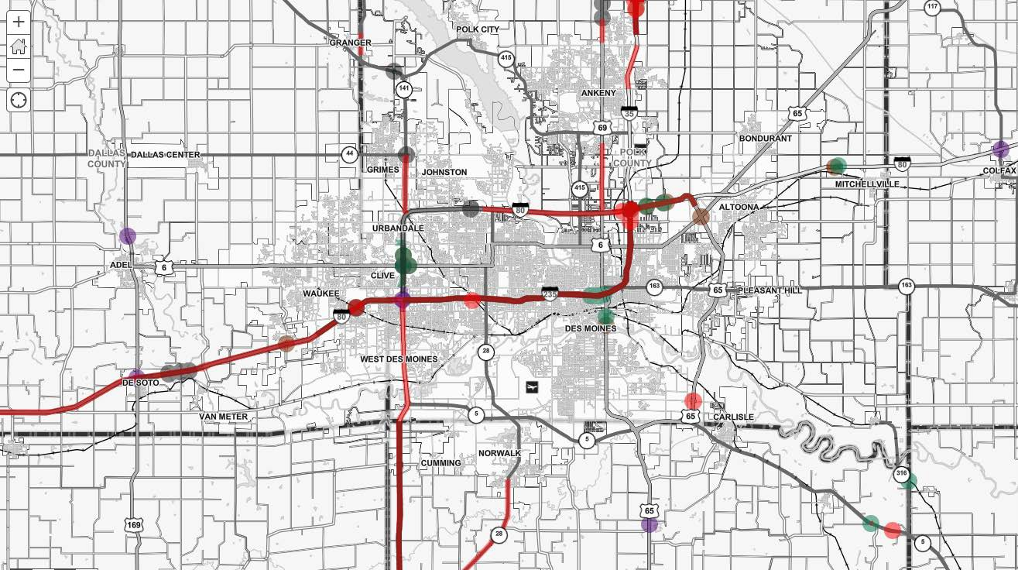

9
DISTRICT 1
PROGRAMMED PROJECTS
(2023-2027)

Slide 3
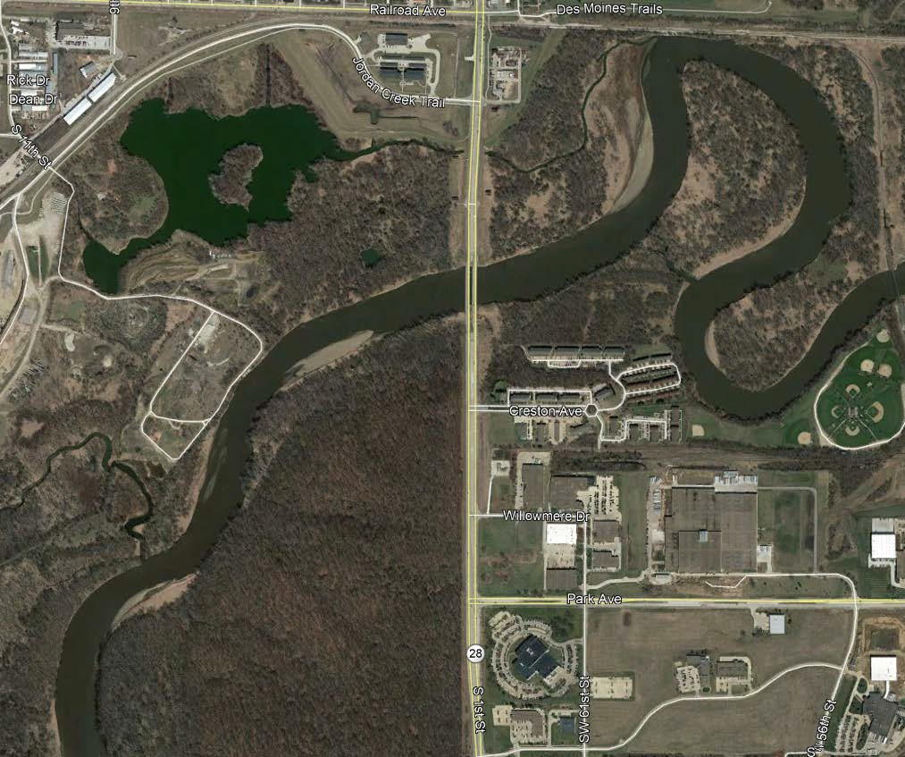
8
Iowa 28 over the Raccoon River
($6.6M 2022)
SB Bridge Replacement

Slide 4
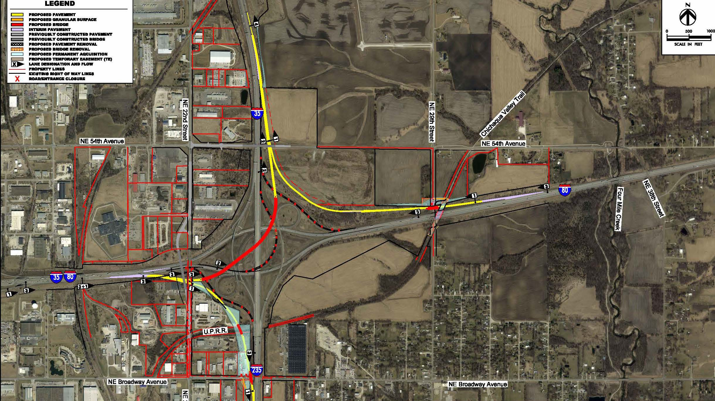
I-35/80/235
SYSTEMS INTERCHANGE ($69.5M total 2023-2025)
10

Slide 5


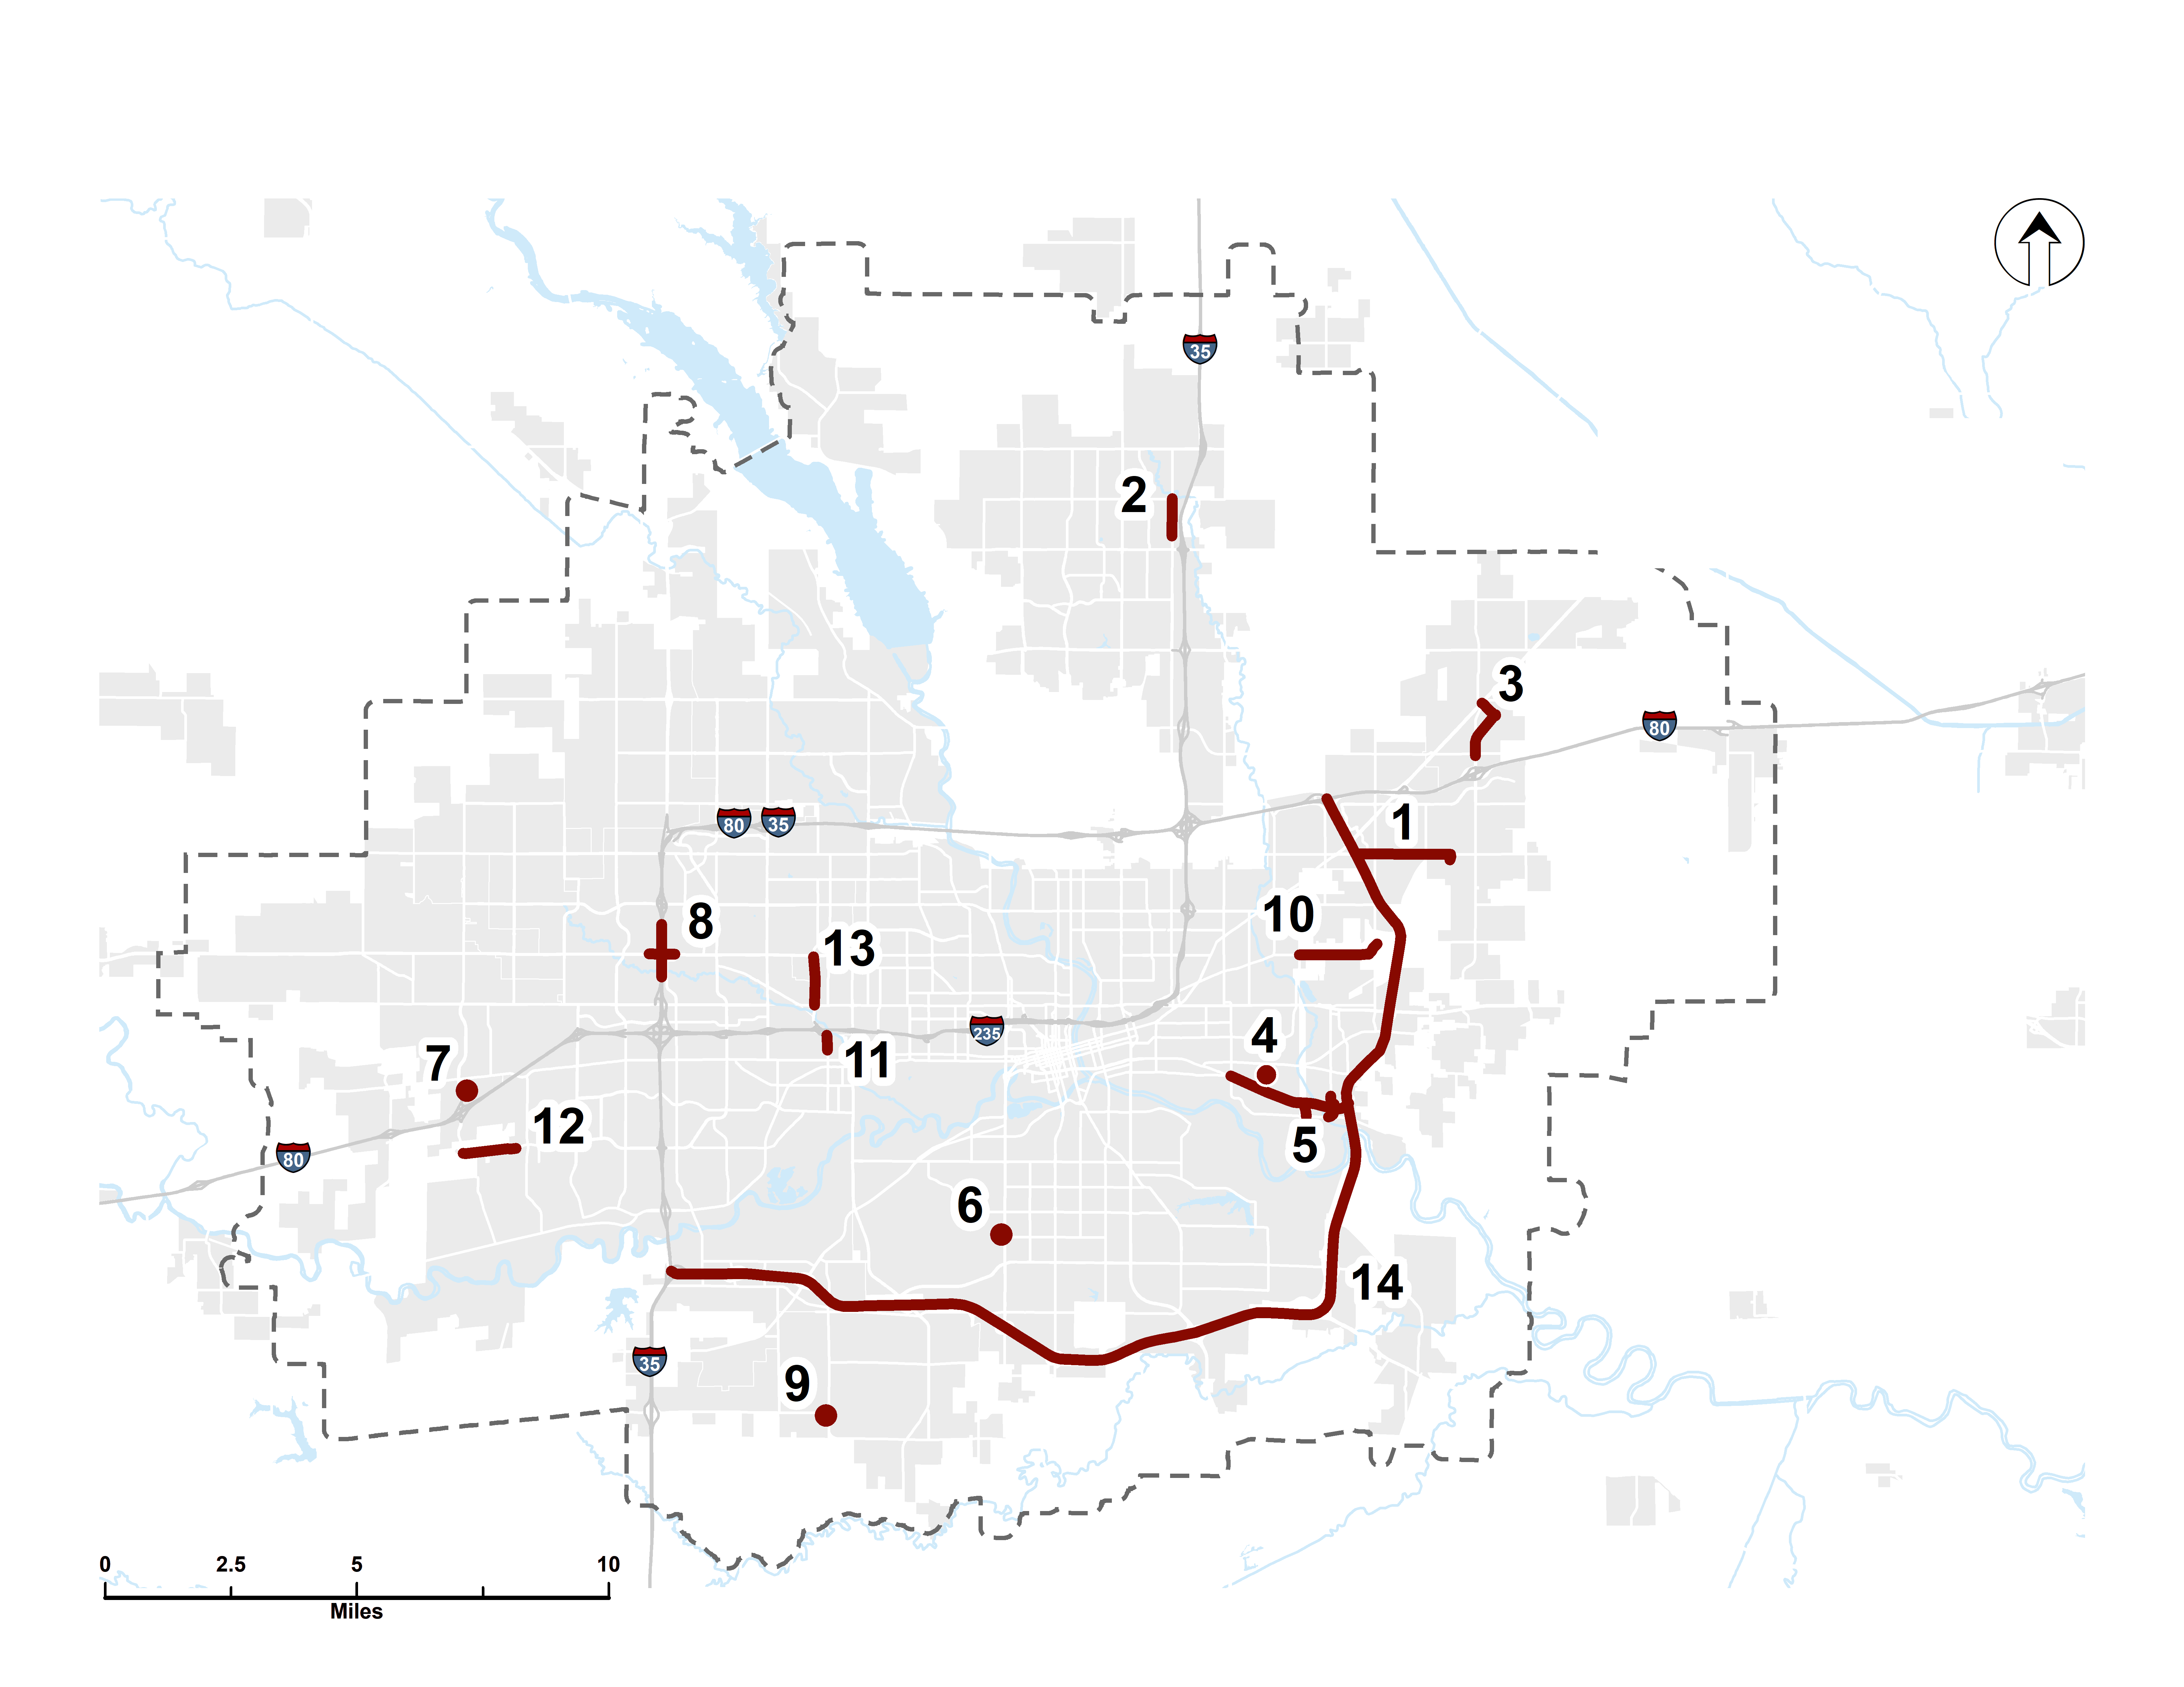
PRIORITY STREET PROJECTS

Slide 6
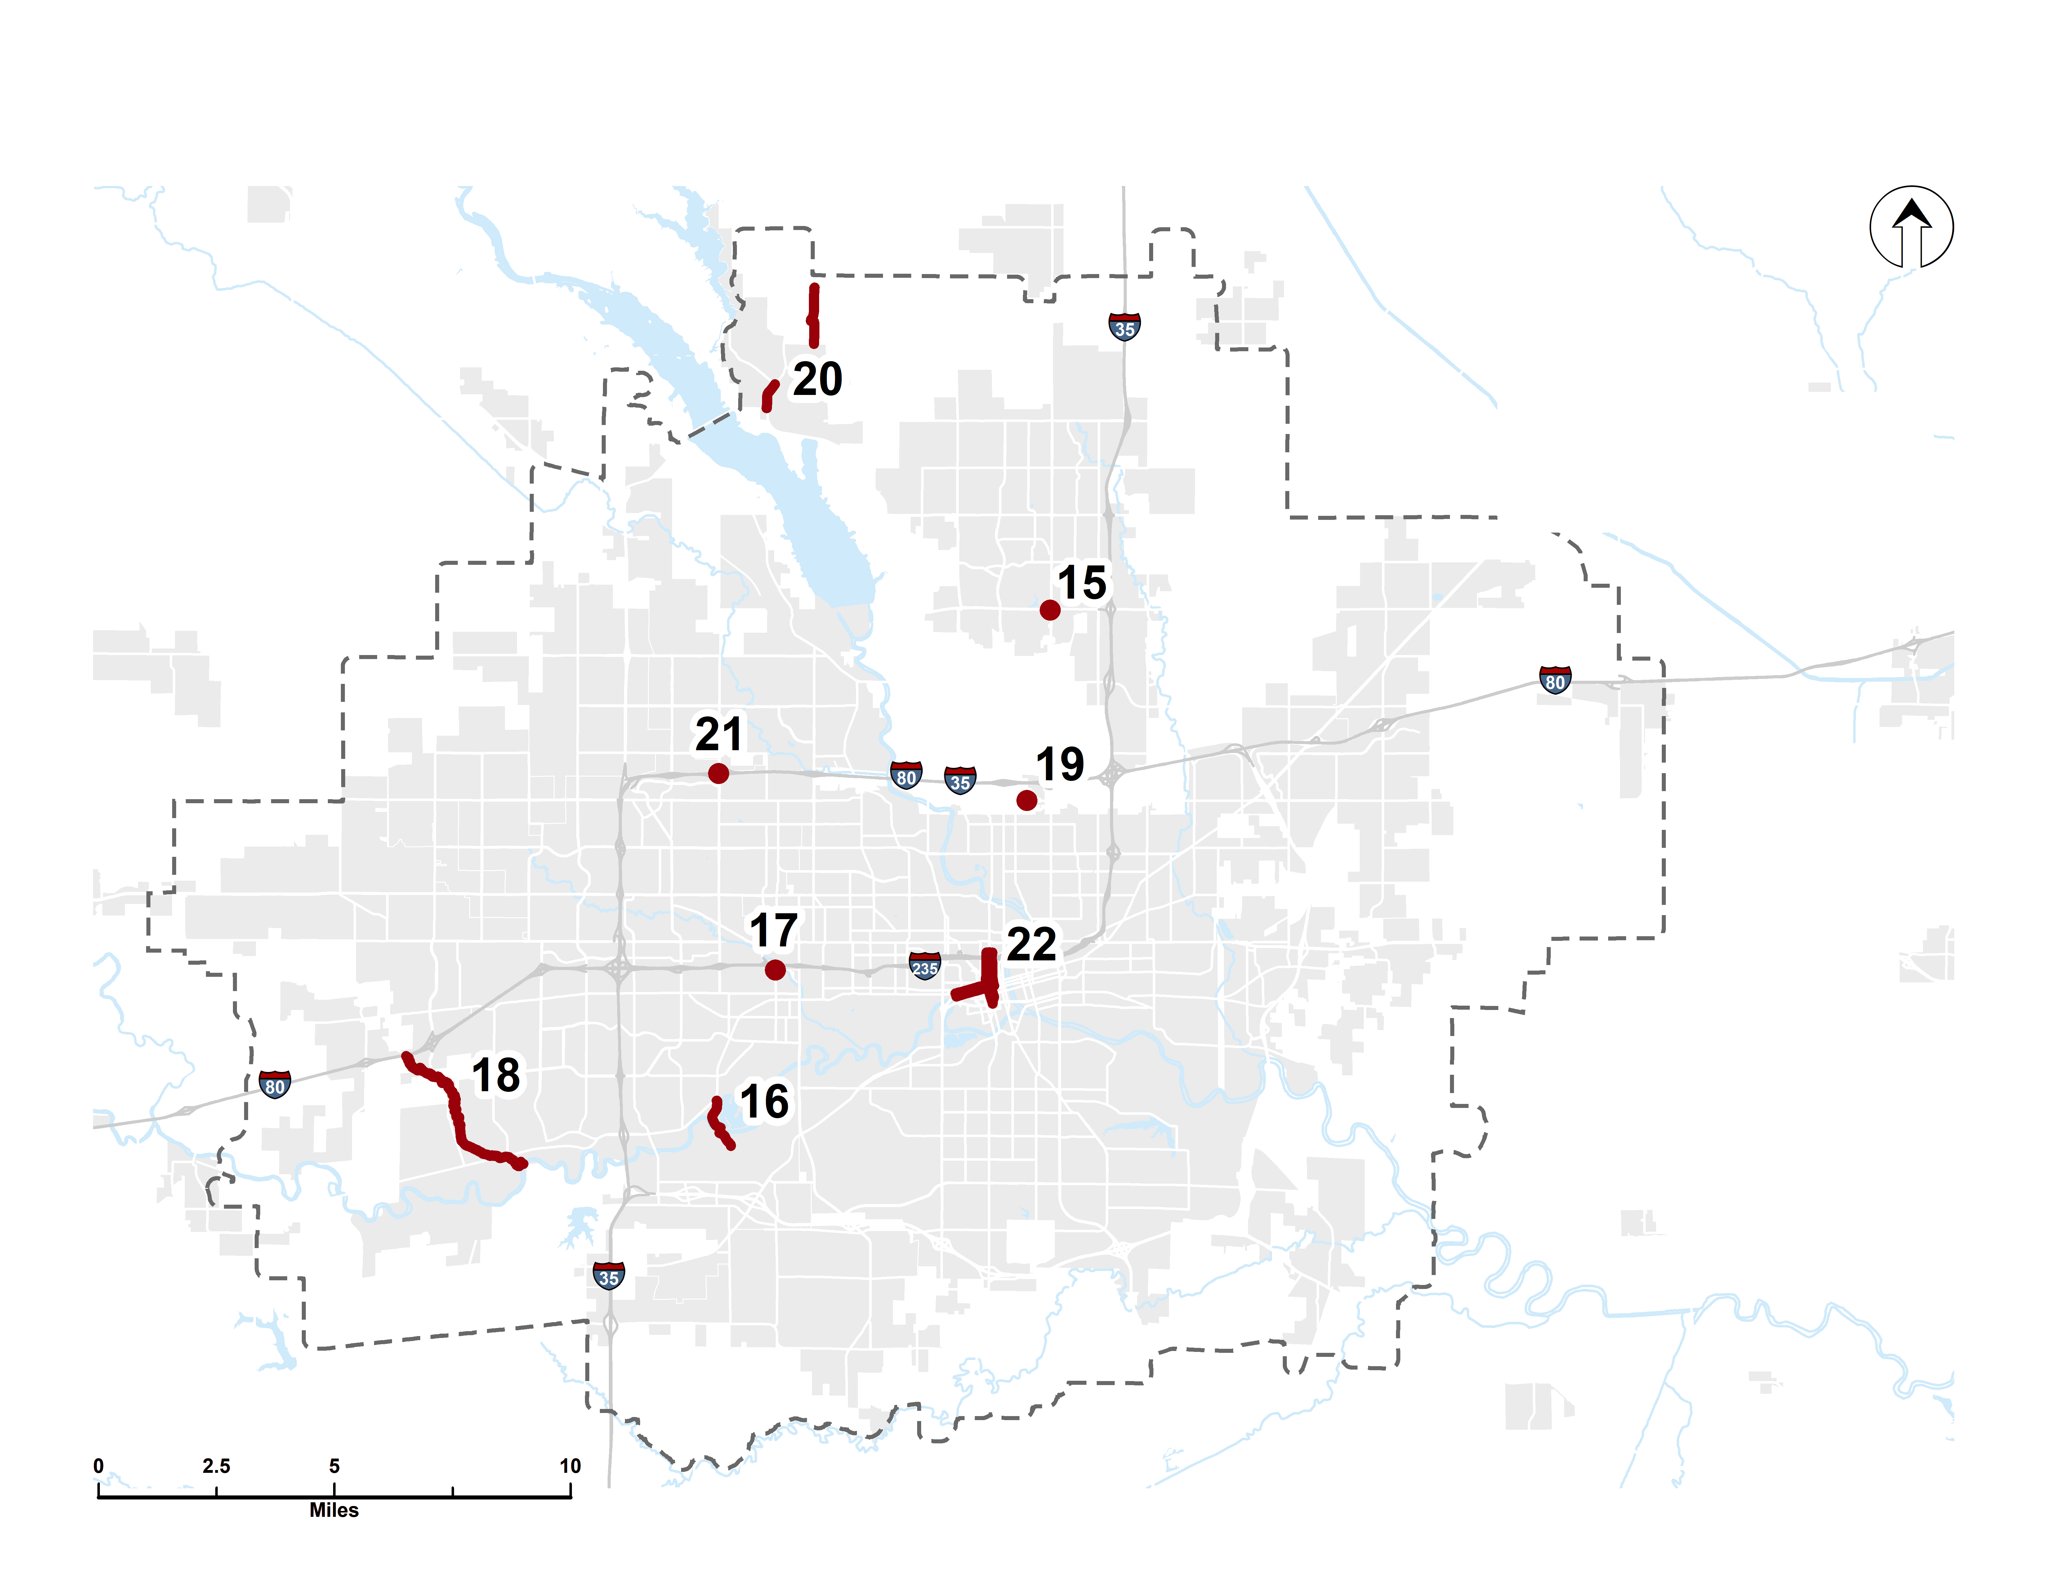
PRIORITY BIKE / PED PROJECTS

Slide 7
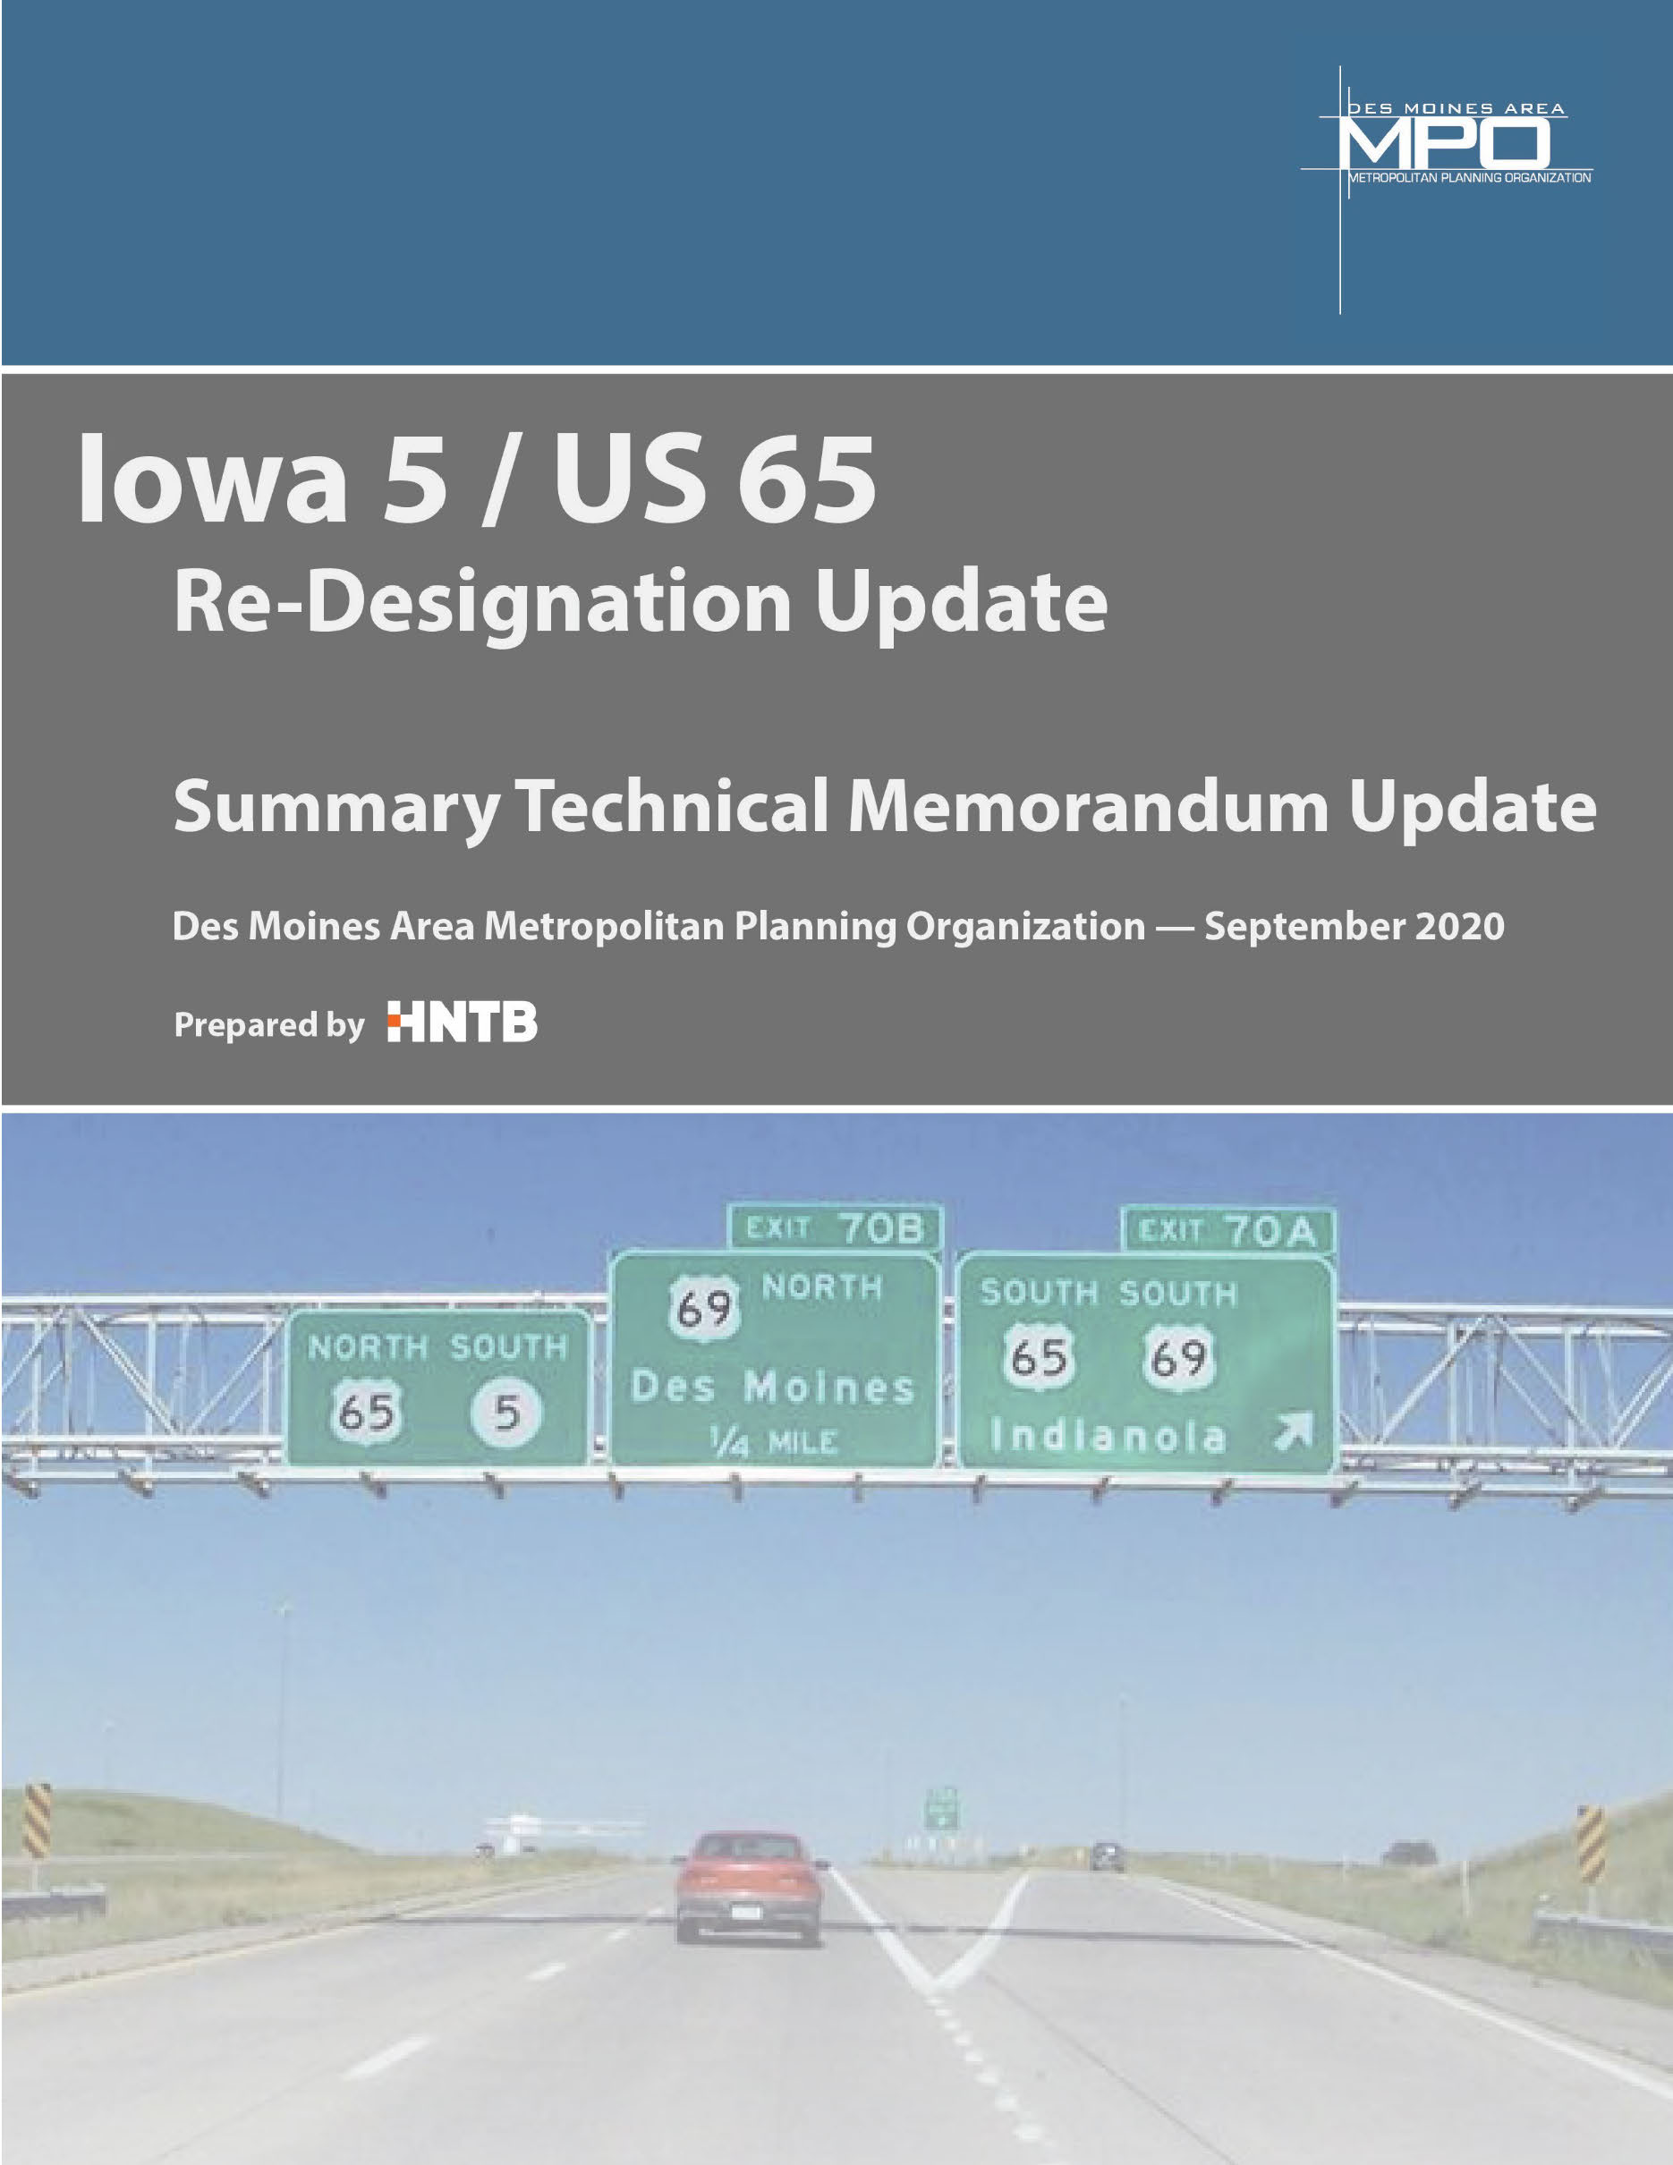
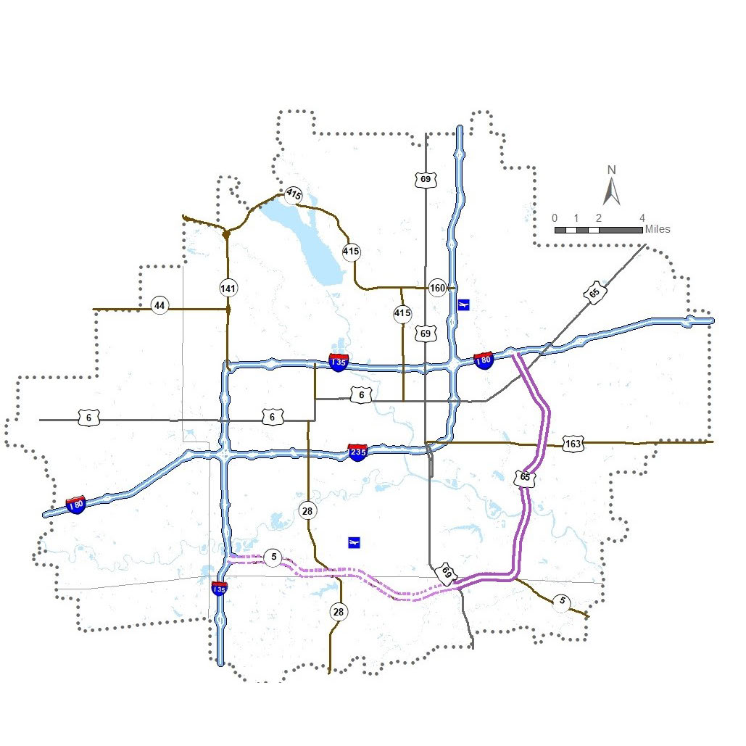
PURPLE HEART HIGHWAY INTERSTATE CONVERSION
THANK YOU: IDOT STUDY OF INTERSTATE DESIGNATION
THANK YOU!
IDOT study helped move conversation forward.
We look forward to continuing working with staff on this project.
Regional leaders are working with IDOT staff on implementation of action plan.
Outreach to stakeholders is ongoing.

Slide 8
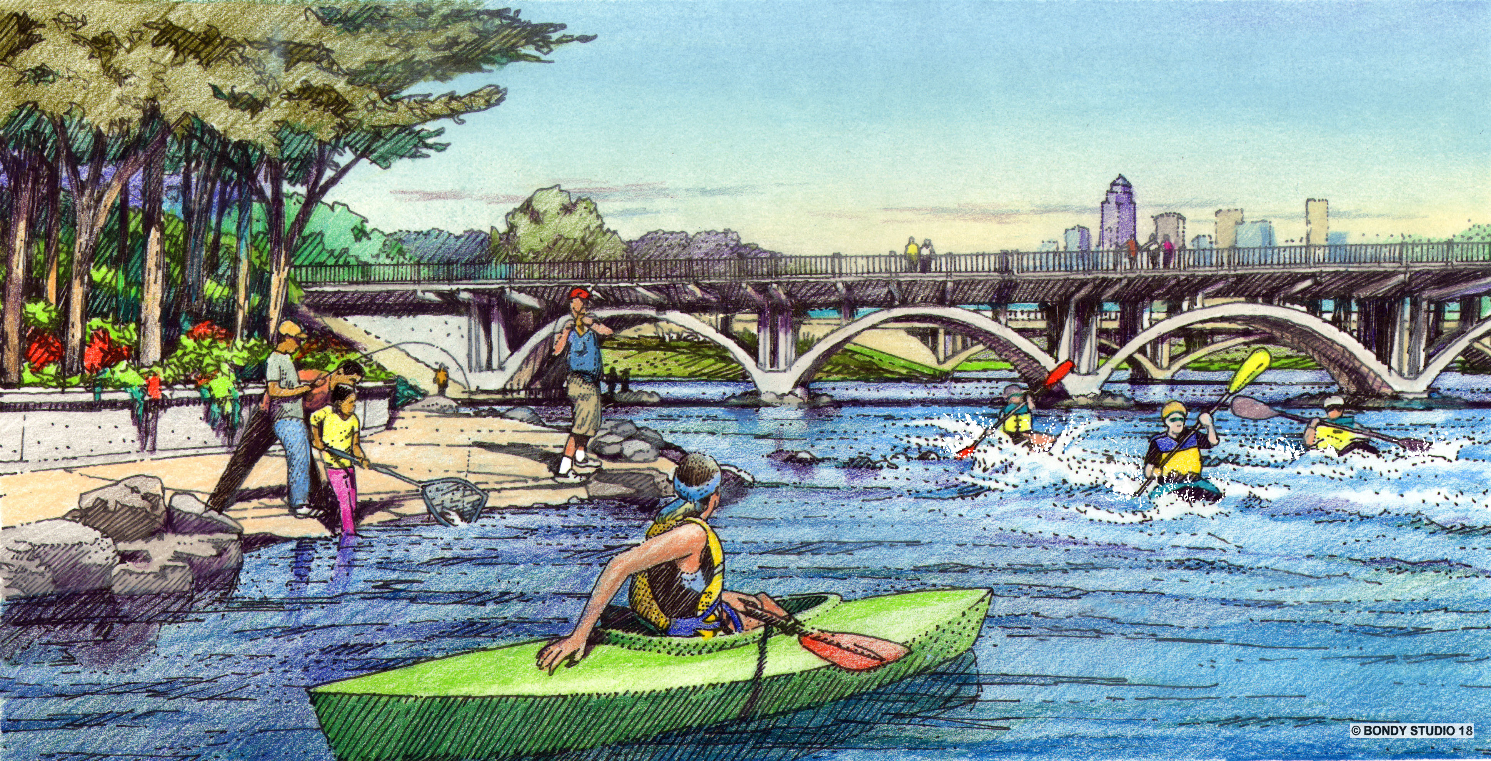
THANK YOU: WATER TRAILS
We appreciate IDOT staff support for BUILD grant bid-letting

Slide 9
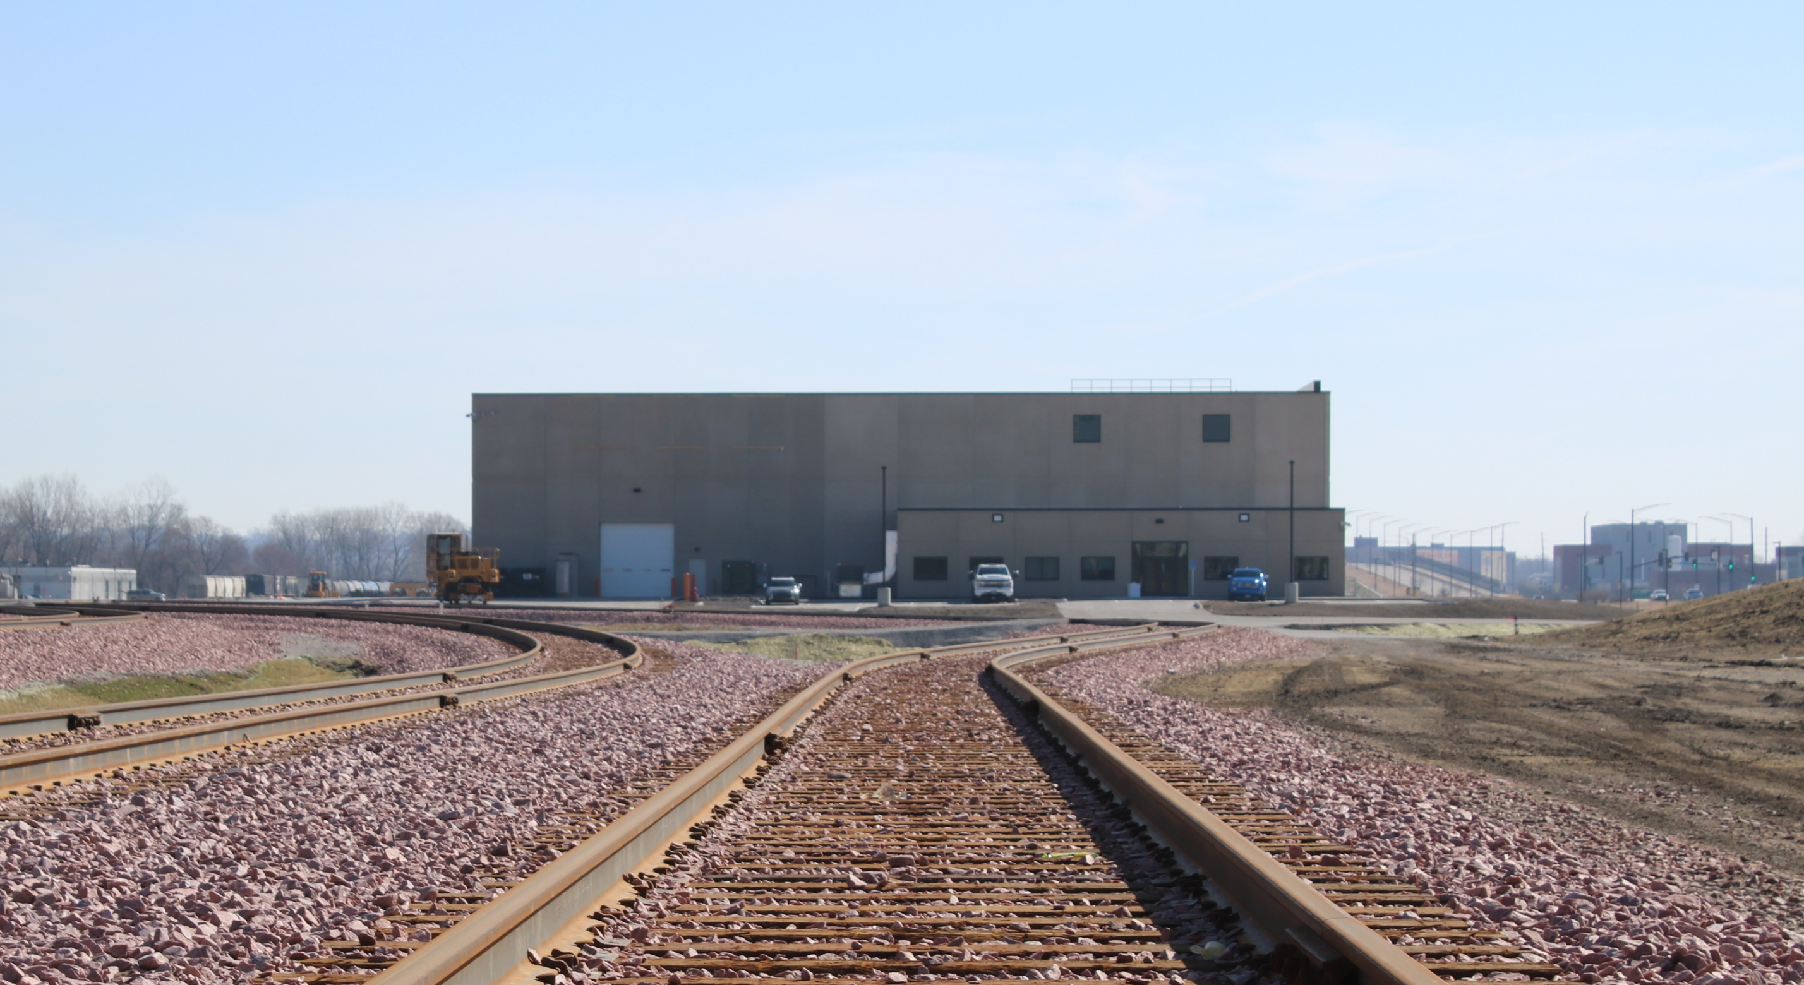


THANK YOU: TRANSLOAD FACILITY
$1.7 MILLION IDOT LOAN
DES MOINES TRANSLOAD FACILITY IS NOW OPEN FOR BUSINESS

