Slide 1
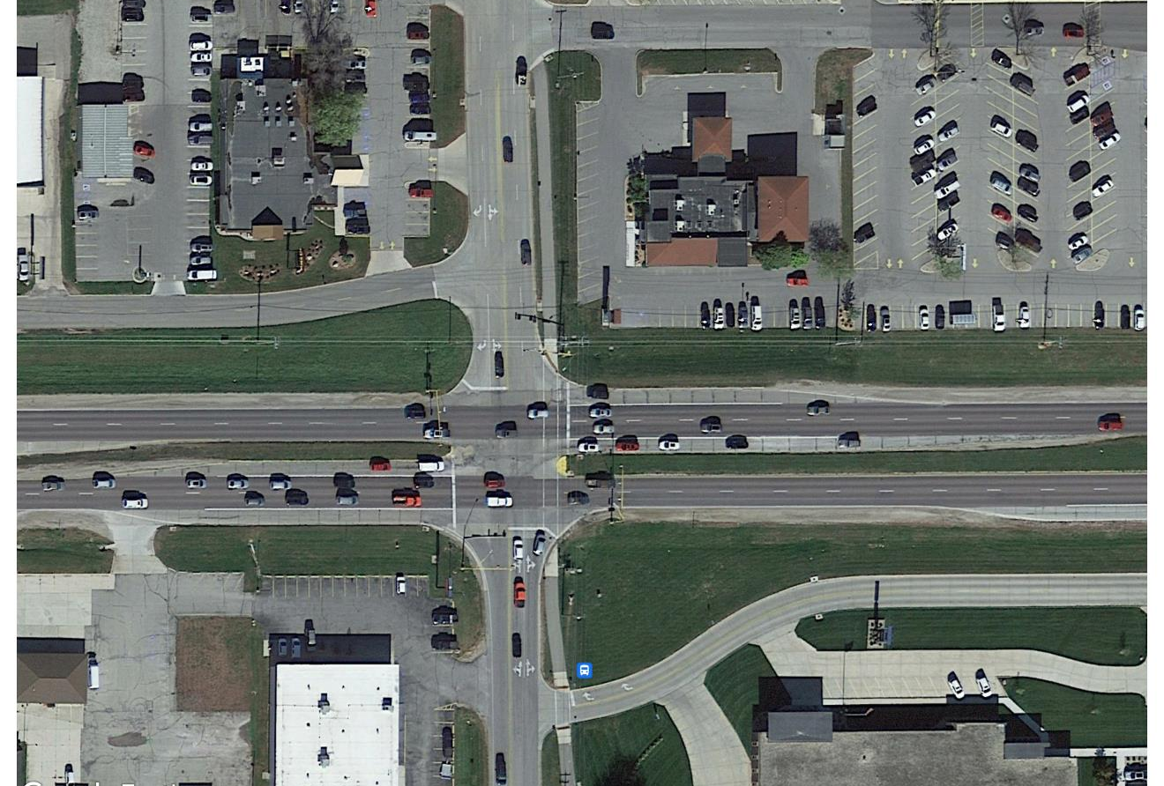
Iowa Highway 122 Corridor
Iowa DOT Commission – October 11, 2022

Slide 2
What’s New in Mason City
Mason City Chamber of Commerce named 2022 National Chamber of the Year by ACCE (Association of Chamber of Commerce Executives)
Several exciting projects in Mason City
Mentioned by Governor Reynolds in her 2022 Condition of the State for work being done to revitalize the City
Completed Multi-Purpose Arena in former Department Store in the Mall
Developing 93 multi-unit and upper story living spaces in the vibrant downtown, creating a total of 228 new housing units downtown over a 3-year period
Planned Riverwalk along Willow Creek in downtown area
Recently broke ground on new $14 million airport terminal along Iowa Highway 122
Redeveloping big box space near downtown for new manufacturing

Slide 3
Study and Proposed Project
City of Mason City hired WHKS to perform a Corridor Feasibility Study of 2.6 miles of Iowa Highway 122
DOT District 2 Staff participated in the Study
West entrance to the community, Lark Avenue to Winnebago Way
Several business along the corridor, including small retail, large commercial, health and personal services
Hospital is just east of the study limits on Iowa Highway 122
Expands upon the 2020 Traffic Engineering Assistance Program (TEAP) study

Slide 4
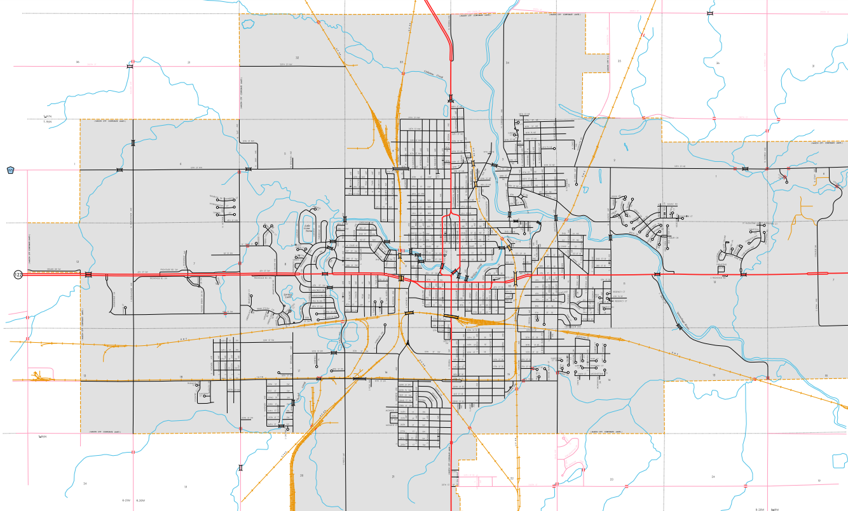
Project Location
City of Mason City
← Airport
Hospital
←
Community College
Project Location

Slide 5
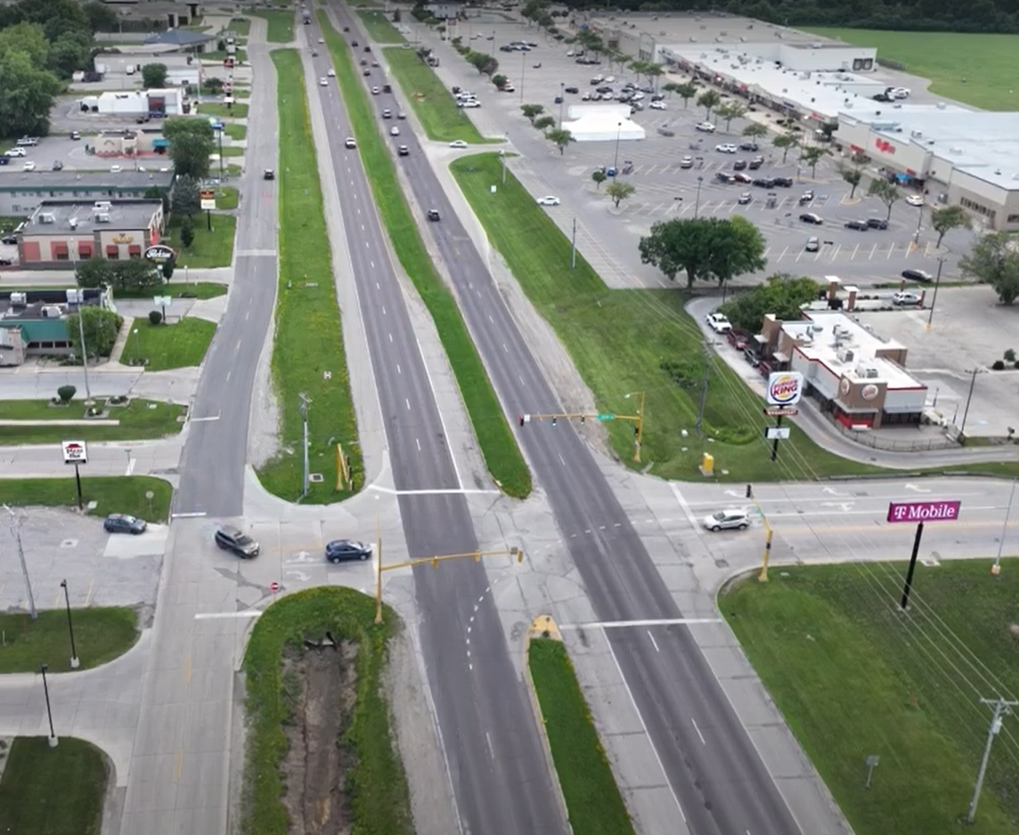
Existing Project Corridor Overview
Four-lane divided roadway, consistent with a rural corridor
Open Ditch drainage system, with granular shoulders
6 major intersections with non-coordinated traffic signals
No longitudinal pedestrian or trail facilities
No pedestrian signals or crossings
2017 Average Daily Traffic = 18,100 vpd
Incomplete frontage road system
Inconsistent access points
Commercial, retail, health and service
corridor serving North Iowa

Slide 6
Goals of the Feasibility Study
Improve Mobility through the Corridor
Provide safe travel through the corridor, add pedestrian and bike mobility by means of a separated trail and a sidewalk
Improve efficiency and operations through the corridor
Improve pavement condition and drainage system
Support vibrancy of businesses located adjacent to the corridor by maintaining or improving access, street lighting
Support economic development for Mason City and surrounding areas
Promote Mason City as a tourist and entertainment destination
Develop an equitable, sustainable and resilient corridor

Slide 7
“No-Build” with TEAP Improvements
Incorporate recommendations from the 2020 TEAP study
TEAP improvements vary and can be implemented individually, all improvements estimated at a total of $7.6 million

Slide 8
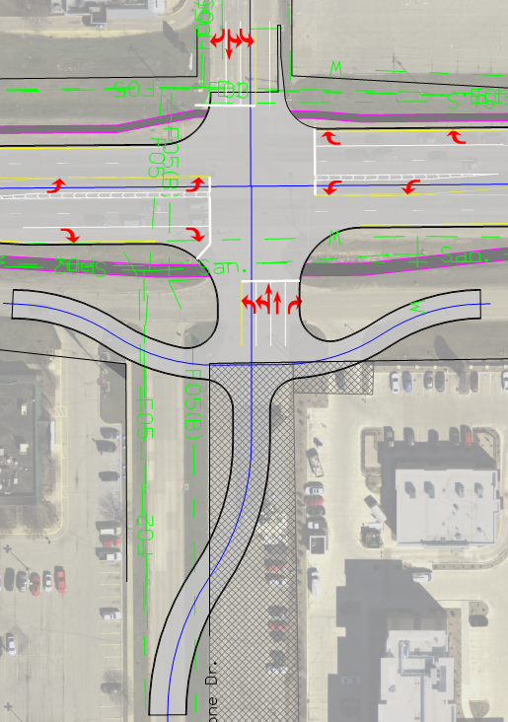
Reconstruction with Signalized Intersections Alternative
Intersections remain signalized, with new pavement (curb and gutter), additional turn lanes to ease congestion
Opportunity for separated trail and sidewalk facilities
Signalized Reconstruction estimated at $49 million

Slide 9
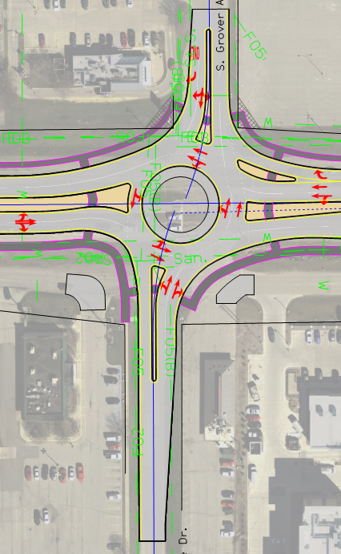
Reconstruction with Roundabouts Alternative
Roundabouts replace Signalized Intersections, with new pavement (curb and gutter), additional turn lanes between intersections for improved access
Opportunity for separated trail and sidewalk facilities
Resilient and Sustainable – does not require electrical power during an outage and lowers emissions
Roundabout Reconstruction estimated at $49 million

Slide 10
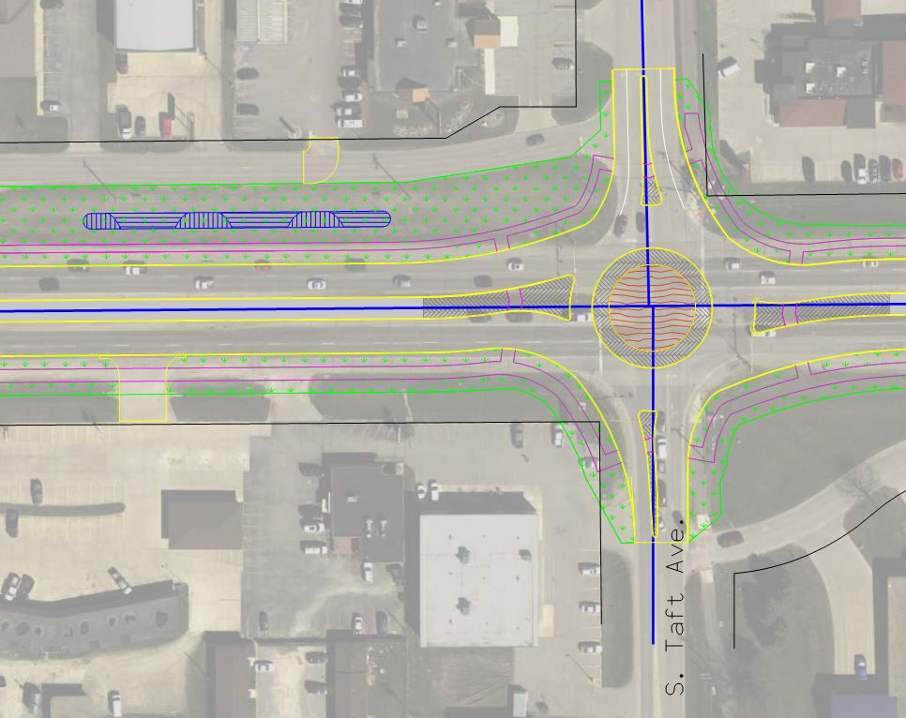
Project Opportunities with Reconstruction Alternatives
Construct a new storm sewer system more consistent with an urban corridor
Add sidewalk and trail facilities in the corridor to enhance mobility & safety
Improve access to currently undeveloped and underdeveloped properties along the corridor
Replace or upgrade aging infrastructure
Improve the operation and look of the existing drainage system, rain gardens
Lighting can be enhanced from operational and aesthetic standpoints
Gateway enhancement opportunities

Slide 11
Mason City Council and Public Involvement
The City and WHKS conducted a Public Information Meeting during development of the feasibility study. All alternatives were well received by the public.
At the September 20th public Council Meeting, the City Council received a presentation on the feasibility study
All members (6) of the City Council unanimously preferred the Roundabout Alternative

Slide 12
Next Steps
Respectfully, we request to partner with the Iowa Department of Transportation to pursue funding and advance the project by including it in the Iowa DOT 5-year Program

Slide 13
Thank you!
Speakers:
Bill Schickel, Mason City Mayor
Delegation:
Mark Rahm, Mason City Engineer
Paul Adams, Mason City Council Person
Tom Thoma, Mason City Council Person
John Lee, Mason City Council Person
Will Symonds, Mason City Council Person
Josh Masson, Mason City Council Person
John Jaszewski, Mason City Council Person
Robin Anderson, President & CEO of Mason City Chamber of Commerce
Lindsey James, Executive Director Visit Mason City
David Sims, Mason City Airport Manager
Casey Callanan, Cerro Gordo County Supervisor
Aaron Burnett, Mason City Administrator
10 First Street NW
Mason City, IA 50401
(641) 421-3600
aburnett@masoncity.net
Fouad Daoud, President and CEO WHKS & Co.
1412 6th Street SW
PO Box 1467
Mason City, IA 504025
(641) 423-8271
fdaoud@whks.com

