Slide 1
Project Name:
Project Purpose:
Iowa’s Living Roadways Community Visioning Program
Iowa State University & Trees Forever
The purpose of this statewide planning program is to help small rural communities create plans to improve the local transportation system.
Sponsored by the Iowa Department of Transportation, the planning program integrates skills and knowledge from local residents, professional planners and non-profit organizations to understand local needs and craft solutions that are the right scale and type to meet those needs.
Trees Forever facilitates the planning process, while ISU provides planning oversight and research-based assessments, maps and other information.
Ten communities a year receive services after a competitive application process. Communities work with ISU, TF facilitators and design teams to work through community plans. An annual meeting for current and past communities allows communities to share work and get insight from project sponsors, researchers, advocacy groups, etc.
We measure our success by what communities accomplish once we end our engaged process. We track progress through check-ins, and also monitor grant programs to see how our clients compete. We also field check to make sure things funded are getting built.

Slide 2
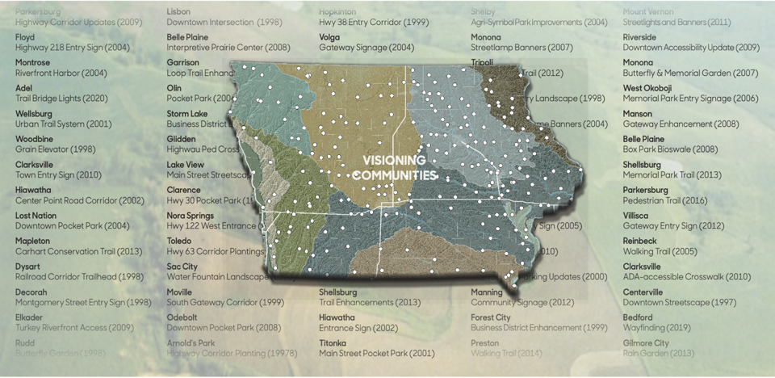
Map of communities that have completed the transportation enhancement planning process
since we started in 1997.

Slide 3
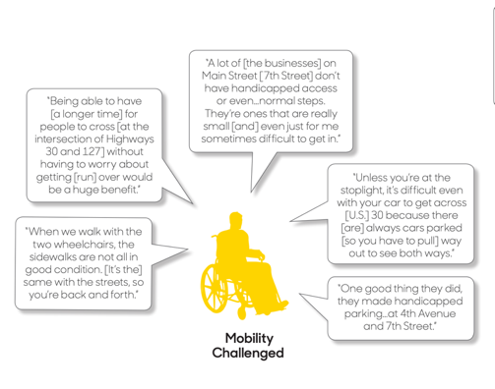
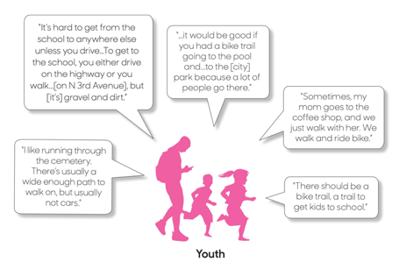
To better understand and communicate resident needs, the program engages residents in the following focus groups mobility impaired, active adults, children, teens, parents, and older adults.
This slide illustrates two groups’ observations about the local system.

Slide 4
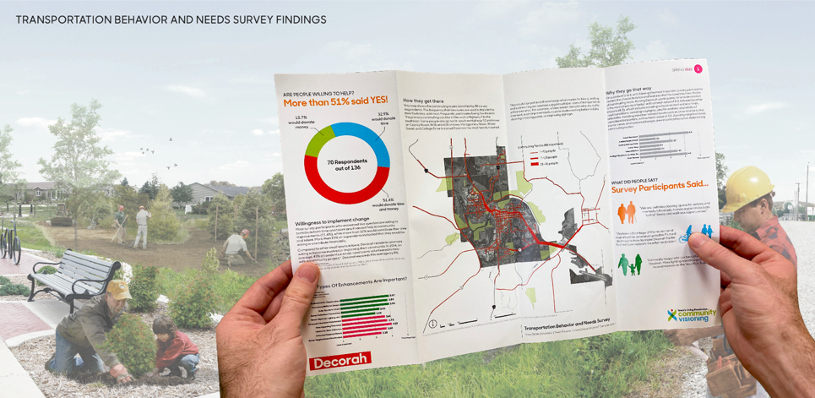
Surveys are conducted in larger communities to get a better understanding of resident behavior, preferences, and routes. In the survey, we also assess willingness to contribute to projects through donations, skilled services, or organization and labor. Results are communicated in a report, presentation boards, and on a community website. The data generated supports future grant applications, in addition to informing steering committees and local staff ad officials.

Slide 5
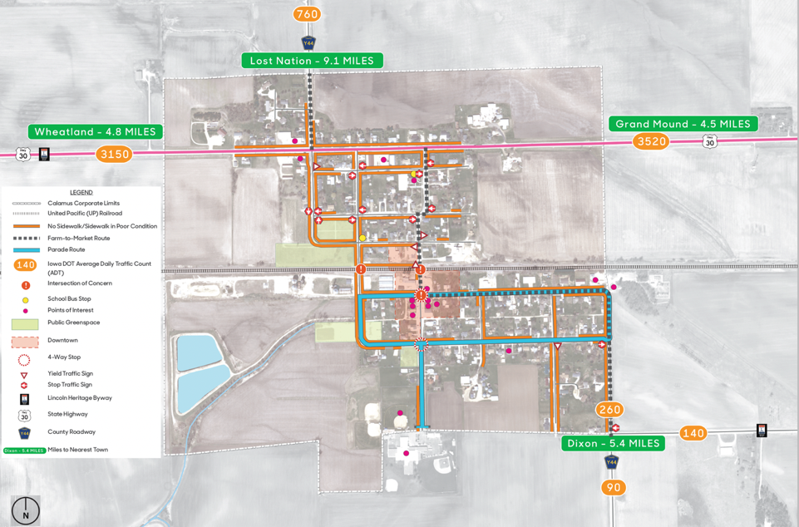
Community Transportation Inventory Map (Typical) is created in consultation with transportation and planning officials o capture existing condition s and projects planned but not yet implemented.

Slide 6
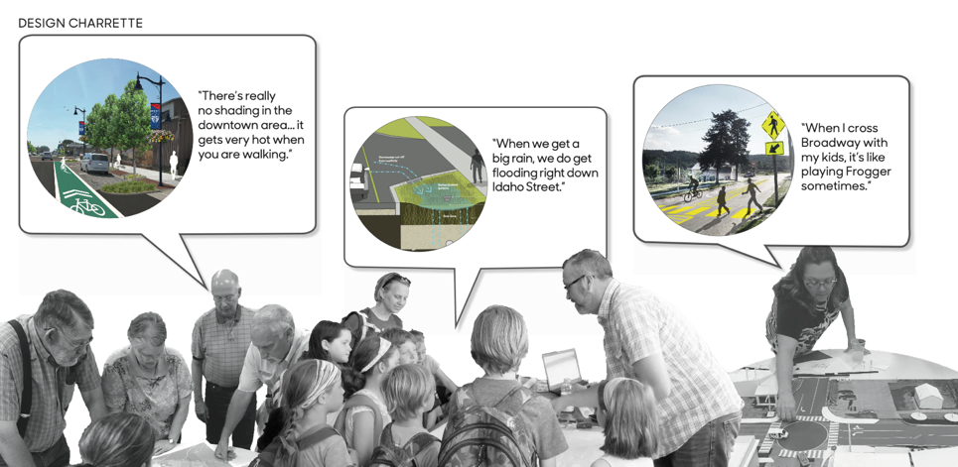
Steering committee goal setting and a public design workshops build on assessments and transportation inventories. We answer the question “Why Change Anything?” and then we propose why where and how to improve the transportation system.

Slide 7
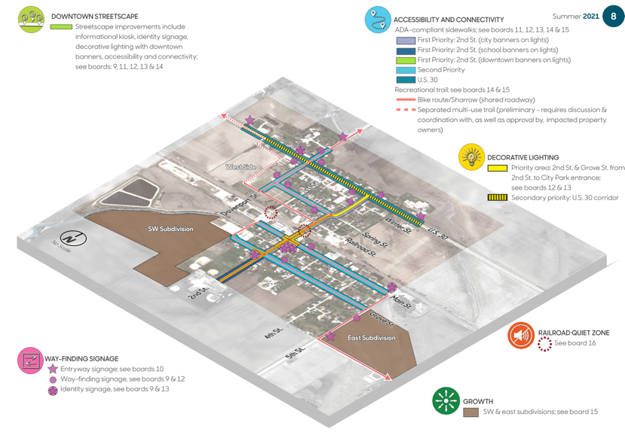
Community Transportation Enhancement Concept Plan (typical) grounds the proposal for holistic, systematic transportation enhancements

Slide 8
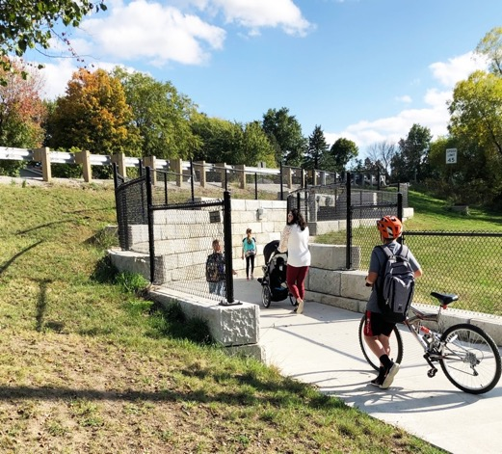
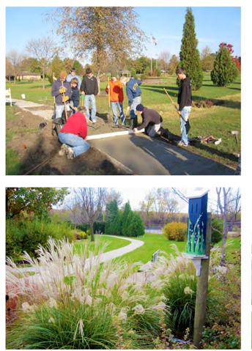
Projects Built: Entryways, wayfinding, highway crossings, sidewalks, trails and parks. Because communities are expanding out along highways, there is a demand for safe highway crossings (below left, Hudson Iowa underpass). Roadside parks help connect along highways and in natural areas, such as in Belle Plaine, Iowa (below, right).

Slide 9
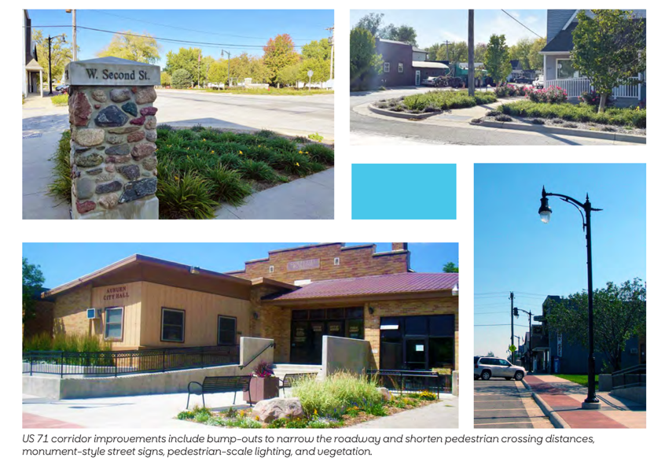
In town enhancements often include wayfinding and pedestrian crossings, parking and access.
These enhancements make communities more accessible and visitor friendly. Below, Audubon, Iowa enhancements completed as envisioned by the community in the program.

Slide 10
We monitor funding programs to track community success. After we added surveys and focus groups to the planning process in 2006, clients were able to compete for health, tourism and community development funds. The cart below summarizes awards from top non-transportation funds awarded to client communities.
xx

