Slide 1
Transportation Trends Update
Transportation Commission Workshop
October 10, 2022

Slide 2
Overview
US total rail carloads
Commercial air service passenger counts
Vehicular traffic

Slide 4
Monthly Passenger Counts at Iowa’s Eight Commercial Service Airports
(through August 2022)

Slide 5
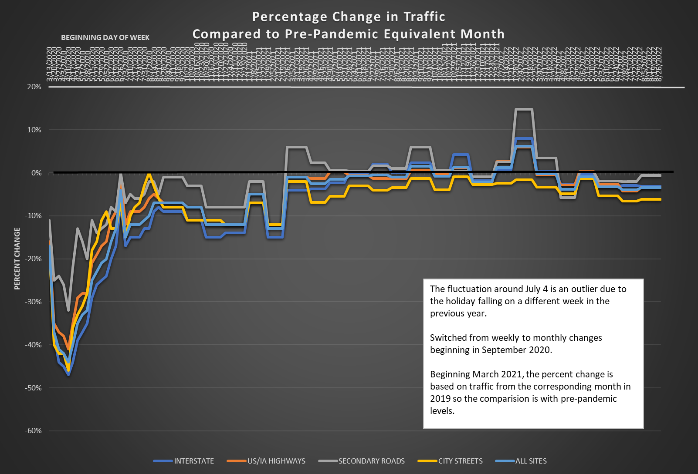

Slide 6
Questions?

