Slide 1
Ty Wheeler City Administrator City of Osceola, IA twheeler@osceolaia.net 641-342-2377

Slide 2
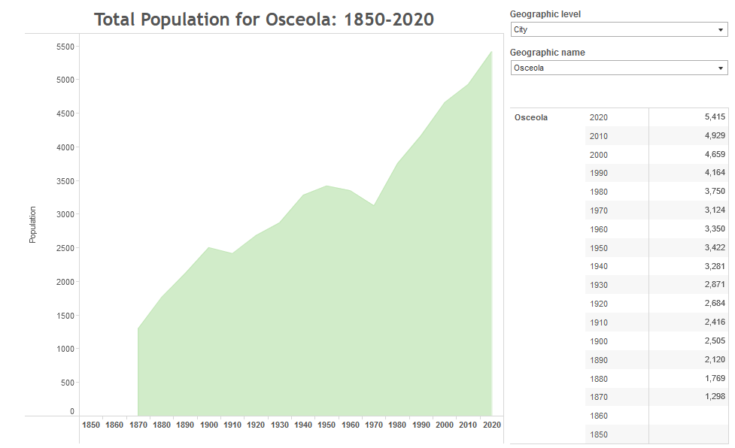
Population Growth 1990 - 2000: 11.9% 2000 - 2010: 5.8% 2010 - 2020: 9.8% Following certification of 2020 census, Osceola will have a representative on the Chariton Valley Transportation Planning Affiliation board.

Slide 3
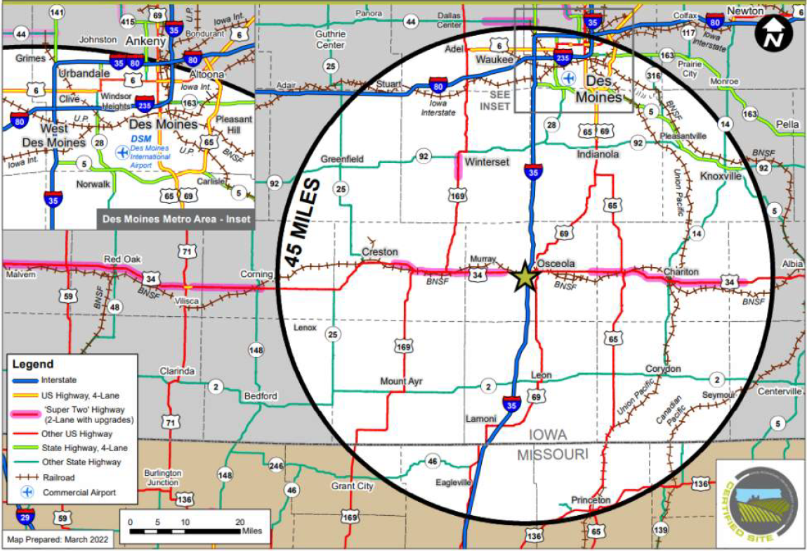
Major Employers: Osceola Foods Altec Salford Inc Simco Drilling Equipment Country Side Tank Boyt Harness Paul Mueller Company Lakeside Casino Miller Products Location, Location, Location

Slide 4
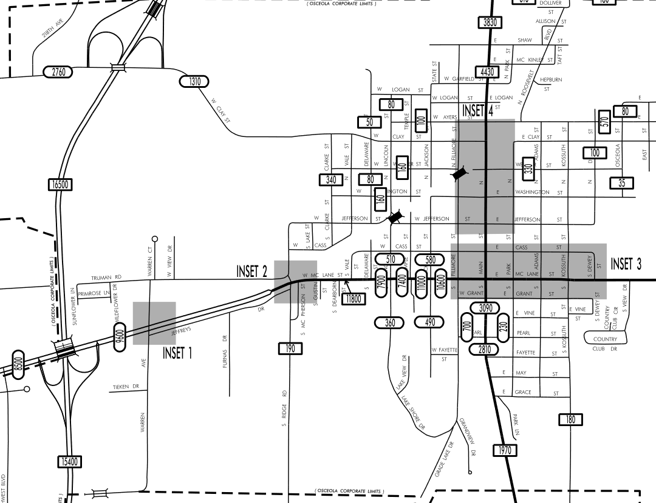
Hwy 34 Commercial Corridor $2.5 million in new development since 2020 Infill redevelopment vs sprawl Supported by increase in population and strong traffic counts

Slide 5
Future Economic Development
E Eddy Saylor Industrial Park 28th industrial site in the State of Iowa to achieve certification through the Iowa Certified Site Program. Site features 138 acres of industrial zoned property with immediate access to Hwy 34 and Interstate 35.

Slide 6
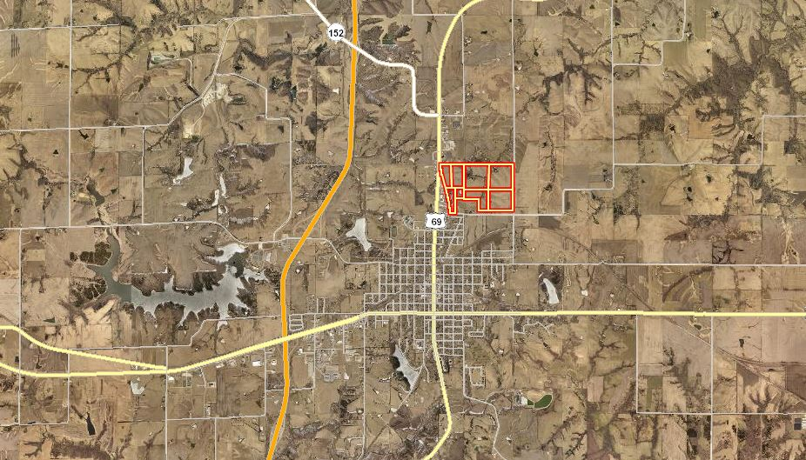
Future Economic Development
United Farmers Cooperative 110-rail car shuttle project Total Project Cost = $15 million Facility projected to transport up to 9,450,000 bushels of corn and 2,520,000 bushels of soybeans annually. Rail loop will be available to other local industries for shipping needs.

Slide 7
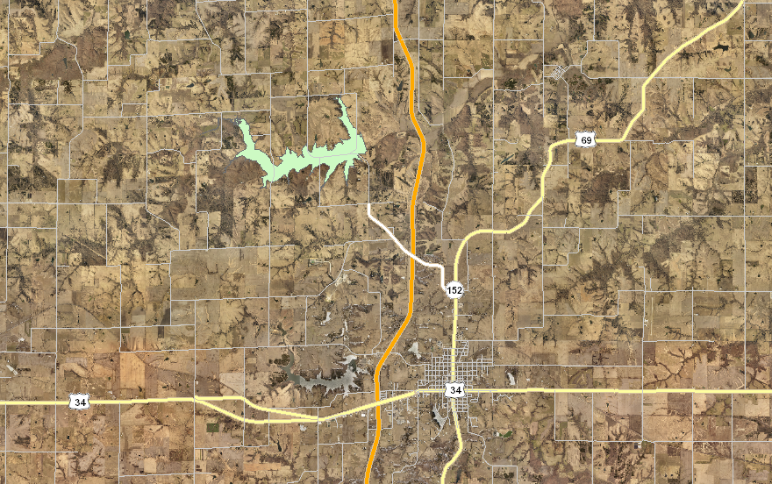
Municipal Utility Expansion
New waste water treatment facility.
New drinking water reservoir will add an additional 2.0 mgd to existing raw water supply for the City of Osceola and the SIRWA territory.

Slide 8
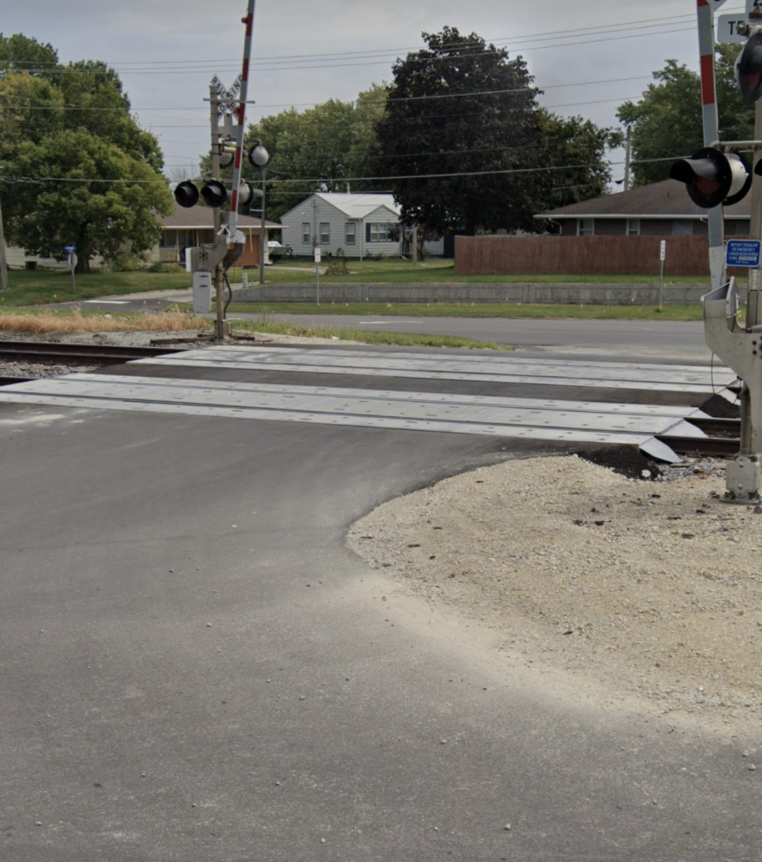
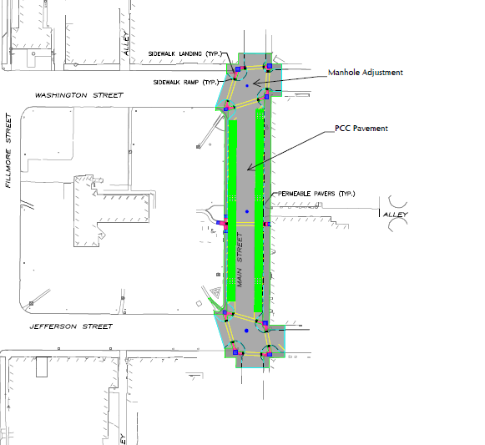
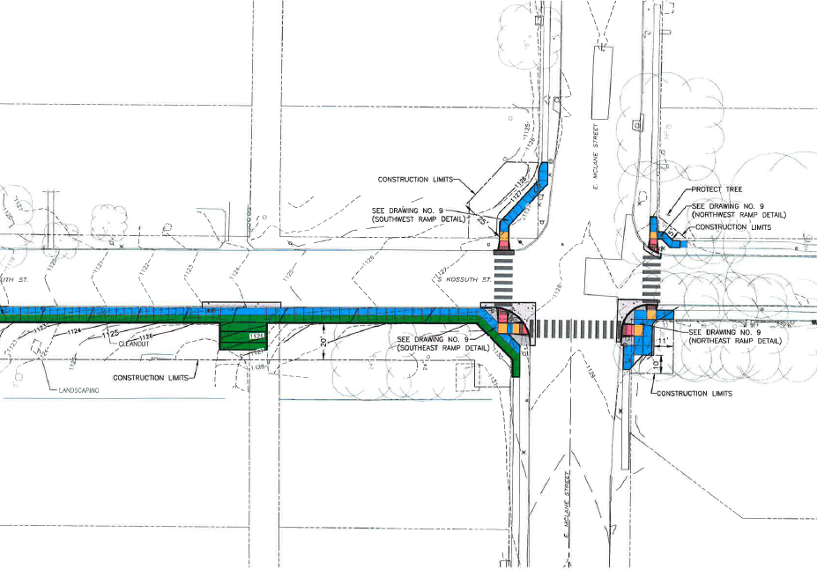
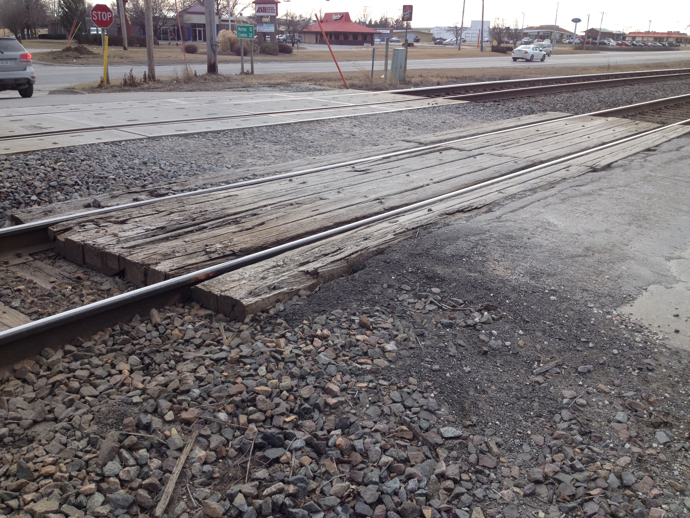
Iowa DOT Partnerships
Statewide Transportation Enhancement Program: Amtrak Depot.
Pedestrian Curb Ramp Program: S Kossuth/Hwy 34 School Crossing Project.
USTEP Project: Hwy 69/Main Street Improvement Project.
Grade-Crossing Surface Repair Fund: 240 Ave & Ridge Rd
GAVI, AIP, TEAP….

Slide 9
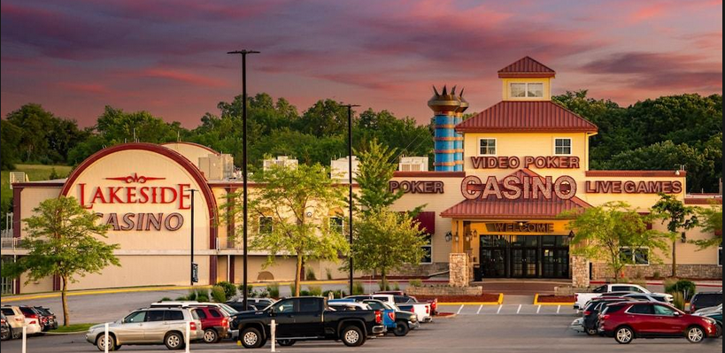
Thank You!
The City of Osceola looks forward to working with the Iowa DOT as we plan for continued growth and economic development.

