Slide 1
Revitalize Iowa’s Sound Economy Program
Iowa Transportation Commission Workshop
October 10, 2022

Slide 2
Revitalize Iowa’s Sound Economy Program
Created in 1985
Purpose: To promote economic development through roadway improvements.
Eligible development shall have value-adding activities that feed new dollars into the economy
Available to cities and counties through an application program

Slide 3
Available Funding and Application Summary
Available Funding
Funded annually with dedicated state motor fuel and special fuel tax revenues
Application Summary for SFY2023
Total number of projects awarded: 3
Total project costs: $9,186,268
Total amount awarded: $4,593,135
 | CITY | COUNTY
Average funding generated monthly | $905,101 | $452,550
SFY 2023 current Road Use Tax Revenue (as of 8/31/2022) | $1,974,336.84 | $987,168.42
Current Unobligated Balance (as of 8/31/2022) | $5,173,985.18 | ($2,662,892.58)

Slide 4
Local Development Project Evaluation Criteria
Development Potential (35 points)
Economic impact and Cost Effectiveness (20 points)
Local Commitment and Initiative (33 points)
Transportation Need and Justification (4 points)
Local Economic Need (6 points)

Slide 5
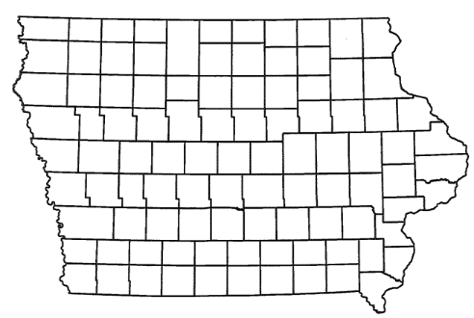
List of Local Development Applications Recommended
PROJECT NAME
SPONSOR
SCORE
TOTAL PROJECT COST
PERCENT PARTICIPATION
RECOMMENDED AMOUNT
Construction of approximately 1,508 feet of Industrial Parkway SW located on the southwest side of town. | Dyersville | 44 | $2,063,014 | 50% | $1,031,507

Slide 6
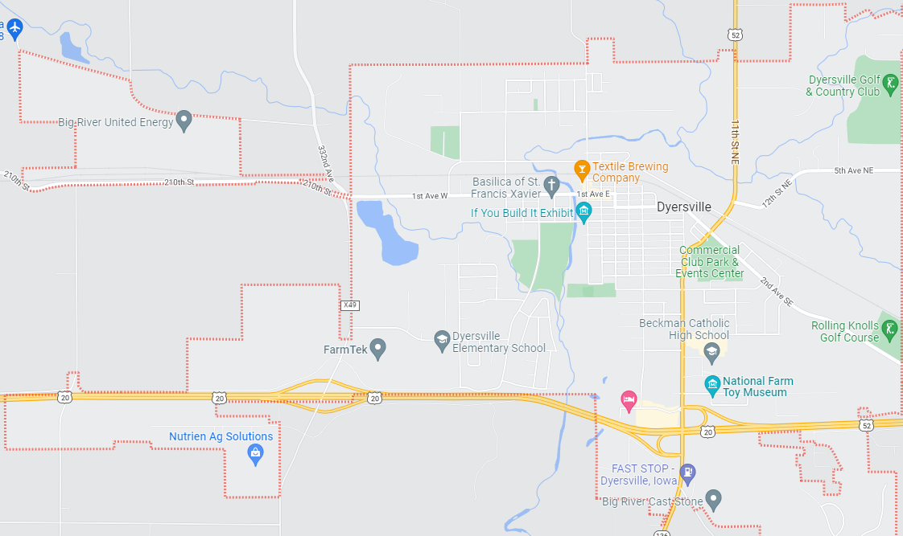
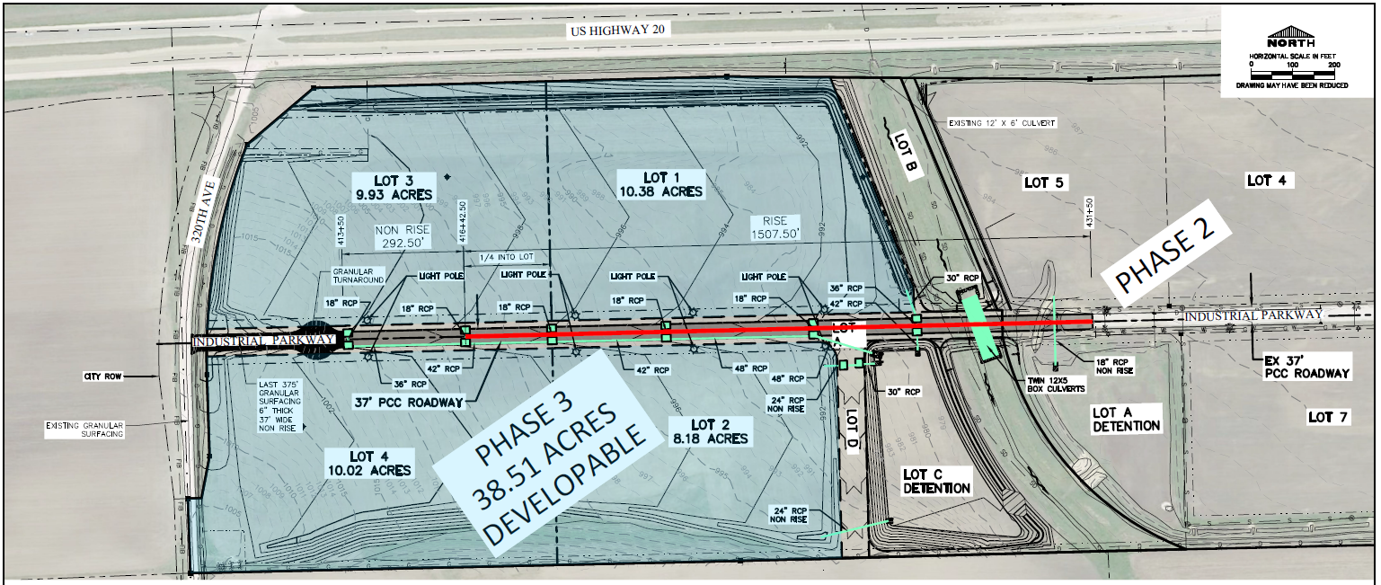
Dyersville
(Local Development)
Construction of approximately 1,508 feet of Industrial Parkway SW located on the southwest side of town. This project will provide access to four lots totaling more than 38 acres for industrial purposes.
Total Cost: $2,063,014
Requested: $1,031,507 (50%)

Slide 7
QUESTIONS?
Craig Markley, Systems Planning Bureau
craig.markley@iowadot.us
515-239-1027

