Slide 1
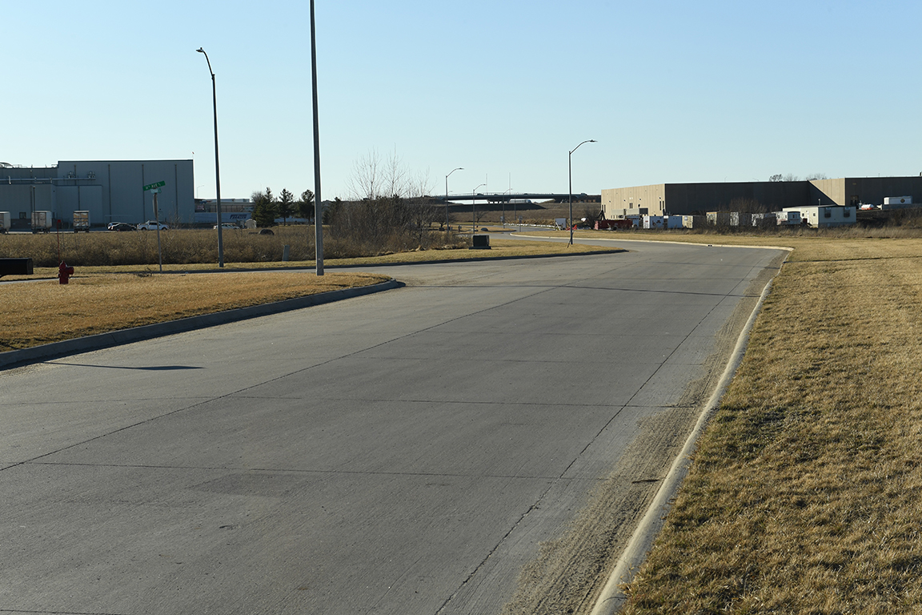
Revitalize Iowa’s Sound Economy Program
Iowa Transportation Commission Business Meeting
October 11, 2022

Slide 2
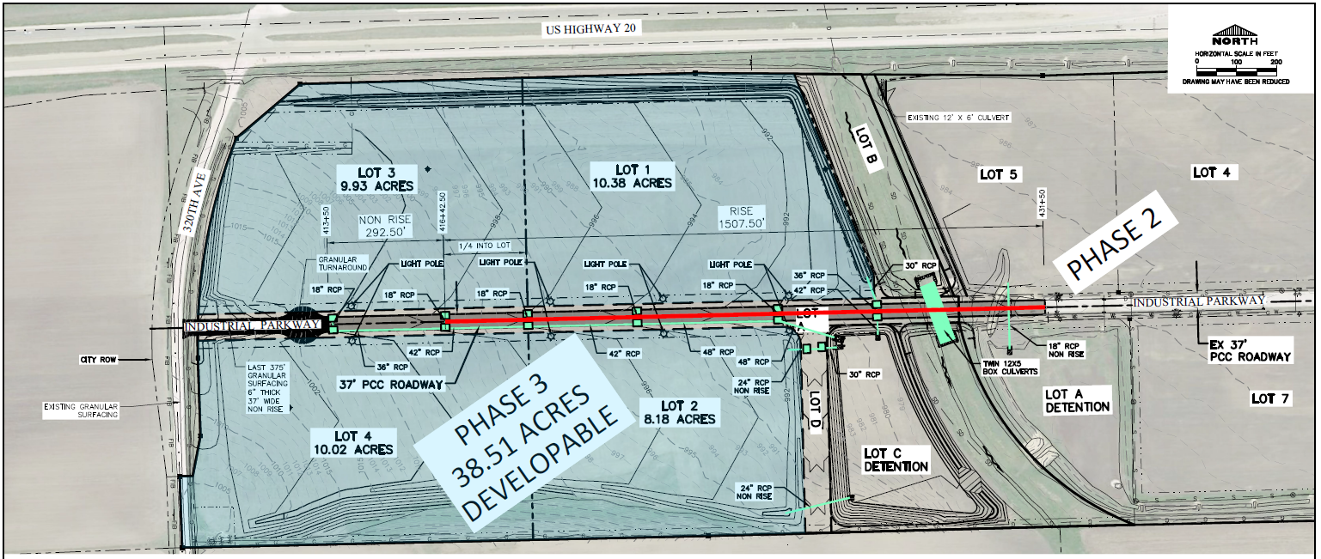
List of Local Development Applications Recommended
PROJECT NAME
SPONSOR
SCORE
TOTAL PROJECT COST
PERCENT PARTICIPATION
RECOMMENDED AMOUNT
Construction of approximately 1,508 feet of Industrial Parkway SW located on the southwest side of town. | Dyersville | 44 | $2,063,014 | 50% | $1,031,507

