Slide 1
Iowa DOT Transportation Commission
October 10, 2023
Okoboji, Iowa
Notes:
Michelle

Slide 2
Presenters
Michelle Bostinelos, Executive Director – SIMPCO
Marty Dougherty, Economic & Community Development Director – City of Sioux City
Mark Nahra, P.E., Woodbury County Engineer
Barbara Sloniker, Executive Vice President – Siouxland Chamber of Commerce
Notes:
Michelle

Slide 3
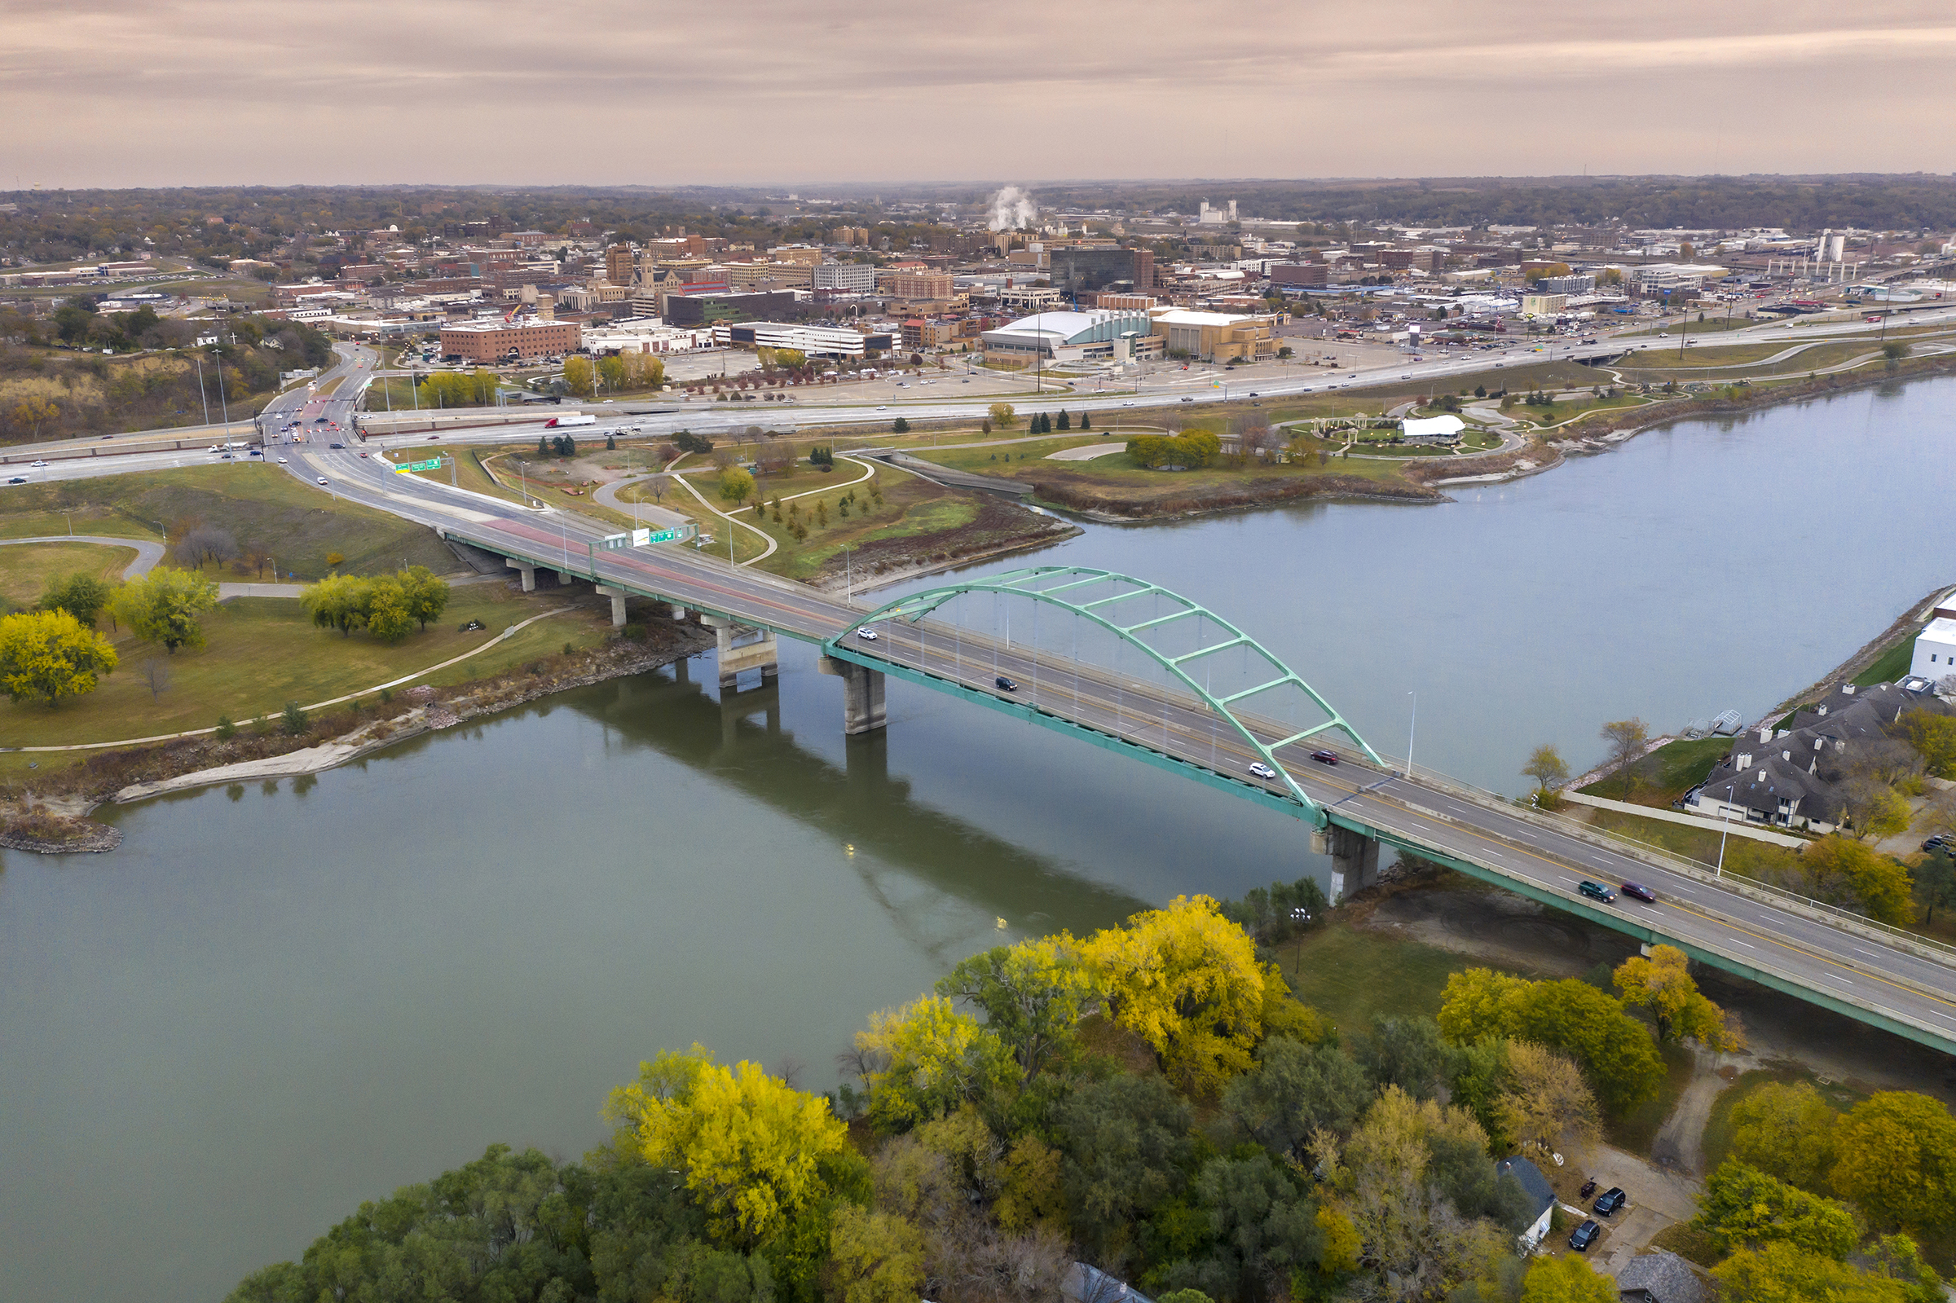
Overview
Gordon Drive Viaduct
Southbridge Interchange & Business Park
SIMPCO/SRTS New Facility
RAGBRAI
Photo Credit: Howard R. Green
Notes:
Michelle

Slide 4
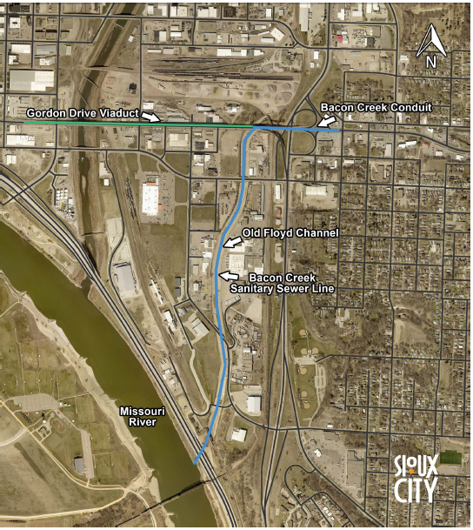
Gordon Drive Viaduct
Originally constructed in 1936
Iowa’s longest grade separation
Replacement will be in conjunction with Bacon Creek conduit which was built in 1909
Key arterial in transportation rich zone
Pedestrians
Vehicles
Railroads
Carries 25,000 vehicles daily
Estimated cost to replace viaduct: over $140 million
Estimated cost to replace Bacon Creek Conduit: $35 million
Public meeting on preferred alternative spring 2024
Multi-year construction scheduled to begin in 2028
Notes:
Thank you for meeting and working with us
The IDOT spent $5 million in the mid 2000s to repave the driving surface and address some structural issues.
Structure in critical need of replacement (fracture critical)

Slide 5
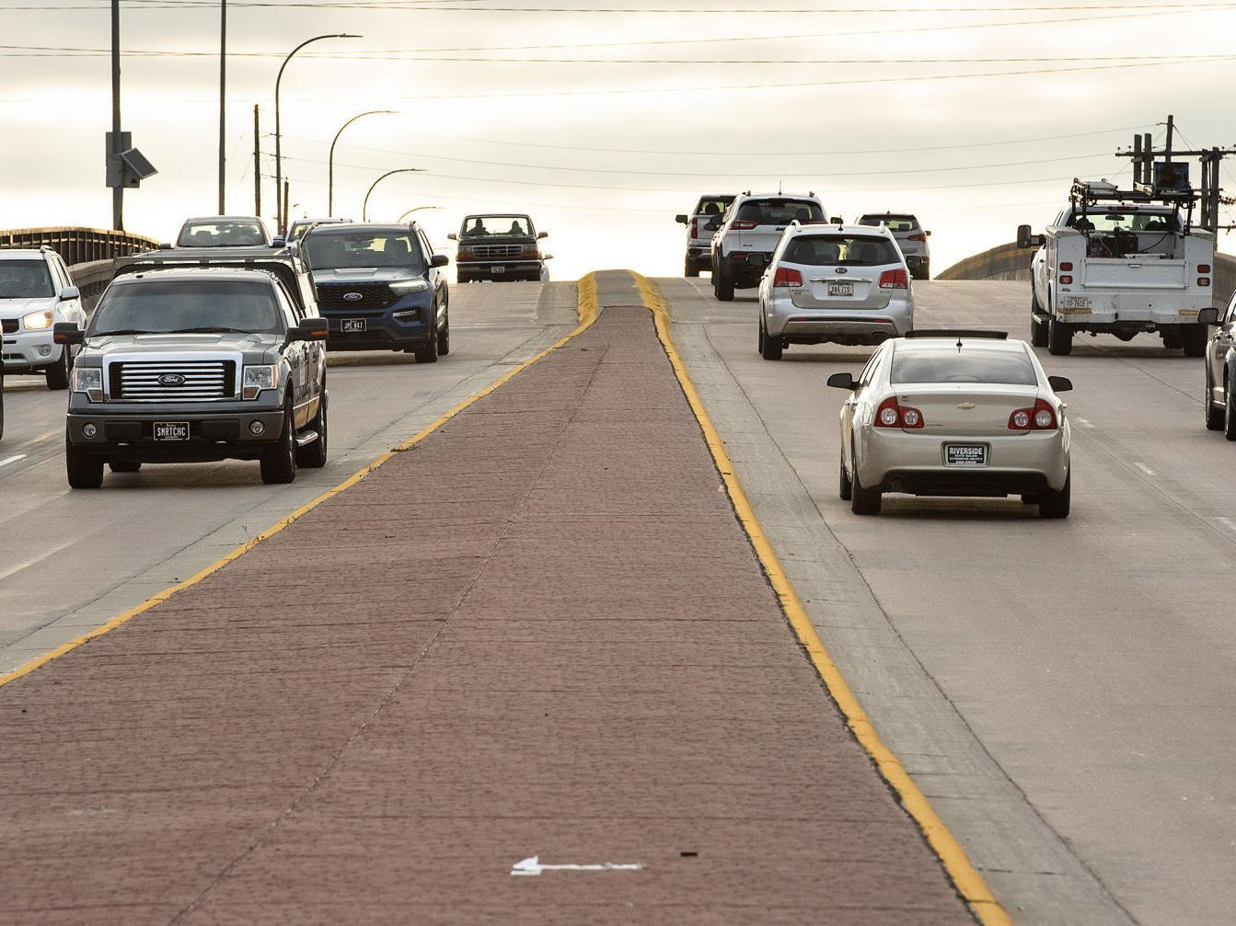
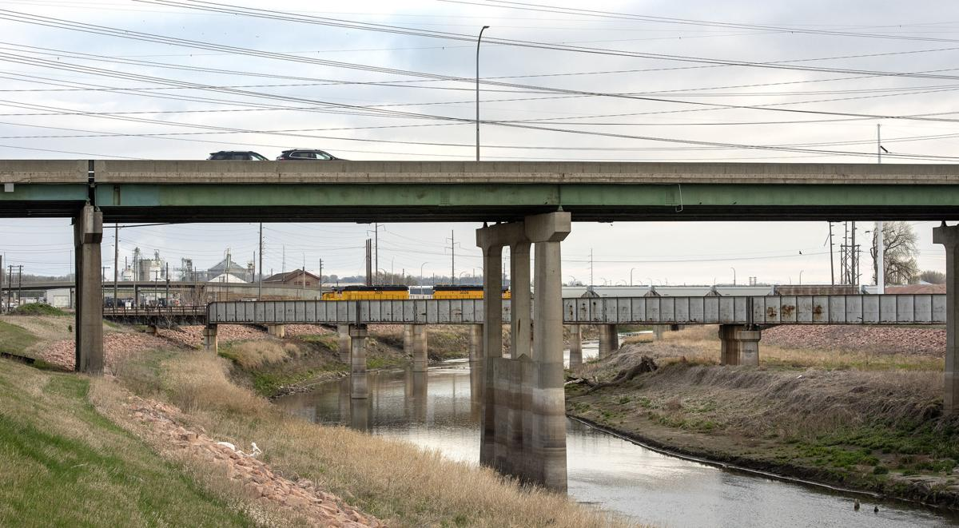
Gordon Drive Viaduct
Serves as a regional connection for emergency services, economic development, and overall mobility for vehicles, pedestrians, and rail
Connects east and west sides of Sioux City
Critical to get funding in place now
Partners should make every effort to take advantage of federal funding through IIJA
Photo Credit: Sioux City Journal
Notes:
This should be the highest priority bridge replacement in Iowa

Slide 6
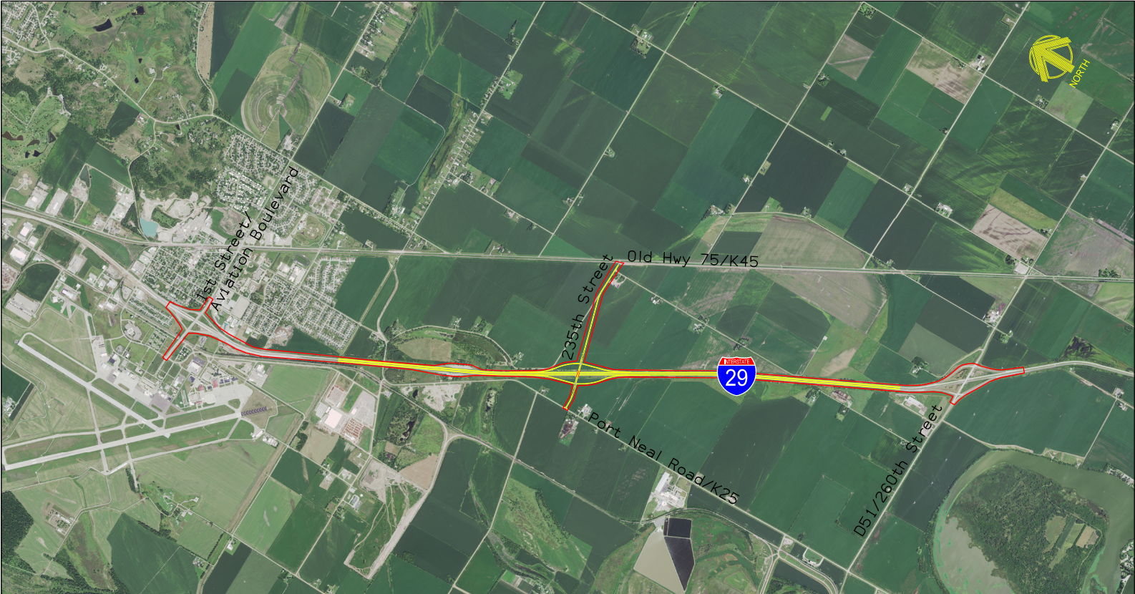
Southbridge Interchange
The interchange with I-29 located south of Sioux City between Airport/Sergeant Bluff and Port Neal interchanges has been approved.
Woodbury County has signed an agreement with the Iowa DOT for design and construction of the new interchange.
Project has been accelerated:
FY 2025 Right-of-Way acquisitions
FY 2026 Construction of interchange and approach roads
Notes:
Mark

Slide 7
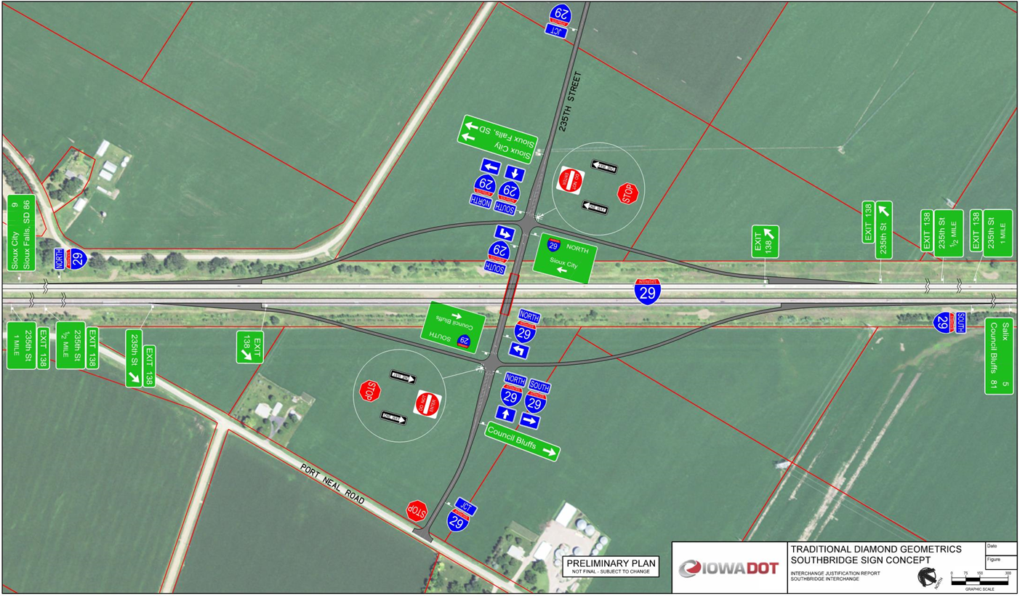
Southbridge Interchange
The Iowa DOT has hired HNTB to do design work on the project. Preliminary design is ongoing and on schedule for a January 2026 project letting.
The County is responsible for project funding and is seeking federal grants to help fund the estimate $28.1 million construction project.
The County appreciates the Iowa DOT and their staff handling the design, right of way acquisition and construction supervision for the project.
The County requests that Iowa DOT provides a letter of support for our INFRA and RURAL competitive grant applications through BIL.
Notes:
Mark

Slide 8
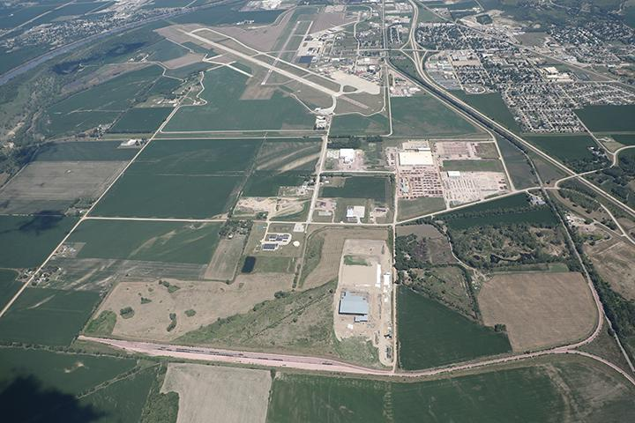
Southbridge Business Park
Notes:
Marty
RISE Grants
Alicia Ave (new)
Andrew Ave (new)
255th Street/CF Industries Drive improvements (2016)
Al Haynes Drive
260th Street

Slide 9
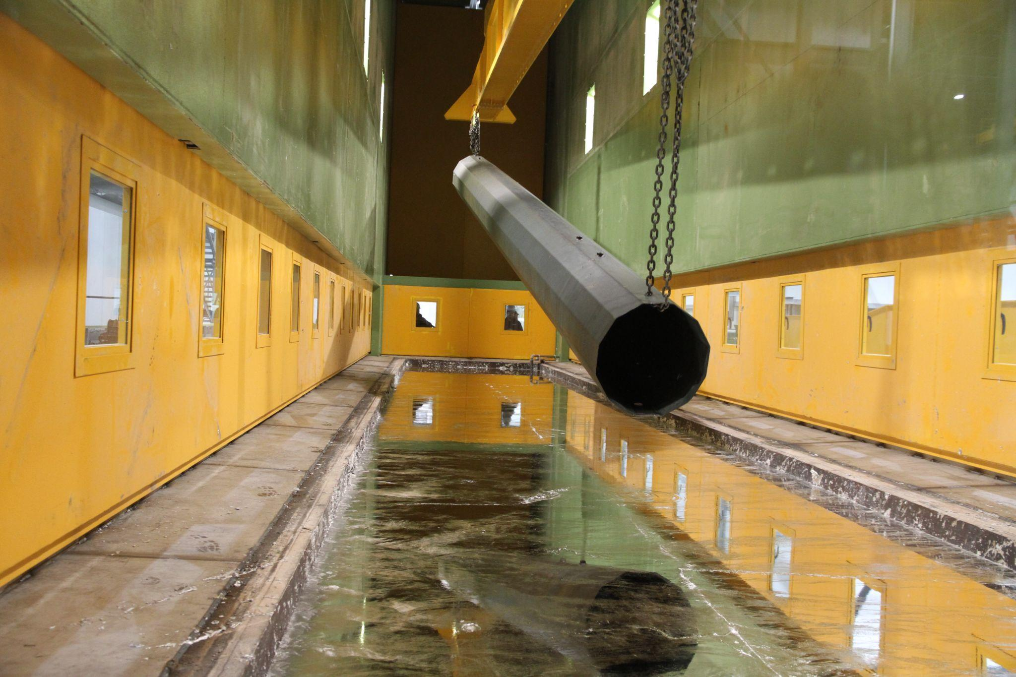
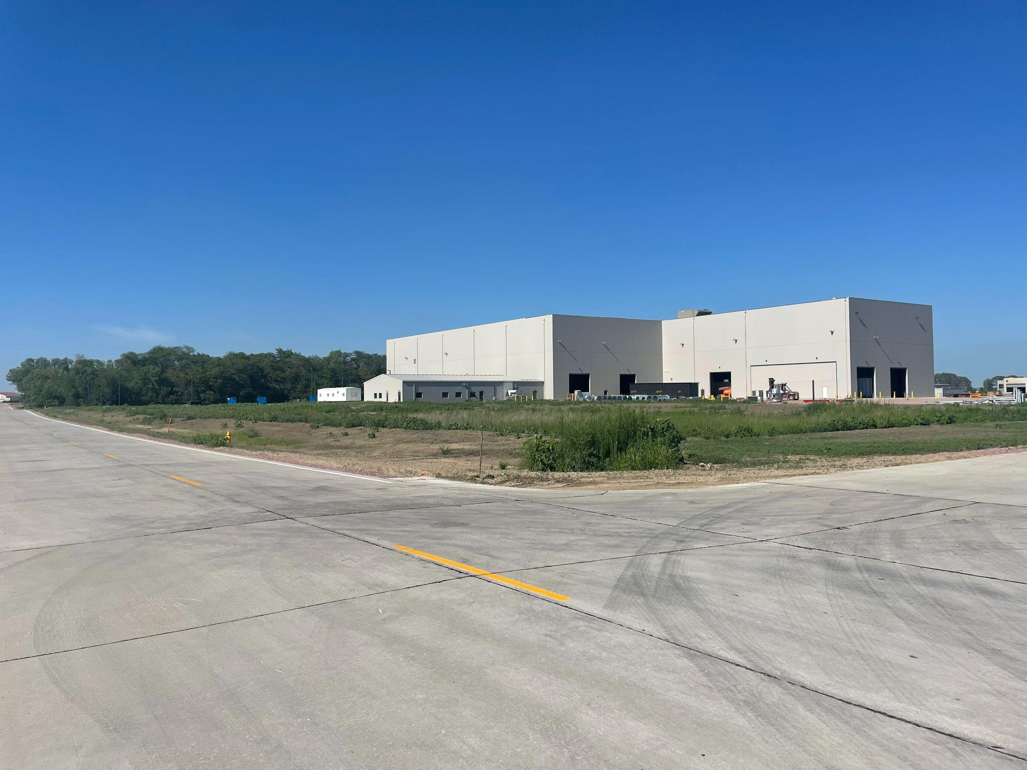
Southbridge Business Park
Sabre Industries Galvanizer Expansion
101,000 SF
76 new jobs
$25M capital investment
Andrew Avenue
$1.3M road improvement
50% RISE
Notes:
Marty
RISE Grants
Alicia Ave (new)
Andrew Ave (new)
255th Street/CF Industries Drive improvements (2016)
Al Haynes Drive
260th Street

Slide 10
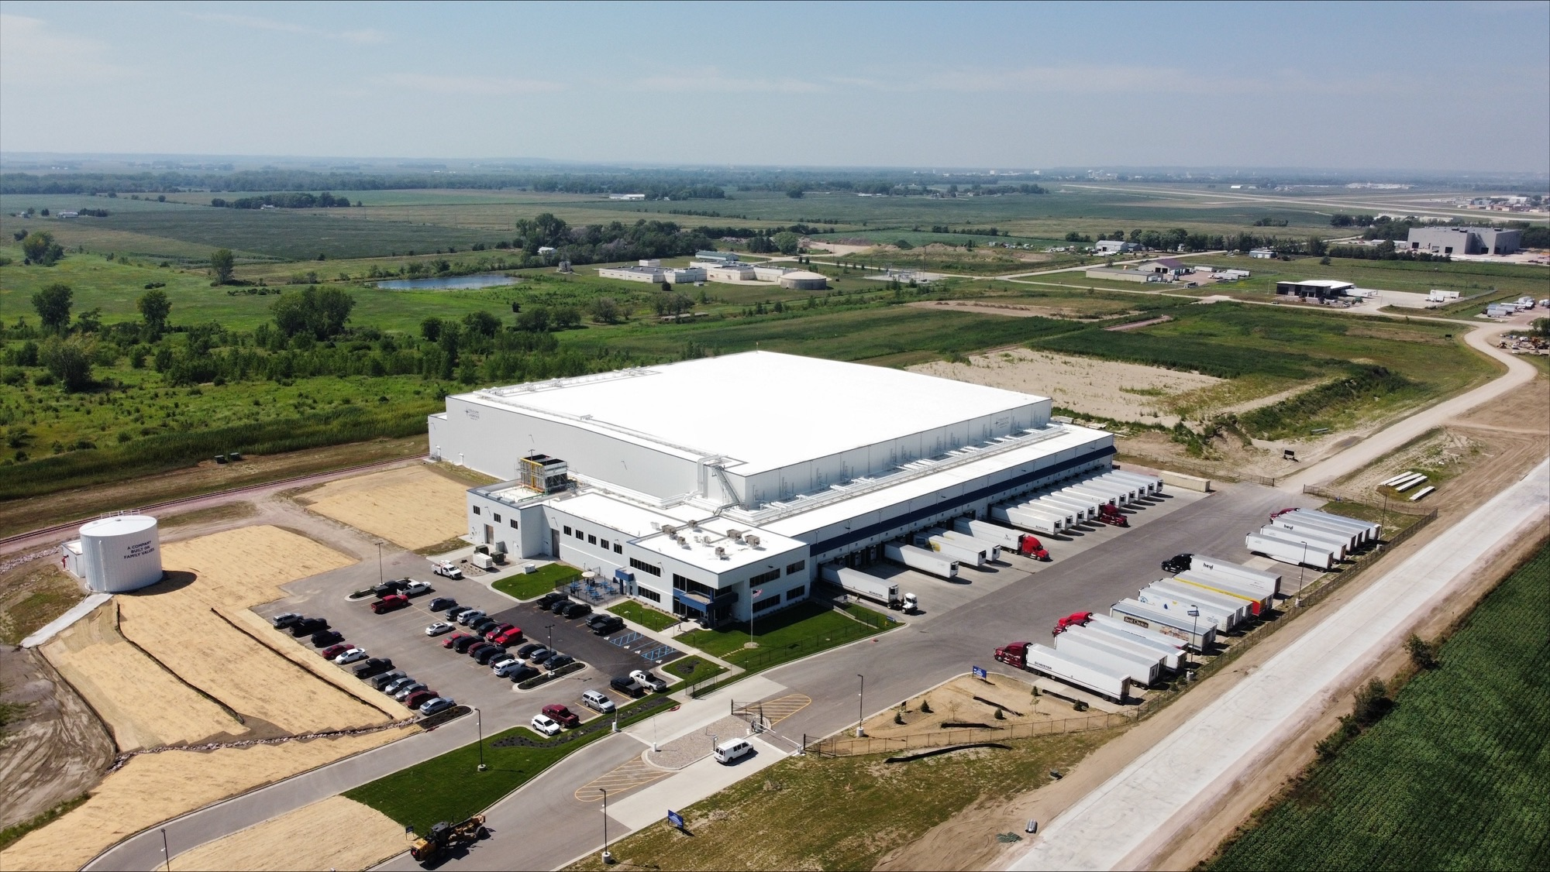
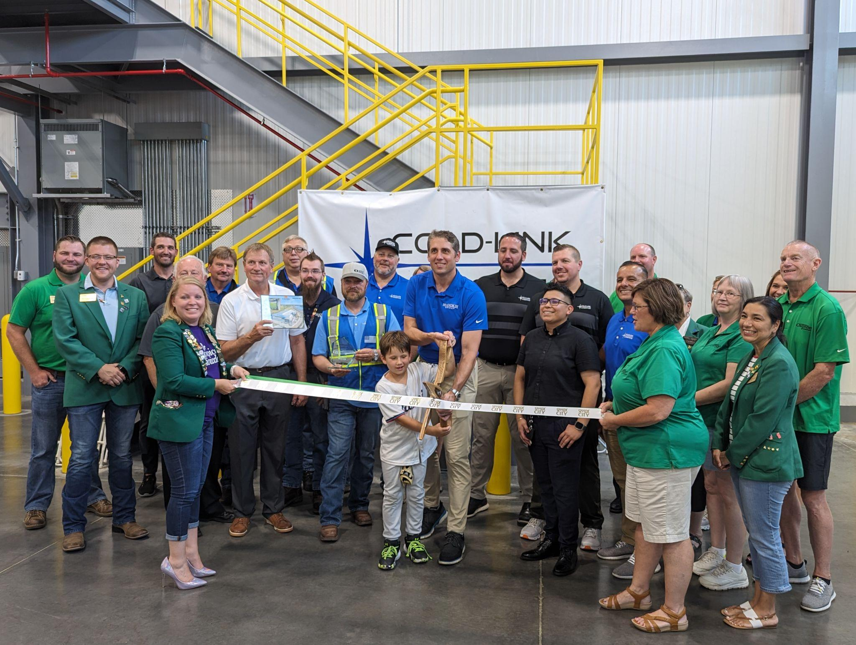
Southbridge Business Park
Cold-Link new cold storage facility
185,000 SF (Began Phase II - addn 300,000 SF)
60 new jobs
$56M capital investment
Alicia Avenue
$2.6M road improvement
80% RISE
Industrial Rail Spur
$1.375M new rail spur
50% RRLG grant
Notes:
Marty
RISE Grants
Alicia Ave (new)
Andrew Ave (new)
255th Street/CF Industries Drive improvements (2016)
Al Haynes Drive
260th Street

Slide 11
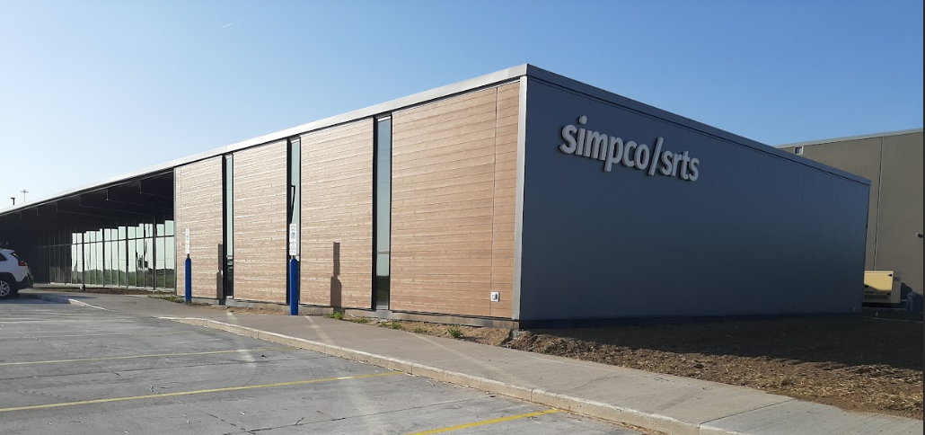
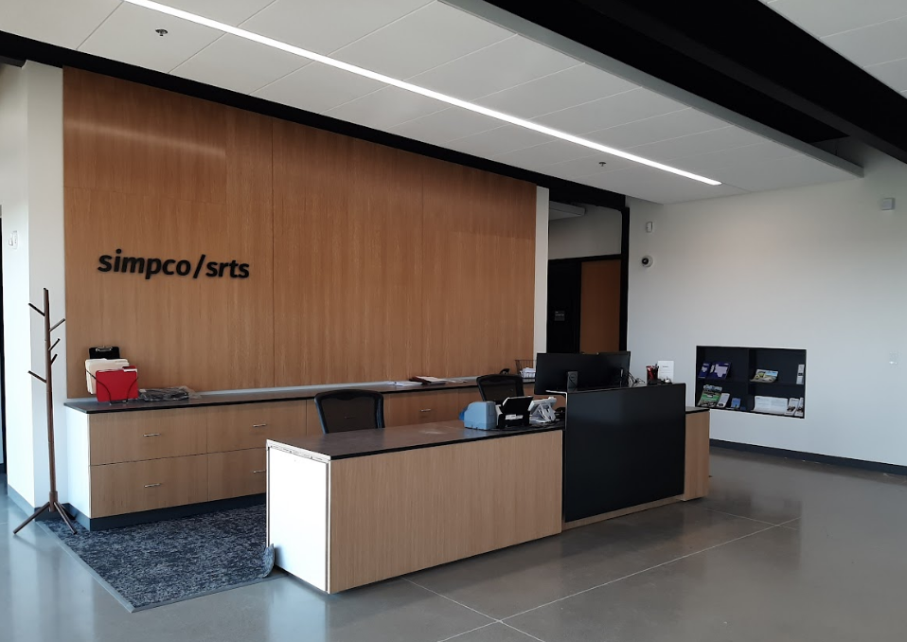
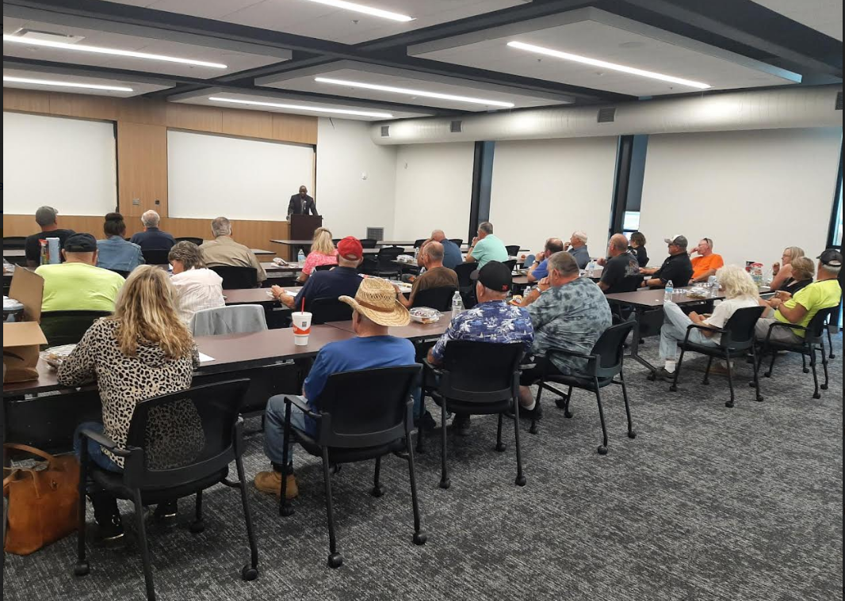
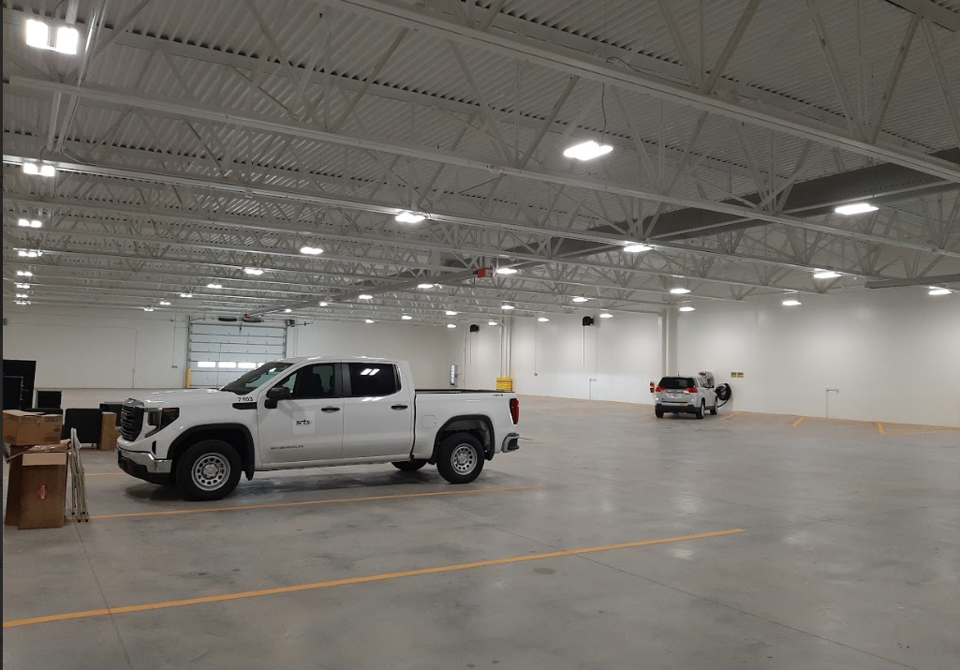
SIMPCO/SRTS New Facility
Thank you to the DOT for their cooperation, support and partnership on this project.
The building includes office space for both SIMPCO & SRTS, indoor bus storage, a training room, breakroom and locker room.
Thank you to the DOT Commission for approving a Public Transit Infrastructure Grant (PTIG) $480,000 for bus wash system for new facility.
Ribbon cutting: October 20, 2023 at 12:30 PM.
Notes:
Michelle

Slide 12
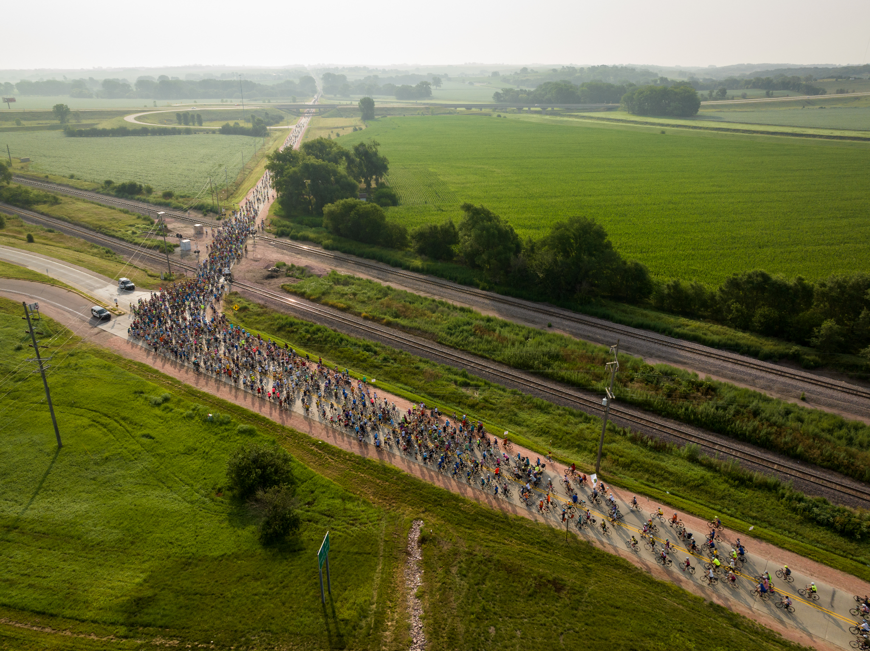
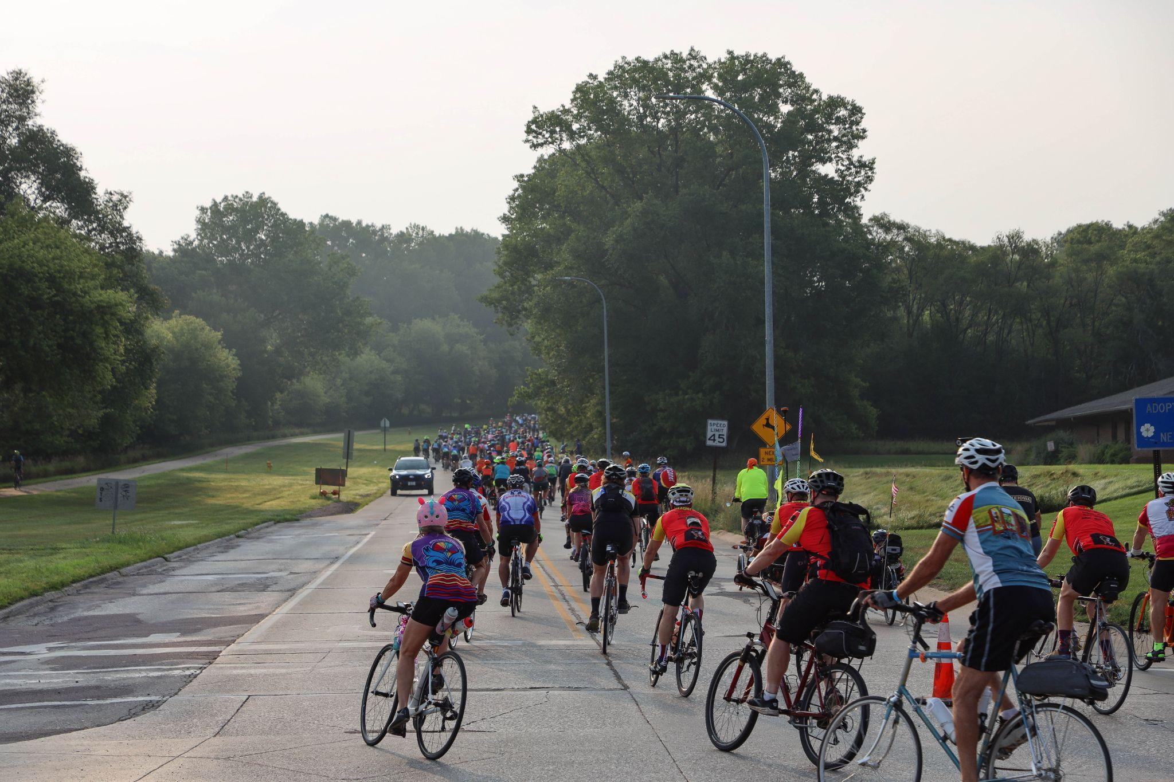
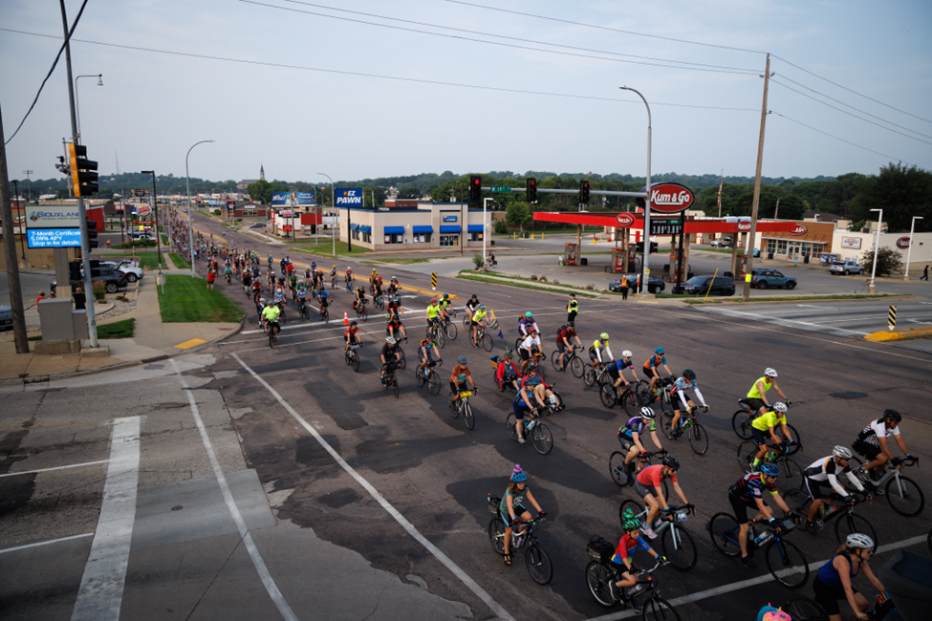
RAGBRAI 50th Anniversary
Started in Sioux City in 1973
30,000 registered riders
Unprecedented number of first-time riders
Thank you to Iowa DOT for your cooperation, communication,
and support
Notes:
Barbara

Slide 13
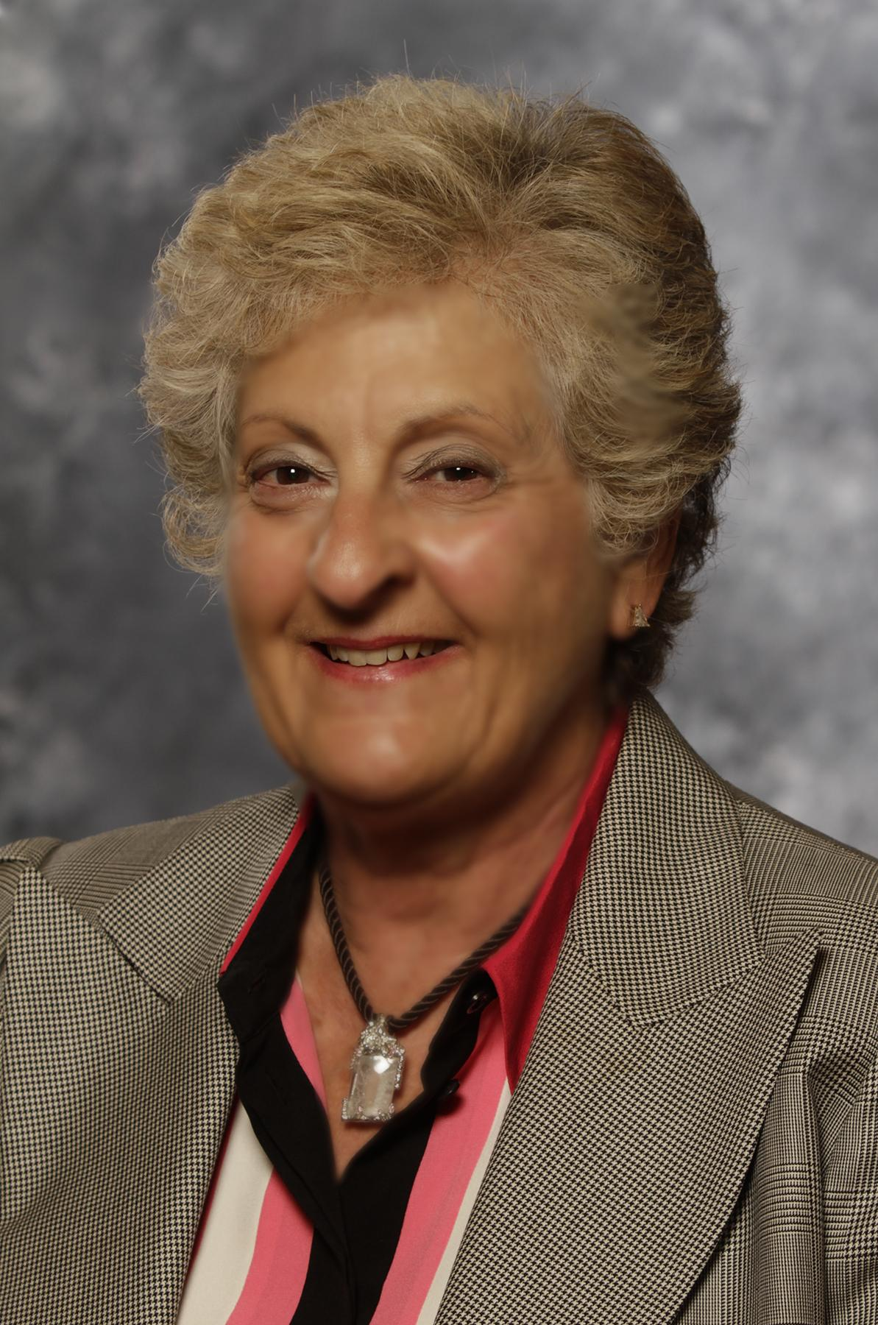
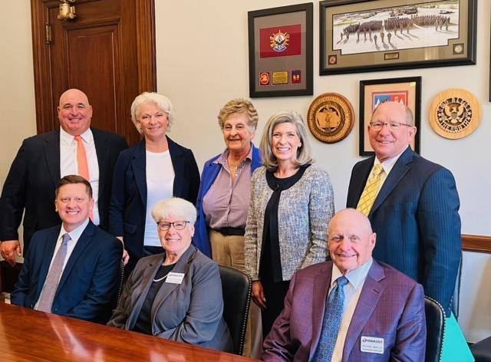
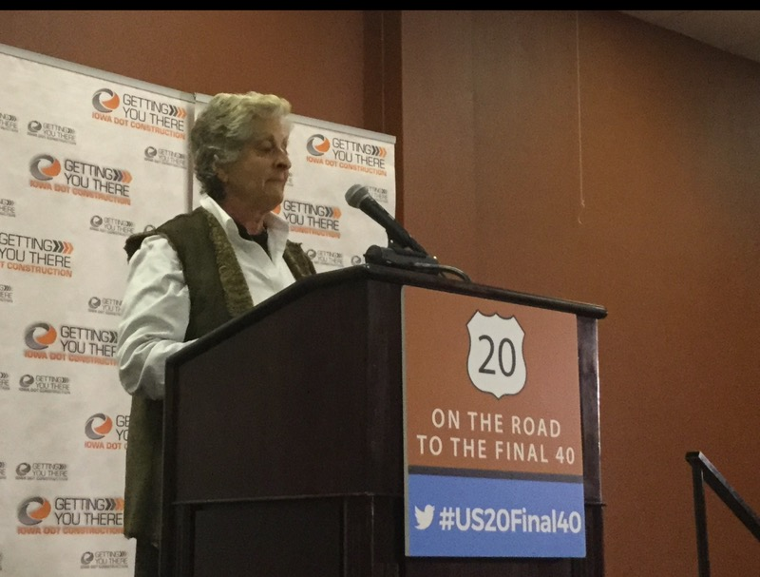
Thank You
Commissioner Charese Yanney
Notes:
Barbara

Slide 14
Thank You!
Contact:
Michelle Bostinelos
SIMPCO
MBostinelos@simpco.org
Marty Dougherty
City of Sioux City
mdougherty@sioux-city.org
Mark Nahra, P.E.
Woodbury County
mnahra@woodburycountyiowa.gov
Barbara Sloniker
Siouxland Chamber of Commerce
bsloniker@siouxlandchamber.com
Notes:
Barbara

