Slide 1
Transportation Trends Update
Transportation Commission Workshop
October 9, 2023

Slide 2
Overview
US total rail carloads
Commercial air service passenger counts
Vehicular traffic
Mississippi River and Panama Canal

Slide 4
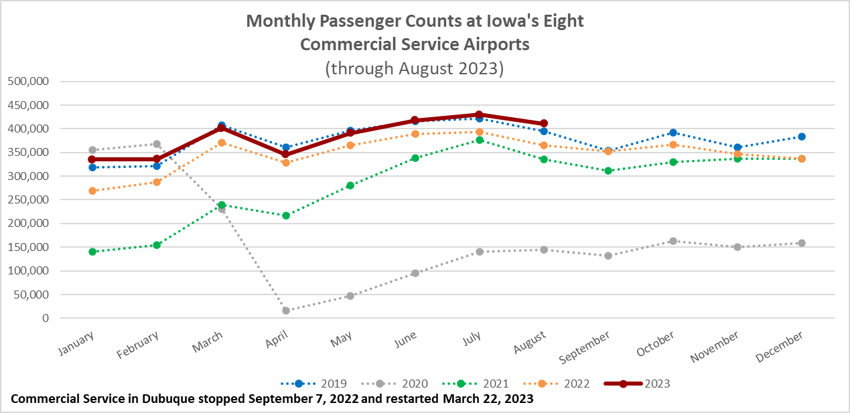

Slide 5
Monthly State Vehicle Miles of Travel
(through August 2023)

Slide 6
Mississippi River
Water levels have been falling since June and expected to continue to drop.
Result is barges are not fully loaded with grain causing reduced barge supply.
Barge transport rates are higher because of the tight supply.
Panama Canal
Drought has reduced the amount of freshwater available to use for the lock system
Maximum ships per day will be restricted to 31 – normal is 36 to 38.
95 boats waiting to transit the canal

Slide 7
Questions?

