Slide 1
Revitalize Iowa’s Sound Economy Program
Iowa Transportation Commission Workshop
October 9, 2023

Slide 2
Revitalize Iowa’s Sound Economy Program
Created in 1985
Purpose: To promote economic development through roadway improvements.
Eligible development shall have value-adding activities that feed new dollars into the economy
Available to cities and counties through an application program

Slide 3
Monthly Program Financial Report
Funded annually with dedicated state motor fuel and special fuel tax revenues
 | City RISE Fund | County RISE Fund
FY2024 Projected Total RISE Road Use Tax Fund (RUTF) Revenue ¹ | $11,759,666 | $5,879,833
Actual RISE Revenue Received as of 8/31/2023 ² (% of FY2024 Projected Revenue) | $2,196,521 (18.7%) | $998,255 (17.0%)
FY2024 RISE Funds Awarded as of 8/31/23 (% of Projected Total RUTF committed) | $2,205,356 (18.8%) | $0 (0%)
Fund Balance as of 8/31/23 | $53,495,988 | $17,079,682
Outstanding Commitments as of 8/31/23 | ($44,766,496) | ($19,118,787)
Uncommitted Balance as of 8/31/23 | $8,729,492 | ($2,039,105)
¹ Calculation based on FY2023 average monthly RISE RUTF revenue of $979,972 to the city RISE fund and $489,986 to the county RISE fund. As of 8/31/2023, FY2024 is 16.7% complete.
² Actual RISE revenue includes RUTF revenue, loan repayments, and project settlements. These revenue sources are variable and are not included in projections.

Slide 4
Local Development Project Evaluation Criteria
Development Potential (35 points)
Economic Impact and Cost Effectiveness (20 points)
Local Commitment and Initiative (33 points)
Transportation Need and Justification (4 points)
Local Economic Need (6 points)

Slide 5
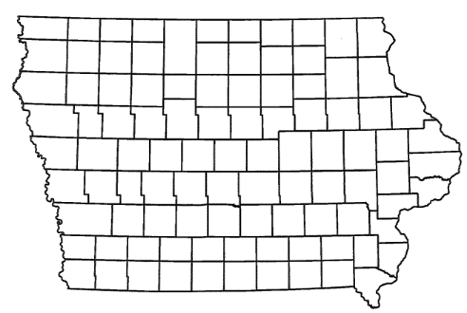
List of Local Development Applications Recommended
PROJECT NAME
SPONSOR
SCORE
TOTAL PROJECT COST
PERCENT PARTICIPATION
RECOMMENDED AMOUNT
Construction of approximately 1,160 feet of Rich Olive Street. | Story City | 48 | $804,113 | 50% | $402,057

Slide 6
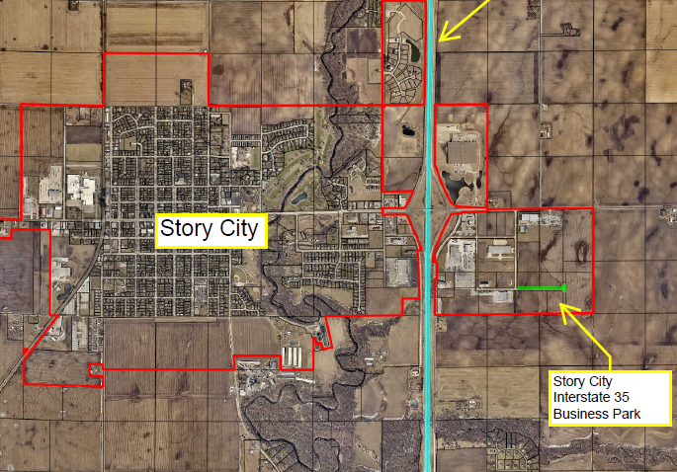
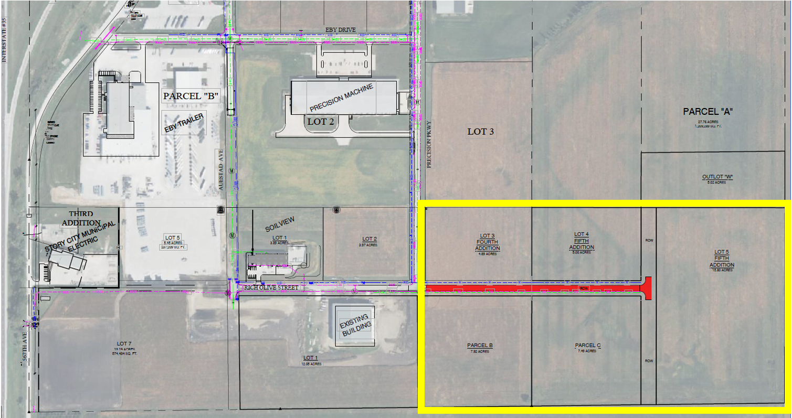
STORY CITY
Local Development
Construction of approximately 1,160 feet of Rich Olive Street located on the southeast side of town. This project is necessary to provide access to five lots totaling more than 41 acres for industrial purposes
Total Cost: $804,113
Requested: $402,057 (50%)

Slide 7
Project Settlement
Mount Pleasant – Local Development
Awarded $112,500 on November 9, 2004, for the construction of approximately 1,300 feet of Industry Avenue South of Commerce Drive in the Crossroads Industrial Park. The roadway was opened to traffic on September 27, 2005.
RISE Funds
Reimbursed: $107,222
Settlement
Recommended: $6,326

Slide 8
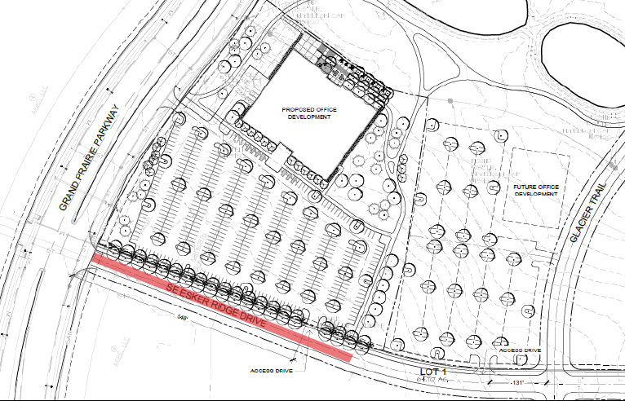
Project Settlement
Waukee – Immediate Opportunity
Awarded $865,372 on July 12, 2016, for the construction of approximately 650 feet of SE Esker Ridge Drive contingent on the creation of 83 new jobs. The roadway was opened to traffic on March 27, 2018. An average of 47 jobs were created.
RISE Funds
Reimbursed: $222,310
Settlement
Recommended: $35,847

Slide 9
Local Development Status Update
February 2022 Application Round
Cedar Rapids: Construct 375’ of new roadway (WITHDRAWN)
Total Cost: $391,458
Requested: $195,729
Evansdale: Construct 946’ of Birdland Dr (WITHDRAWN)
Total Cost: $762,502
Requested: $381,251
Tipton: Construct 1,850’ of Commerce Blvd (WITHDRAWN)
Total Cost: $1,221,200
Requested: $854,840

Slide 10
Local Development Status Update
September 2022 Application Round
Orange City: Construction of 920’ of 18th St SW (WITHDRAWN)
Total Cost: $1,780,937
Requested: $358,173
Pottawattamie County: Improvements to Magnolia Road (WITHDRAWN)
Total Cost: $5,585,824
Requested: $2,792,812

Slide 11
QUESTIONS?
Debra Arp, Systems Planning Bureau
Debra.Arp@iowadot.us
515-239-1681

