Slide 1


Transportation Asset Management (TAM) Overview
Charlie Purcell
Deputy Director, Transportation Development Division
Transportation Commission Workshop
October 9, 2023

Slide 2

Presentation Outline
What is TAM?
Why is TAM important?
What are we doing to implement TAM?
Preview of upcoming TAM presentations

Slide 3
What is TAM?

Slide 4

TAM is:
Making the right investments at the right time in order to maximize the benefits to the transportation system while minimizing the costs
Both an art and a science
Notes:
Right investments at right time
Avoids worst first approach
Fixing roof example -
Science
starts with collecting good data about our assets and their condition,
smartly using that data about to understand current trends,
developing models to predict future conditions based on estimated costs and available funds,
then using this information to inform the development of a program of projects
Art
data and models always have limitations
“All models are wrong, but some are useful”
Even the best models don’t take into account everything that needs to be considered
We'll always need the wisdom gained by our experience staff to use this data to make informed decisions

Slide 5
Why is TAM important?

Slide 6
TAM helps us:
Build, preserve, operate, maintain, upgrade, and expand the transportation system more cost-effectively throughout its whole life.
Improve performance of the transportation system.
Deliver to Iowa DOT’s customers the best value for every dollar spent
Enhance Iowa DOT’s credibility and accountability in its stewardship of transportation assets
Notes:
Right investments at the right time allow us to stretch our limited dollars as far as they will go
This in turn leads to a better performing system because it helps us keep the system in the best possible condition
Delivering the best value while maximizing performance builds credibility
Credibility is important because we serve as stewards of a tremendously valuable transportation system
Current replacement value of all primary roads and bridges is about $36 billion
When considering the value of the goods and services that depend on this system, the value is even more

Slide 7
TAM saves money
Notes:
Good roads cost less

Slide 8
What are we doing to implement TAM?

Slide 9
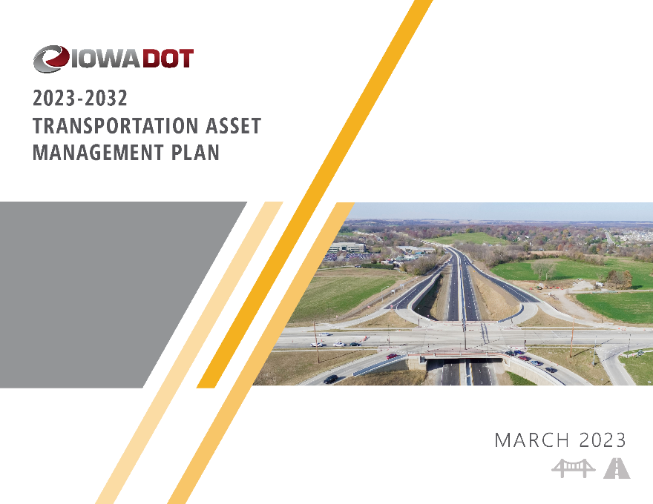
We have a plan
(we call it our TAMP)
TAMP Objectives
Defines clear links among agency goals, objectives, and decisions
Defines the relationship between proposed funding levels and expected results
Develops a long-term outlook for asset performance
Documents how decisions are supported by sound information
Develops a feedback loop from observed performance to subsequent planning and programming decisions
Improves accountability for decision making
Unifies existing data, business practices, and divisions to achieve Iowa DOT’s asset management goals
Notes:
Basic parts of the plan include:
Asset inventory and condition
Lifecycle planning
Performance assessments
Risk management techniques
Financial plan and investment strategies
Process improvements

Slide 10
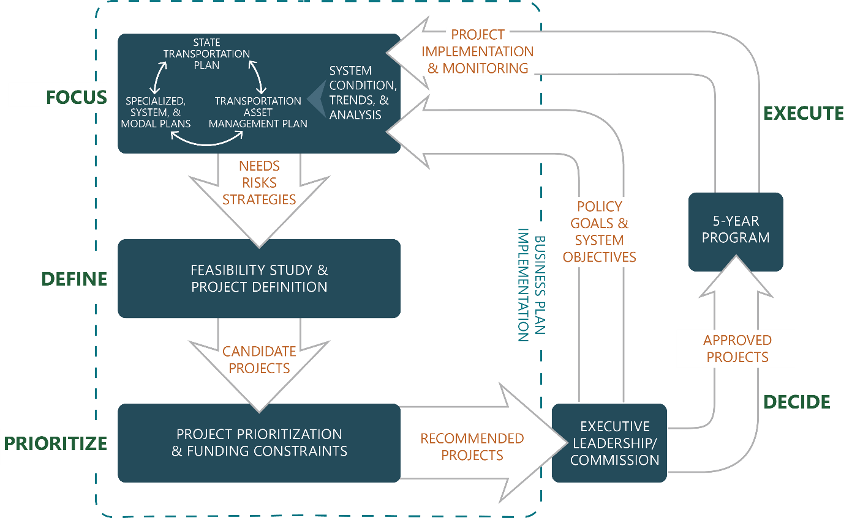
How does the TAMP fit in the planning and programming process?
Notes:
Diagram illustrates how the TAMP is connected to our long range plan, various system and modal plans, and our 5 year program

Slide 11
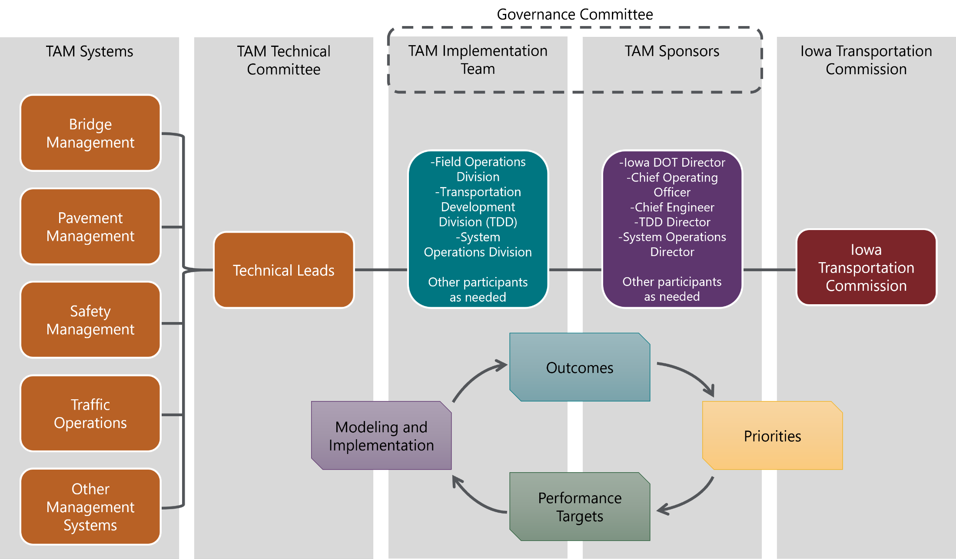
TAM Governance Structure
Notes:
TAM is applied within the structure shown in this chat
Each group is involved in TAM in a different way

Slide 12
Upcoming TAM presentations

Slide 13
Upcoming TAM Presentations
Presentation | Objectives
Interstate Investment Plan Update (December) | Present updated recommendations for timing and location of future capacity and stewardship investments Request input on proposed schedule and funding level Include a “preview” of revisions to the options list for major Interstate projects
Pavement Asset Management (January) | Review of current pavement conditions Present different investment scenarios and resulting conditions
Bridge Asset Management (February) | Review of current bridge conditions Present different investment scenarios and resulting conditions
Asset Management Summary (March) | Review and summarize recommendations from previous presentations Receive feedback on recommendations

Slide 14
Questions and feedback

