Slide 1
Revitalize Iowa’s Sound Economy Program
Iowa Transportation Commission Business Meeting
October 10, 2023

Slide 2
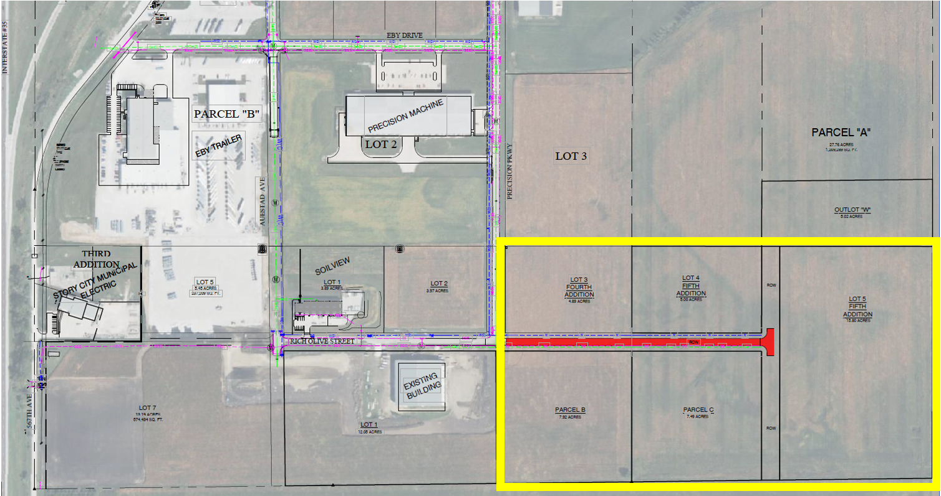
List of Local Development Applications Recommended
PROJECT NAME
SPONSOR
SCORE
TOTAL PROJECT COST
PERCENT PARTICIPATION
RECOMMENDED AMOUNT
Construction of approximately 1,160 feet of Rich Olive Street. | Story City | 48 | $804,113 | 50% | $402,057

