Slide 1
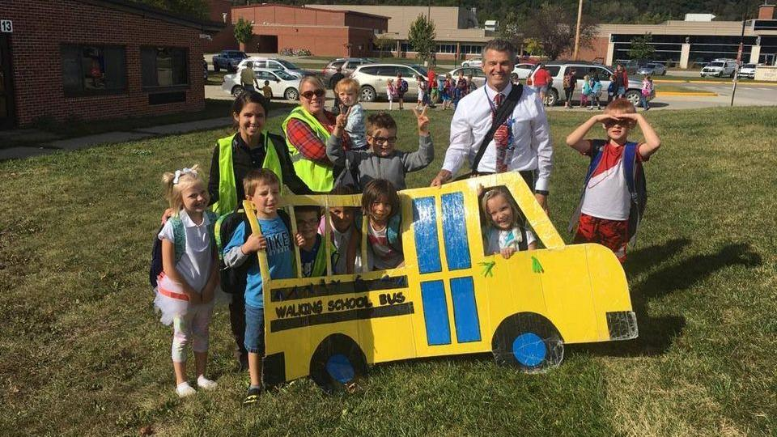
Safe Routes to School
Iowa DOT Commission
October 8th, 2024
April Bril

Slide 2
Iowa Safe Routes Partnership
Bicycle Coalition
Iowa Northland Regional Planning Commission
Upper Explorerland Regional Planning Commission (UERPC)

Slide 3
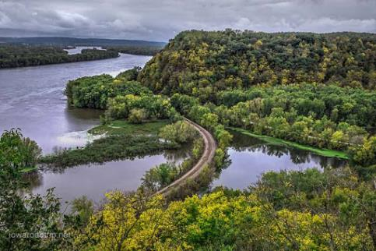
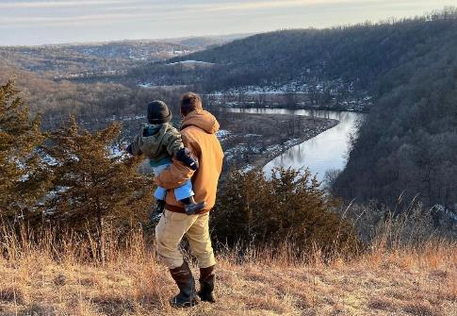
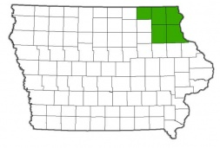
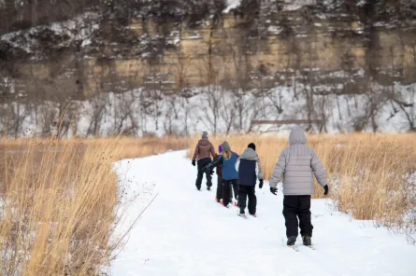
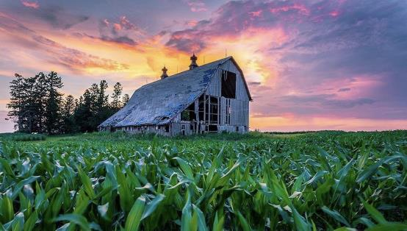
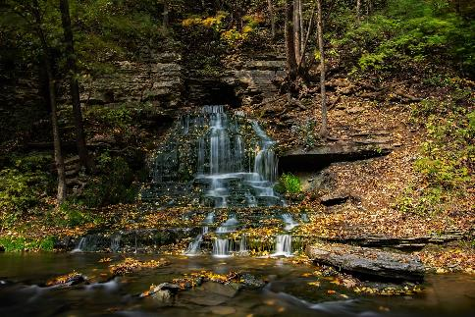
Upper Explorerland Regional Planning Commission

Slide 4
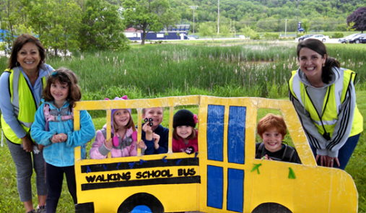
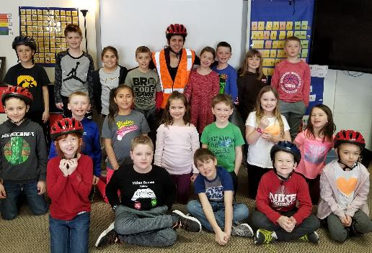
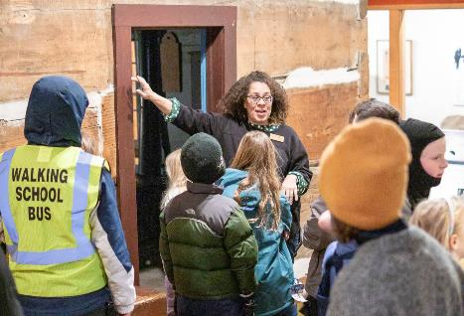
Upper Explorerland’s Safe Routes to School (SRTS)
Walking and Biking School Buses
Bicycle/Pedestrian Safety Education
Community Programs/Partnerships

Slide 5
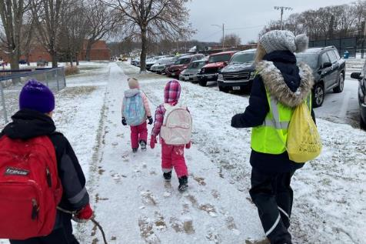
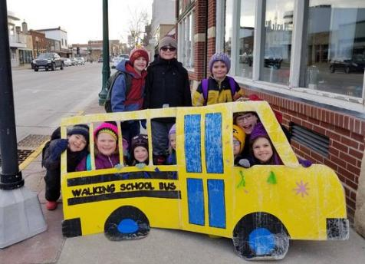
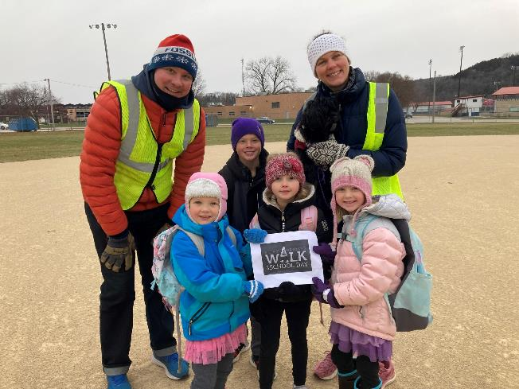
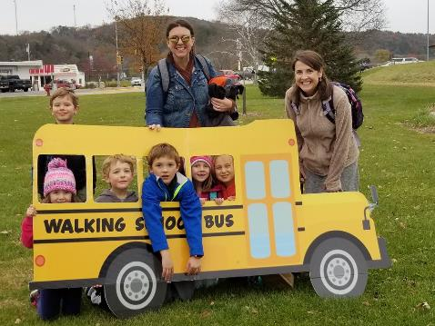
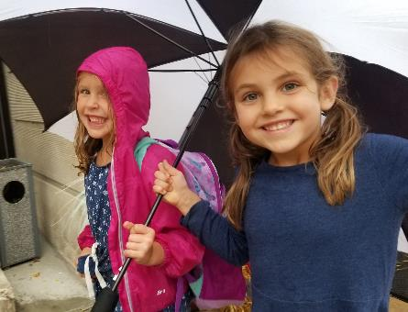
Walking School Bus

Slide 6
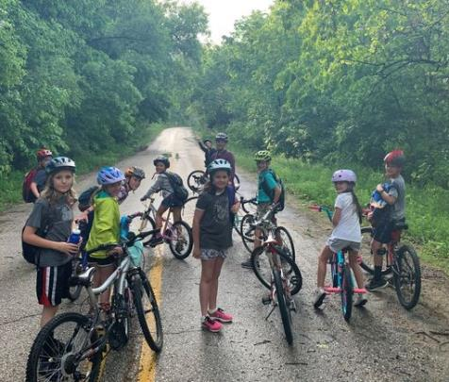
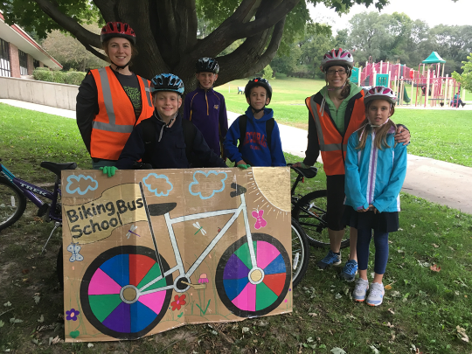
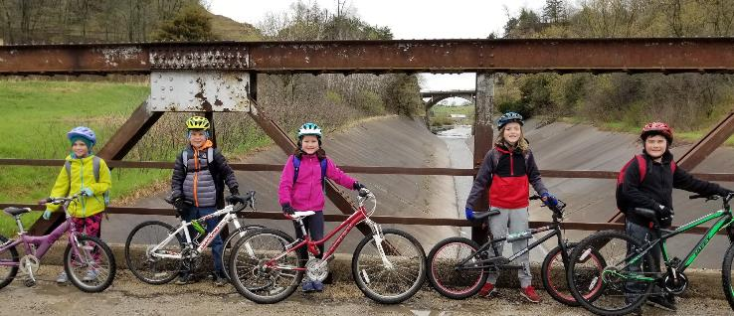
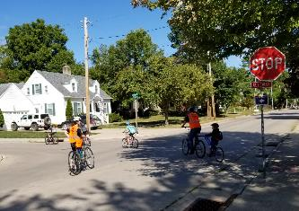
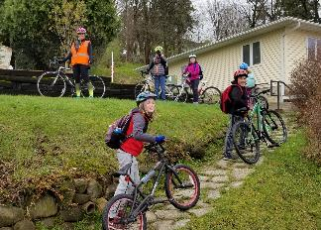
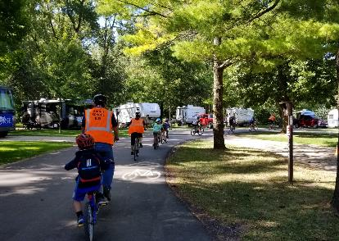
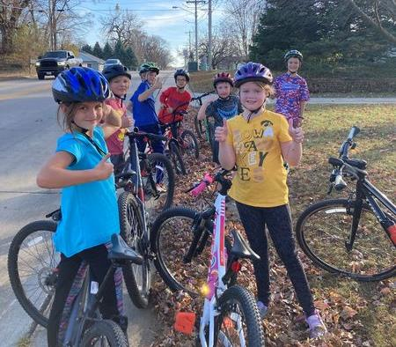
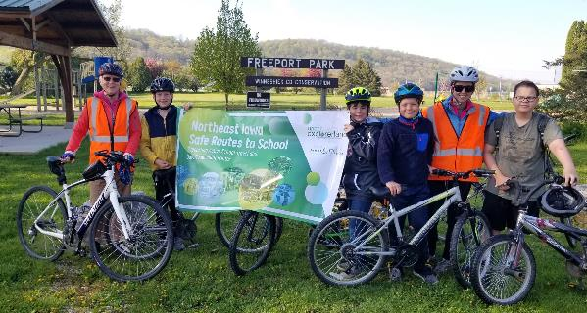
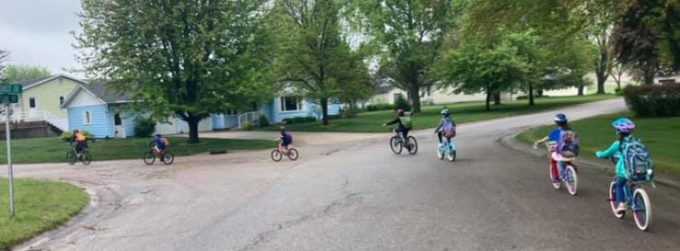
Biking School Bus

Slide 7
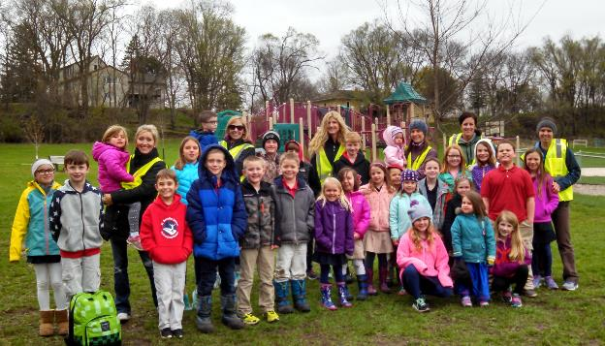
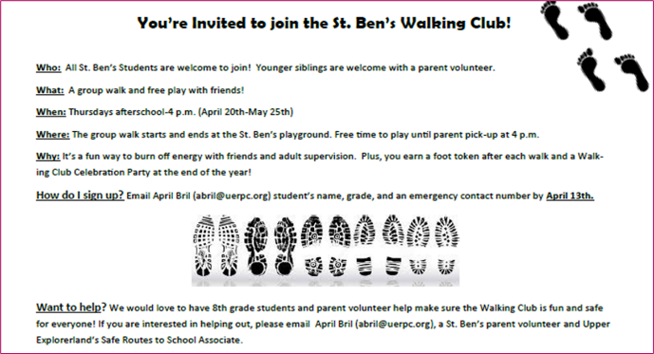
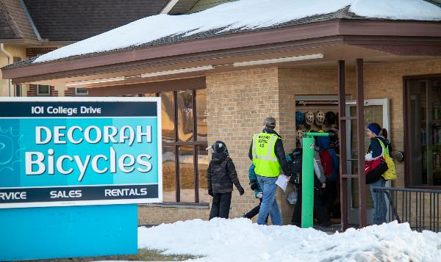
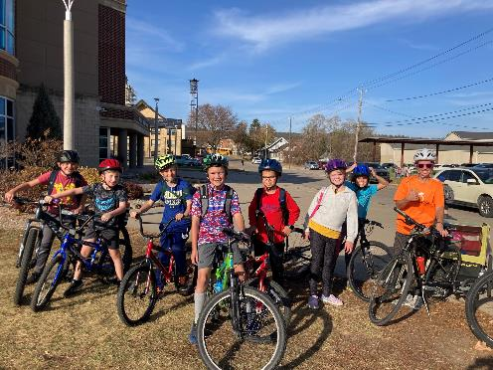
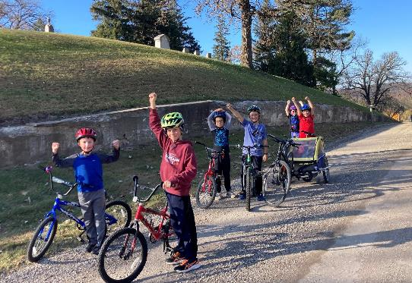
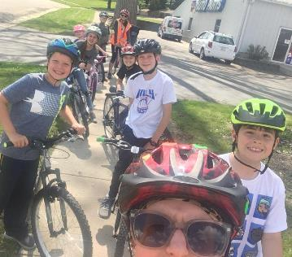
Alternative Walking and Biking School Buses

Slide 8
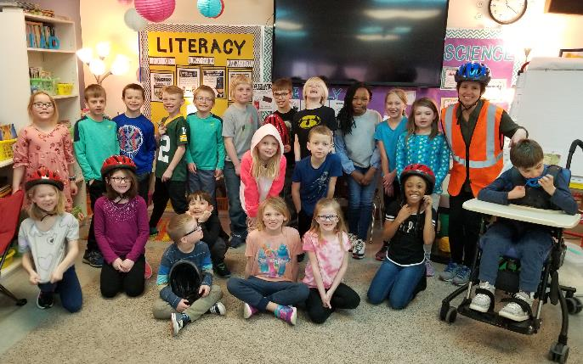
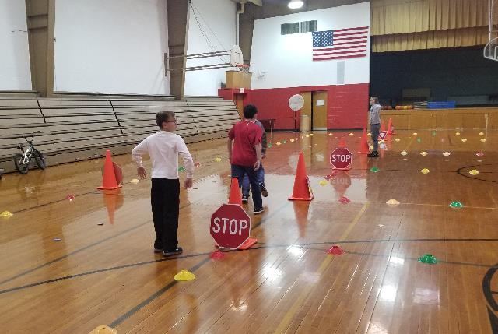
Bicycle and Pedestrian Safety Education
Classroom Bike Safety Lessons
Bike Rodeos and Bike Safety Kits

Slide 9
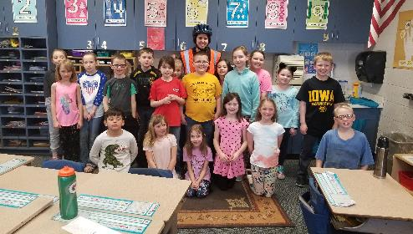
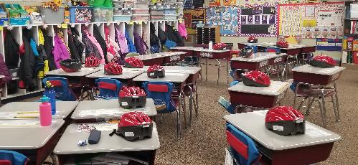
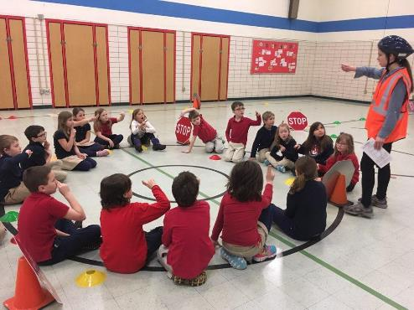
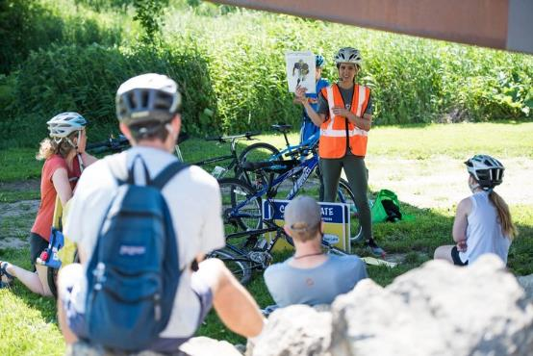
Classroom Bicycle and Pedestrian Safety Education

Slide 10
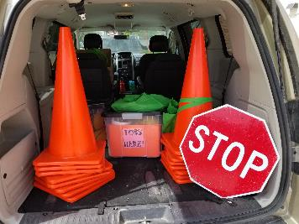
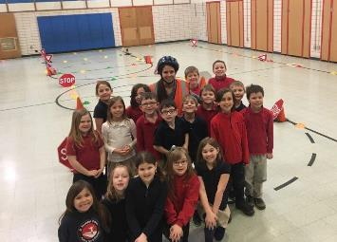
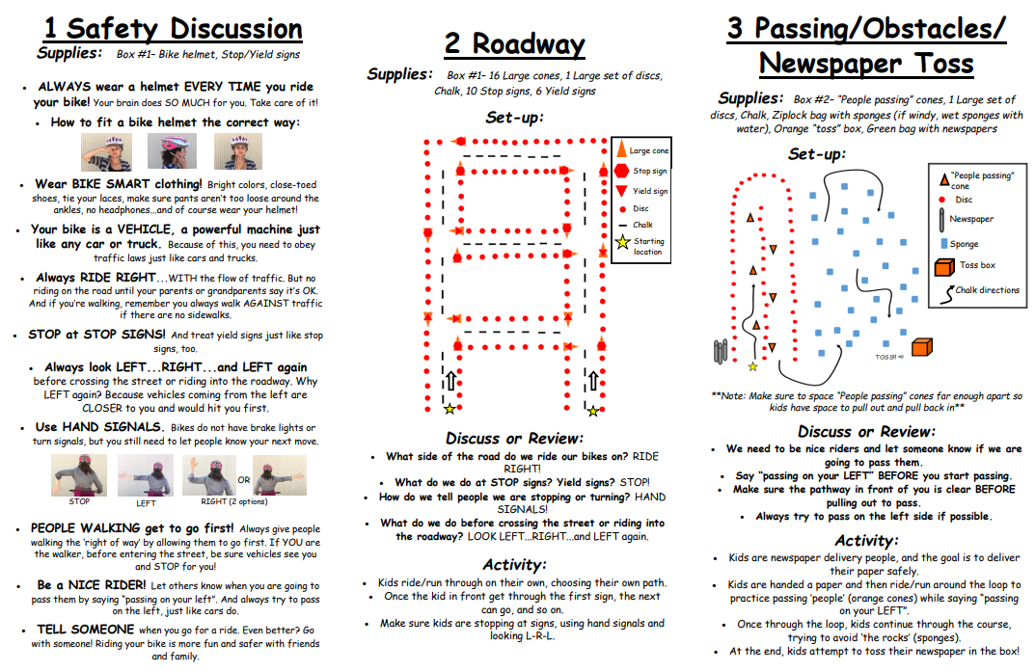
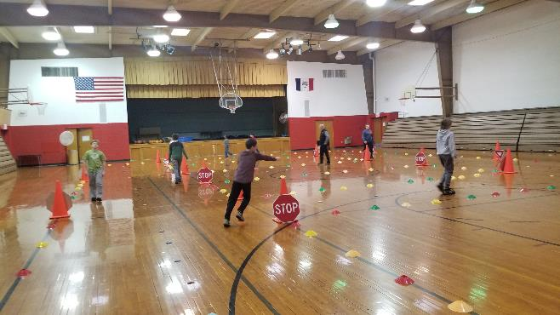
Bike Rodeos and Bike Safety Kits

Slide 11
Community Programs and Partnerships
Community Walks
Community Walking Supper
Kindness Project
Walking Field Trips
Biking Field Trips
Winter Field Trips

Slide 12
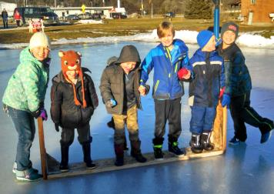
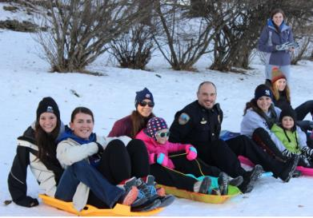
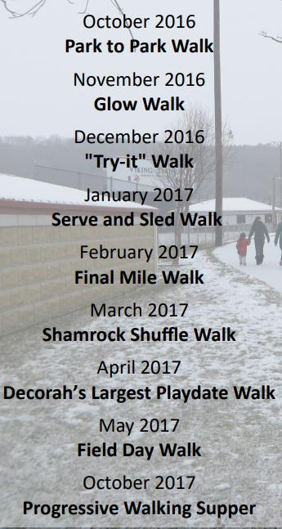
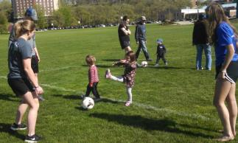
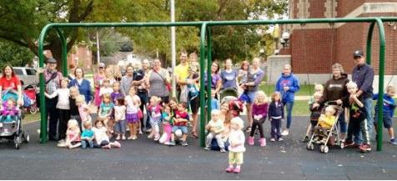
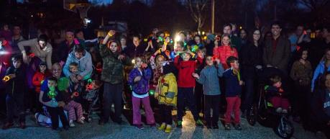
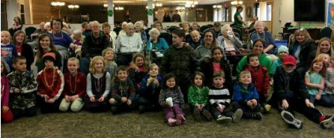
Community Walks

Slide 13
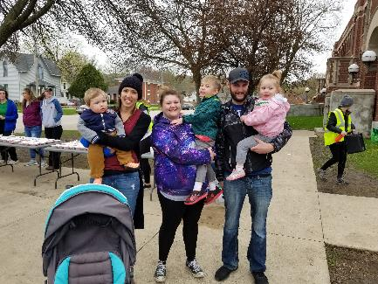
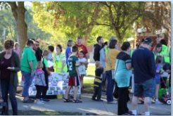
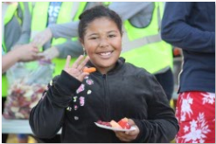
Community Walking Supper

Slide 14
Walking School Bus Kindness Project

Slide 15
Walking and Biking Field Trips

Slide 16
Winter Field Trips

Slide 17
Why Safe Routes to School is Important
Physical:
Safe Routes to School supports increased physical activity, helps form healthy habits that can last a lifetime, and decreases the risk of chronic disease and obesity.
Academic:
Quicker response to test questions with greater accuracy and also completed learning tasks faster and more accurately following physical activity.
Better attendance rate.
Environmental:
Safe Routes to School programs can improve air quality by reducing vehicle trips and miles traveled.
Private vehicles still account for half of school trips between 1/4 and 1/2 mile—a distance easily covered on foot or bike.
Financial:
Safe Routes to school provides low-cost options for students to get to and from school, reducing the amount of money needed for personal vehicle use and busing.
Source: https://www.saferoutespartnership.org/safe-routes-school/101/benefits

Slide 18
Success Storytime
Mechanic/Mill St. WSB
WE ARE THE WALKING BUS
MILL STREET, MECHANIC,
THAT IS US!
NIKA AND CHASE
SAM, EMILY, BRIE,
6 BODIES, 12 LEGS
ALL MOVING FREE.
WE STEP, HOP, SLIDE
AND RUN
WATCHING OUR STAR,
THE RISING SUN.
SNOW CRUNCHING
UNDER OUR FEET,
WE WATCH AND LISTEN
AT EVERY STREET.
WE WONDER AT PINECONES,
RIDDLES AND STONES
AS WE EXERCISE
OUR MUSCLES AND BONES.
HEADING FOR SCHOOL
WE’RE THE WALKING BUS
JULIE AND LISA
DELIVER US

Slide 19
Testimonials
The WSB has helped develop a sense of community and social companionship with walking members. Volunteers each share different perspectives and I appreciate their diversity.
- WSB Parent
As a Walking School Bus volunteer for the past four years, I appreciate and strongly support the Safe Routes message of active school travel and safe neighborhood routes. I am an advocate of physical activity for our children to encourage and preserve healthy lifestyles. I have witnessed the development of listening skills, teamwork, empathy, and flexibility as children engage in relationships created through neighborhood networking and educational programs. Learning these life skills at a young age enable our children to become tomorrow’s effective leaders. -WSB Volunteer
I am proud to be a Safe Routes supporter. I have seen first-hand the impact that the Walking School Bus program has had on my son and daughter the past four years. They are excited to walk to school every day, to feel connected to our community as they experience it on foot, and to build confidence in their ability to navigate the one mile walk through town. The skills they are learning in this program make them safer pedestrians at all times, and my son has now begun walking to school on his own. This would not be possible without their participation in this program, and I wish every child had the privilege to participate in such a positive, constructive program.
-WSB Parent

Slide 20
Volunteers and Families

Slide 21
Dear WSB and BSB Volunteers (within our region and beyond), We truly appreciate each and every one of you. Day in and day out, you take time out of your busy lives to corral a peppy, zany, silly, squirrel-y gaggle of kids. Your “job” as a WSB or BSB volunteer seems so straightforward—and on the surface, it is—just a simple walk or bike to school with neighborhood kids. But dig a little deeper, and we begin to realize that you are doing SO much more for our kids than just simply getting them to or from school: YOU are instilling in our kids a lifelong love of daily movement YOU are helping our kids develop a sense of independence and responsibility YOU are introducing our kids to the magical wonders of nature YOU are teaching our kids about personal safety and community awareness YOU are a mentor and friendly face for our kids to love and learn from And YOU are inspiring our communities to make positive changes for a brighter future And on those days when your gaggle of kids is just a little too loosey goosey, try and remember that even when it doesn't seem like it, you really are making a difference in the lives of these kids, their families and their communities. YOU are leading the next generation of leaders.
THANK YOU!

Slide 22
How to Get Involved?
*Volunteer *Spread the Word
*Collaborate
“Too often we underestimate the power of a touch, a smile, a kind word, a listening ear, an honest compliment, or the smallest act of caring, all of which have the potential to turn a life around.” – Leo Buscaglia

