Slide 1
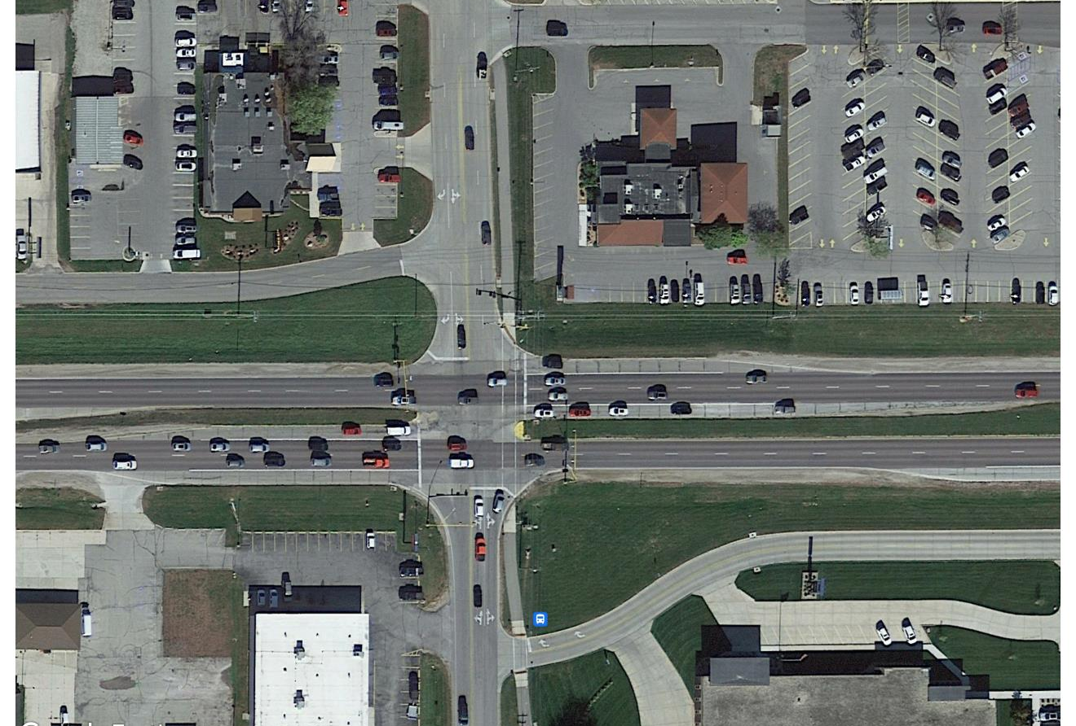
Iowa Highway 122 West Corridor
Iowa DOT Commission – October 8, 2024

Slide 2
What’s new in Mason City
Several exciting projects in Mason City
Destination Iowa trail projects are underway across the city
Riverwalk along Willow Creek in the downtown area is underway
Proposed Hotel in the Southbridge Mall parking Lot
Developed 93 multi-unit and upper story living spaces in the vibrant downtown, creating a total of 228 new housing units downtown over a 3-year period
50,000 sq ft Amazon Last Mile Distribution Facility under construction
Reconstruction of about 1.5 miles of US 65 in South Portion of Mason City
New $18 million Airport Terminal opened on July 31
Several new Restaurants and Other Developments

Slide 3
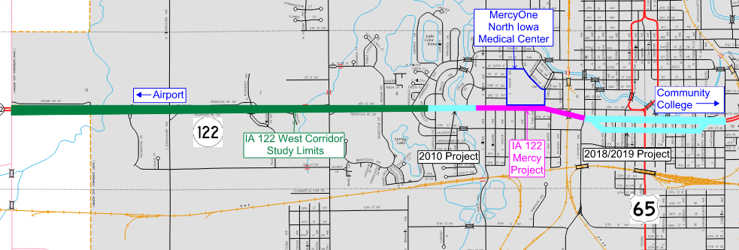
IA 122 Projects
City of Mason City

Slide 4
MercyOne North Iowa Medical Center
Regional teaching hospital located in Mason City
Largest provider of health care services in the North Iowa Region
Largest employer in the Region
342 Beds serve more than 400,000 inpatients and outpatients each year

Slide 5
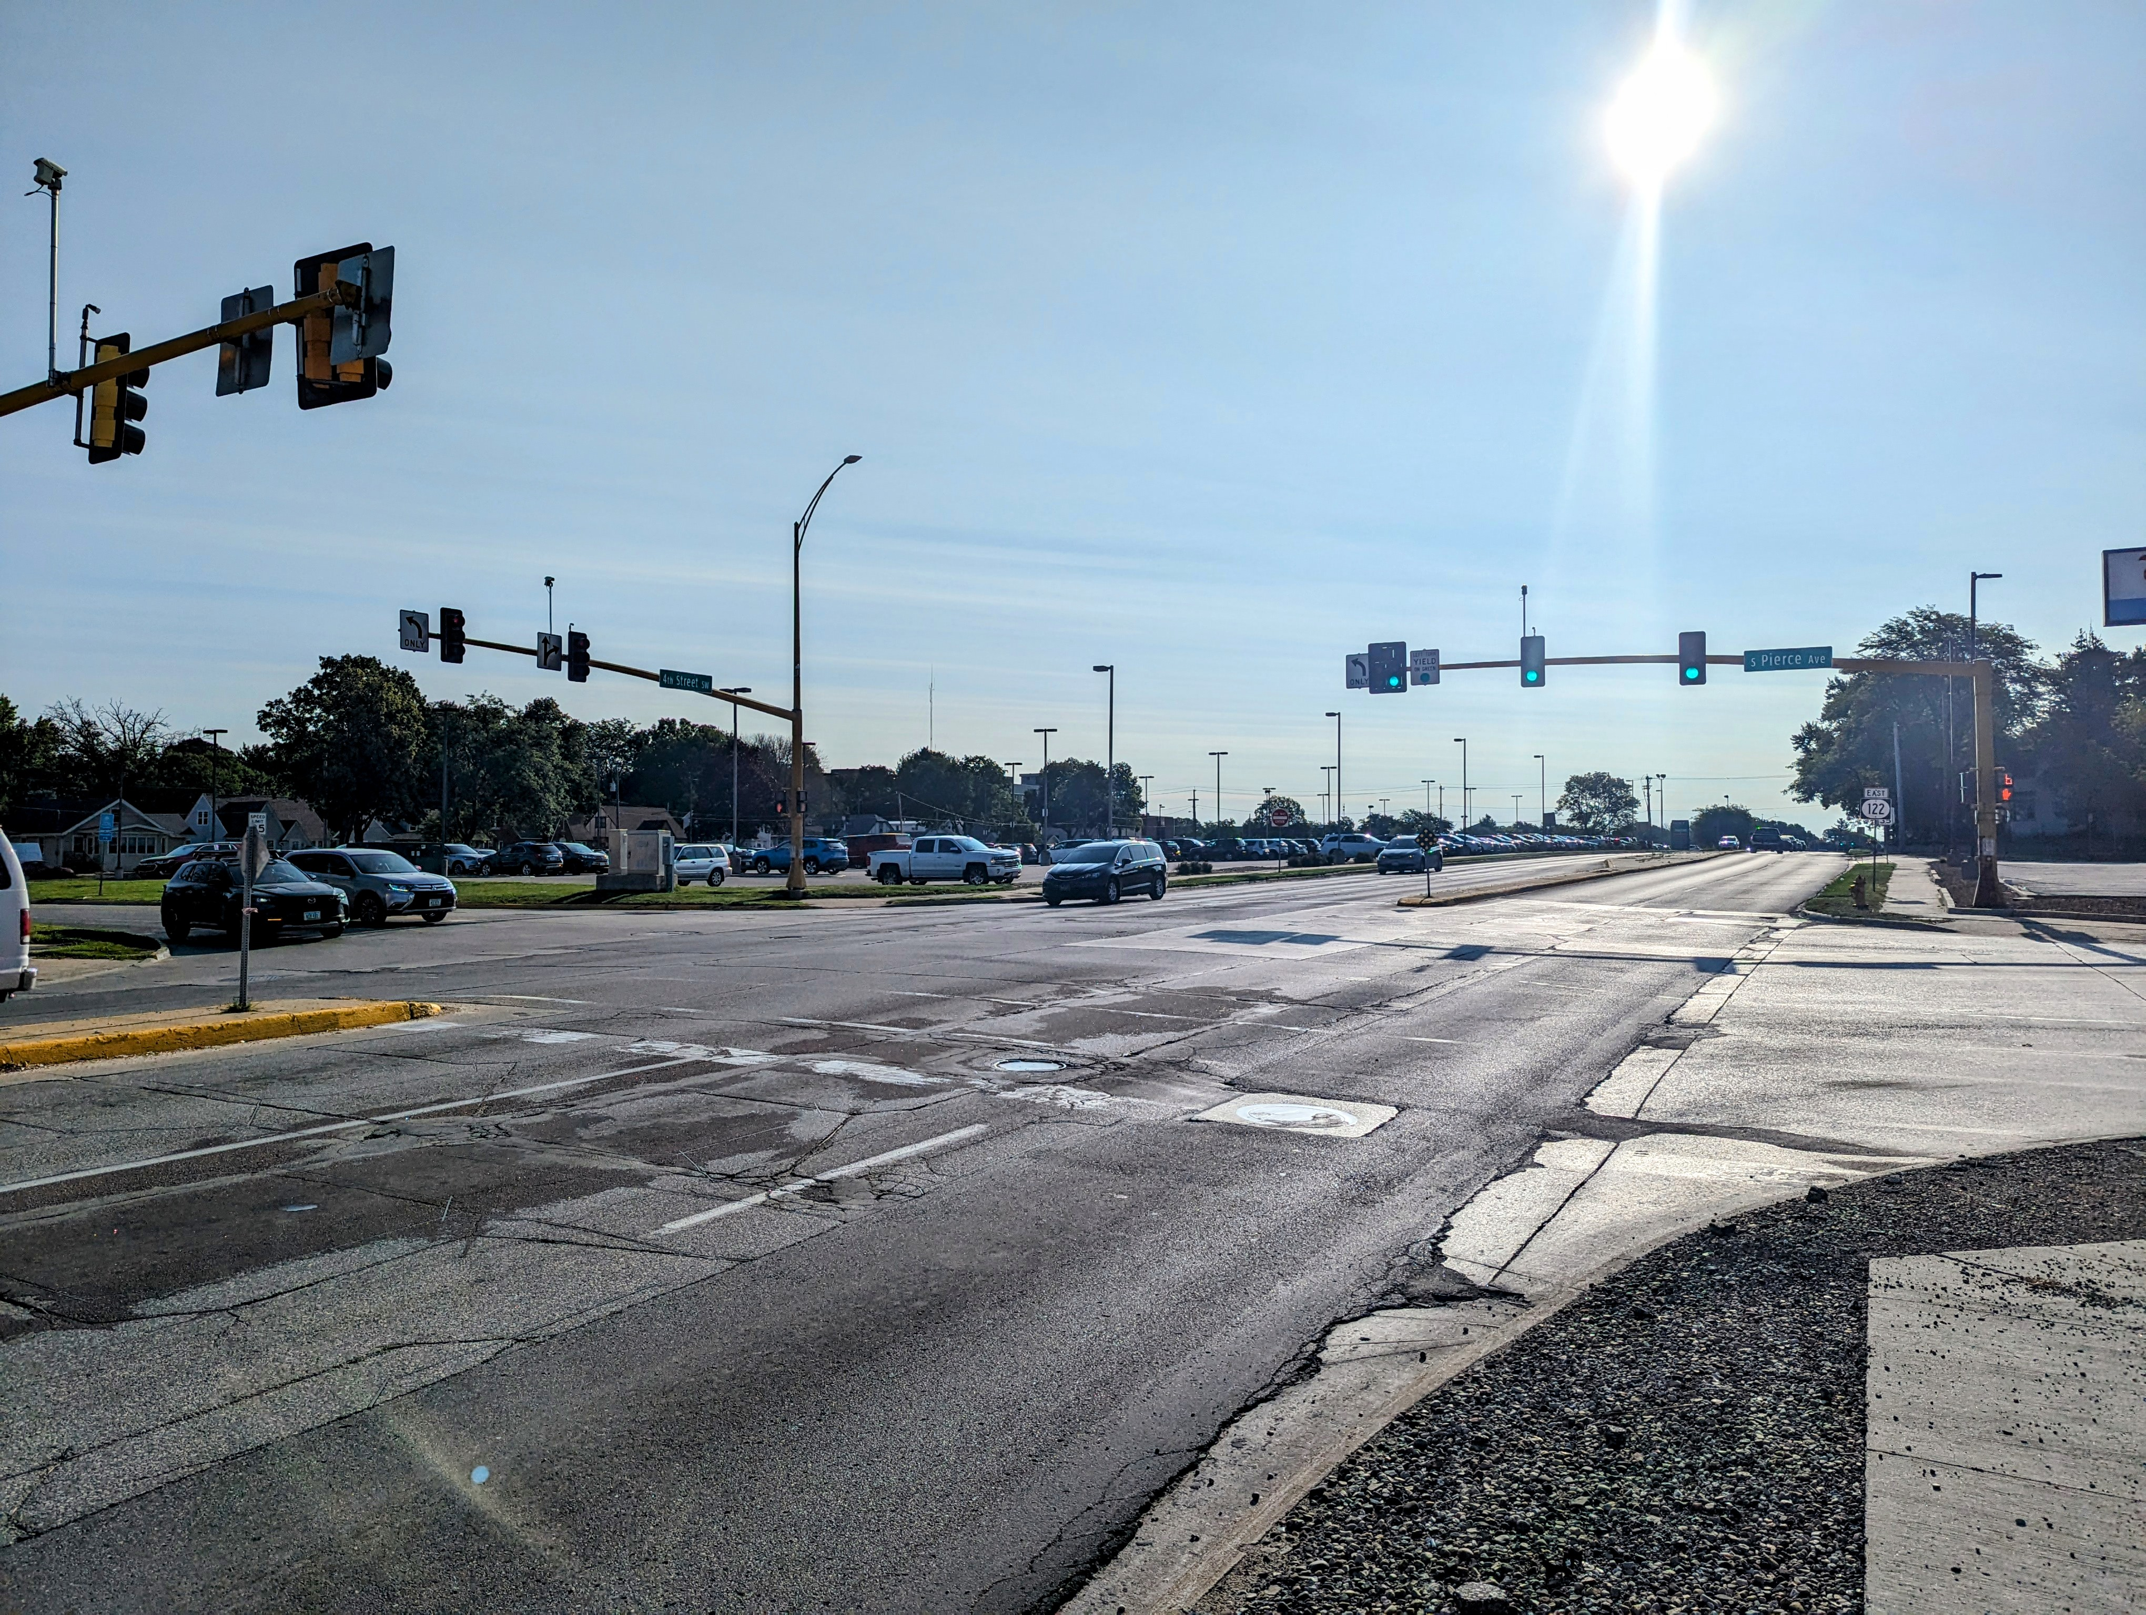
IA 122 Mercy Corridor Project Schedule
Presented at Iowa DOT Commissioners Meeting – August 8, 2023
Letting – January 2025
Construction – 2025 to 2026

Slide 6
IA 122 Mercy Corridor Iowa DOT and City of Mason City Partnership
City is leading the design of the Mercy Corridor project, with assistance from the DOT
City is funding the design fees
City and DOT will fund construction of the project
DOT responsible for 60% of Participating Items
City responsible for 40% of Participating Items and 100% of Non-Participating Item
Total Project Cost is estimated to be $12,620,000

Slide 7
IA 122 West Section Project
Future reconstruction to urbanize with roundabouts
Approximately 2.6 miles
Presented to Commission on October 11, 2022

Slide 8
Grant and Funding Opportunities
The US Department of Transportation recently awarded Mason City an SS4A Grant
Safe Streets and Roads for All (SS4A) Grants provide funds to prevent roadway deaths and serious injuries
Mason City has been awarded $200,000 to develop a City-Wide Comprehensive Safety Plan
Mason City will contribute $40,000 to the development of the Comprehensive Safety Plan

Slide 9
Grant and Funding Opportunities
The SS4A grant and subsequent Action Plan will evaluate Mason City’s streets across the entire jurisdiction
Safety Impact – Which Mason City Streets can be improved?
Equity – How to address transportation insecurity by increasing street safety for all users, motorized and non-motorized?
The IA 122 West corridor is identified as a priority improvement in the SS4A Application
A dedicated portion of the Action Plan will focus on the IA 122 West Corridor
Plan to use the Action Plan to bolster the IA 122 West application for SS4A Implementation funds in the future

Slide 10
Grant and Funding Opportunities
Mason City recently applied for an Active Transportation Infrastructure Investment Program (ATIIP) Grant
$2 million dollars were requested in the application, requiring a $400,000 match by the City
The application specified that the City would be open to a reduced, scalable award should funding be insufficient to grant the requested $2 million
ATIIP funding would pay for the NEPA process, Survey and Preliminary Design of the IA 122 West Section Project
We hope to receive notification of grant awards in the next 2 months, to help fund the design of the IA 122 West Section Project

Slide 11
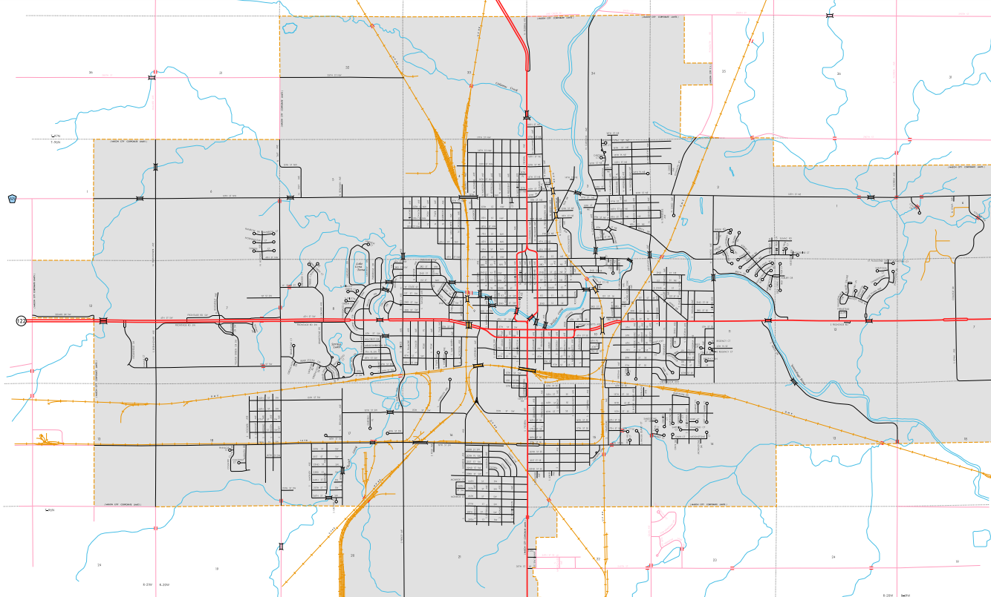
IA 122 West Section Project Location
City of Mason City
← Airport
Hospital
←
Community College
Project Location

Slide 12
IA 122 West Section Study and Proposed Project
West entrance to the community, Lark Avenue to Winnebago Way
Many businesses along the corridor, including small retail, large commercial, hospitality, health and personal services
Hospital is just east of the study limits on Iowa Highway 122
Expands upon the 2020 Traffic Engineering Assistance Program (TEAP) study
Continues Improvements to the Iowa Highway 122 Corridor through Mason City

Slide 13
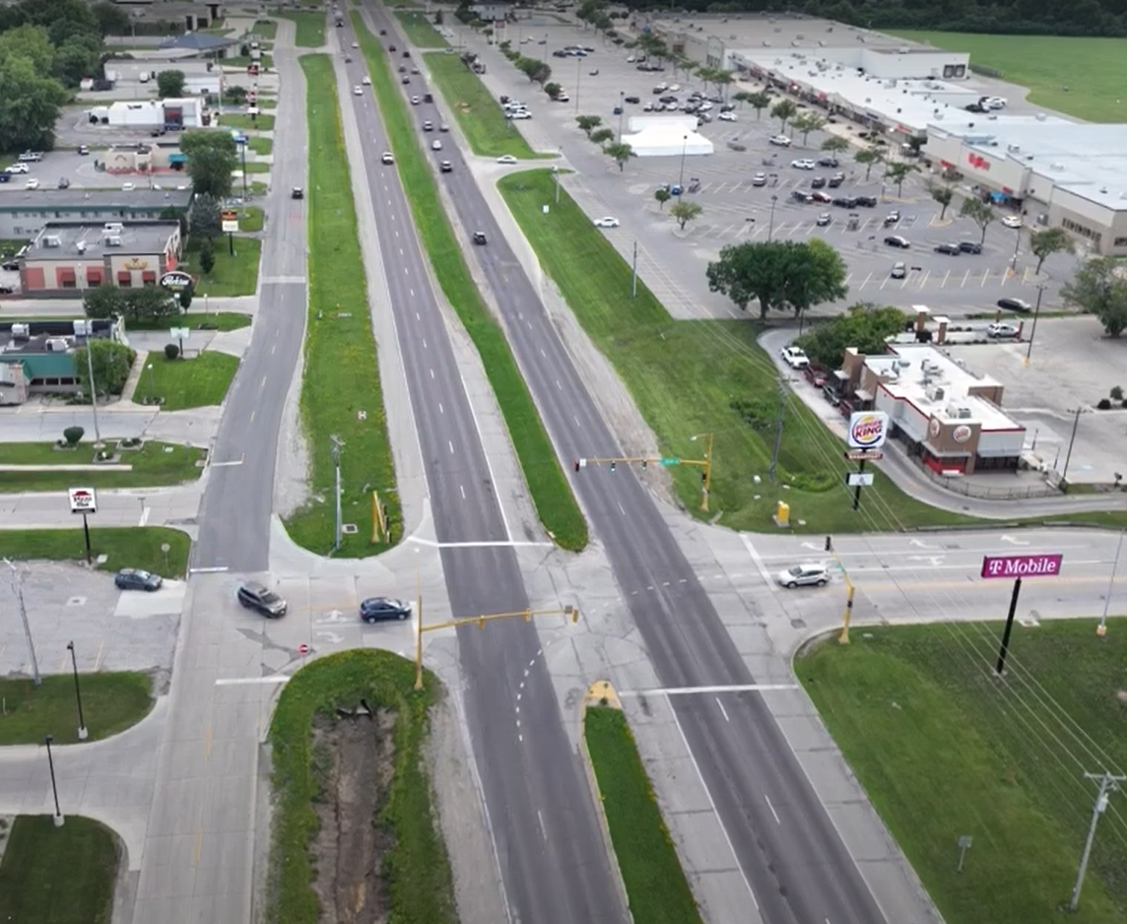
IA 122 West Section Existing Project Corridor Overview
Mason City hired WHKS to Complete a Corridor Feasibility Study of 2.6 miles of Iowa Highway 122
DOT District 2 Staff participated in the Study
Four-lane divided roadway, consistent with a rural corridor
Open Ditch drainage system, with granular shoulders
6 major intersections with non-coordinated traffic signals
No longitudinal pedestrian or trail facilities
No pedestrian signals or crossings
2017 Average Daily Traffic = 18,100 vpd
Incomplete frontage road system
Inconsistent access points
Commercial, retail, health and service corridor serving North Iowa

Slide 14
IA 122 West Project Scope
Full reconstruction of the pavement
Original pavement is more than 60 years old
Replace 5 signalized intersections with Roundabouts
To improve safety, efficiency and operation of traffic through the Corridor
Provide shared use path and sidewalk to improve pedestrian and bike mobility
Maintain or improve access to surrounding properties to support vibrancy of businesses located adjacent to the corridor
Improve drainage along the corridor to provide a sustainable and resilient corridor

Slide 15
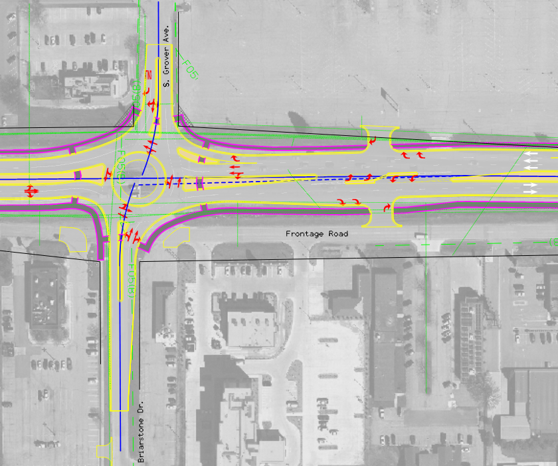
IA 122 West Section Reconstruction
Roundabouts replace Signalized Intersections, with new pavement (curb and gutter), additional turn lanes between intersections for improved access
Separated trail and sidewalk facilities
Resilient and Sustainable – does not require electrical power during an outage and lowers emissions
Gateway Enhancement Opportunities
Estimated at $7 million for Engineering and Construction Engineering and $42 million for construction

Slide 16
Next Steps
Complete the SS4A Safety Plan
City to apply for an SS4A Implementation Grant
Begin Survey, NEPA and Design of the IA 122 West Corridor
Respectfully, we request to partner with the Iowa Department of Transportation to advance the project by including it in the Iowa DOT 5-year Program

Slide 17
Speakers:
Bill Schickel, Mason City Mayor
Aaron Burnett, Mason City Administrator
10 First Street NW
Mason City, IA 50401
(641) 421-3600
aburnett@masoncity.net
Delegation:
Mark Rahm, City Engineer, Mason City
Chad Schreck, President & CEO, North Iowa Corridor
Lindsey James, Executive Director, Visit Mason City
Colleen Frein, President & CEO, Mason City Chamber of Commerce
Chad Boore, Chief Operating Officer, MercyOne North Iowa
Scott Curtis, Vice President, MercyOne North Iowa
Ben Kofoot, Vice President, MercyOne North Iowa
Scott Sweet, WHKS & Co.
Chase Holien, WHKS & Co.
Fouad Daoud, President and CEO WHKS & Co.
1412 6th Street SW, PO Box 1467
Mason City, IA 504025
(641) 423-8271
fdaoud@whks.com

