Slide 1



Transportation Trends Update
October 7, 2024
3/2/2023

Slide 2
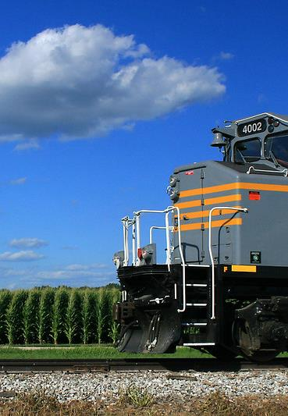

Agenda
US total rail carloads
Commercial air service passenger counts
Vehicular traffic
Water transportation
Port strike

Slide 4
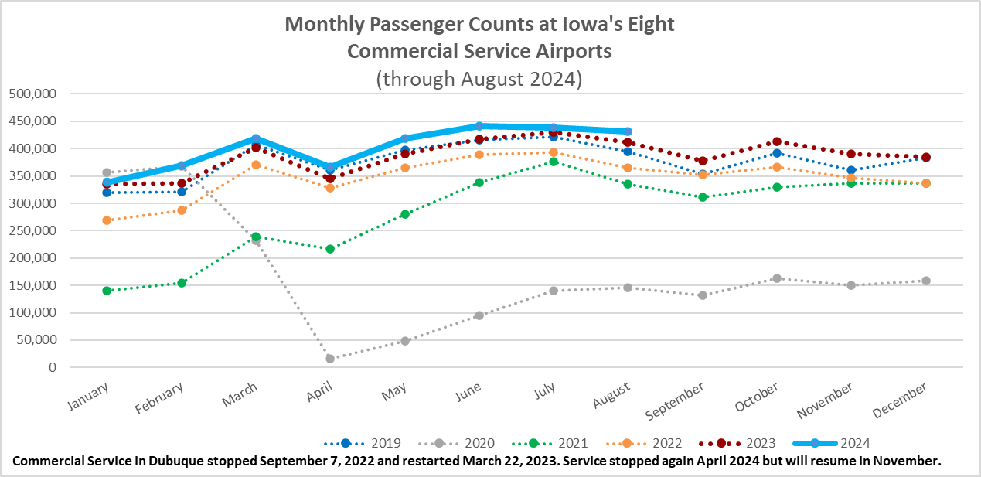

Slide 5
Monthly State Vehicle Miles of Travel
(through August 2024)

Slide 6
Water Transportation
Mississippi River
Drought in the Ohio River basin had caused low water conditions on the lower Mississippi River.
Limits were placed on drafts and how many barges can be towed.
Spike in barge transportation rates
Increased rainfall, including from Hurricane Helene is improving water levels on the lower Mississippi River.
11.5 foot draft and full tow sizes allowed on lower Mississippi
Below normal precipitation predicted over next month so restrictions may be reinstituted

Slide 7
Port Strike
Dockworker strike began on October 1
Impacts 36 ports along the east coast and gulf coast
Primarily impacts containerized imports/exports and not bulk grain export facilities.
Ag products exported by container are impacted.
68 percent of all containerized exports and 56 percent of all containerized imports are handled at the impacted ports
If the strike continues for several weeks, expect some supply-chain disruptions and cost increases for some items.
USDA statement on Oct. 1 that the strike is not expected to cause significant changes to food prices or availability in the near term for most items.

Slide 8
Questions?

