Slide 1
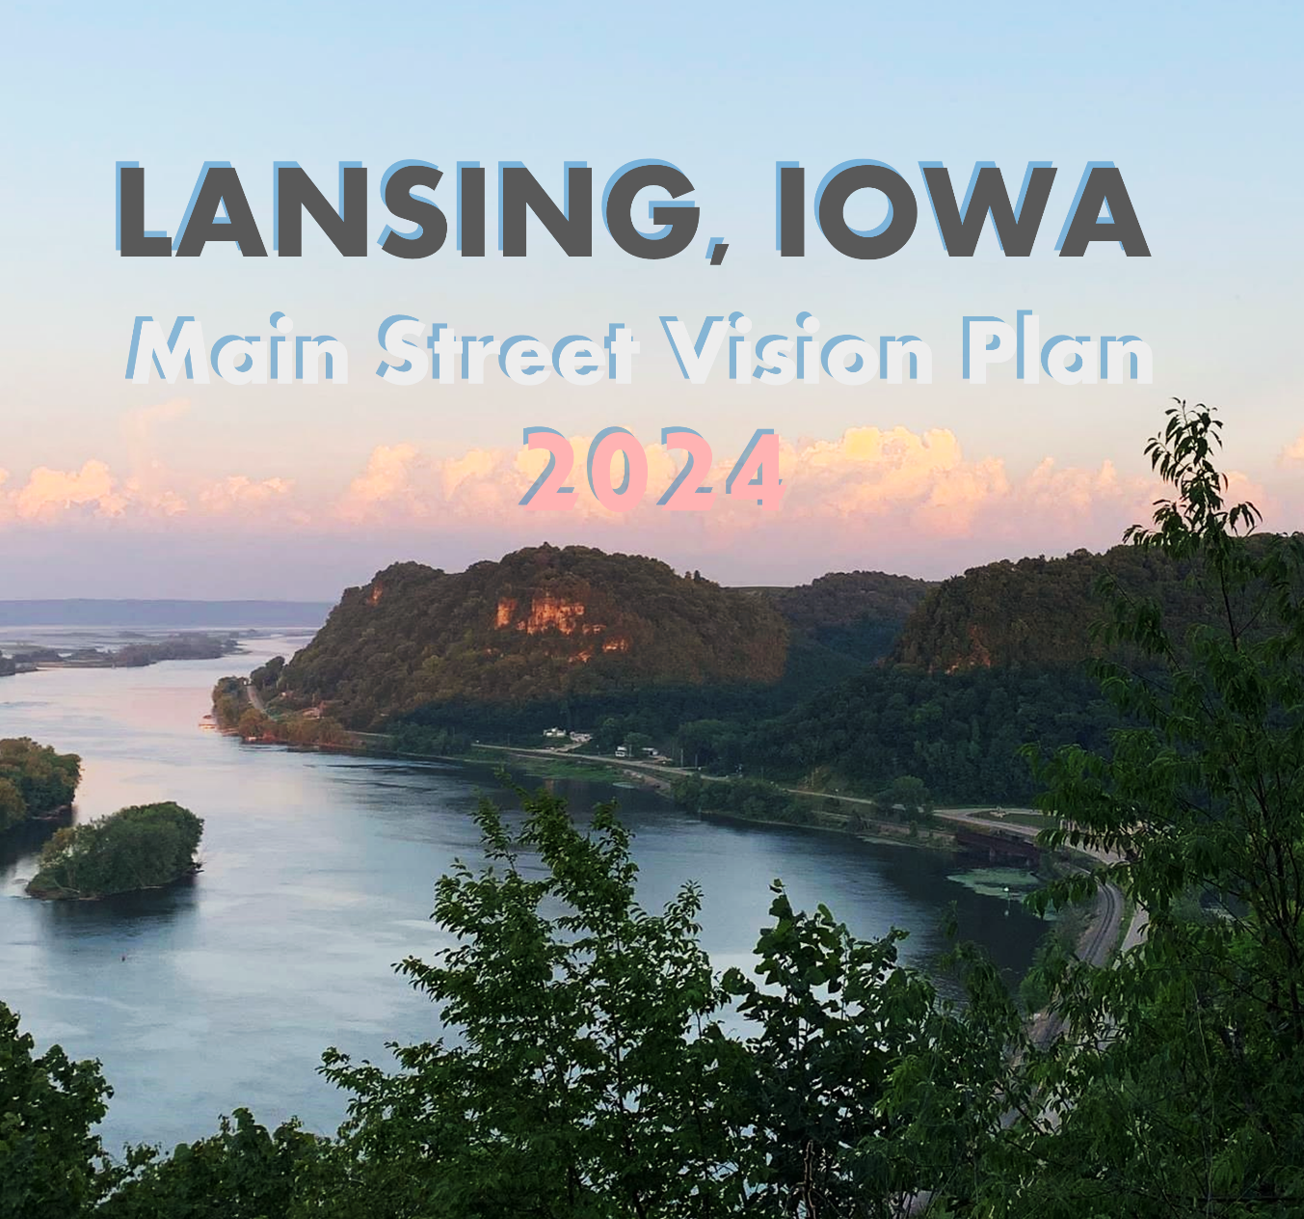
Iowa Transportation Commission
Public Input Meeting
October 8th, 2024
Decorah
Photos Credit: Main Street Lansing

Slide 2
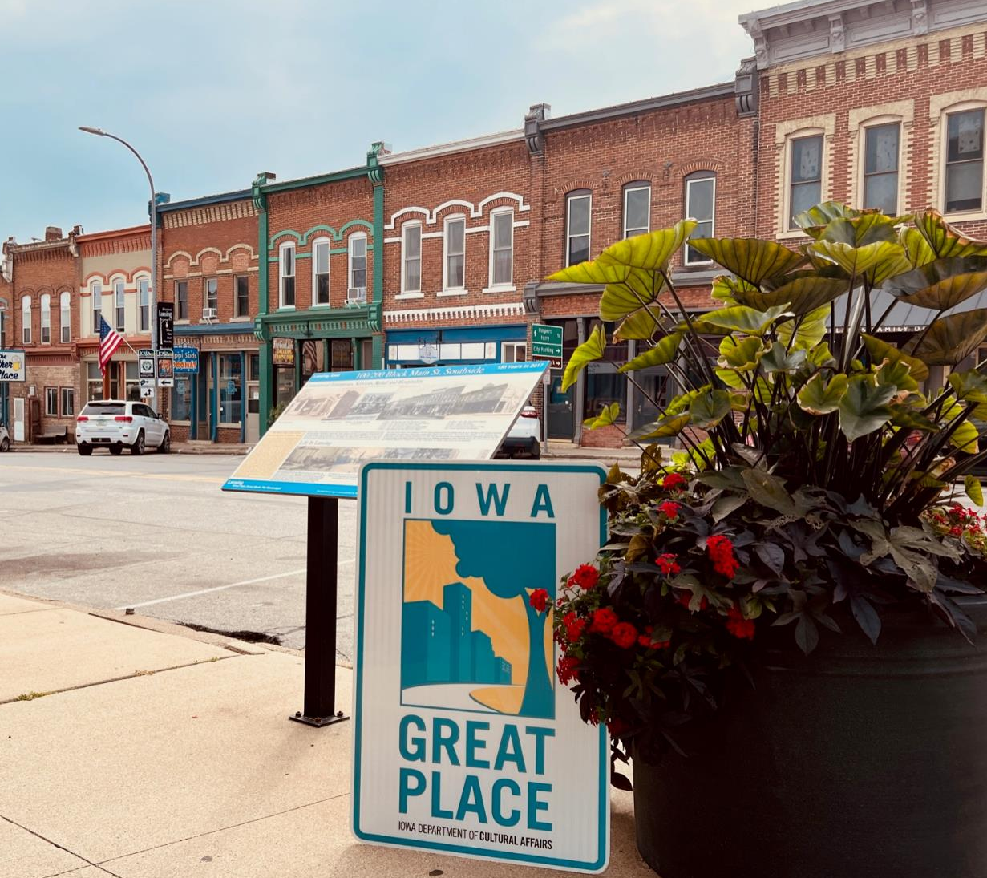
Idea
Process
Vision
2022
City explores potential funding sources for a planning and visioning effort for the Main Street/Iowa-9 corridor in Lansing
City applies for Surface Transportation Block Grant (STBG) funding to do a Main Street Vision Plan
City awarded STBG funding by RPA-1 Board
2023
City hires Upper Explorerland Regional Planning Commission to carry out the planning effort
Planning process kicks off in early 2023 with multiple work sessions with City Council
Public outreach begins summer 2023
Photos Credit: Main Street Lansing

Slide 3
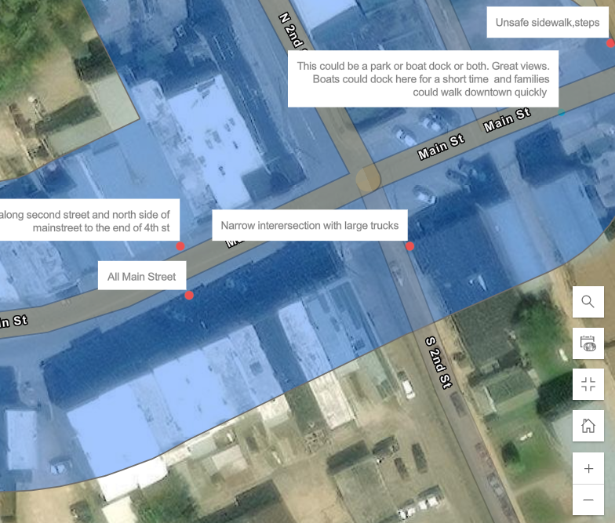
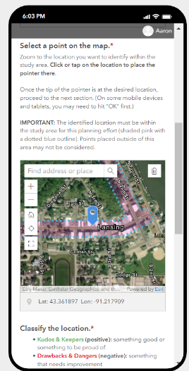
Idea
Process
Vision
Coordination with IDOT
Early coordination with District 2 staff about the possibility of a vision plan and guidance on planning process and NEPA considerations
Feedback sought from District 2 staff on proposed design concepts
Met with Lansing Bridge project engineer to discuss plan
Draft plan shared with District 2 staff prior to finalization

Slide 4
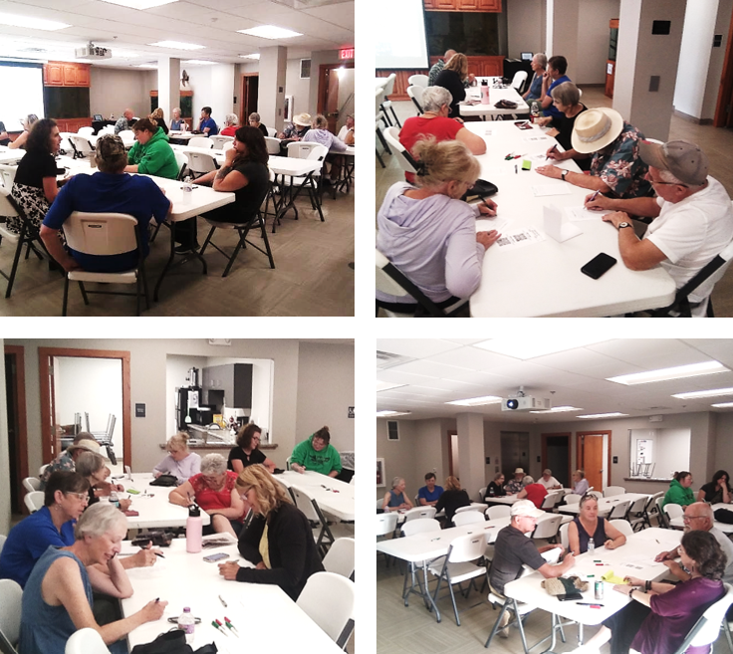
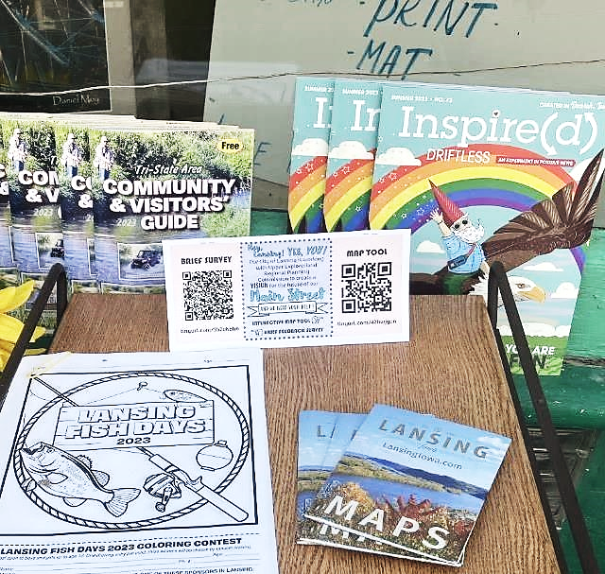
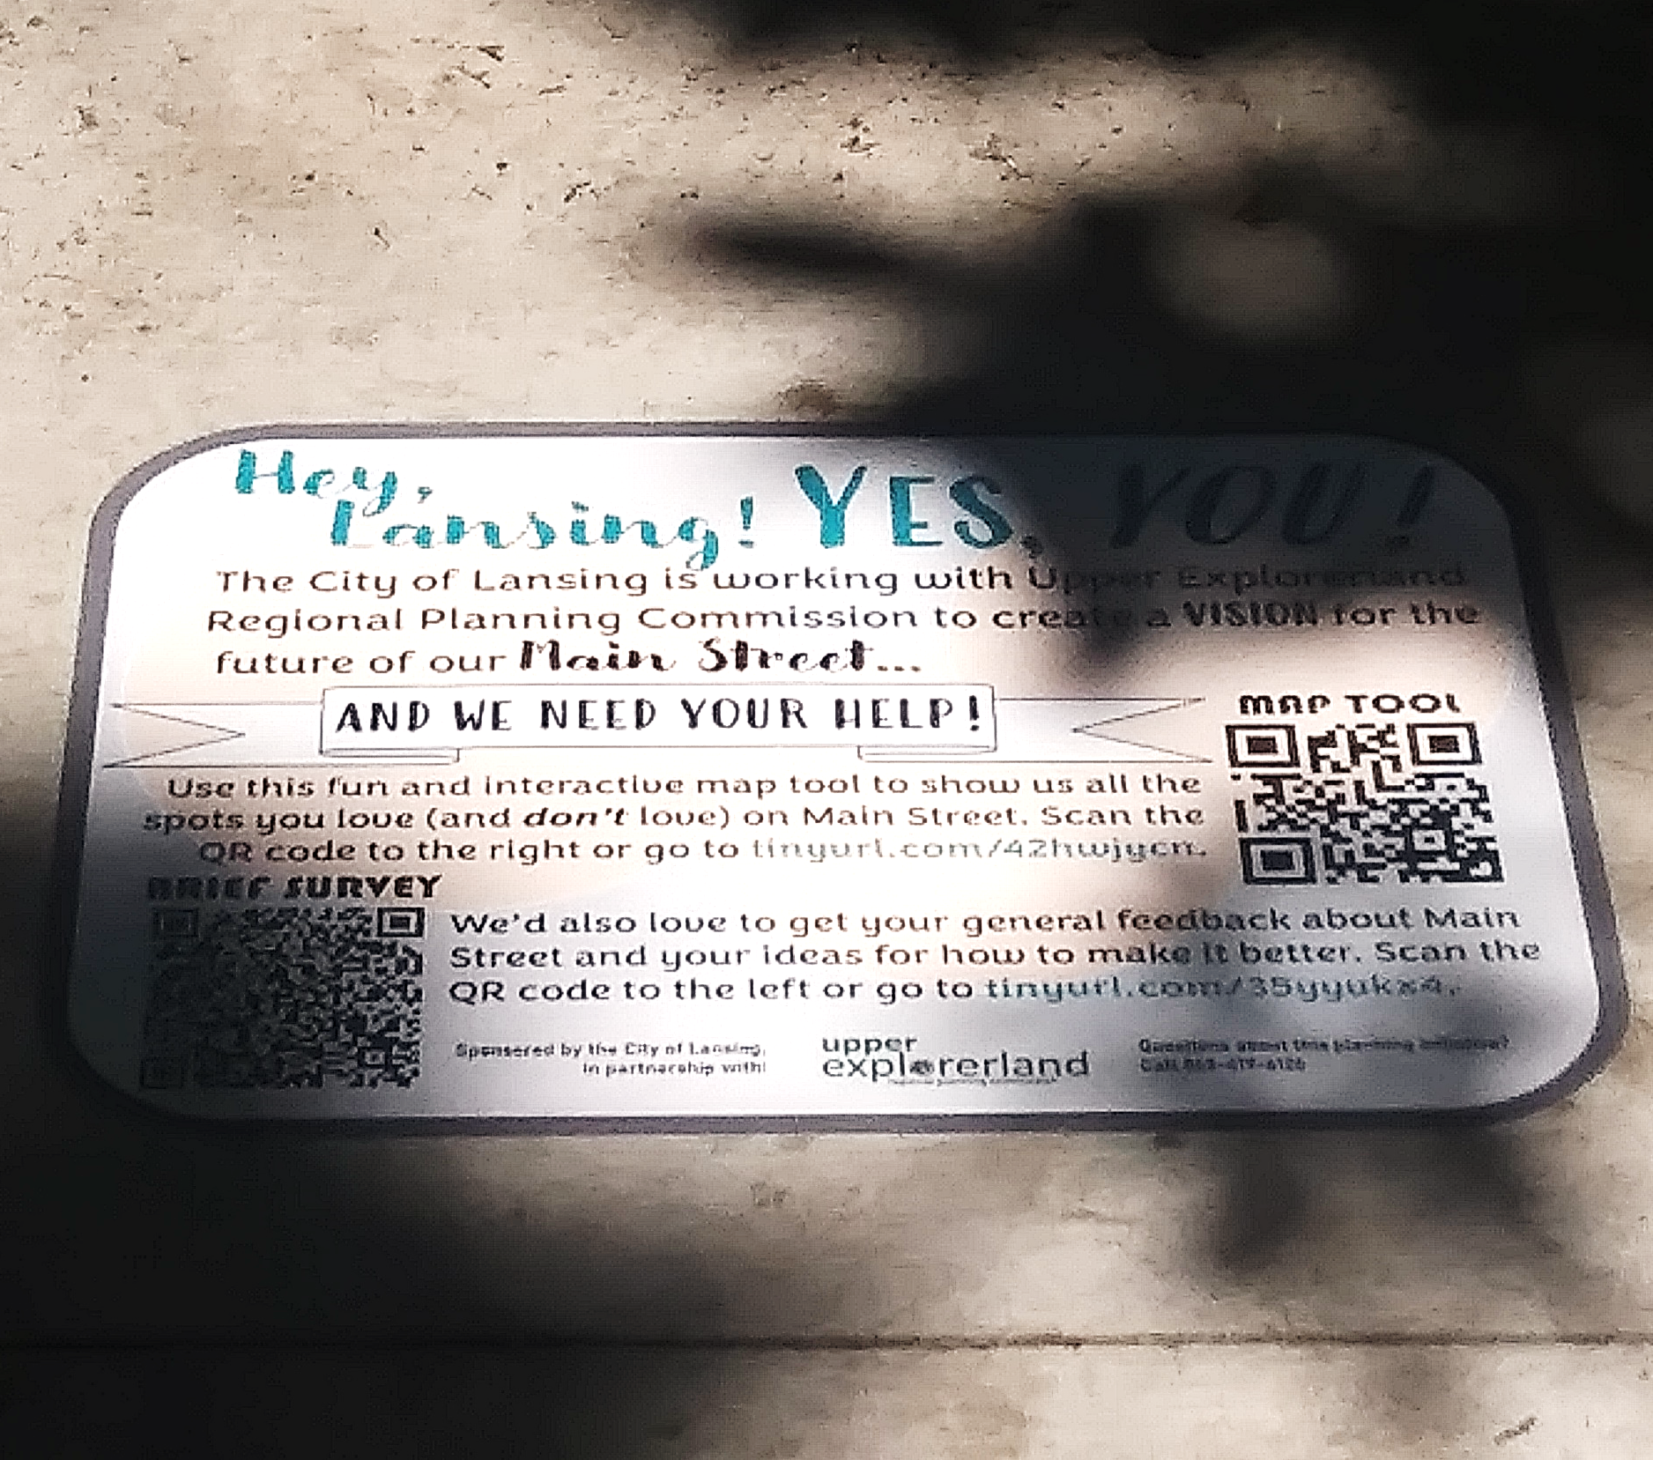
Idea
Process
Vision
Public Outreach
Focus group with Main Street business and property owners
In-person community meeting with Lansing residents and key stakeholders
Online community survey open throughout summer and fall 2023
Interactive online/mobile mapping tool for identifying “the good and the bad” of Main Street—available throughout summer and fall 2023
Over 90 plan participants—roughly one out of 10 Lansing residents aged 20 and over

Slide 5
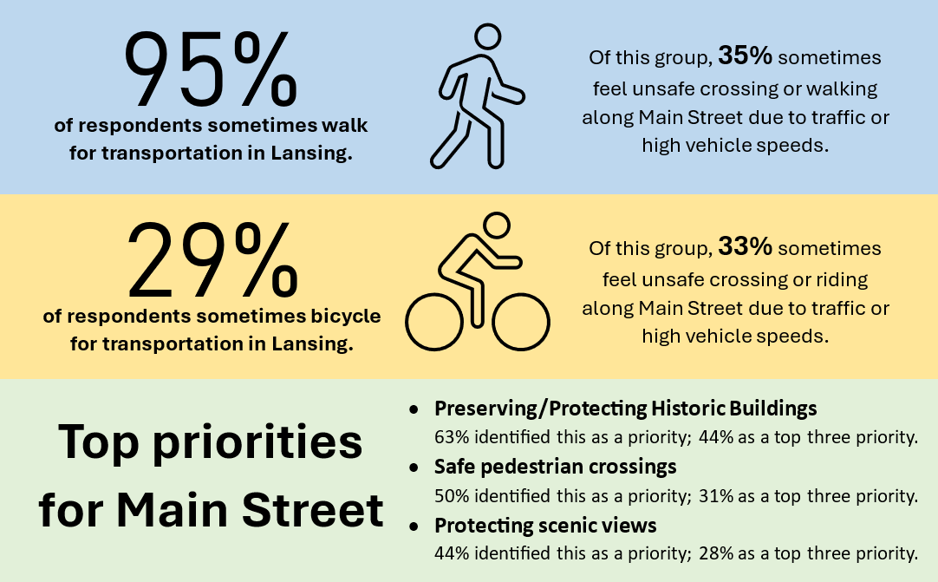
Survey Snapshot

Slide 6
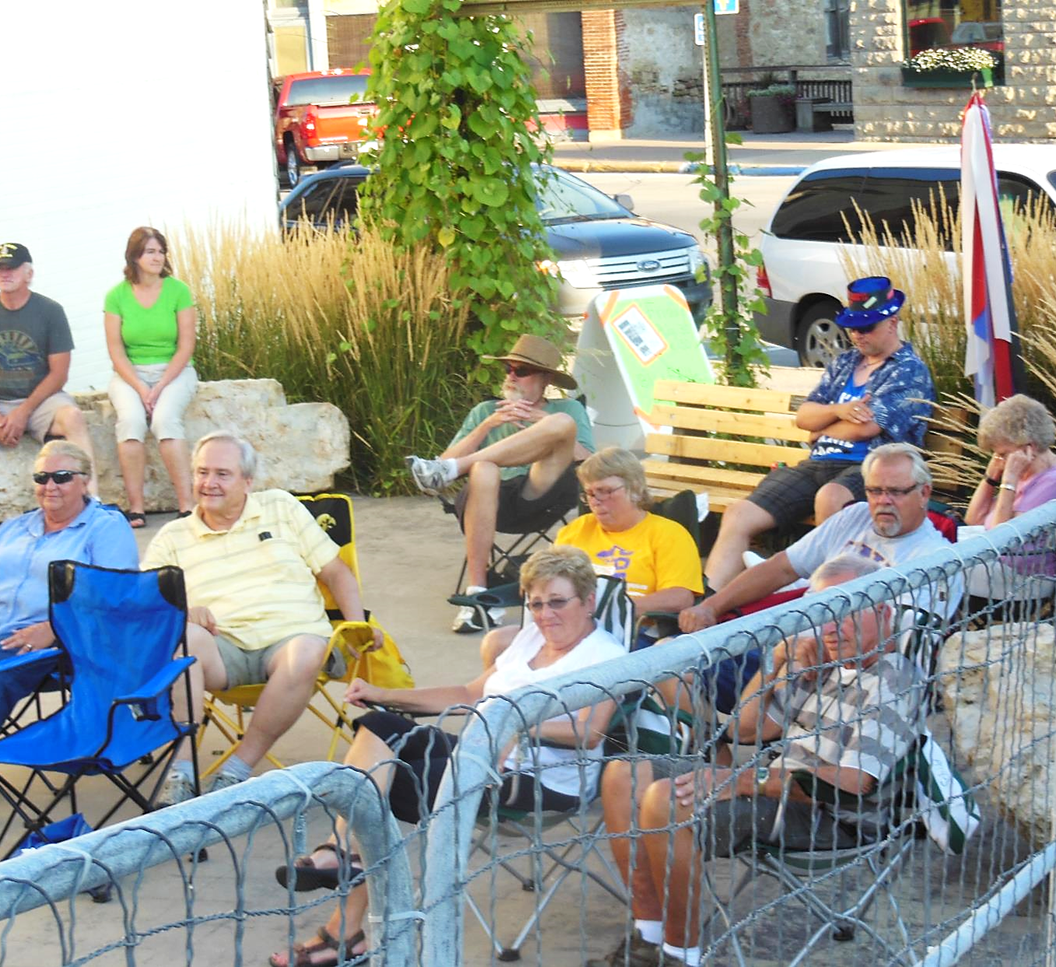
Idea
Process
Vision
Overarching Themes from Community Outreach
Pedestrian safety and accessibility
Historic character
Vibrant community space
Streetlights and pedestrian lighting
Stormwater management and environmental friendliness
Parking
Wayfinding and signage
Photos Credit: Main Street Lansing

Slide 7
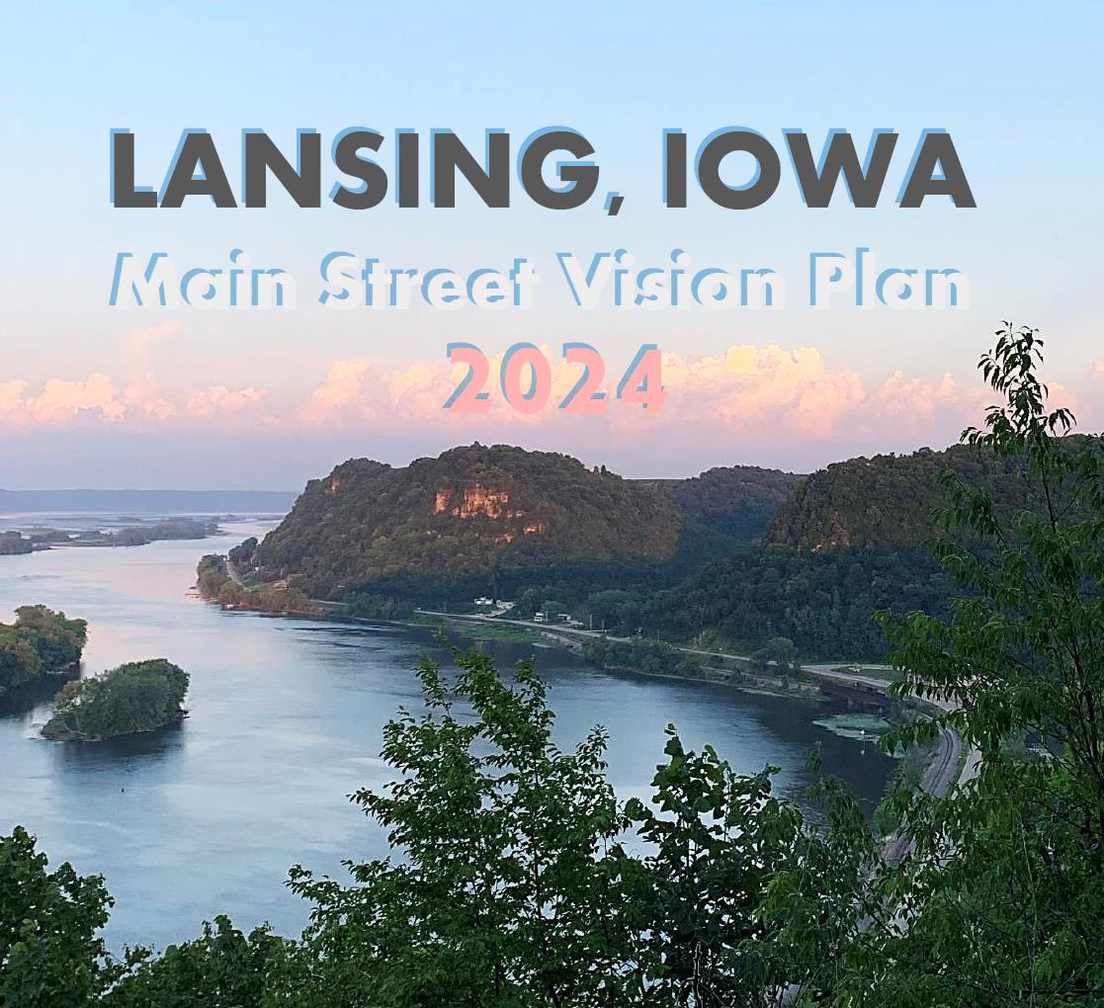
Idea
Process
Vision
The Plan - 2024
Draft plan developed—winter/spring
City Council reviewed and provided feedback—spring/summer
Plan finalized—summer
City Council approved final plan September 16th, 2024
Possible future community open house

Slide 8
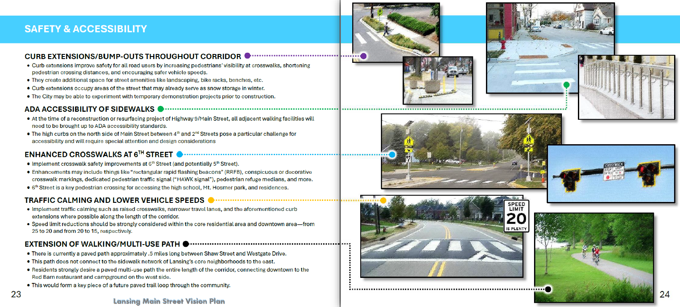
Idea
Process
Vision
Community Needs, Preferences, & Considerations
Safety & Accessibility
Operations, Utilities, & Parking
Amenities & Quality of Life
Signage & Wayfinding
Environmental Mitigation
Streetscape & Community Character

Slide 9
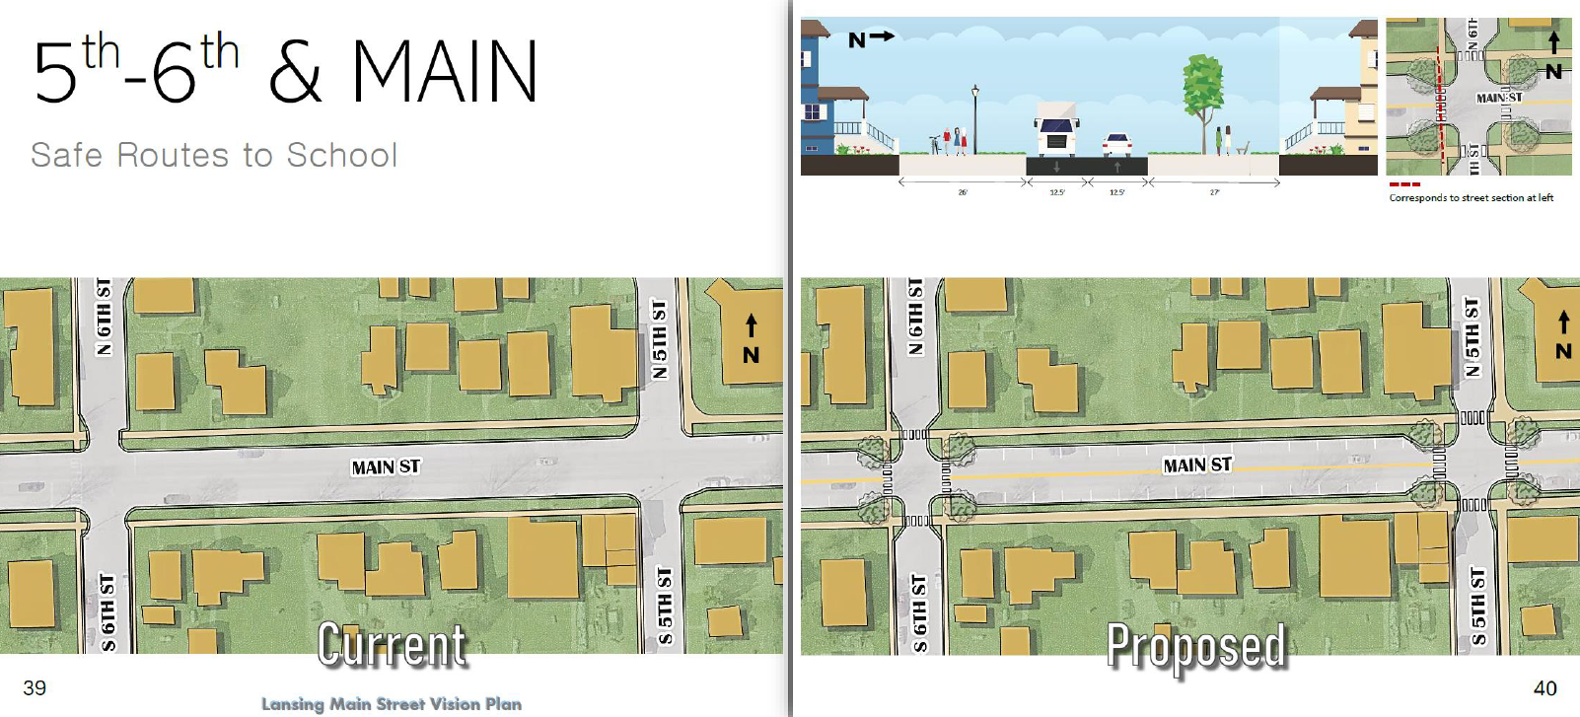
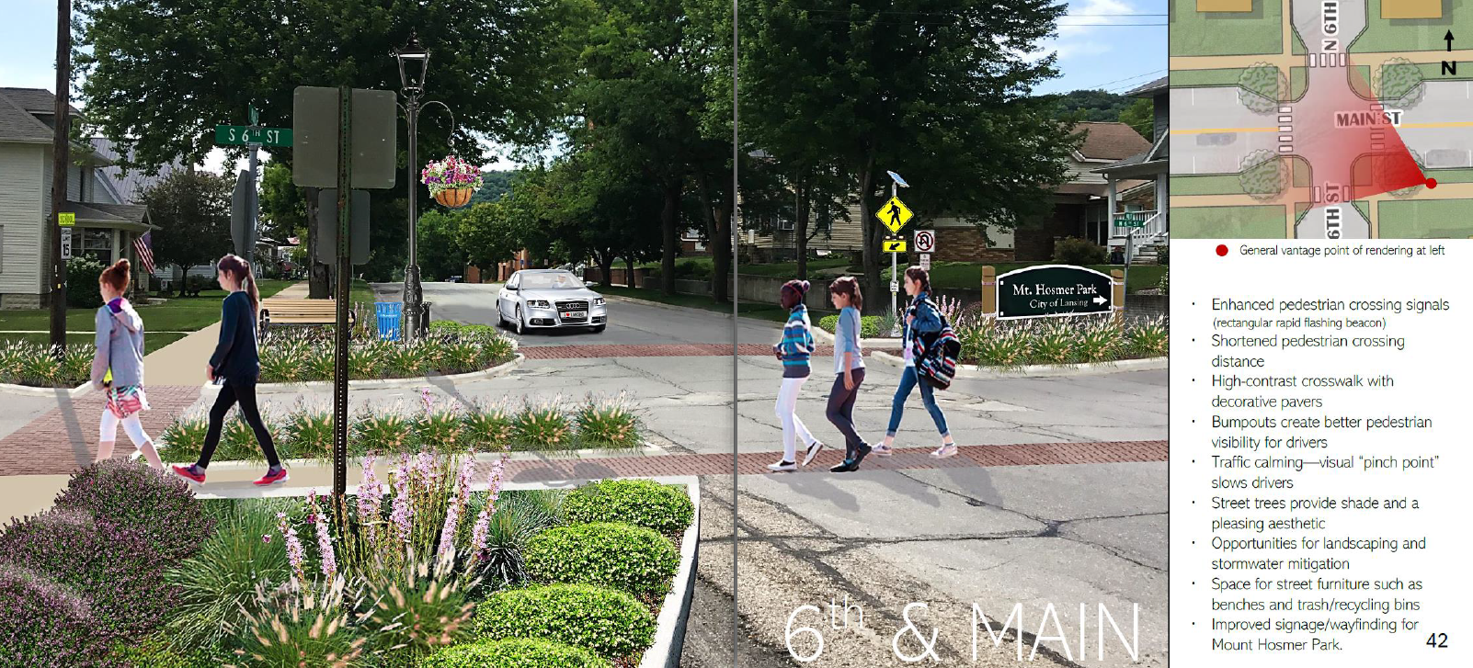
Idea
Process
Vision
Street Design Concepts and renderings
Give visual representations of the priorities and needs that came out of the community involvement process
Stress that proposed concepts make no change to current travel lane widths and no reductions to the current number of on-street parking spaces
Provide a visual basis for working with Iowa DOT on possibilities for roadway design when IA-9 is reconstructed through Lansing

Slide 10
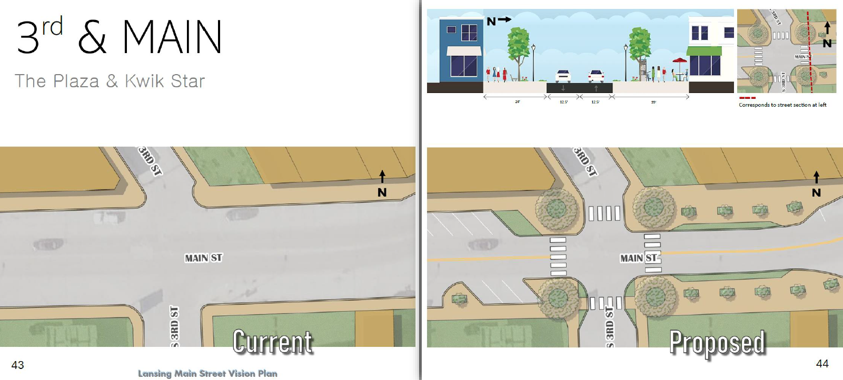
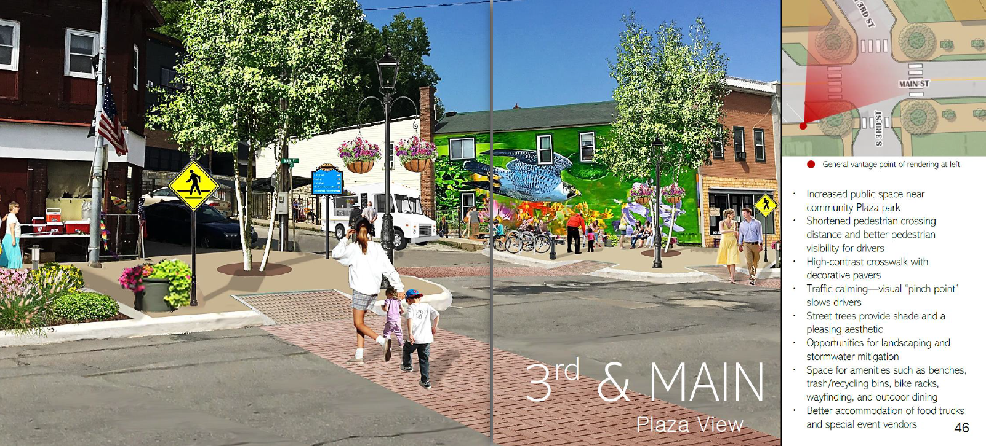
Idea
Process
Vision
Street Design Concepts and renderings
Give visual representations of the priorities and needs that came out of the community involvement process
Stress that proposed concepts make no change to current travel lane widths and no reductions to the current number of on-street parking spaces
Provide a visual basis for working with Iowa DOT on roadway design when IA-9 is reconstructed through Lansing

Slide 11
“Today’s transportation engineers need to strike a balance between standards and addressing the specific circumstances and context of each project. In addition to considering standard roadway characteristics, their designs have to account for economic, environmental, and social impacts, as well as support larger community and regional goals, including meeting the needs of all users.”
Hilton, E., & Goodman, D. (2016). Toward more flexible design. Public Roads, 79(5). FHWA Publication # FHWA-HRT-16-003

Slide 12
Thank You
Contact: Aaron Detter
563-419-6126
adetter@uerpc.org
Photos Credit: Main Street Lansing

