Slide 1
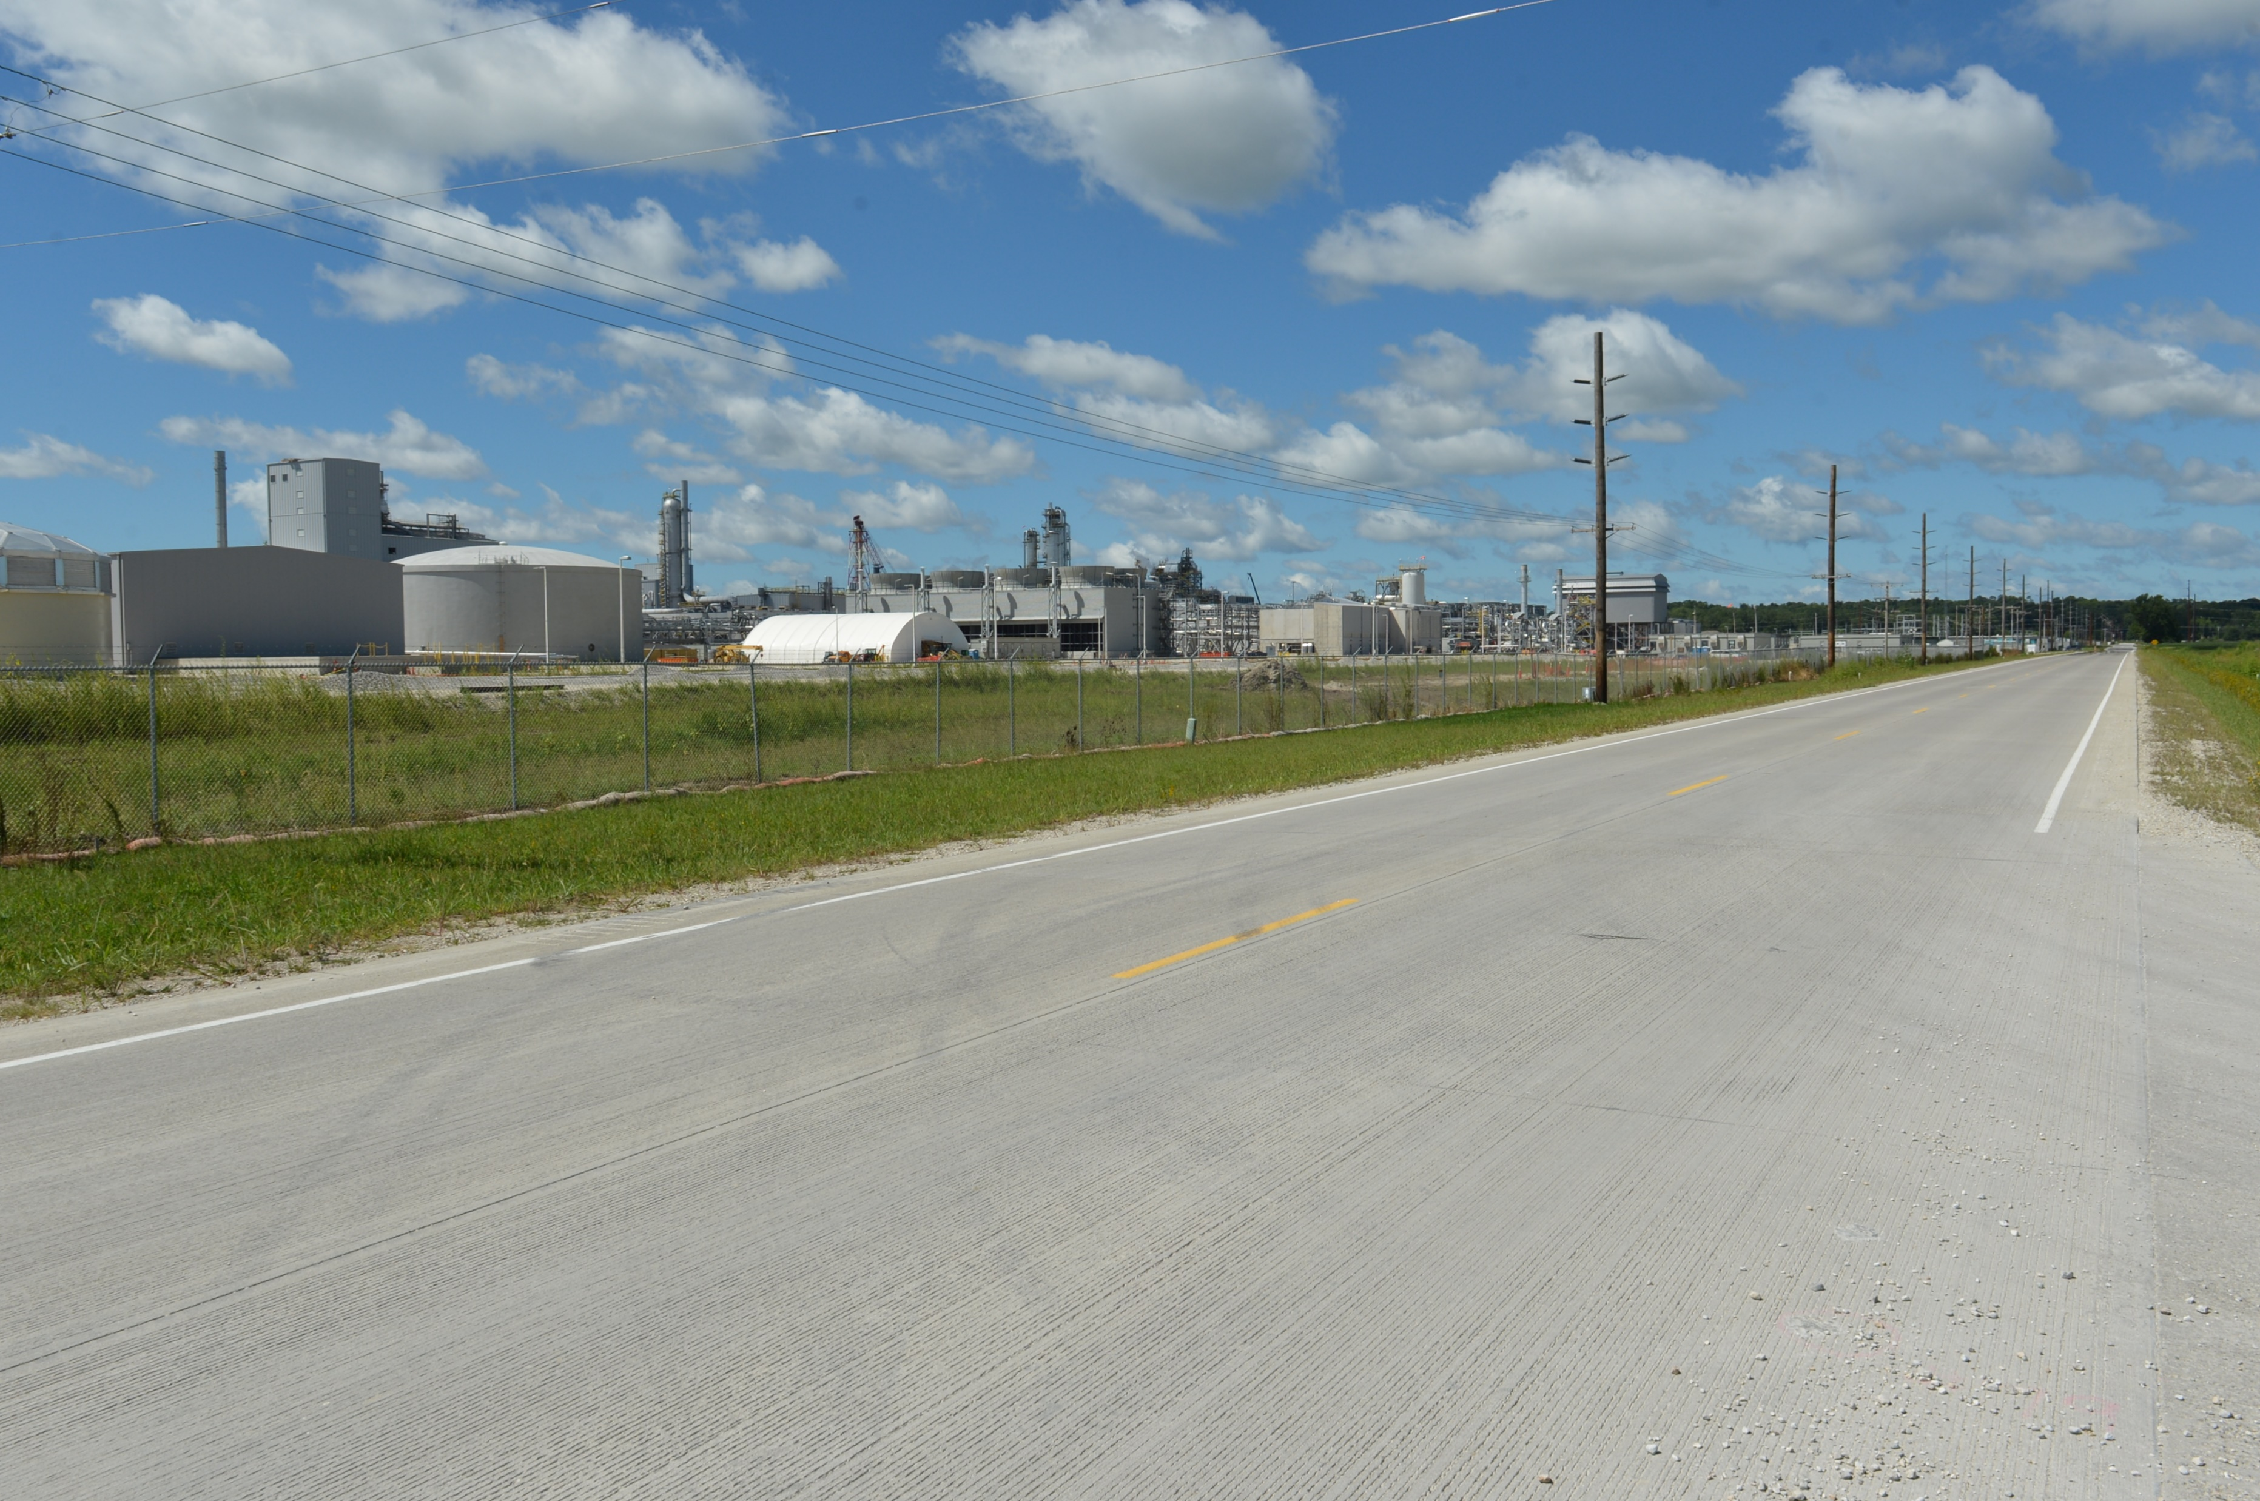
Revitalize Iowa’s Sound Economy Program
Funding Recommendation
Debra Arp
Grant Program Administration Team Lead
10/8/2024

Slide 2
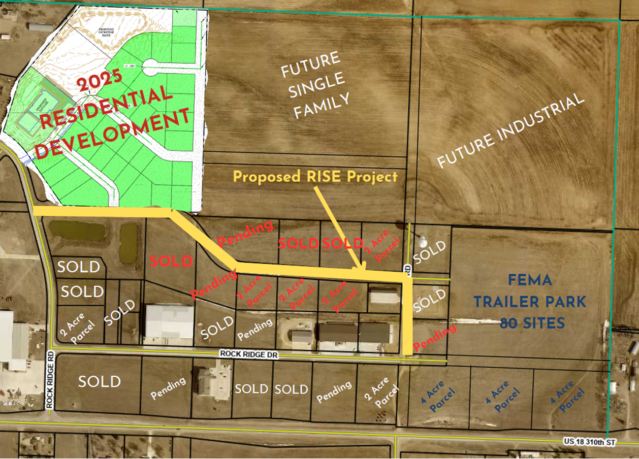
Local Development Recommendation
PROJECT NAME | SPONSOR | SCORE | TOTAL PROJECT COST | PERCENT PARTICIPATION | RECOMMENDED AMOUNT
Construction of approximately 2,570 feet of Summit Drive and 541 feet of Tower Road located on the east side of town (Business Relocation & Job Retention) | Rock Valley | 61 | $2,118,225 | 70% | $1,482,758
2
2

Slide 3
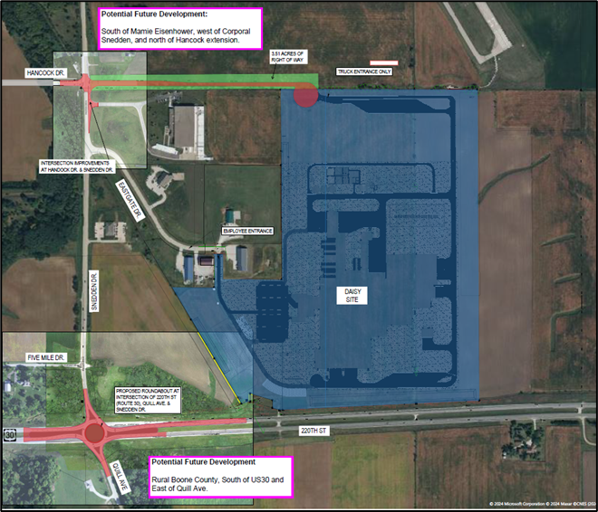
Immediate Opportunity/Local Development Hybrid Recommendation
PROJECT | SPONSOR | JOBS/ SCORE | TOTAL PROJECT COST | PERCENT PARTICIPATION | RECOMMENDED AMOUNT
Construction of approximately 1,700 feet of Hancock Drive & turn lanes with traffic signal at the intersection of Corporal Roger Snedden Drive & Hancock Drive | Boone | 217 Jobs | $3,781,913 | 80% | $3,025,530
Construction of a multi-lane roundabout at the intersection of U.S. 30 and Corporal Roger Snedden Drive | Boone | Score 73 | $5,500,000 | 50% | $2,750,000
3
3

Slide 4
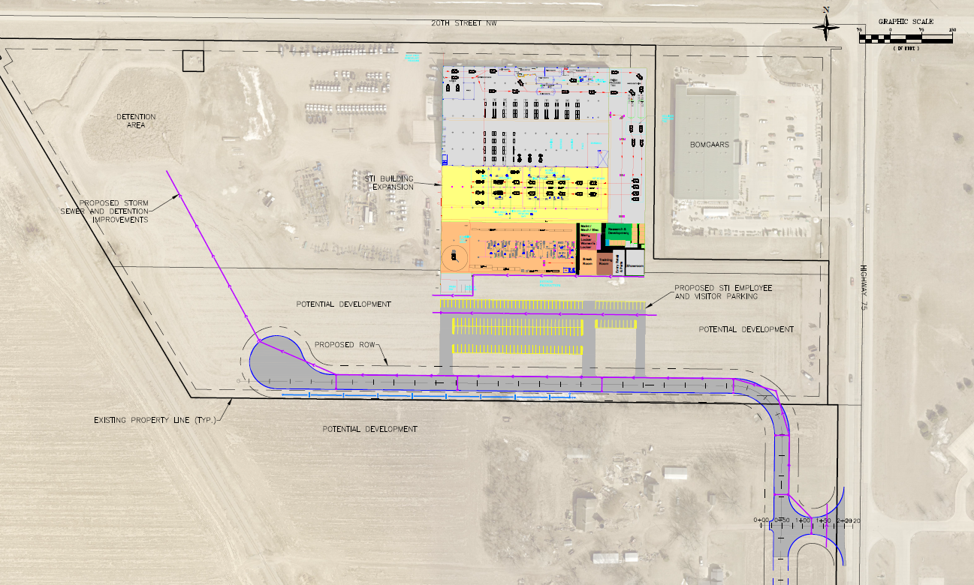
Local Development Recommendation
PROJECT NAME | SPONSOR | SCORE | TOTAL PROJECT COST | PERCENT PARTICIPATION | RECOMMENDED AMOUNT
Construction of approximately 1,650 feet of Frontage Road NW located on the northwest side of town | Sioux Center | 57 | $1,884,588 | 50% | $942,294
4
4

Slide 5
Questions?
jennifer.kolacia@iowadot.us
515-239-1738

