Slide 1
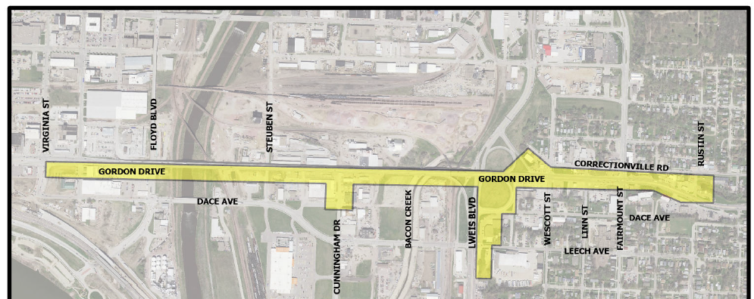
Corridor Preservation : Gordon Drive Viaduct from Virginia Street to Rustin Street in Sioux City, Iowa
Iowa Transportation Commission Workshop – October 7, 2024
3/2/2023

Slide 2
Corridor Preservation
Corridor preservation is not a legal encumbrance on the property or an exercise of eminent domain but is instead a right of notice.
Corridor preservation avoids inconsistent development of property needed for highway right-of-way, by allowing us to receive notice of intended development of property within the proposed right-of-way and giving us the opportunity to take action to acquire it before the development occurs.
Notes:
It is a valuable tool that provides mutual benefit to the DOT and the property owner or developer that allows us to be notified of an intended property improvement within a proposed ROW, and provides the opportunity for the Iowa DOT to acquire it before actual development occurs.

Slide 3
Corridor Preservation Zone (CPZ)
Process for new designations and renewals
Present the proposed CPZ to the Commission at a monthly workshop for initial guidance.
If the Commission’s initial guidance is positive for the use of CPZ, we will request formal approval of the CPZ at the same month Commission business meeting.
If approved, official letters will be sent to city and county officials and property owners notifying them of the CPZ and requesting comments for the next two weeks. Notice will be published in the newspaper.
The comments received will be shared with the Commission before the next Commission meeting and the Commission can reassess CPZ decision-making, if necessary.

Slide 4
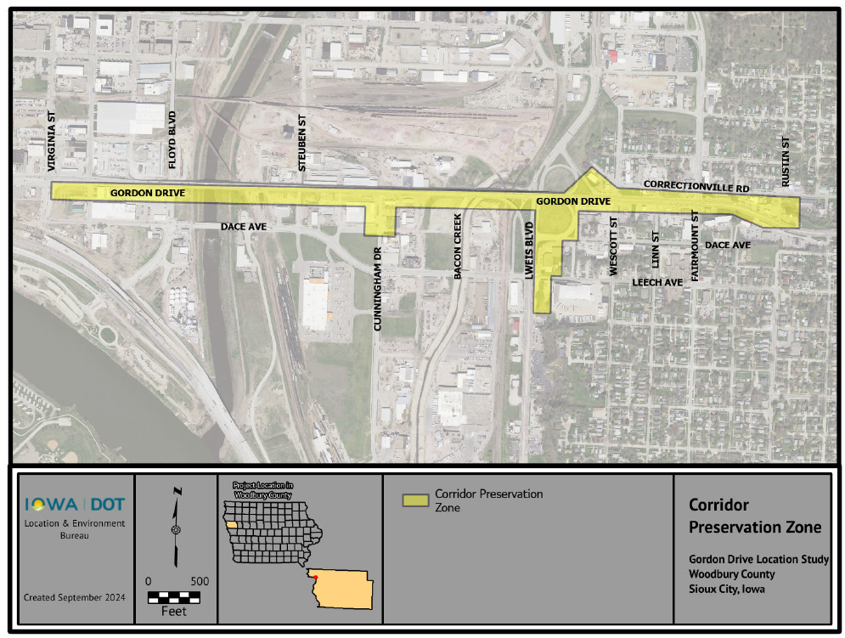
Corridor Preservation Zone: Gordon Drive Viaduct from Virginia Street to Rustin Street in Sioux City, Iowa
Notes:
The highlighted areas show the additional coverage needed for the CPZ from the original 2021 map that was shown to the Commission in August. Our preliminary design work since 2021 shows a need for additional coverage at key intersection areas along the corridor, and this more accurately reflects that.

Slide 5
Questions?
Recommendation: Approve the CPZ on Gordon Drive Viaduct from Virginia Street to Rustin Street in Sioux City, Iowa.
Once established/renewed, a CPZ is valid for three years.
If there are no concerns, this approval is an action item on the agenda for tomorrow.
Gary Harris, P.E.
Location and Environment Bureau
Gary.Harris@iowadot.us
(515) 239-1459

