Slide 1
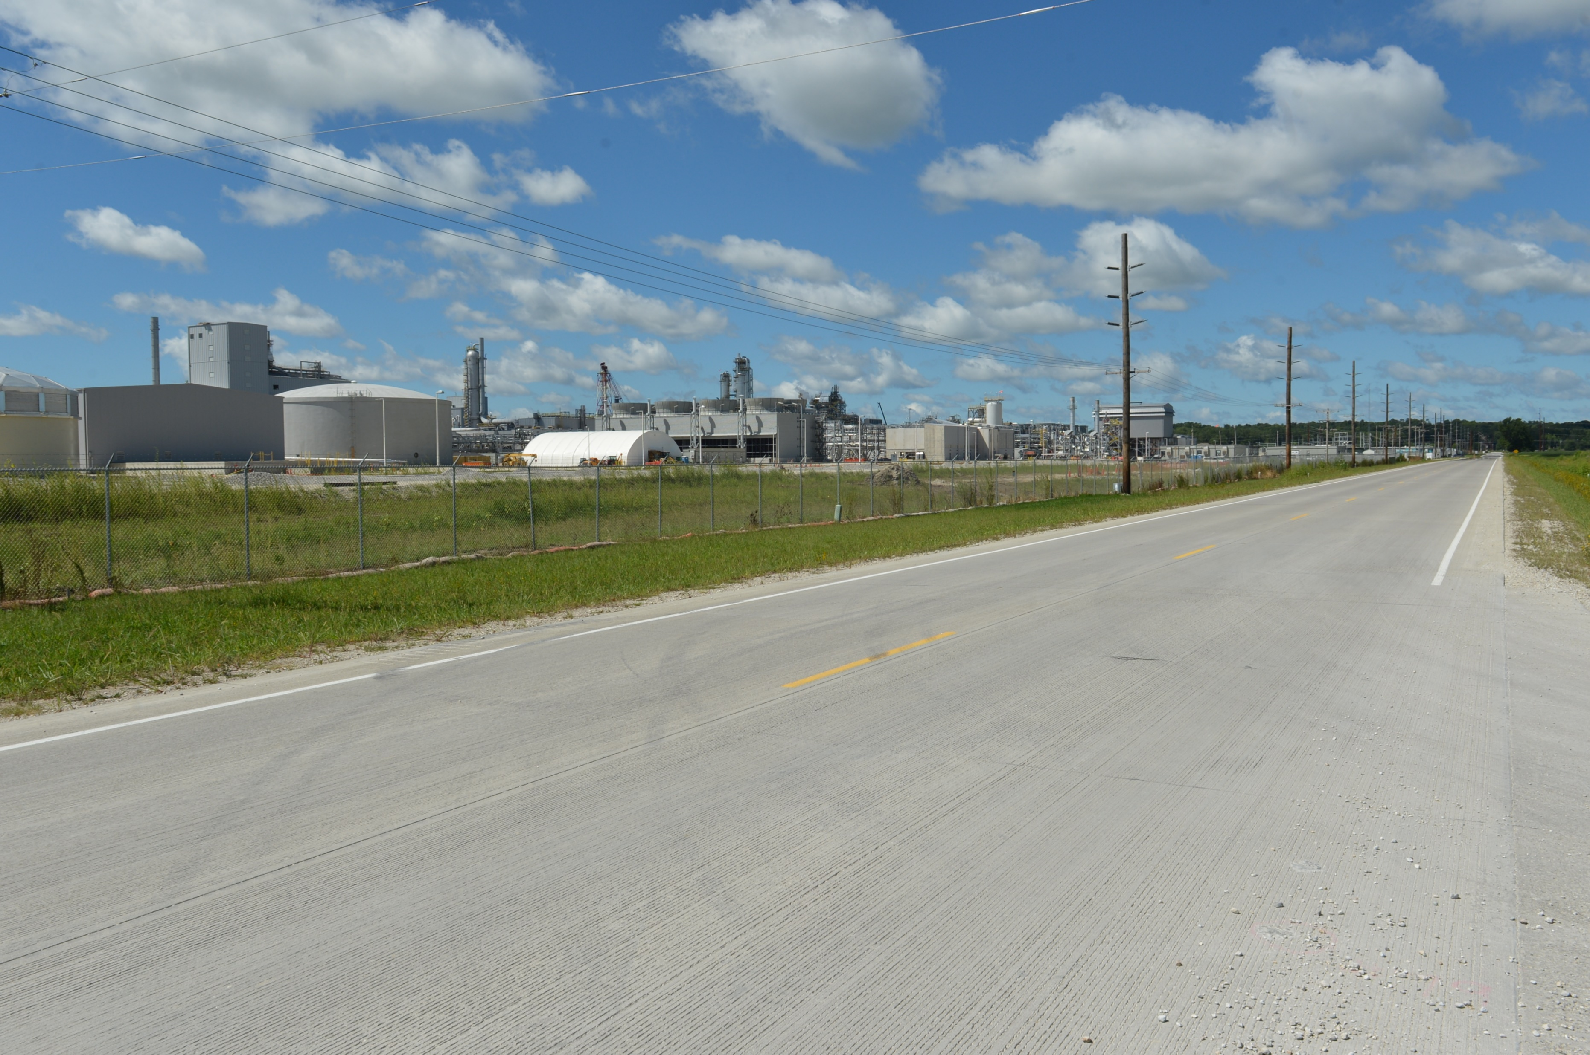
Revitalize Iowa’s Sound Economy
Business Relocation & Job Retention Local Development Program
Policy Discussion
Debra Arp
Grant Program Administration Team Lead
10/7/2024

Slide 2
Background
June 2024 – Devastating flooding impacted northwest Iowa
August 2024 – Discussed how RISE could be leveraged to revitalize flooded communities and presented initial concept. Received Commission input and direction to modify the concept.
September 2024 – Based on August Commission feedback, presented modified concept. Received Commission feedback.
Today – Discuss department recommendation
2
2

Slide 3
What would be an eligible community?
In a county covered by a proclamation of disaster emergency by the Governor & Presidential Disaster Declaration
Flooded businesses requesting permanent relocation outside the flood hazard area
Every community in a county that experienced flooding would not be eligible to apply
3
3

Slide 4
What would an eligible project look like?
Very similar to other standard Local Development projects
Requests to build new roadways outside the flood hazard area
An eligible project would not include repair to any existing roadways
4
4

Slide 5
What RISE participation rate would apply?
 | RISE Participation Rate
Immediate Opportunity | 80%
Local Development:
Standard | 50%
Certified Site (varies by size) - 50-499 acres certified - 500-999 acre certified - 1,000 acres or more certified | 60% 65% 70%
University Research Park | 70%
Business Relocation & Job Retention (Recommended) | 70% (recommendation)
5

Slide 6
Recommendation
Limited to communities that experienced state & federally recognized emergency events
Limited to communities where existing businesses are committing to permanent relocation
Documentation of business interest in relocation and the economic distress of the community is required to be submitted with the application
RISE participation held to 70% of eligible project costs
6
6

Slide 7
QUESTIONS?
7
7

