Slide 1
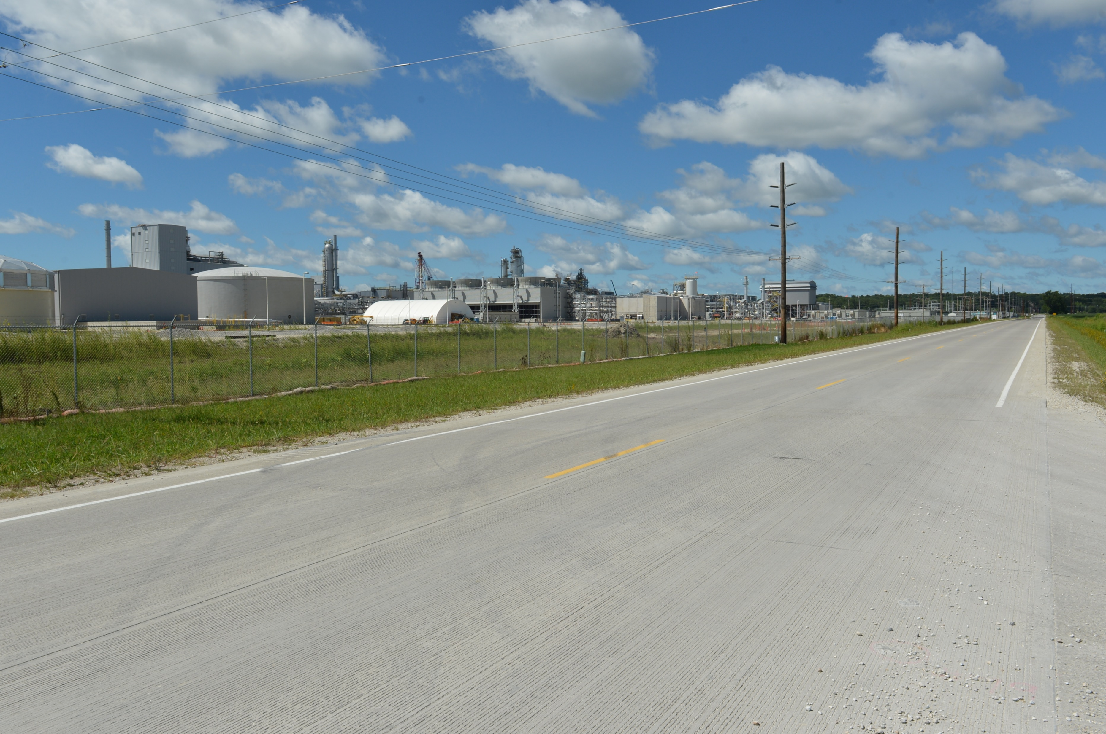
Revitalize Iowa’s Sound Economy Program
Funding Recommendation
Debra Arp
Grant Program Administration Team Lead
10/7/2024

Slide 2
Revitalize Iowa’s Sound Economy Program
Created in 1985
Purpose: To promote economic development through roadway improvements
Eligible development shall have value-adding activities that feed new dollars into the economy
Available to cities and counties through an application program
2
2

Slide 3
Monthly Program Financial Report
Funded annually with dedicated state motor fuel and special fuel tax revenues
 | City RISE Fund | County RISE Fund
FY2025 Projected Total RISE Road Use Tax Fund (RUTF) Revenue ¹ | $11,611,933 | $5,805,967
Actual RISE Revenue Received as of 8/31/2024 ² (% of FY2025 Projected Revenue) | $1,987,000 (17.1%) | $993,500 (17.1%)
FY2025 RISE Funds Awarded as of 8/31/2024 (% of Projected Total RUTF committed) | $695,775 (6.0%) | $0 (0%)
Fund Balance as of 8/31/2024 | $53,156,432 | $18,154,020
Outstanding Commitments as of 8/31/2024 | ($38,332,600) | ($17,160,520)
Uncommitted Balance as of 8/31/2024 | $14,823,833 | $993,500
¹ Calculation based on FY2023 average monthly RISE RUTF revenue of $967,661 to the city RISE fund and $483,831 to the county RISE fund. As of 8/31/2024, FY2025 is 16.7% complete.
² Actual RISE revenue includes RUTF revenue, loan repayments, and project settlements. These revenue sources are variable and are not included in projections.
3
3

Slide 4
Local Development Project Evaluation Criteria
Criteria | Points
Development Potential | 35
Economic Impact and Cost Effectiveness | 20
Local Commitment and Initiative | 33
Transportation Need and Justification | 4
Local Economic Need | 6
4
4

Slide 5
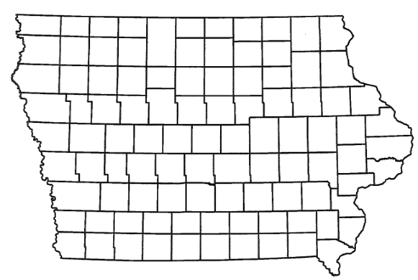
Local Development Recommendations
PROJECT NAME | SPONSOR | SCORE | TOTAL PROJECT COST | PERCENT PARTICIPATION | RECOMMENDED AMOUNT
Construction of approximately 2,570 feet of Summit Drive and 541 feet of Tower Road located on the east side of town (Business Relocation & Job Retention) | Rock Valley | 61 | $2,118,225 | 70% | $1,482,758
Construction of approximately 1,650 feet of Frontage Road NW located on the northwest side of town | Sioux Center | 57 | $1,884,588 | 50% | $942,294
5
5

Slide 6
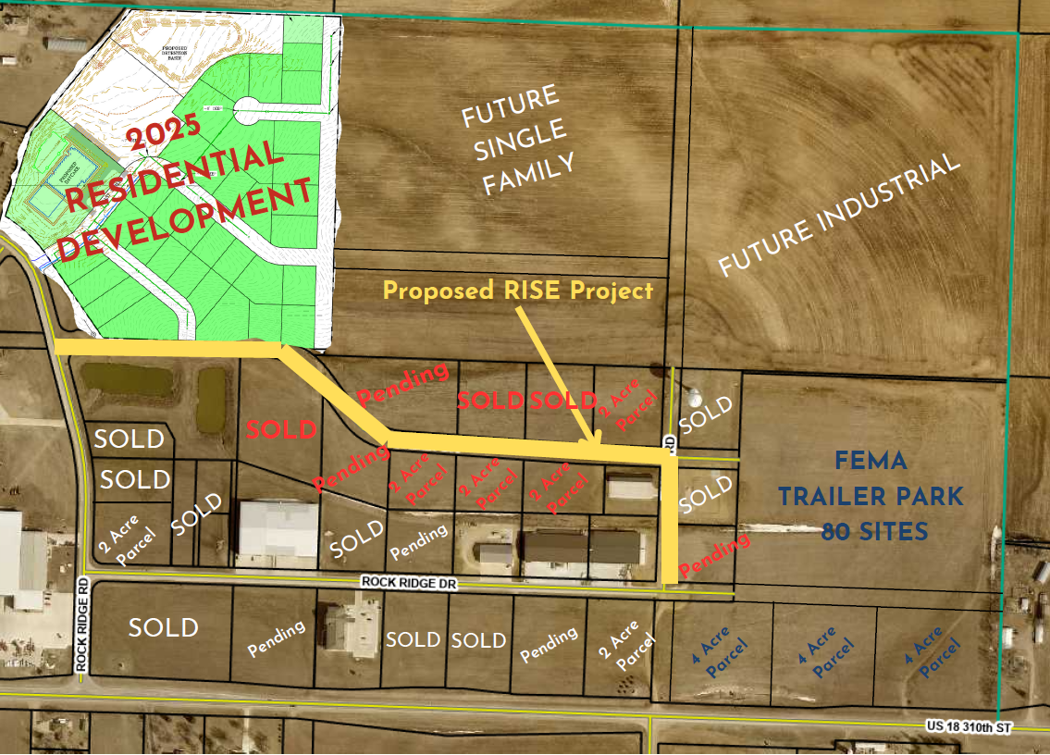
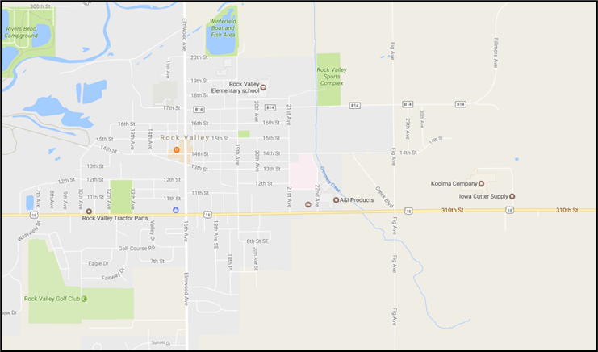
Rock Valley
Local Development (Business Relocation & Job Retention)
Construction of approximately 2,570 feet of Summit Drive and 541 feet of Tower Road located on the east side of town. This project is necessary to provide access to 14 lots totaling approximately 25 acres.
Total Cost: $2,118,225
Requested: $1,482,758 (70%)
6

Slide 7
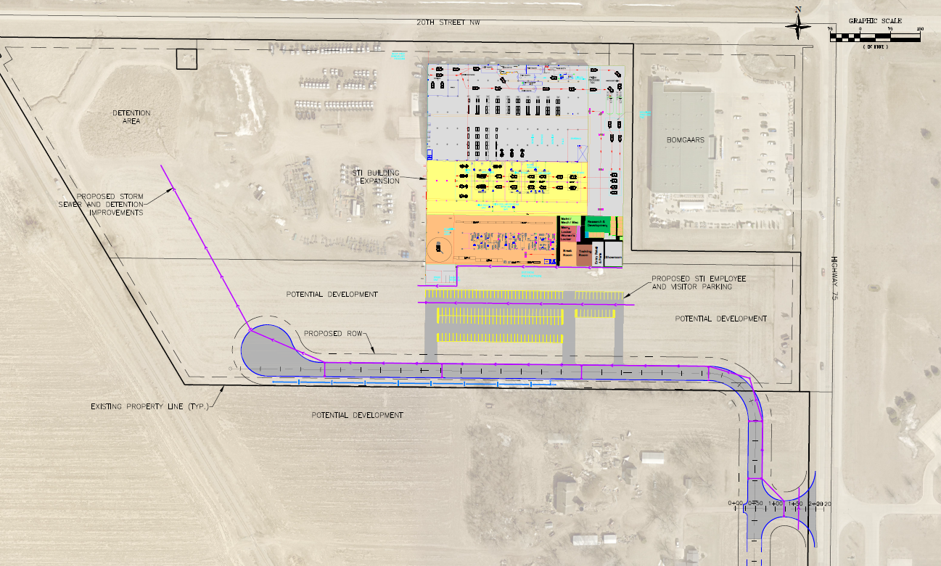
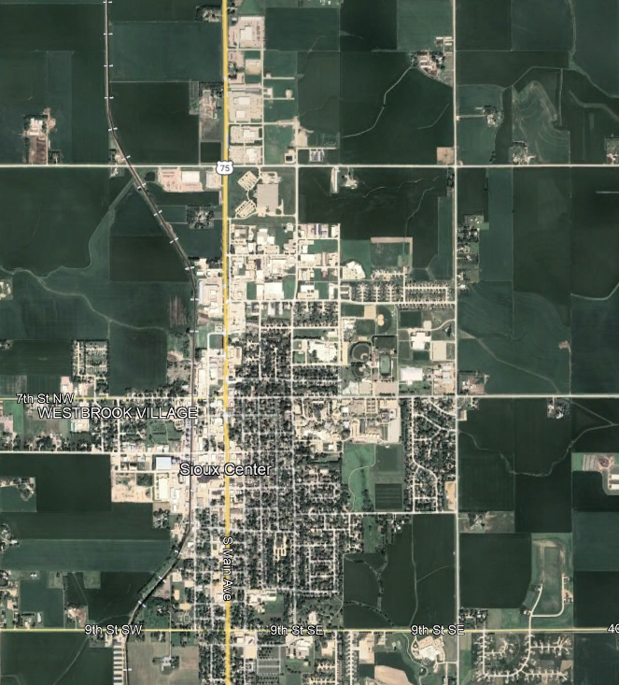
Sioux Center
Local Development
Construction of approximately 1,650 feet of Frontage Road NW located on the northwest side of town. This project will provide improved access to more than 12 acres for industrial purposes.
Total Cost: $1,884,588
Requested: $942,294 (50%)
7

Slide 8
Immediate Opportunity Project Evaluation
Job Creation and/or Retention | Economic Development Assisted
Quality of jobs | Diversifies Iowa’s economy
Potential for future job growth | Few in-state competitors
Hiring Iowa residents | Higher proportion of in-state suppliers
Average wages 100% of laborshed rate | Higher proportion of out-of-state sales
 | Import substitution
 | No pattern of violations
8
8

Slide 9
Immediate Opportunity/Local Development Hybrid Recommendation
PROJECT | SPONSOR | JOBS/ SCORE | TOTAL PROJECT COST | PERCENT PARTICIPATION | RECOMMENDED AMOUNT
Construction of approximately 1,700 feet of Hancock Drive & turn lanes with traffic signal at the intersection of Corporal Roger Snedden Drive & Hancock Drive | Boone | 217 Jobs | $3,781,913 | 80% | $3,025,530
Construction of a multi-lane roundabout at the intersection of U.S. 30 and Corporal Roger Snedden Drive | Boone | Score 73 | $5,500,000 | 50% | $2,750,000
9
9

Slide 10
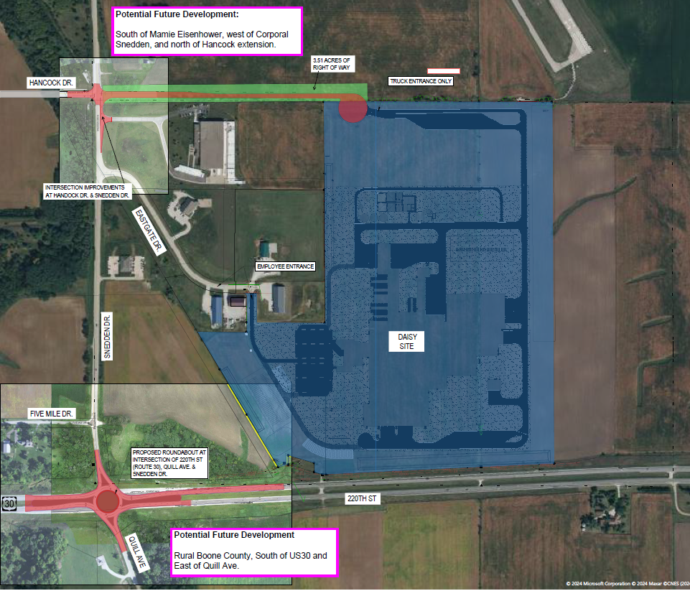
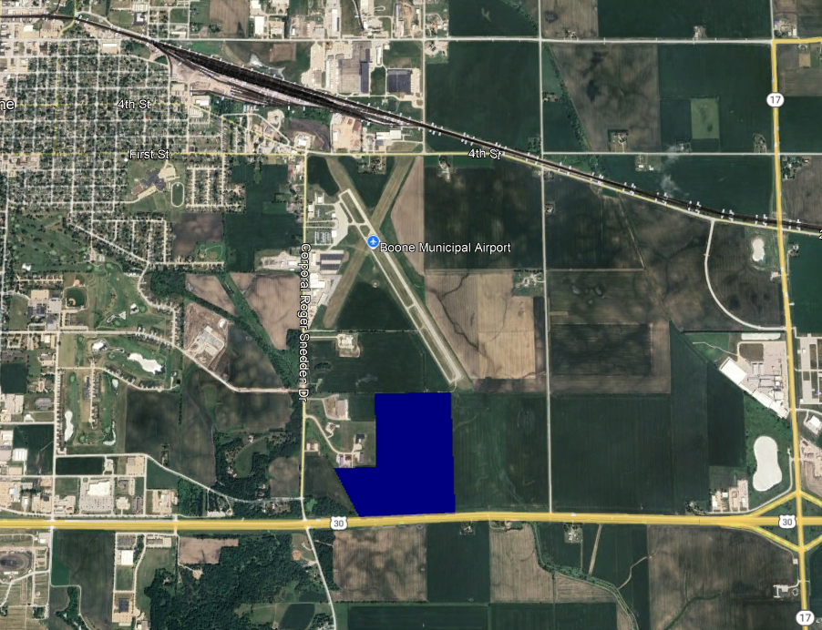
Boone Immediate Opportunity Component
Construction of approximately 1,700 feet of Hancock Drive & turn lanes with traffic signal at the intersection of Corporal Roger Snedden Drive & Hancock Drive located on the southeast side of town. These improvements are necessary to provide improved access to the proposed Daisy Brands site.
Component Cost: $3,781,913
Requested: $3,025,530 (80%)
Jobs Committed: 217
RISE Cost/Job Assisted: $13,942.53
Capital Investment/RISE: $241.22
Ave Wage of Committed Jobs: $35.75
Percent of Laborshed Wage: 143%
10

Slide 11
Boone Local Development Component
Construction of a multi-lane roundabout at the intersection of U.S. 30 and Corporal Roger Snedden Drive
These improvements to provide access to support development at the proposed Daisy Brands site as well as other imminent development in the area.
Component Cost: $5,500,000
Requested: $2,750,000 (50%)
Total Project Cost: $9,281,913
Total RISE: $5,775,530 (62%)
11

Slide 12
Questions?
jennifer.kolacia@iowadot.us
515-239-1738

