Slide 1
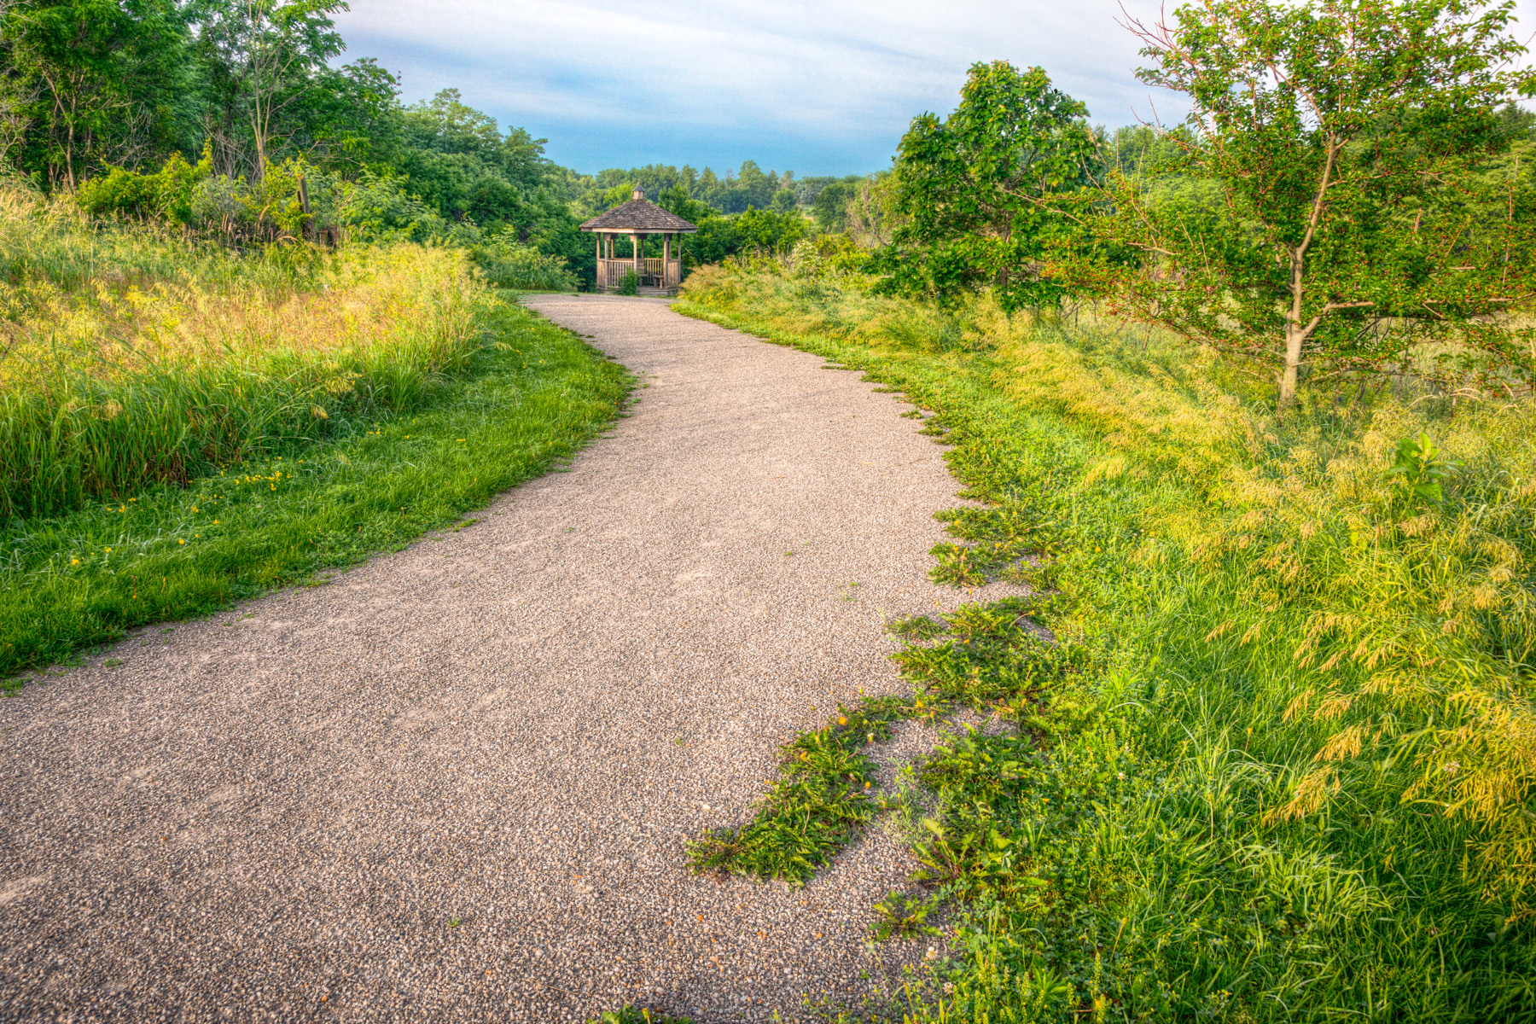
State Recreational Trails Program
Funding Recommendation
Debra Arp
Grant Program Administration Team Leader
10/07/2024

Slide 2
State Recreational Trail Program
Created in 1988
Available to cities, counties, state agencies, local governments, or non-profit organizations through an application program
Purpose is to establish recreational trails in Iowa for the use, enjoyment and participation of the public.
2
2

Slide 3
Project Evaluation Criteria
Criteria | Points
Need in terms of population to be served and existing trails in the area | 25
Compatibility with local, areawide, regional or statewide plans | 15
Benefits of multiple uses and recreational opportunities | 20
Quality of the site | 25
Economic benefits to the local area | 10
Special facilities for disabled users | 5
Project is “shovel ready” and will be completed by 6/30/2026 | 25
Projects with cash match | 5
MAXIMUM POINTS | 130
3
3

Slide 4
Available Funding and Application Summary
Available Funding: | Column 2
FY24 Legislative appropriation | $3,500,000
Underruns from closed projects | $23,206
Total available funding | $3,523,206
Application Summary:
Total number of projects | 30
Total project costs | $38,382,944
Total amount requested | $17,108,808
4
4

Slide 5
List of Applications Recommended
PROJECT NAME | SPONSOR | SCORE | TOTAL PROJECT COST | REQUESTED AMOUNT (% of Total Project Cost) | RECOMMENDED AMOUNT (% of Total Project Cost)
Neal Smith to High Trestle Trail Connector and Trailhead | Polk City | 102 | $1,740,000 | $700,000 (40%) | $700,000 (40%)
Clay County Connection Phase 2 | Dickinson County | 102 | $1,485,670 | $520,000 (35%) | $520,000 (35%)
Pony Hollow Trail Extension Phase 1 | Clayton County Conservation Board | 100 | $1,098,140 | $325,000 (30%) | $325,000 (30%)
Jewellsworth Trail Acquisition | Hamilton County Conservation Board | 98 | $256,975 | $180,000 (70%) | $180,000 (70%)
5
Jump to Applications Not Recommended for Funding
5

Slide 6
List of Applications Recommended
PROJECT NAME | SPONSOR | SCORE | TOTAL PROJECT COST | REQUESTED AMOUNT (% of Total Project Cost) | RECOMMENDED AMOUNT (% of Total Project Cost)
Iowa River’s Edge Trail Resurfacing and Bridge Replacement | Hardin County | 96 | $3,990,000 | $745,000 (19%) | $745,000 (19%)
Carlson Park Trail Development | Decorah | 96 | $498,795 | $298,795 (60%) | $298,795 (60%)
Bentonsport Bridge Rehab | Van Buren County Conservation Board | 94 | $2,015,000 | $403,000 (20%) | $403,000 (20%)
Flint River Trail Connection | Burlington | 93 | $95,500 | $71,625 (75%) | $71,625 (75%)
Pioneer Trail Reinbeck Gap | Grundy County Conservation Board | 92 | $1,126,000 | $500,000 (44%) | $279,786 (25%)
6
Jump to Applications Not Recommended for Funding
6

Slide 7
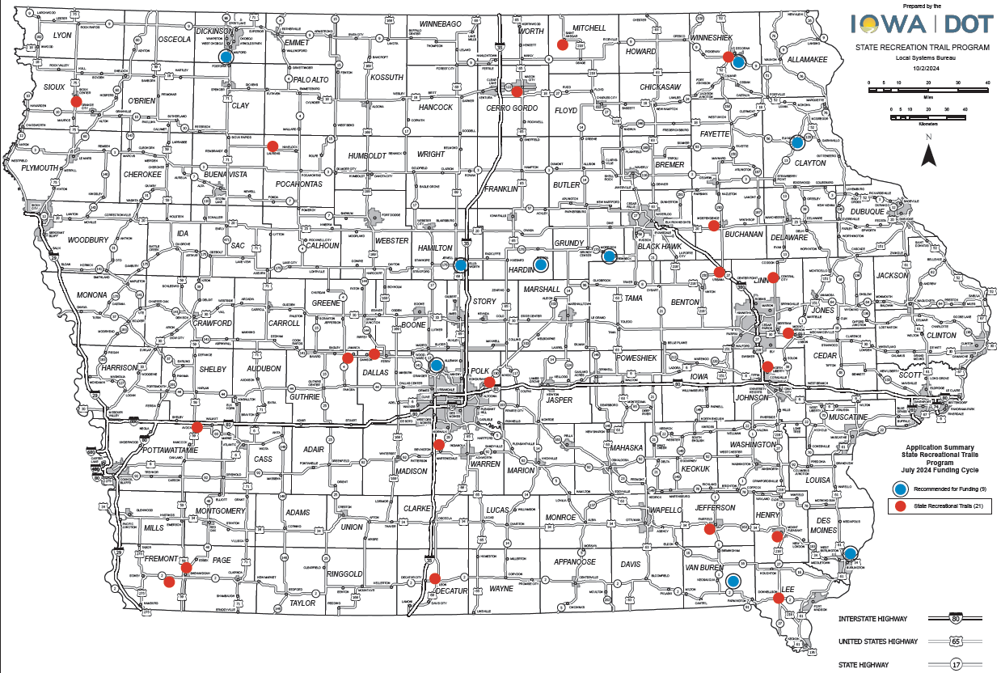
Map of Applications Received
7

Slide 8
Questions?
scott.flagg@iowadot.us
515-239-1252

Slide 9
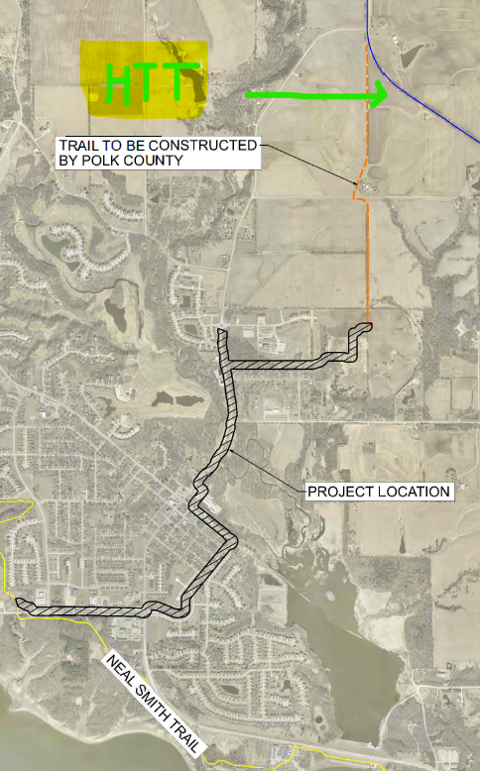
Neal Smith to High Trestle Trail Connector and Trailhead
(Polk City)
This project will construct over 2 miles of paved trail connecting the existing Neal Smith Trail and High Trestle Trail through Polk City and also includes construction of a trailhead north of the town center.
Total Cost: $1,740,000
Requested: $700,000 (40%)
Return to List of Applications Recommended
9

Slide 10
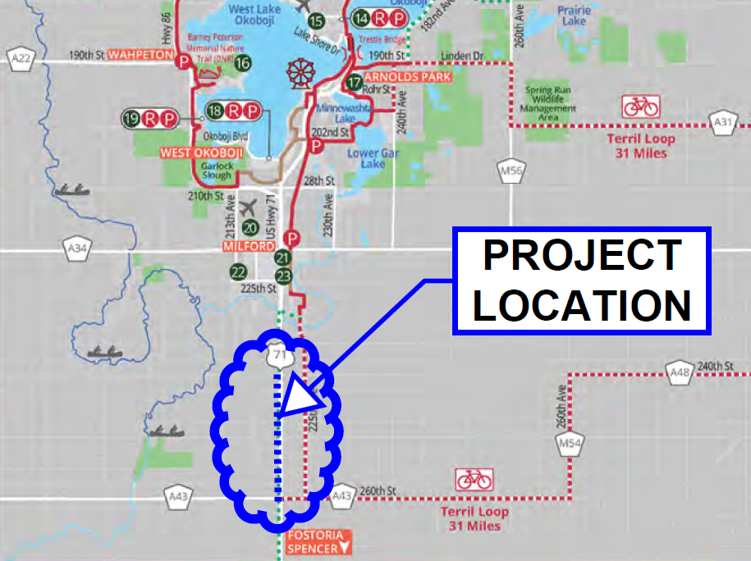
Clay County Connection Ph. 2
(Dickinson County)
This project will construct 2 miles of paved trail along US 71 from 240th Street to 260th Street. This trail will be part of a 4.5-mile connection between Dickinson and Clay counties and will contribute to the 135-mile Iowa Great Lakes Connection trail in northwest Iowa.
Total Cost: $1,485,670
Requested: $520,000 (35%)
Return to List of Applications Recommended
10

Slide 11
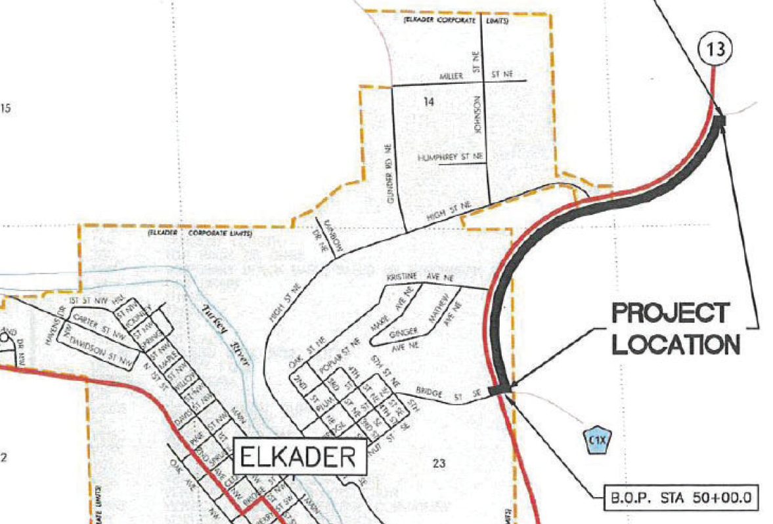
Pony Hollow Trail Extension Phase 1
(Clayton County Conservation Board)
This project will construct 1-mile of paved trail from 250th Street to Grape Road along Iowa 13 adding to the existing 4-mile Pony Hollow Trail along the Turkey River and contributing to the creation of a loop trail on the east side of Elkader.
Total Cost: $1,098,140
Requested: $325,000 (30%)
Return to List of Applications Recommended
11

Slide 12
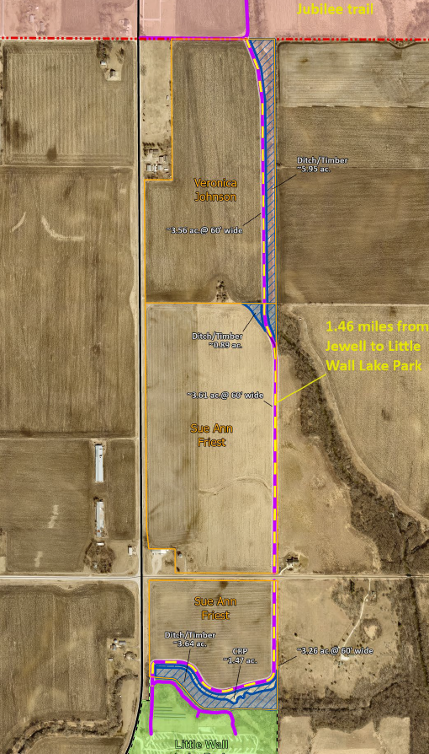
Jewellsworth Trail Acquisition
(Hamilton County Conservation Board)
This project will assist in acquiring 22.38 acres for future trail development. The acquisition will provide a 1.5 mile new trail corridor from the existing Jewellsworth Trail south to Little Wall Lake County Park.
Total Cost: $256,975
Requested: $180,000 (70%)
Return to List of Applications Recommended
12

Slide 13
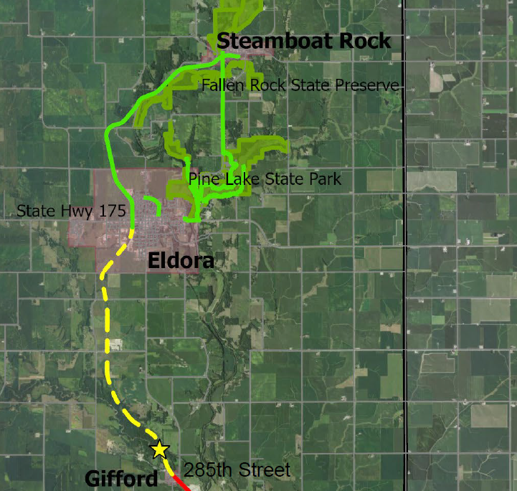
Iowa River’s Edge Trail Resurfacing and Bridge Replacement
(Hardin County)
This project will pave 5.5 miles of the Iowa River’s Edge Trail from the Iowa 175 and Edgington Avenue in Eldora to the south side of 285th Street in Gifford. It will also rehab a 235-foot bridge over the South Fork of the Iowa River.
Total Cost: $3,990,000
Requested: $745,000 (19%)
Return to List of Applications Recommended
13

Slide 14
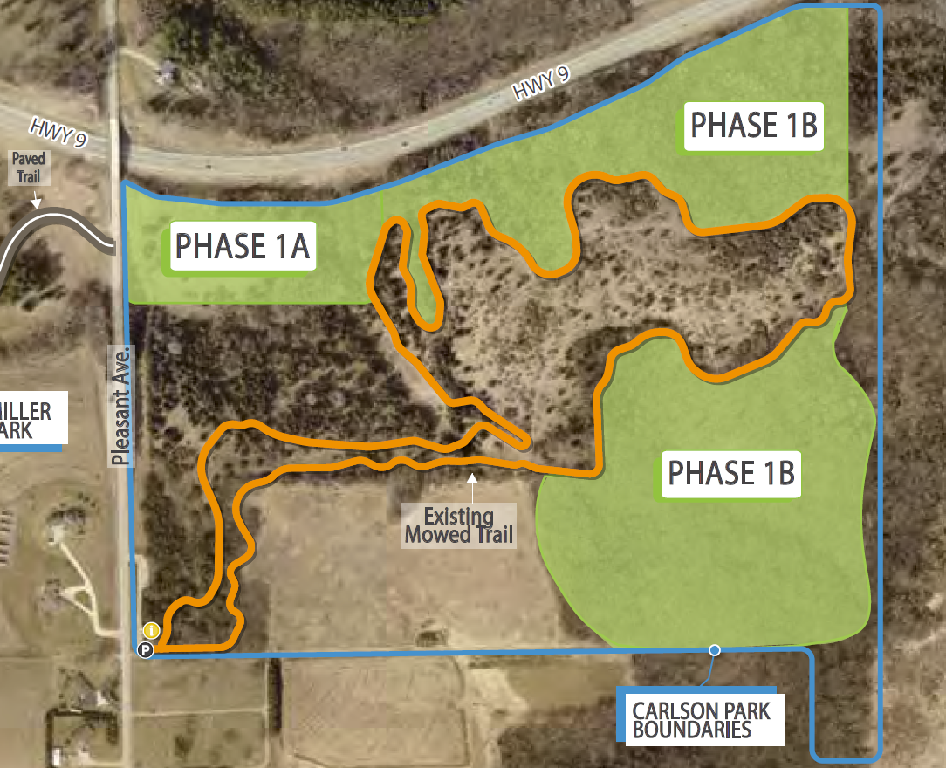
Carlson Park Trail Development
(Decorah)
This project will construct 5.7 miles of natural-surface, mixed-use, all-ability trails in Carlson Park in Decorah. The trails are a mix of two-way single-track shared use trails and bike-optimized one-way and two-way trails.
Total Cost: $498,795
Requested: $298,795 (60%)
Return to List of Applications Recommended
14

Slide 15
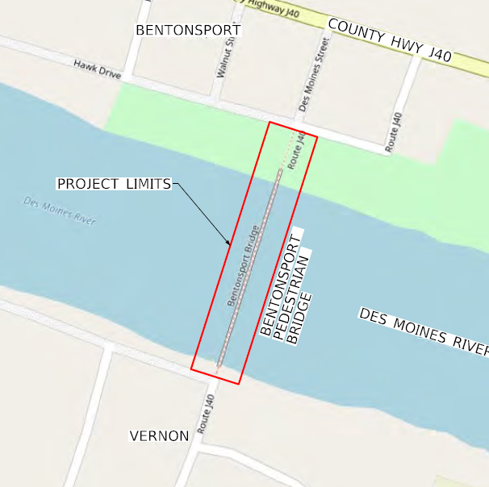
Bentonsport Bridge Rehab
(Van Buren County Conservation Board)
This project repairs a damaged 730-foot five-span truss bridge in the Bentonsport National Historic District and connects the unincorporated villages of Bentonsport and Vernon across the Des Moines River.
Total Cost: $2,015,000
Requested: $403,000 (20%)
Return to List of Applications Recommended
15

Slide 16
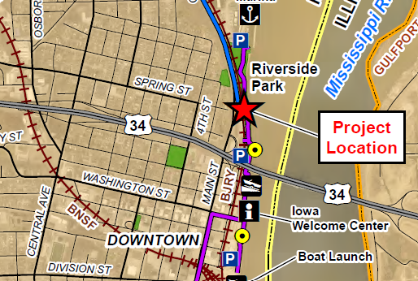
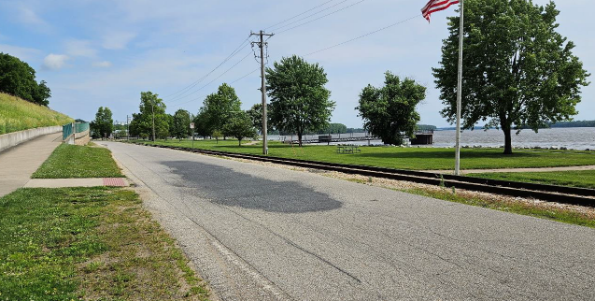
Flint River Trail Connection
(Burlington)
Constructs a railroad crossing for Flint River Trail in Riverside Park and widens the existing trail between railroad crossing and Riverside Park Trail.
Total Cost: $95,500
Requested: $71,625 (75%)
Return to List of Applications Recommended
16

Slide 17
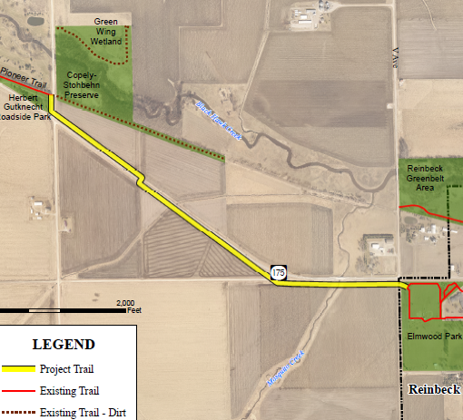
Pioneer Trail Reinbeck Gap
(Grundy County Conservation Board)
This project will construct a 1.3-mile paved trail along Iowa 175 from Elmwood Park in Reinbeck to Gutknecht Roadside Park. This project extends the existing 6-mile long Pioneer Trail to Reinbeck
Total Cost: $1,126,000
Requested: $500,000(44%)
Recommended: $279,786 (25%)
Return to List of Applications Recommended
17

Slide 18
List of Applications Not Recommended for Award
PROJECT NAME | SPONSOR | SCORE | TOTAL PROJECT COST | REQUESTED AMOUNT (% of Total Project Cost) | RECOMMENDED AMOUNT (% of Total Project Cost)
Little River Scenic Pathway Ph 2 | Decatur County Conservation Board | 91 | $550,000 | $52,500 (10%) | $0
Prairie Restoration Trail | Laurens | 91 | $598,500 | $401,167 (67%) | $0
Raccoon River Valley Trail Phase IV | Dallas County Conservation Board | 90 | $1,981,000 | $440,030 (22%) | $0
Prairieland Trail Connector | Mason City | 90 | $355,000 | $266,250 (75%) | $0
Dry Run Trail Greenbelt Connection | Winneshiek County Conservation Board | 88 | $2,887,713 | $650,000 (23%) | $0
Great Western Trail Rehab Phase 2 | Warren County Conservation Board | 88 | $828,000 | $583,500 (70%) | $0
18
Return to List of Applications Recommended
18

Slide 19
List of Applications Not Recommended for Award
PROJECT NAME | SPONSOR | SCORE | TOTAL PROJECT COST | REQUESTED AMOUNT (% of Total Project Cost) | RECOMMENDED AMOUNT (% of Total Project Cost)
Admiral Trail Bridge Phase 2 | Farragut | 87 | $695,918 | $521,938 (75%) | $0
Mount Pleasant Trail Connector | Mount Pleasant | 85 | $1,942,100 | $1,156,575 (60%) | $0
Westview Park Trail Phase 2 | Donnellson | 85 | $180,000 | $135,000 (75%) | $0
Interurban Trail Phase 1 | Mount Vernon | 82 | $348,089 | $248,089 (71%) | $0
Wabash Trace Rapp Park Connector | Southwest Iowa Nature Trails Project, Inc. | 82 | $2,496,657 | $650,000 (26%) | $0
19
Return to List of Applications Recommended
19

Slide 20
List of Applications Not Recommended for Award
PROJECT NAME | SPONSOR | SCORE | TOTAL PROJECT COST | REQUESTED AMOUNT (% of Total Project Cost) | RECOMMENDED AMOUNT (% of Total Project Cost)
North Liberty Trail Connector | North Liberty | 82 | $1,362,500 | $817,500 (60%) | $0
Wapsi Bluff Trail Connection to Pinicon Ridge Park | Linn County Conservation Board | 81 | $1,163,630 | $750,000 (64%) | $0
Sioux Center Trail Extension | Sioux Center | 80 | $936,728 | $561,728 (60%) | $0
55th Street Trail | Urbana | 76 | $1,623,000 | $1,080,000 (67%) | $0
Cedar View Trail Paving Project | Jefferson County Conservation Board | 76 | $886,000 | $424,000 (48%) | $0
20
Return to List of Applications Recommended
20

Slide 21
List of Applications Not Recommended for Award
PROJECT NAME | SPONSOR | SCORE | TOTAL PROJECT COST | REQUESTED AMOUNT (% of Total Project Cost) | RECOMMENDED AMOUNT (% of Total Project Cost)
Enterprise Drive Trail Phase 2 | Independence | 75 | $631,692 | $401,544 (64%) | $0
Chichaqua Valley Trail Relocation and Bridge Replacement | Bondurant | 71 | $876,000 | $250,000 (29%) | $0
Edgington Park Trail Restoration | Avoca | 71 | $529,000 | $394,000 (74%) | $0
Raccoon River Valley Trail Resurfacing | Guthrie County Conservation Board | 69 | $4,888,567 | $3,556,567 (73%) | $0
St. Ansgar Trail Connection | St. Ansgar | 68 | $316,770 | $25,000 (8%) | $0
21
Return to List of Applications Recommended
21

