Slide 1

National Electric Vehicle Infrastructure Program
Program Overview and Award Update
Debra Arp
Grant Program Administration Team Leader
10/07/2024

Slide 2
Summary
September 2023: Overview of National Electric Vehicle Infrastructure (NEVI) program
October 2023: Updated Infrastructure Investment and Jobs Act (IIJA) policies to include NEVI program policies
Today: Update on status of the program, results of first funding availability, and next steps
2
2

Slide 3
National Electric Vehicle Infrastructure Program
Formula program included in IIJA
Iowa allocated about $10.3 million per year FFY 2022-26 totaling over $51 million
Eligible for acquisition, installation, and network connection of chargers as well as operations and maintenance of NEVI compliant sites
Initially, for use to purchase/install electric vehicle charging infrastructure within one mile of Alternative Fuel Corridor Routes until full build out
3
3

Slide 4
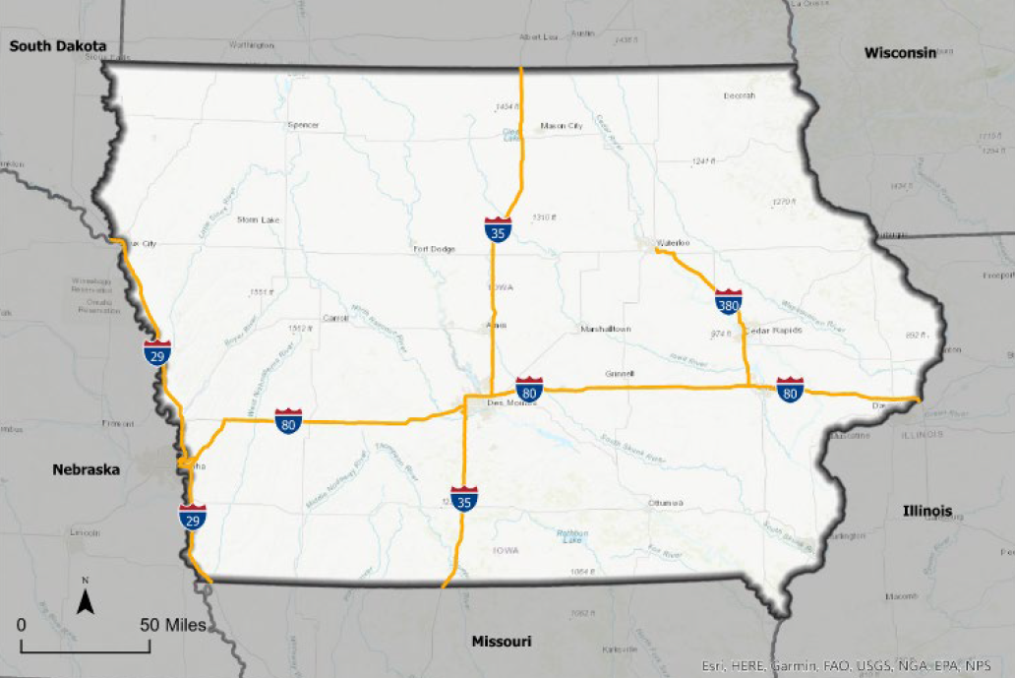
Iowa’s Alternative Fuel Corridors
4

Slide 5
NEVI Charging Station Requirements
<1 mile
<1 mile
<50 miles
<50 miles
Along Alternative Fuel Corridors (AFC)
  <50 mile spacing along AFC
  <25 mile from state borders
  <1 mile off AFC
At least four 150 kW DC Fast Charging ports
Open to general public
Need to build out AFC’s before investing off-corridor
5
5

Slide 6
Electric Vehicle Deployment Plan
State Deployment Plan required to be approved by FHWA annually to access funds
Initial plan submitted August 2022; updates required each year to address program status and priorities
Content: stakeholder/public engagement, vision/goals, contracting, existing & future conditions, charger deployment & implementation
Iowa DOT and Iowa Economic Development Authority have coordinated on the development and update of plan
6
6

Slide 7
Federal Program Requirements
Title 23 requirements apply to this program in the same manner as they apply to highway or bridge projects.
Each electric vehicle charging site will require design, specialized equipment, utility upgrades, construction/installation, workforce requirements, technical compliance, etc. that will require development by teams of property owners, vendors, contractors, and utilities.
7
7

Slide 8
Iowa NEVI Policies
Awarded through a competitive procurement process Governmental entities and municipal utilities are not eligible applicants.
Capital costs are eligible for reimbursement up to 80 percent. Operating and maintenance (O&M) costs across the five-year O&M period is eligible for reimbursement up to 80 percent or $200,000, whichever is less.
Proposals meeting the minimum technical requirements evaluated on a competitive basis according to scoring criteria for technical and cost elements.
8
8

Slide 9
Competitive Procurement
Competitive Notice of Funding Opportunity (NOFO)offering funds for deployment of EV charging infrastructure meeting NEVI requirements along AFCs was published December 14, 2023
Deadline for submission of applications was April 19
Agency partners IEDA and technical experts were included in the evaluation of applications
Project selection based on alignment to scoring criteria
9
9

Slide 10
Application Evaluation Criteria
Criteria | Points
Applicant Background, Experience, and Team Organization | 30
General Project Approach and Understanding | 25
Site Proposal | 60
Innovation and Resiliency | 15
Workforce, Equity, and Rural Considerations | 20
Cost Proposal | 25
Site Location Efficiency | 25
MAXIMUM POINTS | 200
10
10

Slide 11
Application and Intended Awards Summary
Application Summary: | Column 2
Applications Reviewed | 73
Total amount requested | $45,192,674
Intended Award Summary:
Intended Awards | 28
Total Intended Award Amount | $16,281,485
Total Project Costs | $21,916,370
11
11

Slide 12
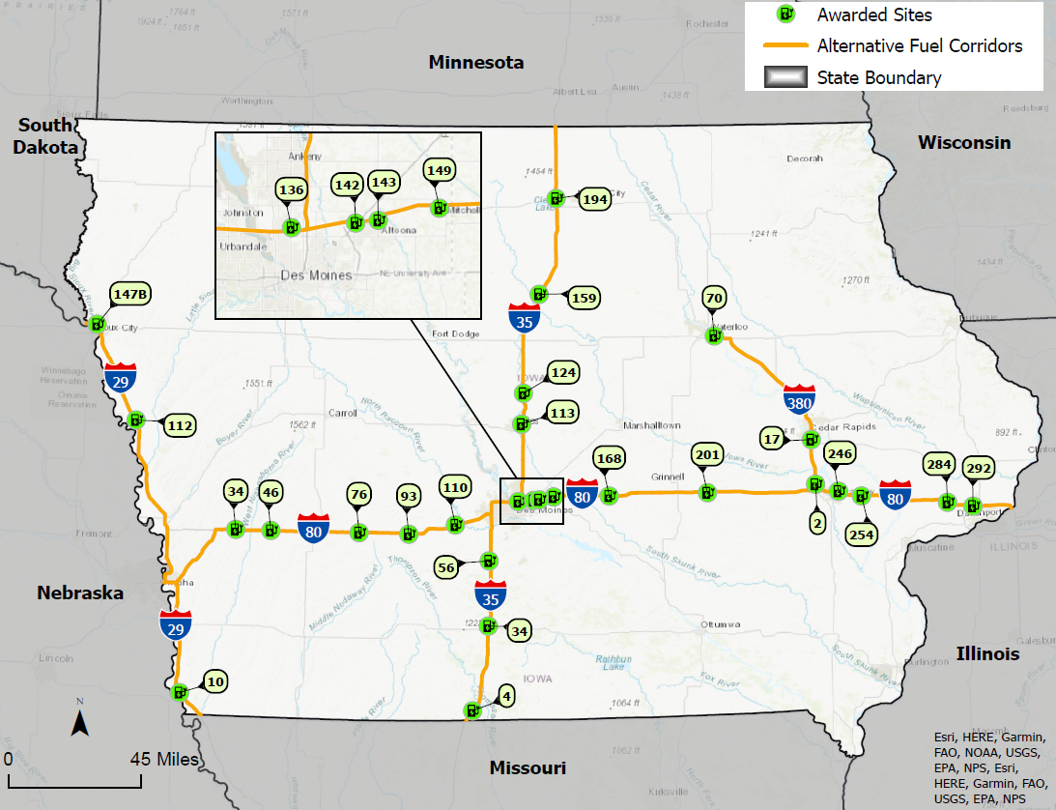
12

Slide 13
Next Steps
Proceed with awards and work with awardees to execute project agreements
Begin logistics of assisting awardees to work through the federal project development process
Conduct outreach regarding gaps prior to proceeding with a next application cycle
Anticipate next cycle focusing on gaps as a priority to work toward full buildout
13
13

Slide 14



Questions?
debra.arp@iowadot.us
515-239-1681

Slide 15
List of Intended Awards
Route/Exit | Awardee | Site Location | Total Project Cost | Funding Awarded
I-29/10 | Pilot TC | Pilot Travel Center, Percival | $774,031.00 | $519,701.70
I-29/112 | Francis Energy | Dairy Queen, Onawa | $827,764.67 | $662,211.74
I-29/147B | Francis Energy | Auditorium Shopping, Sioux City | $1,178,292.52 | $942,634.01
I-35/4 | Tesla | Amish Country Store LLC, Lamoni | $624,920.00 | $437,444.00
I-35/34 | Pilot TC | Pilot Travel Center, Osceola | $770,535.00 | $517,254.50
I-35/56 | Francis Energy | Hitchin Post Bar and Grill, Bevington | $821,534.97 | $657,227.98
I-35/113 | EvGateway | Quality Inn & Suites, Ames | $803,000.00 | $578,160.00
I-35/124 | Kwik Trip | Kwik Star, Story City | $712,727.00 | $502,219.30
I-35/159 | Francis Energy | Casey’s, Dows | $802,240.56 | $641,792.45
I-35/194 | Kwik Trip | Kwik Star, Clear Lake | $758,597.00 | $498,382.31
15
15

Slide 16
List of Intended Awards
Route/Exit | Awardee | Site Location | Total Project Cost | Funding Awarded
I-80/34 | Tesla | Corn Crib, Shelby | $493,904.00 | $345,732.80
I-80/46 | Red E Charging | Yesway, Walnut | $735,285.00 | $588,228.00
I-80/76 | Francis Energy | Chuckwagon Restaurant, Adair | $851,672.38 | $681,337.91
I-80/93 | Kwik Trip | Kwik Star, Stuart | $801,497.00 | $625,829.74
I-80/110 | Kwik Trip | Kwik Star, De Soto | $779,785.00 | $599,459.82
I-80/136 | Kwik Trip | Kwik Star, Des Moines | $758,708.00 | $571,936.20
I-80/142 | Pilot TC | Pilot Travel Center, Altoona | $829,239.00 | $497,543.40
I-80/143 | Kwik Trip | Kwik Star, Altoona | $786,518.00 | $629,214.40
I-80/149 | Kwik Trip | Kwik Star, Mitchellville | $743,823.00 | $561,819.24
I-80/168 | EvGateway | BP Gas, Newton | $778,000.00 | $583,500.00
16
16

Slide 17
List of Intended Awards
Route/Exit | Awardee | Site Location | Total Project Cost | Funding Awarded
I-80/201 | Kwik Trip | Kwik Star, Brooklyn | $851,396.00 | $645,019.76
I-80/246 | Francis Energy | The Highlander Hotel, Iowa City | $931,873.09 | $745,498.47
I-80/254 | Francis Energy | Casey’s, West Branch | $729,443.48 | $583,554.79
I-80/284 | BP North America | Iowa 80-The World’s Largest Truckstop, Walcott | $902,885.00 | $497,200.00
I-80/292 | BP North America | BP Gas, Davenport | $569,090.00 | $365,050.00
I-380/2 | Kwik Trip | Kwik Star, North Liberty | $781,185.00 | $588,793.95
I-380/17 | Kwik Trip | Kwik Star, Cedar Rapids | $785,608.00 | $628,486.40
I-380/70 | Red E Charging | Casey’s, Evansdale | $732,815.00 | $586,252.00
17
17

