Slide 1
Transportation Asset Management Overview
October 7, 2024
Charlie Purcell, P.E.
Deputy Director, Transportation Development Division
3/2/2023

Slide 2
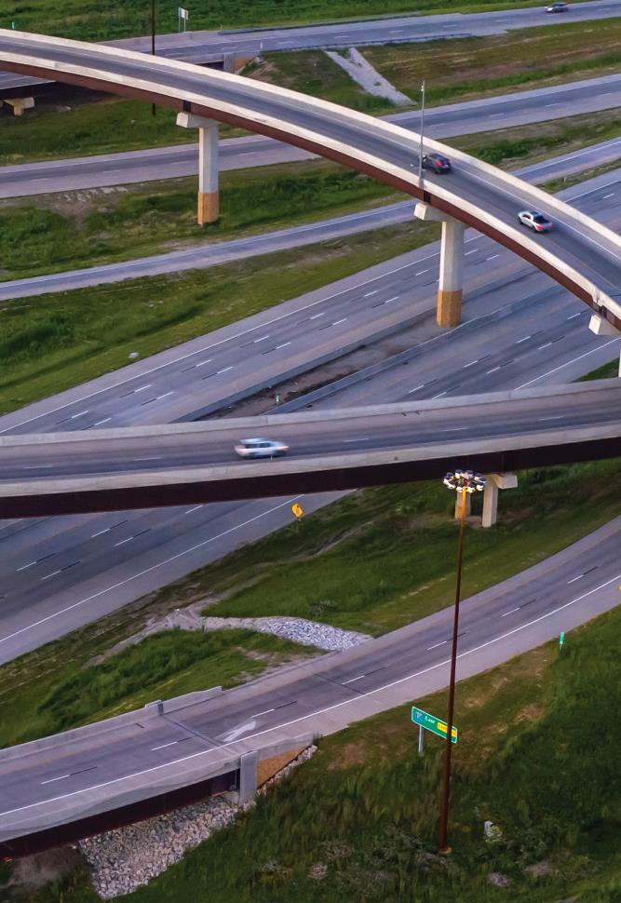
Agenda
What is asset management?
Why is asset management important?
What are we doing to implement asset management?
Preview of upcoming asset management presentations

Slide 3
Making the right investments at the right time to maximize the benefits to the transportation system while minimizing the costs
It’s both an art and a science
What is asset management?

Slide 5
It helps us:
Build, preserve, operate, maintain, upgrade, and expand the transportation system more cost-effectively throughout its whole life.
Improve performance of the transportation system.
Deliver to Iowa DOT’s customers the best value for every dollar spent
Enhance Iowa DOT’s credibility and accountability in its stewardship of transportation assets
Why is asset management important?
Notes:
Even a 1% increase in efficiency yields $510M in savings over the entire asset lifecycle
Right investments at the right time allow us to stretch our limited dollars as far as they will go
This in turn leads to a better performing system because it helps us keep the system in the best possible condition
Delivering the best value while maximizing performance builds credibility
Credibility is important because we serve as stewards of a tremendously valuable transportation system
Current replacement value of all primary roads and bridges is about $36 billion
When considering the value of the goods and services that depend on this system, the value is even more

Slide 6
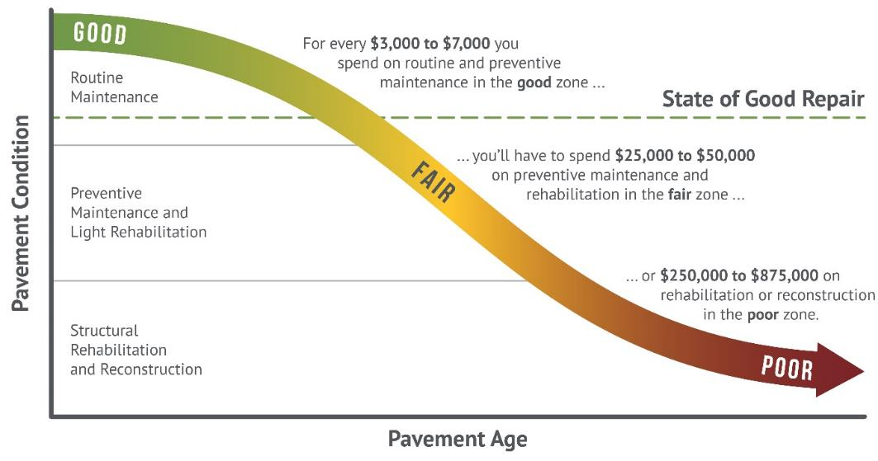
Good roads cost less
Notes:
Targets are set to maintain a state of good repair
Maintaining assets in a state of good repair minimizes overall lifecycle costs (good roads cost less)

Slide 7
We have a plan
What are we doing to implement asset management?
(we call it our TAMP)

Slide 8
TAMP Objectives
Defines clear links among agency goals, objectives, and decisions
Defines the relationship between proposed funding levels and expected results
Develops a long-term outlook for asset performance
Documents how decisions are supported by sound information
Develops a feedback loop from observed performance to subsequent planning and programming decisions
Improves accountability for decision making
Unifies existing data, business practices, and divisions to achieve Iowa DOT’s asset management goals

Slide 9
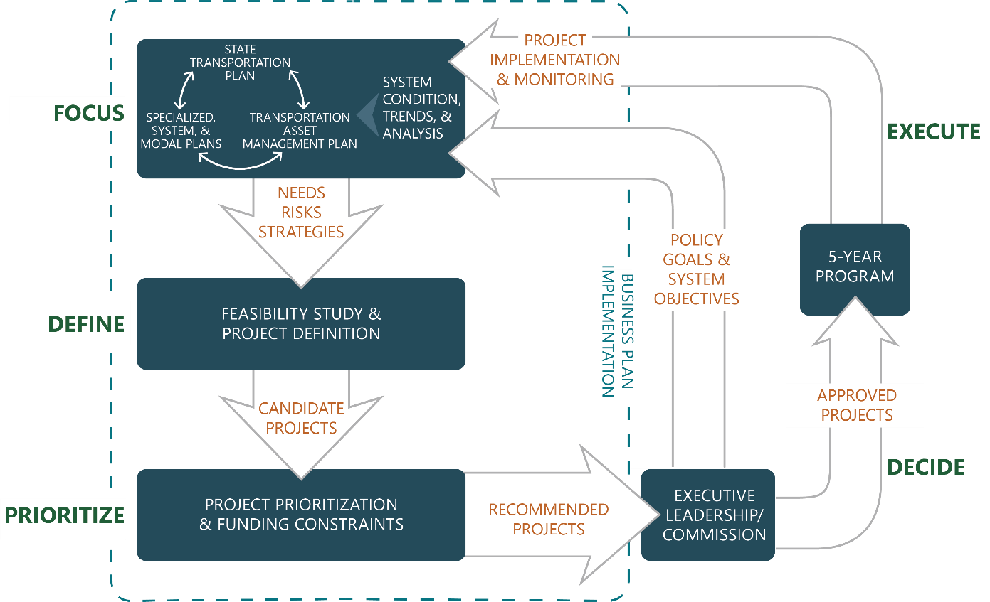
How does our TAMP fit in the planning and programming process?
Notes:
Diagram illustrates how the TAMP is connected to our long-range plan, various system and modal plans, and our 5-year program

Slide 10
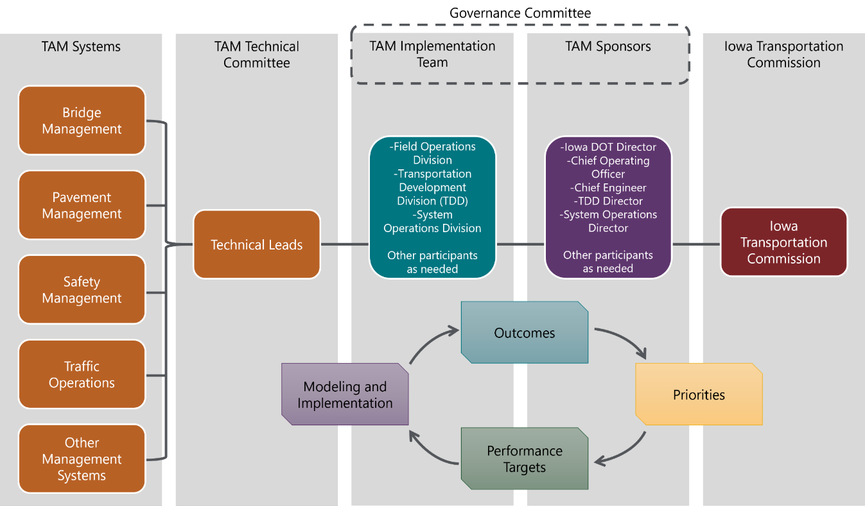
TAM Governance Structure

Slide 11
Preview of upcoming presentations
Dec 2024 – Interstate Plan Update
Jan 2025 – Pavement Asset Management
Feb 2025 – Bridge Asset Management
Mar 2025 – Asset Management Summary
Notes:
Dec 2024 – Interstate Plan Update
Present updated recommendations for timing and location of future capacity and stewardship investments
Receive Commission input on proposed schedule and funding level
Jan 2025 – Pavement Asset Management
Review of current conditions
Present different investment scenarios and resulting conditions
Feb 2025 – Bridge Asset Management
Review of current conditions
Present different investment scenarios and resulting conditions
Mar 2025 – Asset Management Summary
Summarize recommendations from previous presentations
Review past growth in stewardship investments and recommend continued increases to stewardship

Slide 12
Questions?

