Slide 1
Upper Mississippi Inland Waterway Infrastructure Partnership Evaluation
Iowa Transportation Commission
September 9, 2019

Slide 2
Evaluation Background
Objective: Develop range of viable investment alternatives to enhance Upper Mississippi inland waterway infrastructure
Leverage recent and ongoing activities
2013 Iowa DOT Reconnaissance Study
2014 & 2016 WRDA / P3 pilot program legislation
2015 Inland Waterway fuel tax increase ($0.20 to $0.29/gal)
Ongoing US Army Corps of Engineers (USACE) initiatives
Federal Administration/Congressional infrastructure plans
Including August 28, 2019 USDA/USACE ASA Town Hall Meeting at Mel Price Lock and Dam
Study examined three upgrade scenarios
2

Slide 3
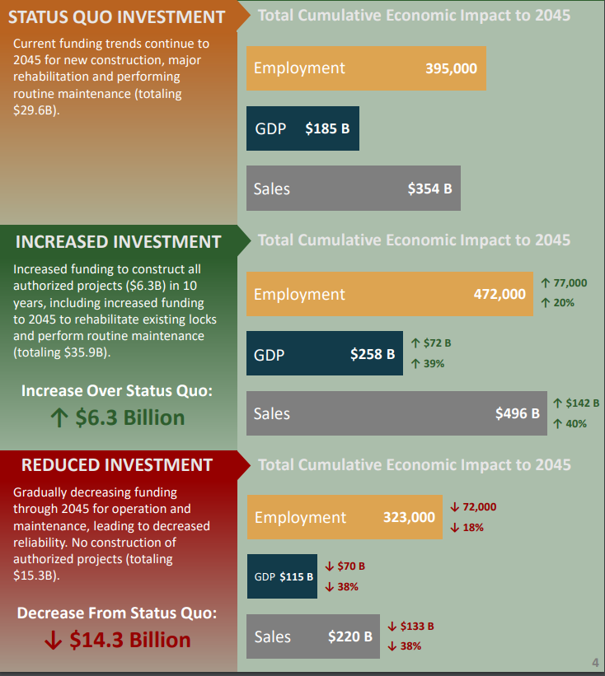
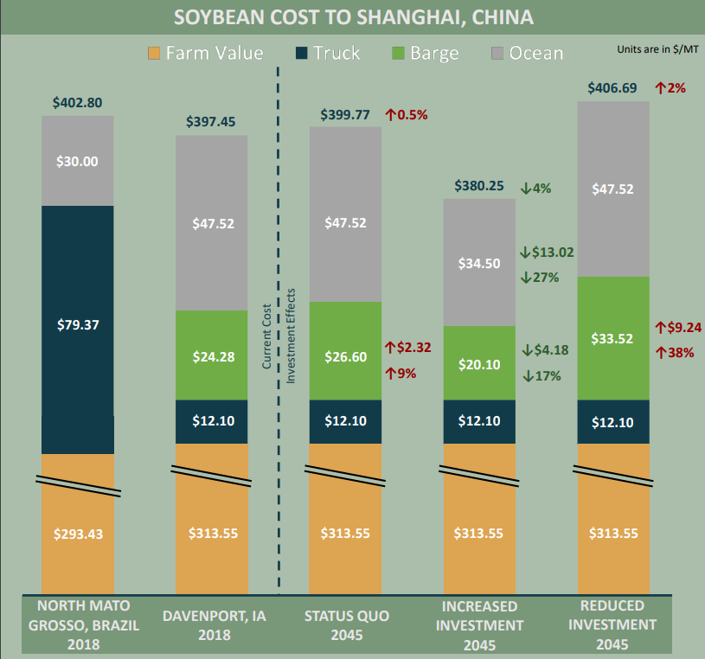
USDA/USACE ASA Town Hall Meeting August 28, 2019 at Mel Price Lock and Dam
Source: The Importance of Inland Waterways to U.S. Agriculture,
USDA Ag Marketing Service, August 2019.
3

Slide 4
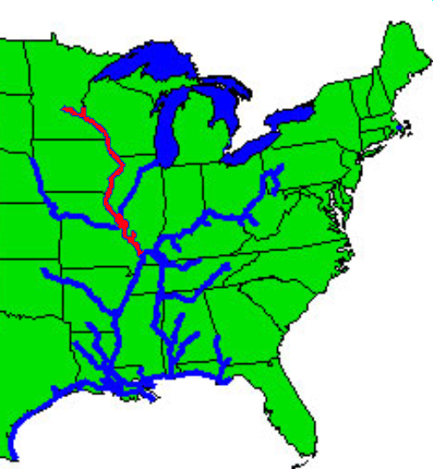
Upgrade Scenarios
Micro Efficiency Upgrade
Mooring Cell – a single project that can be replicated and improves the efficiency of the locking process and reduces navigation impacts to the environment
System Reliability Improvements
Major Rehabilitation Program – scenario project that increases the reliability of the existing UMR locks and provides for a sustainable river transportation system
Large-Scale Capacity, Efficiency & Reliability Upgrade
1,200-Foot Lock Chambers – a lock system upgrade that increases system capacity, efficiency, and reliability by adding a new 1,200-foot lock at three existing UMR locks & dams
4

Slide 5
Study Recommendations
Study included four recommendations for Iowa:
Use State-Federal project partnership agreement and/or contributed funds to implement the Micro Upgrade scenario of a mooring cell at L&D 14.
Establish a regional cooperative working group with other UMR states to expand and promote the Micro Upgrade scenario concepts across the UMR region.
Update State of Iowa port authority statutes to provide the ability to enter into USACE partnership agreements and develop financing tools for navigation systems improvements.
Evaluate an additional economic scenario that focuses on new markets, technologies, and innovation in the uses for transporting goods on the UMR, such as container traffic or new commodities.
5

Slide 6
Study Recommendations
Study also included three recommendations for federal/regional partners:
Encourage Congress, the Administration, and USACE to fund and complete necessary implementation guidance for WRRDA 2014 Section 2004a, Inland Waterways Construction Bonds Study; Section 2004b, Potential Revenue Sources for Inland and Intracoastal Waterways Infrastructure; and Section 5014, Water Infrastructure Public Private Partnership Program.
Explore implementation of portions of NESP as separable elements or a split delivery model, specifically the first increment of mooring cells identified in NESP alternative 4.
Engage with regional stakeholders to consider establishment of a broader UMR port or navigation authority to promote UMR navigation improvements.
6

Slide 7
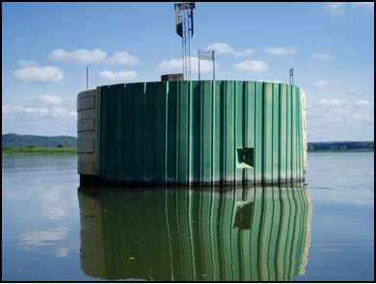
Micro Efficiency Upgrade
What is a mooring cell?
Efficient and environmentally friendly facility for tows approaching a L&D to moor (tie off) while waiting for the lock to be available
Typically located adjacent to main navigation channel
Constructed of sheet-piling driven into a circular cell and filled with earth and/or concrete
Without mooring facility, towboats must move close to shore and ground barges, tie off to bankline trees, or maintain engine power
Benefits
Improved lock approach times for
exchange lockages
Reduced environmental impacts
Improved operational safety
Replicability
7
Courtesy of US Army Corps of Engineers

Slide 8
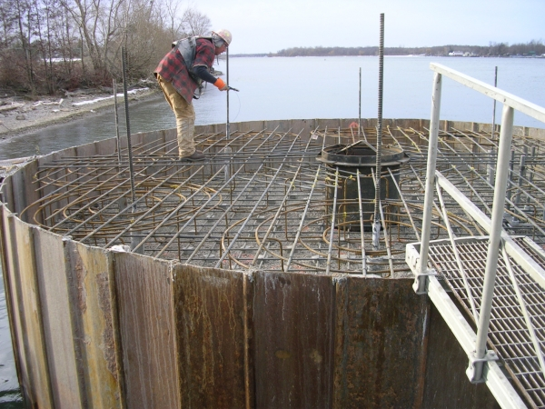
Micro Efficiency Upgrade
Mooring cells are authorized projects in WRDA 2007
USACE Mooring Cell UMR Working Group identified top priority locations: L&D 14 lower pool was #1
Waiting area currently 3.6 miles downstream
Proposed mooring cell location would be only 1.4 miles downstream
= 2.2 mile difference
8
Courtesy of US Army Corps of Engineers

Slide 9
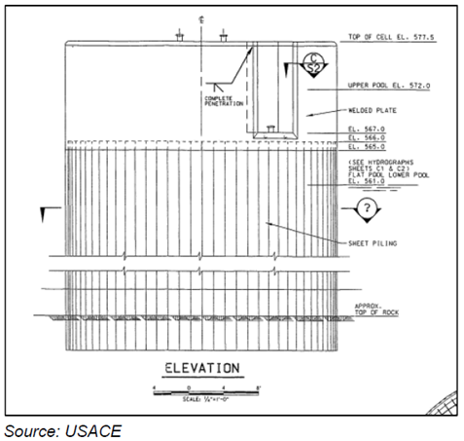
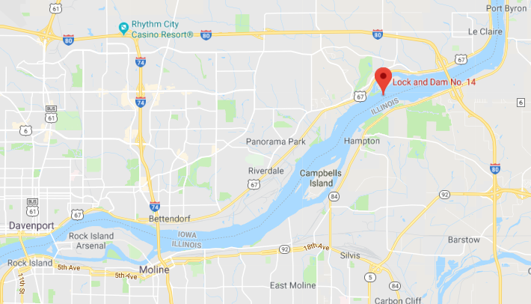

Slide 10
Economic Benefits
2.2 mile difference for waiting area = estimated 217 hours or 9 days time savings per navigation year
Relative to other scenarios, Micro Upgrade scenario yields the highest benefit-cost
*Includes 3% annual operating and maintenance costs
Importance to Iowa:
Inland waterways benefit landside transportation: congestion, safety, infrastructure damage, transportation costs, etc.
Demonstrated commitment to UMR infrastructure
Pilot can be replicated by other UMR states
 | Total discounted benefits | Total discounted costs* | Net present value | Benefit-cost ratio
Mooring cell | $8.7 million | $2.5 million | $6.2 million | 3.52
10

Slide 11
Pilot Project
Costs
$2 million for L&D 14 lower pool site
Existing funding (when available)
100% Federal Operations & Maintenance (Major Maintenance) or
50% Federal Construction General (Major Rehab) & 50% IWTF
Pilot funding proposal
Up to 100% Contributed Funds (state and/or federal) from non-Federal waterway stakeholders
Contributed funds agreement with USACE
Iowa DOT contributed funds with USACE for design and construction
Sources include original LIFTS infrastructure bank funds and National Highway Freight Program funds
Project timeline
Estimated at 2 years from kickoff to construction completion
11

Slide 12
Contributed Funds
Linking Iowa’s Freight Transportation System (LIFTS)
2016 pilot utilized repurposed State Infrastructure Bank funds from FHWA
Awarded $500,000 to proposed Eastern Iowa Logistics Park
Funds can now be used for a different project
National Highway Freight Program (NHFP)
Allocated roughly $13 million - $18 million annually through 2020
Up to 10% may be used for freight intermodal projects
Project Funding
Source | Amount
NHFP allocated funds (Federal) | $1,600,000
Repurposed LIFTS funds (Non-Federal) | $400,000
Total | $2,000,000
12

Slide 13
Potential Recommendation
Consider the following for the Mooring Cell Pilot Project at Lock and Dam 14 lower pool
Use of $1,600,000 federal NHFP Funds
Repurposing and use of $400,000 LIFTS funding as match
13

Slide 14
Questions?

