Slide 1
Railroad Revolving Loan and Grant Program FY 2020 Funding Cycle

Slide 2
Railroad Revolving Loan and Grant Program
Created by legislation in 2005
Purpose: To provide loans and grants for railroad related improvement projects to benefit Iowa.
Funded by loan repayments and appropriations by the Iowa Legislature, and is available to cities, counties, economic development organizations and other non-profit organizations through an application program.

Slide 3
Available Funding and Application Summary
Available Funding
FY 2020 Legislative appropriation (RIIF): $1,000,000
Loan repayment (June ‘18-current): $887,627
Previous Balance: $509,367
Rescinded funds $1,600,000
Total: $3,996,994
Application Summary
Total number of projects: 6
Total rail project costs: $17,857,259
Total amount requested: $7,301,027

Slide 4
Project Evaluation Criteria
Targeted Job Creation Projects:
Hourly wage rates must meet 100% of the average county wage
Criteria:
Job leverage: 40 pts
Wage quality: 20 pts
Capital investment: 20 pts
Loan leverage: 20 pts
Rail Network Improvement Projects:
Project readiness
Rail network impact
Economic impact
Financial readiness
Rail Port Planning and Development Studies:
Existing/potential site information
Goals of the study
Organizational structure and capacity to complete the study

Slide 5
Applications Received & Recommended Awards
TOTAL PROJECT COST
REQUESTED AMOUNT
(% of Total Project Cost)
RECOMMENDED AMOUNT
(% of Total Project Cost)
PROJECT NAME
SPONSOR
SCORE
Ottumwa/ BJRY Rail Port Relocation Study | City of Ottumwa | NA (planning grant) | $100,000 | $80,000 (80%) | $80,000 (40%)
Sioux City 27 Flags Study | City of Sioux City | NA (planning grant) | $40,000 | $32,000 (80%) | $32,000 (80%)
Trinity Rail | Trinity Rail | 36 (grant only) | $12,367,611 | $3,000,000 (24.3%) | $2,130,973 (17%)
Agri Trading | Agri Trading | 29.2 (grant and loan) | $2,071,284 | Grant: $360,000 Loan: $1,297,027 (80%) | Grant: $360,000 Loan: $1,297,027 (80%)
Jump to applications not recommended for funding
Notes:
Ottumwa/BJRY Rail Relocation Study
City of Ottumwa is currently undergoing a planned downtown Riverfront redevelopment project. However, several existing uses conflict with this project. One of those is the current BJRY railport/transload facility. The proposed study seeks to determine the feasibility and potential costs associated with relocating- and potentially expanding the facility to a location within the existing South Iowa Avenue industrial corridor.
27 Flags
Purpose of this study is to plan for the future of rail service in the Southbridge Business Park, which includes land currently owned by the City. Chosen consultant will be tasked with developing a layout for industry spurs as well as determining options for the future direction of the rail yard expansion and property acquisitions for additional rail served site.
Trinity Rail
Trinity Rail is one of the market leaders in railcar manufacturing. Proposed project will construct a loop track for railcar cleaning and maintenance in the Butler Logistics park. Iowa Northern will serve the site. Project will create 263 new jobs.
Agri Trading
Project proposes to expand the current Agri Trade business to establish a more permanent presence in the Sioux City area. The project will build track for a new transload facility allowing rail movement in and out.. UP will serve the site. Project will also create 30 new jobs.
Total Cost: $2,071,284
Requested: $1,657,027 (80%)

Slide 6
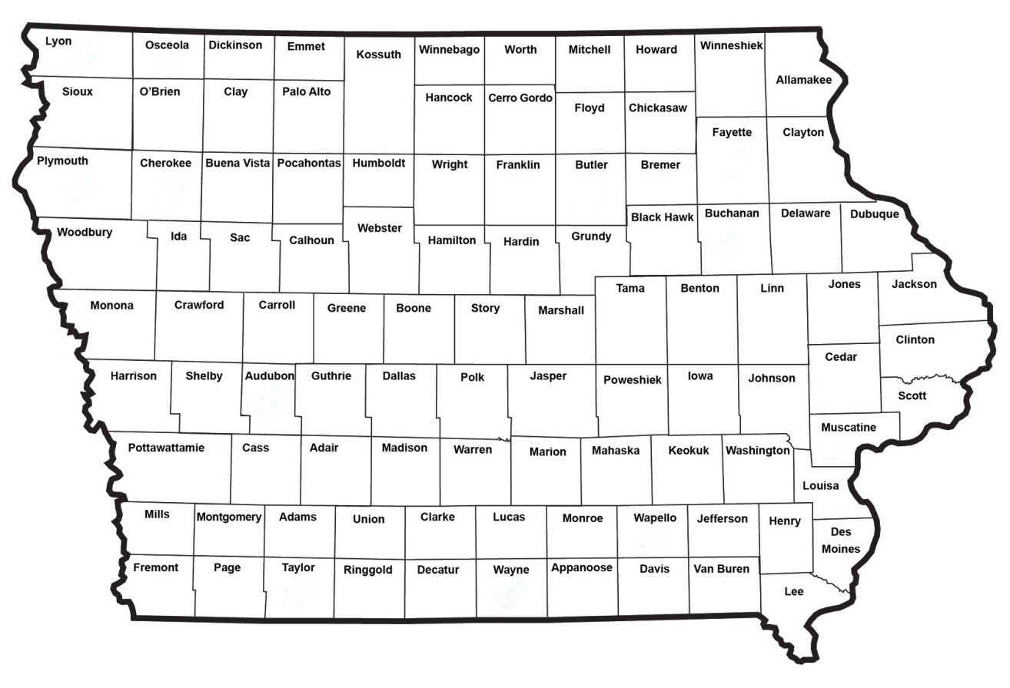
Map of Applications Received

Slide 7
QUESTIONS?
Laura Hutzell, Office of Rail Transportation
Laura.Hutzell@iowadot.us
515-239-1066

Slide 8
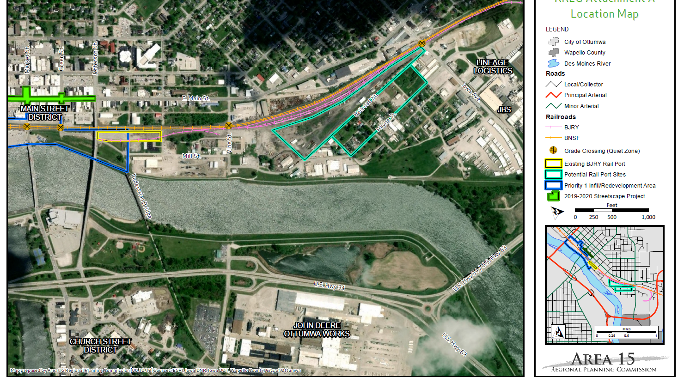
Ottumwa BJRY Railport Relocation Study
The proposed study seeks to determine the feasibility and potential costs associated with relocating- and potentially expanding the facility to a location within the existing South Iowa Avenue industrial corridor.
Total Cost: $100,000
Requested: $80,000
(80%)
Return to Recommendation Summary
Notes:
City of Ottumwa is currently undergoing a planned downtown Riverfront redevelopment project. However, several existing uses conflict with this project. One of those is the current BJRY railport/transload facility. The proposed study seeks to determine the feasibility and potential costs associated with relocating- and potentially expanding the facility to a location within the existing South Iowa Avenue industrial corridor.

Slide 9
Sioux City 27 Flags Study
Purpose of this study is to plan for the future of rail service in the Southbridge Business Park, which includes land currently owned by the City. The chosen consultant will be tasked with developing a layout for industry spurs as well as determining options for the future direction of the rail yard expansion and property acquisitions for additional rail served site.
Total Cost: $40,000
Requested: $32,000 (80%)
Return to Recommendation Summary
Notes:
Purpose of this study is to plan for the future of rail service in the Southbridge Business Park, which includes land currently owned by the City. Chosen consultant will be tasked with developing a layout for industry spurs as well as determining options for the future direction of the rail yard expansion and property acquisitions for additional rail served site.

Slide 10
Trinity Rail
Trinity Rail is one of the market leaders in railcar manufacturing. Proposed project will construct a loop track for railcar cleaning and maintenance in the Butler Logistics park. Iowa Northern will serve the site. Project will create 263 new jobs.
Total Cost: $12,367,611
Requested: $3,000,000 (24.3%)
Return to Recommendation Summary
Notes:
Trinity Rail
Trinity Rail is one of the market leaders in railcar manufacturing. Proposed project will construct a loop track for railcar cleaning and maintenance in the Butler Logistics park. Iowa Northern will serve the site. Project will create 263 new jobs.

Slide 11
Agri Trading
Project proposes to expand the current Agri Trade business to establish a more permanent presence in the Sioux City area. The project will build track for a new transload facility allowing rail movement in and out.. UP will serve the site. Project will also create 30 new jobs.
Total Cost: $2,071,284
Requested: $1,657,027 (80%)
Return to Recommendation Summary
Notes:
Agri Trading
Project proposes to expand the current Agri Trade business to establish a more permanent presence in the Sioux City area. The project will build track for a new transload facility allowing rail movement in and out.. UP will serve the site. Project will also create 30 new jobs.
Total Cost: $2,071,284
Requested: $1,657,027 (80%)

Slide 12
List of Applications Not Recommended for Award
REQUESTED AMOUNT
(% of Total Project Cost)
RECOMMENDED AMOUNT
(% of Total Project Cost)
PROJECT NAME
SPONSOR
SCORE
TOTAL PROJECT COST
Pattison Sand Phase IV | Pattison Sand Company | 28.41 (grant and loan) | $3,178,364 | Loan: $2,272,000 Grant: $180,000 (77%) | $0
Greater Fort Dodge Growth Alliance Study | Greater Fort Dodge Growth Alliance Study | NA (planning grant) | $100,000 | Loan: $0 Grant: $80,000 (80%) | $0
Return to Recommendation Summary

