Slide 1
FY 2021 Highway-Railroad Crossing Safety Program
September 9, 2019

Slide 2
Program
FHWA Funding available for states to improve warning devices at railroad crossings. (23 USC Section 130)
Amount of appropriation funded by FHWA is determined by the number of public crossings in the state.
Iowa currently has 5,062 public railroad crossings.

Slide 3
Project Evaluation Criteria
Benefit-Cost Ratio
Formula includes:
Number of accidents
Exposure Index, (number of trains x number of vehicles)
Train traffic
Vehicle traffic
Predicted Accidents, (train speed, roadway speed, number of traffic lanes, number of tracks)
Existing warning devices vs. possible upgrades
On-site safety diagnostic review
An application must be filed with the department

Slide 4
Available Funding and Application Summary
90% Federal Funds from FHWA
10% match by Highway Authority or Railroad
Applicant can be either Roadway Authority or Railroad, or combination of the two
Number of projects: 24 (19 & 5 closure incentives)
Total project costs: $5,693,500
Total FHWA project costs: $5,124,150
Annual Apportionment: $5,195,890

Slide 5
List of Applications Recommended
PROJECT NAME | SPONSOR | SCORE | TOTAL PROJECT COST | REQUESTED AMOUNT (% of Total Project Cost) | RECOMMENDED AMOUNT (% of Total Project Cost)
Talon Avenue, 603280W | IAIS Railroad Guthrie County | 2.2 | $225,000 | $202,500 (90%) | $202,500 (90%)
Colorado Street, 190763H | UP Railroad City of Glidden | 2.1 | $591,000 | $531,900 (90%) | $531,900 (90%)
6th Street, 606842A | BNSF Railroad City of Sioux City | 1.9 | $50,000 | $45,000 (90%) | $45,000 (90%)
Oak Street, 606842A | IAIS Railroad City of Atalissa | 1.8 | $180,000 | $162,000 (90%) | $162,000 (90%)
Lincoln Street / IA 14, 063403M | BNSF Railroad Iowa DOT (in the city of Knoxville) | 1.1 | $500,000 | $450,000 (90%) | $450,000 (90%)

Slide 6
List of Applications Recommended
PROJECT NAME | SPONSOR | SCORE | TOTAL PROJECT COST | REQUESTED AMOUNT (% of Total Project Cost) | RECOMMENDED AMOUNT (% of Total Project Cost)
360th Avenue, 067364M | BNSF Railroad Sioux County | 1 | $275,000 | $247,500 (90%) | $247,500 (90%)
48th Street, 078051D | BNSF Railroad Lee County | 0.9 | $250,000 | $225,000 (90%) | $225,000 (90%)
210th Street, 082342A | BNSF Railroad Lyon County | 0.9 | $250,000 | $225,000 (90%) | $225,000 (90%)
2nd Street, 063246W | BNSF Railroad City of Fort Madison | 0.8 | $400,000 | $360,000 (90%) | $360,000 (90%)
1st Street SW, 376717A | CRANDIC Railway City of Cedar Rapids | 0.8 | $185,000 | $166,500 (90%) | $166,500 (90%)

Slide 7
List of Applications Recommended
PROJECT NAME | SPONSOR | SCORE | TOTAL PROJECT COST | REQUESTED AMOUNT (% of Total Project Cost) | RECOMMENDED AMOUNT (% of Total Project Cost)
County Road A-26, 082337D | BNSF Railroad Lyon County | 0.7 | $250,000 | $225,000 (90%) | $225,000 (90%)
27th Street, 063232N | BNSF Railroad City of Ft. Madison | 0.7 | $250,000 | $225,000 (90%) | $225,000 (90%)
1st Ave. SE, 190580Y | UP Railroad City of Cedar Rapids | 0.7 | $400,000 | $360,000 (90%) | $360,000 (90%)
192nd Street, 074396K | BNSF Railroad Pottawattamie County | 0.7 | $250,000 | $225,000 (90%) | $225,000 (90%)
Court Street, 382037T | BNSF Railroad City of Sioux City | 0.7 | $500,000 | $450,000 (90%) | $450,000 (90%)

Slide 8
List of Applications Recommended
PROJECT NAME | SPONSOR | SCORE | TOTAL PROJECT COST | REQUESTED AMOUNT (% of Total Project Cost) | RECOMMENDED AMOUNT (% of Total Project Cost)
Zinnia Avenue, 385463L | DME Railroad City of Floyd | 0.6 | $275,000 | $247,500 (90%) | $247,500 (90%)
25th Avenue, 190563Y | UP Railroad Benton County | 0.6 | $350,000 | $283,500 (90%) | $283,500 (90%)
Talon Avenue, 926050N | IAIS Railroad Guthrie County | 0.1* | $225,000 | $202,500 (90%) | $202,500 (90%)
Buck Creek Road, 603112R | IAIS Railroad & N Bowdish Co. Ltd. Cass County | 0.1* | $250,000 | $225,000 (90%) | $225,000 (90%)
5 projected closure incentive payments at various locations ($7,500 each location) | TBD | N/A | $37,500 | $33,750 (90%) | $33,750 (90%)
* Advanced over other projects due to new ethanol plant with increased truck traffic, skewed crossing and line of sight issues. Moved forward by Rail Transportation Bureau through specific on-site inspection recommendation.

Slide 9
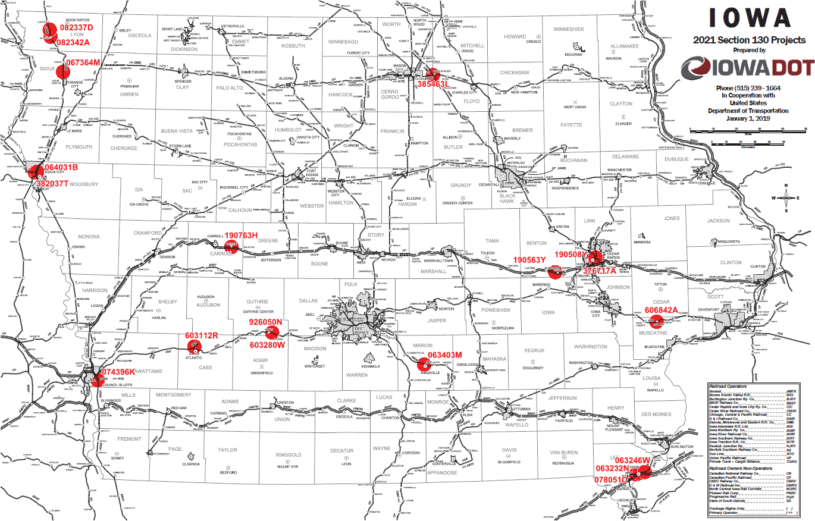
Map of Recommended Awards

Slide 10
QUESTIONS?
Kristopher Klop
Manager, Highway-Rail Crossing Programs
kristopher.klop@iowadot.us

