Slide 1
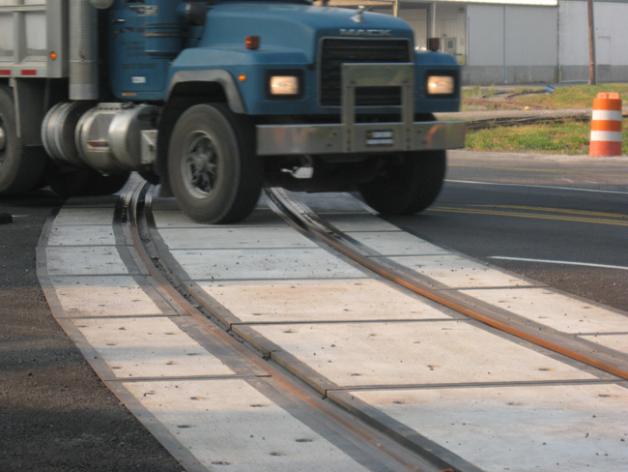
FY 2021 Highway-Railroad Crossing
Surface Repair Program
September 9, 2019

Slide 2
Program
Highway-Railroad crossing surface repair program incentivizes railroads and roadway authorities to participate in the cooperative repair of crossing surfaces.
Project funding breakdown:
60% State
20% Roadway authority
20% Railroad
Responsibilities:
Railroad: Replacement of rock (ballast), ties, track, underlayment, and crossing panels
Roadway Authority: Replacement of crossing approaches and existing sidewalks (ADA compliant), road closures and detours

Slide 3
Project Evaluation Criteria
Projects are funded in the order the applications are received, except that up to 50% of the program allocation can be used in a discretionary manner.
All 49 crossings currently in the program queue were scored according to the following criteria:
Type of route the crossing is on, (crude oil, ethanol, passenger)
Average daily vehicle traffic
Exposure index, (number of trains x number of cars)
Predicted Accidents, (train speed, roadway speed, number of traffic lanes, number of tracks)
Planned concurrent roadway projects
On-site inspection
Final Projects
The five highest scored crossings were brought forward to be funded in addition to those already scheduled to be funded for FY 2021 for a total of 12 projects.
Associated railroads and highway authorities were contacted and confirmed they were able to participate with funding and repairs.

Slide 4
Available Funding and Application Summary
Crossing Surface Repair Program receives an annual statutory appropriation of $900,000 (off-the-top of the Road Use Tax Fund)
Program funding queue currently has 49 applications submitted.
Number of projects:
7 in order received
5 with scoring
12 total
Total program funding request: $860,820
In order received: $556,200 / 65%
Scored: $304,620 / 35%

Slide 5
List of Applications Recommended
PROJECT NAME | SPONSORS | SCORE | TOTAL PROJECT COST | REQUESTED AMOUNT (% of Total Project Cost) | RECOMMENDED AMOUNT (% of Total Project Cost)
Newton Street, 307861E | CCP Railroad City of Waterloo | N/A Order Received | $134,000 | $80,400 (60%) | $80,400 (60%)
Conger Street, 307869J | CCP Railroad City of Waterloo | N/A Order Received | $143,000 | $85,800 (60%) | $85,800 (60%)
Burton Avenue, 307173S | CCP Railroad City of Waterloo | N/A Order Received | $167,000 | $100,200 (60%) | $100,200 (60%)
Rainbow Drive, 307897M | CCP Railroad City of Waterloo | N/A Order Received | $119,000 | $71,400 (60%) | $71,400 (60%)

Slide 6
List of Applications Recommended
PROJECT NAME | SPONSOR | SCORE | TOTAL PROJECT COST | REQUESTED AMOUNT (% of Total Project Cost) | RECOMMENDED AMOUNT (% of Total Project Cost)
Washington Street, 307615U | CCP Railroad City of Remsen | N/A Order Received | $141,000 | $84,600 (60%) | $84,600 (60%)
SW 5th Avenue, 603720K | IAIS Railroad City of Des Moines | N/A Order Received | $102,000 | $61,200 (60%) | $61,200 (60%)
Main Street, 307526C | CCP Railroad City of Alta | N/A Order Received | $121,000 | $72,600 (60%) | $72,600 (60%)
South Bowling Street, 840206T | CIC Railroad City of Cedar Rapids | 29 | $79,200 | $47,520 (60%) | $47,520 (60%)

Slide 7
List of Applications Recommended
PROJECT NAME | SPONSOR | SCORE | TOTAL PROJECT COST | REQUESTED AMOUNT (% of Total Project Cost) | RECOMMENDED AMOUNT (% of Total Project Cost)
20th Ave. / CR R20, 608601T | UP Railroad Winnebago County | 26 | $53,000 | $31,800 (60%) | $31,800 (60%)
South Monroe Street, 201859G | UP Railroad City of Mason City | 25 | $171,500 | $102,900 (60%) | $102,900 (60%)
Zinnia Avenue, 385463L | DME Railroad Cerro Gordo County | 25 | $71,000 | $42,600 (60%) | $42,600 (60%)
210th Street / CR B-40, 385619H | DME Railroad Kossuth County | 24 | $133,000 | $79,800 (60%) | $79,800 (60%)

Slide 8
Map of Recommended Awards

Slide 9
QUESTIONS?
Kristopher Klop
Manager, Highway-Rail Crossing Programs
kristopher.klop@iowadot.us

