Slide 2
Benefits
Better identify projects
Be more data driven in decision making
Transparent and repeatable project selection
Better coordinate projects
Better communicate & evaluate potential program additions

Slide 3
TAM Principles
Asset management is policy driven Funding decisions reflect the vision for how the transportation system should look in the future.
Asset management is performance based We understand the condition of its assets, define performance targets, and make decisions that support these targets.
Asset management involves making trade-offs We have options for how to allocate transportation funding. We evaluate these options and make informed decisions regarding the best path forward.
Asset management relies on quality information We use data and analytical tools to support our decisions.
Asset management requires transparency and accountability We document how funding decisions are made, monitor performance, track progress towards performance targets, and report on results.

Slide 4
Timeline
2015 – Project Prioritization Underway
2015-2016 – Dynamic Data Integration
2016 – vs 1.0 Prioritization Launch
2017 – vs 2.0 Prioritization Launch
2018 – Project Scoping begins
2018 – Scoping Application Launch
2018 - Commission Weightings Workshop
2019 –Project Valuation integration (Options List)
Benefit/Cost & Local Contribution Discussion

Slide 5
Prioritization & Scoping
Criteria | Weight | Basis for scoring
Safety | 18% | Score based on average crashes per mile adjusted for fatalities and major injuries
Roadway Class | 10% | Score is based on the projects inclusion on important Iowa networks like the CIN
Freight | 12% | Score is based on truck percentage, normalized by AADT and adjusted for freight bottlenecks
Pavement | 16% | Structural condition of the pavement adjusted for smoothness & rideability
Bridge | 15% | Bridge condition index, which includes age, load capacity, traffic count, and a few other factors
Traffic | 15% | A weighted measure of the volume of traffic that each road is carrying in comparison to what it can carry
Mobility | 14% | Based on actual hours of delay when available, or when not available, the relationship between incidents, numbers of access points, and traffic volumes

Slide 6
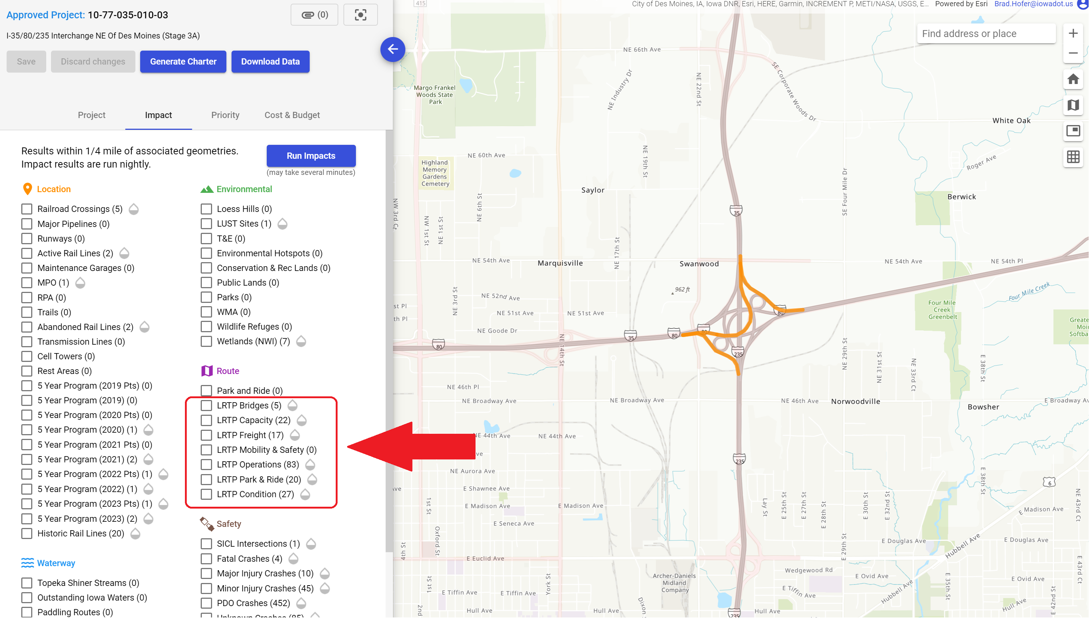
LRTP Consistency

Slide 7
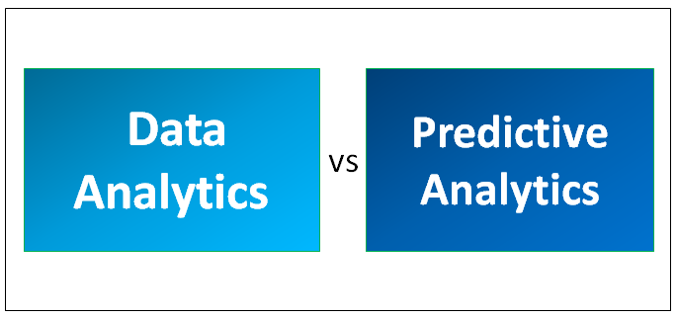

Slide 8
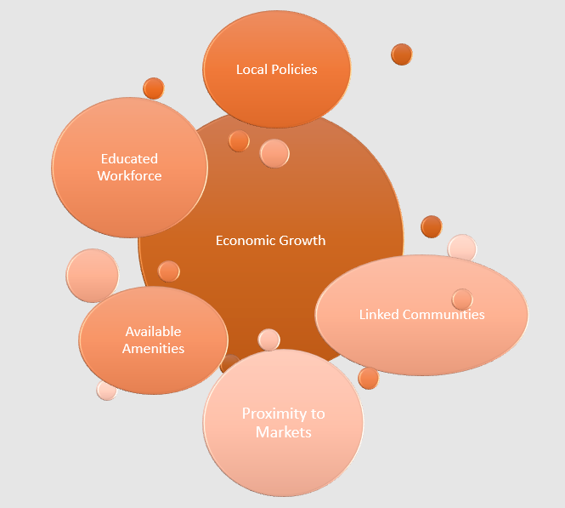
What Drives Economic Development?
Population Growth
Presence of An Educated Workforce
Proximity to Markets
Community and County Interlinkages
Local Economic Development Policies
Amenities

Slide 9
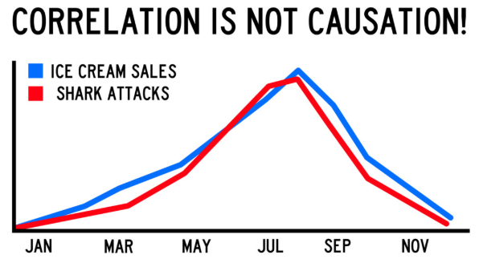
Data Relationships

Slide 10
Data Relationships

Slide 11
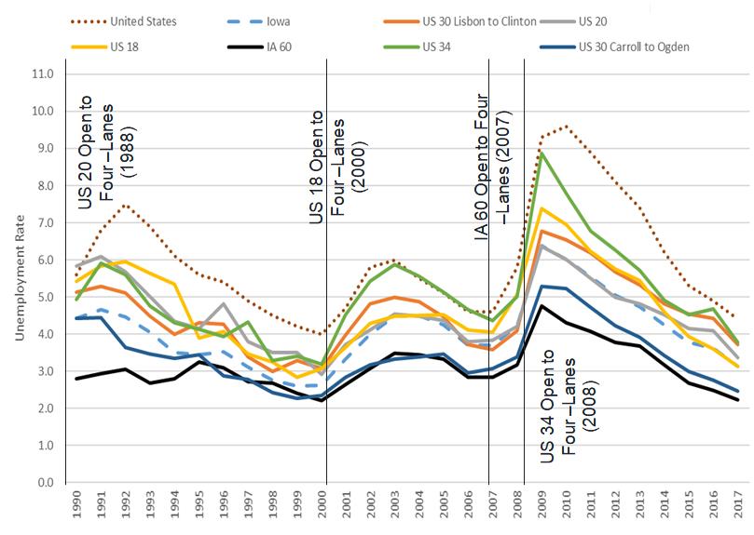
Correlating Data Relationships

Slide 12
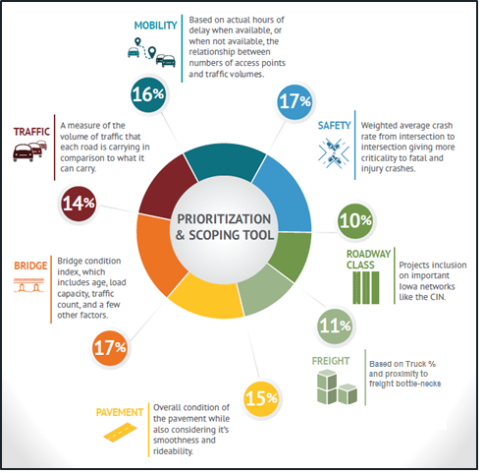
Current criteria that correlate to
economic development & growth
Freight
Traffic
Mobility
Road Class

Slide 13
Correlating Data Relationships
ECONOMIC DEVELOPMENT
Transportation
Indicators
Traffic
Freight
Mobility
Population growth
Presence of an educated workforce
Proximity to markets
Community and county interlinkages
Local economic development policies
Amenities
Road Class

Slide 14
Existing Weighting Correlation
Criteria | Weight | Basis for scoring
Safety | 18% | Score based on average crashes per mile adjusted for fatalities and major injuries
Roadway Class | 10% | Score is based on the projects inclusion on important Iowa networks like the CIN
Freight | 12% | Score is based on truck percentage, normalized by AADT and adjusted for freight bottlenecks
Pavement | 16% | Structural condition of the pavement adjusted for smoothness & rideability
Bridge | 15% | Bridge condition index, which includes age, load capacity, traffic count, and a few other factors
Traffic | 15% | A weighted measure of the volume of traffic that each road is carrying in comparison to what it can carry
Mobility | 14% | Based on actual hours of delay when available, or when not available, the relationship between incidents, numbers of access points, and traffic volumes

Slide 15
Recommendations
Review the existing weightings for potentially more weight to criteria that correlate with economic development
Include local contributions in the benefit/cost analysis of options for program additions
Discuss including priority corridors in the road classifications score
Discuss completion of 2019 weightings workshop

Slide 16
BRAD HOFER
DEPUTY DIRECTOR/ LOCATION ENGINEER
LOCATION & ENVIRONMENT BUREAU
Brad.hofer@iowadot.us
Office: 515-239-1787
QUESTIONS ???

