Slide 1
Iowa DOT Commission
September 10, 2019
Notes:
Opening remarks. Introduce team.

Slide 2
Key Projects
For Industry
Communities
in the
East
Central Iowa
Region
Notes:
1448 Total employers
Marion County 41% mfg
Mahaska 25% mfg
99,020,027 mfg. shipments
$ 92,876,100 annual payroll

Slide 3
East Central Iowa Region
Notes:
175,000 population
80,000 jobs
Advanced Manufacturing – Truckloads
Mfg. corridor: Pella, Oskaloosa, Knoxville, Albia, Ottumwa

Slide 4
US 63 NHS Route
Notes:
Intersects 7 US Interstates

Slide 5
Freight Route Significance

Slide 6
US 63 Provides N/S connection to fill the gap between I-35 and I-380/US 218
100100-mile Gap

Slide 8
US 63/IA 92 Intersection
Notes:
Add downtown intersection picture.
Intersects the busiest intersection at US 63 and IA 92
Increases travel time – inefficient. Traffic includes heavy grain trucks 500 and growing/day to Cargill Eddyville.
US 63 is also connector to I80

Slide 9
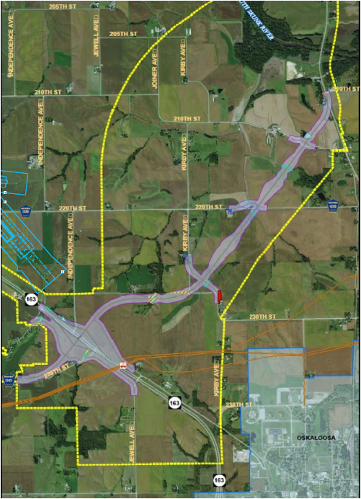
Oskaloosa
NW Bypass
Notes:
Thank you!
Provide safe efficient travel for through truck and vehicle traffic on US 63 CIN. Bypass safest.
2010-2017 171 crashes in Oskaloosa limits. Total number reflects crash rate of 451/100 million vmt or 1.8 times the 5-yr ave.
Traffic increases expected:
2014 volumes thru town = 5300-7600 vpd, 7-11% truck 2040 = 5200-8800 vpd, 8-13% truck
2014 volumes north of town = 3500-4500 vpd 2040 = 4200-6700 vpd, 12-16% truck

Slide 10
Notes:
Gateway Commercial Development
Growth to the west connected by infrastructure improvements proposed.

Slide 12
Downtown Oskaloosa

Slide 15
Oskaloosa Industrial Connector

Slide 17
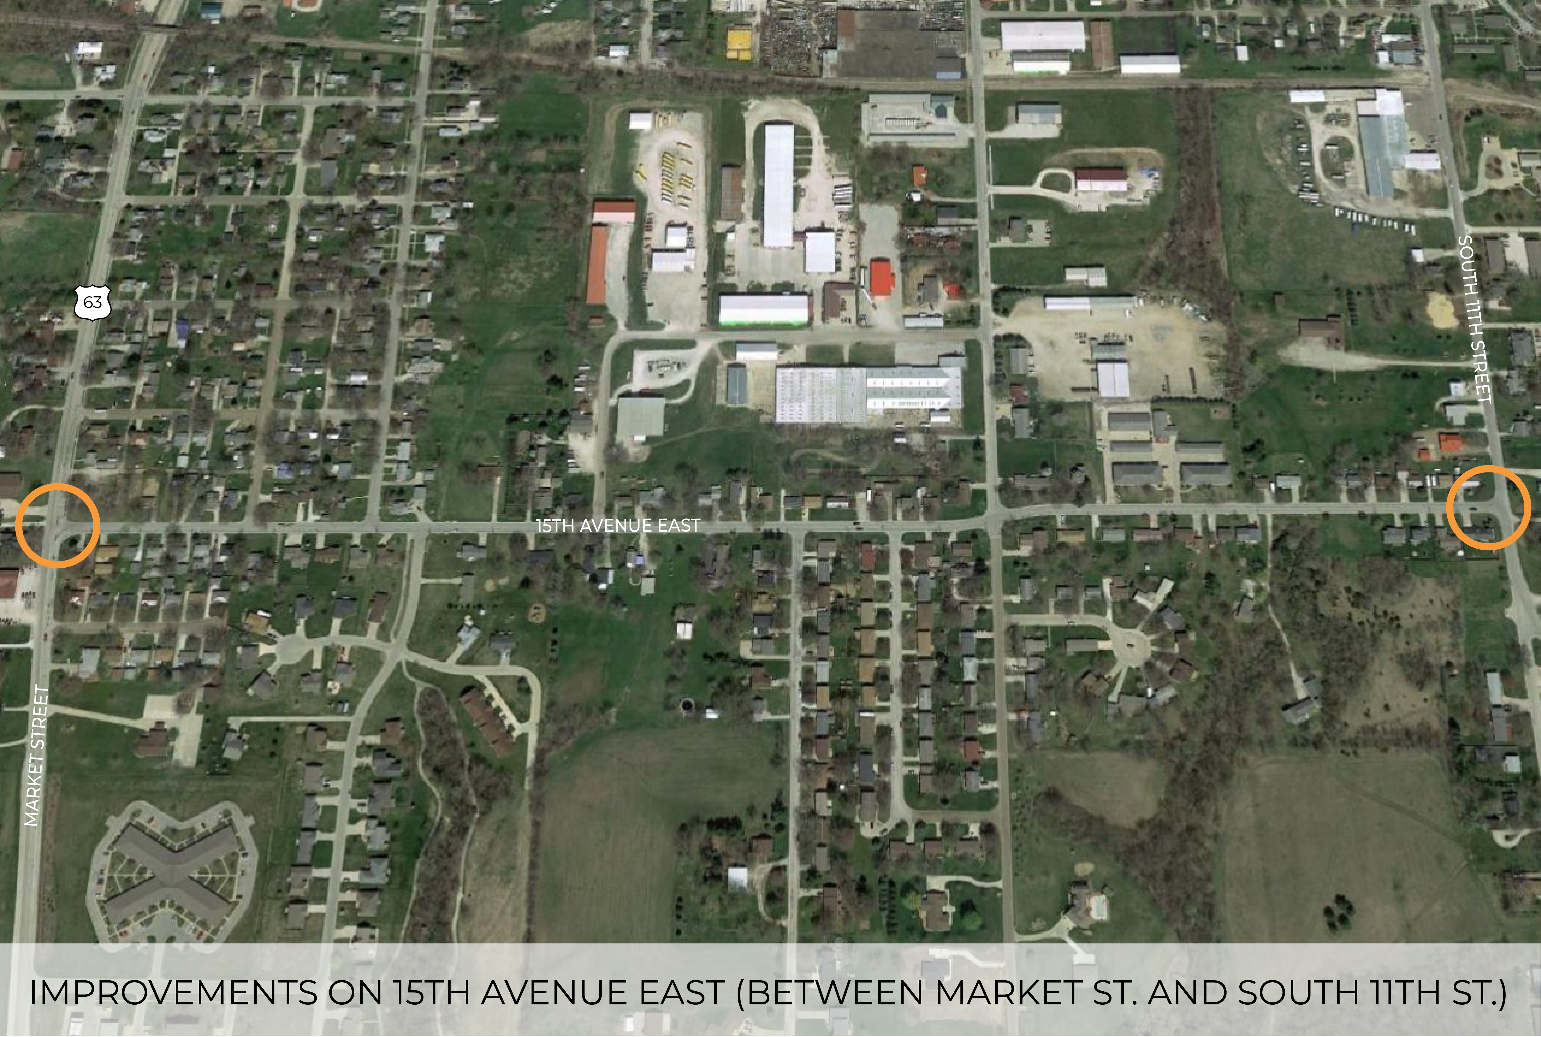

Slide 18
South Central Iowa Regional Airport

Slide 20
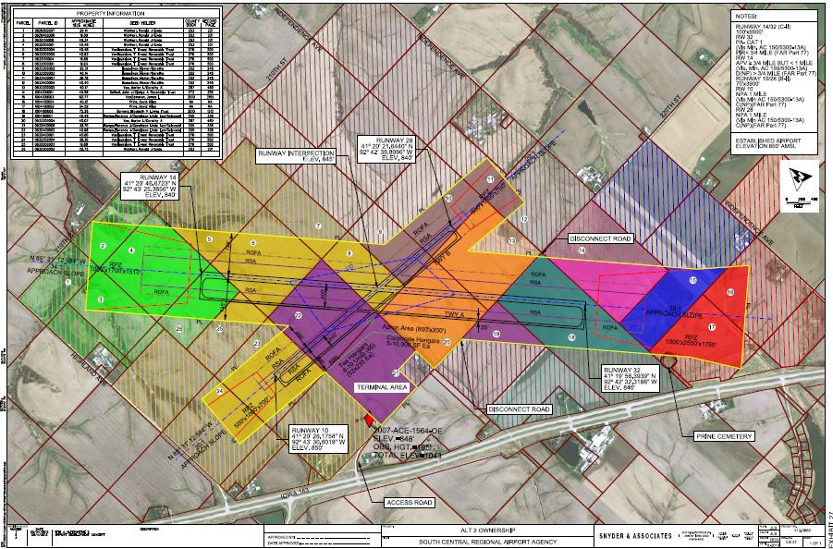

Slide 22
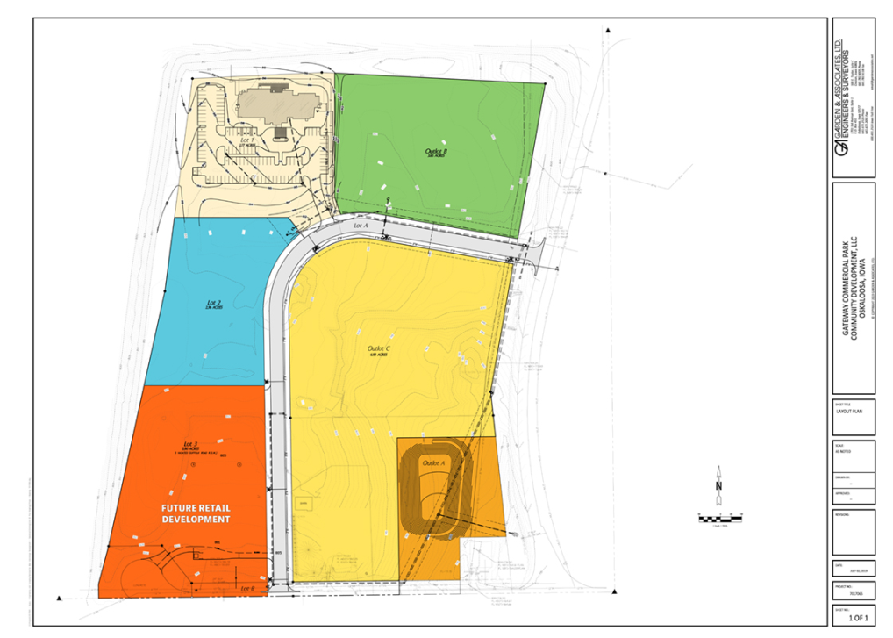
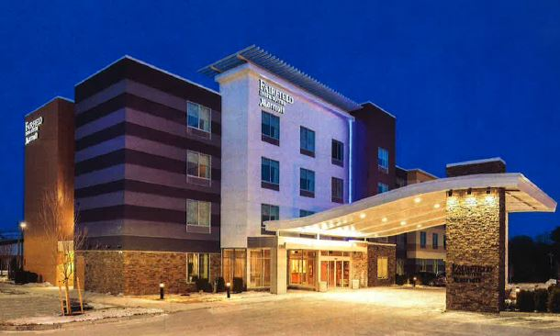

Slide 23
Thank you. East Central Iowa Transportation Coalition

