Slide 1
Highway 150 Coalition

Slide 2
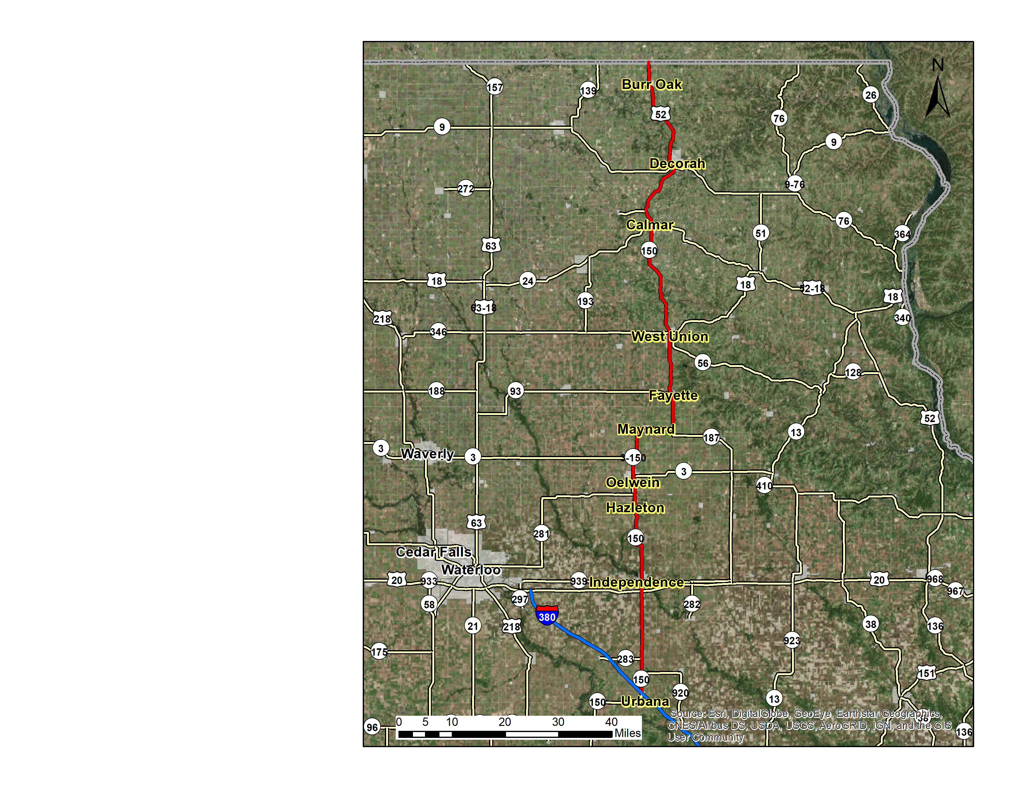
Our Mission
The Highway 150 Coalition is determined to bring improvements to the transportation issues along Highway 150, specifically within the City of Independence, a critical point along Highway 150.

Slide 3
What North East Iowa Needs
North East Iowa needs a vision for Highway 150, and the coalition wants to work toward creating that vision and working with the DOT
Independence downtown along Highway 150

Slide 4
Specific Improvements Needed
The coalition has identified the following areas for review
Downtown Independence
D16 and IA 150
IA 281 and IA 150
US 52 and Pulpit Rock Road
281 and 150 South of Oelwein

Slide 5
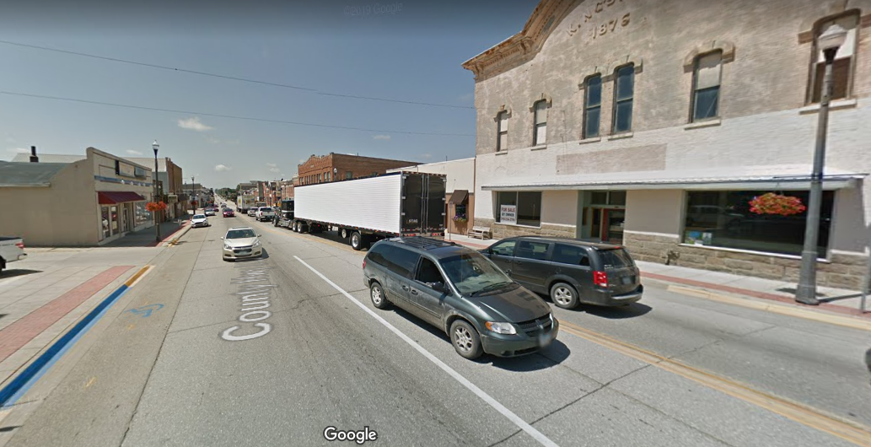
Independence Bottleneck
Independence is a crucial point for Highway 150, and the safety and congestion issues in Independence needs to be addressed.
Independence downtown looking west on Highway 150

Slide 6
Freight Bottleneck
The DOT recognizes an improvement is needed for the freight and pavement condition for Independence in their State Transportation Long Range Plan

Slide 7
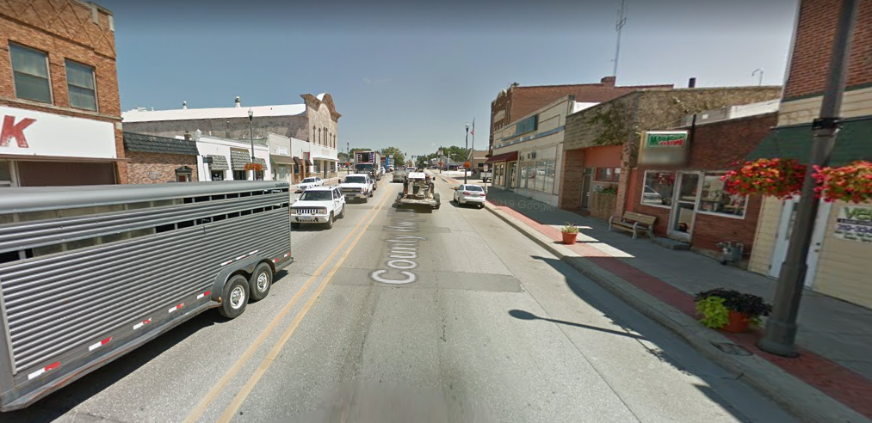
Study Needed
The Highway 150 Coalition is requesting the Iowa DOT to conduct a study in Independence to improve the safety and efficiency of the traffic flow through 150
Independence looking east on Highway 150

Slide 8
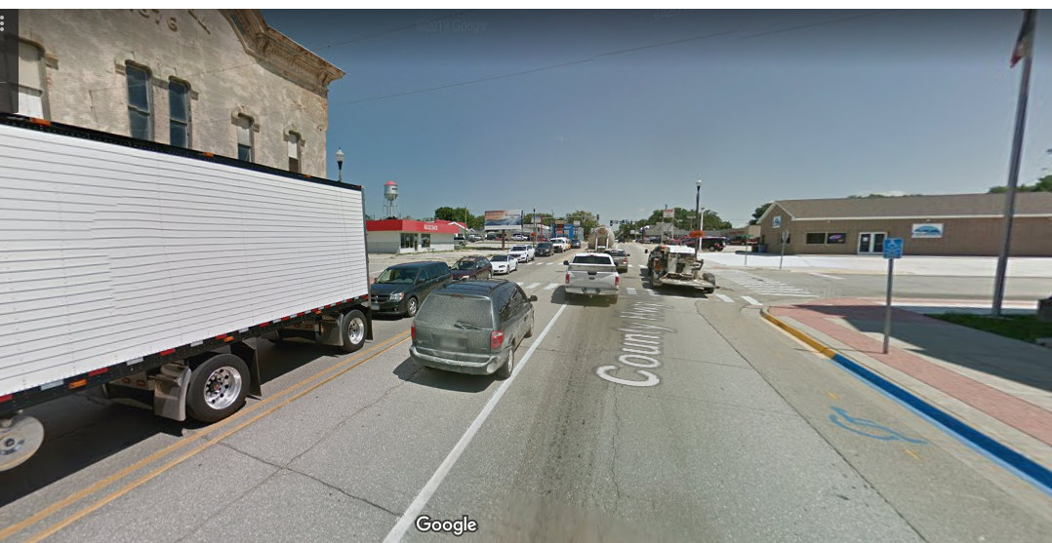
Why We Need It
Independence is a critical point in the Highway 150 corridor and affects communities north and south along Highway 150
A study is needed to determine how the road networks in and around Independence will efficiently and effectively move traffic along Highway 150
Independence looking east on Highway 150

Slide 9
Highway 150 Coalition Members
Independence and Buchanan County
Oelwein, Fayette, West Union, and Fayette County,
Decorah and Winneshiek County
Upper Explorerland Regional Planning Commission and Iowa Northland Regional Council of Governments
Iowa DOT Districts 2 and 6

Slide 10
Thank you
The Highway 150 Coalition respectively requests that the Iowa DOT conduct a study through Independence to improve safety and efficiency issues

