Slide 1
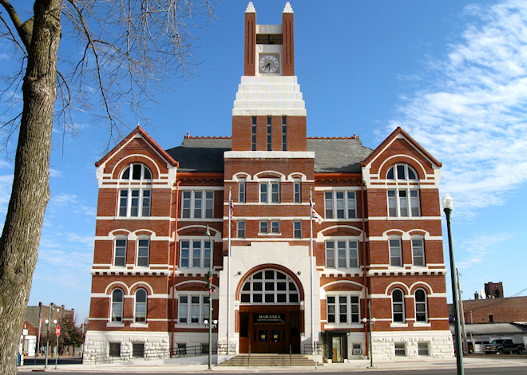

Mahaska County Courthouse
Oskaloosa Iowa
Iowa Transportation Commission
August 2020
District 5 – Southeast Iowa

Slide 2

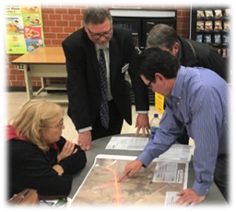
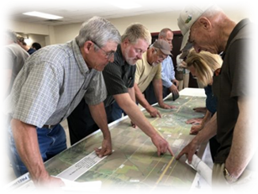
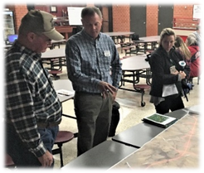
Mark Van Dyke
Assistant District Engineer
Jim Webb
District Construction Engineer
Jim Armstrong
District Engineer
Diana Upton
District Maintenance Manager
Vacant
District Materials Engineer
Liz Finarty
Resident Construction Engineer - Chariton
Lauren Giarmo
Resident Construction Engineer – Fairfield

Slide 3

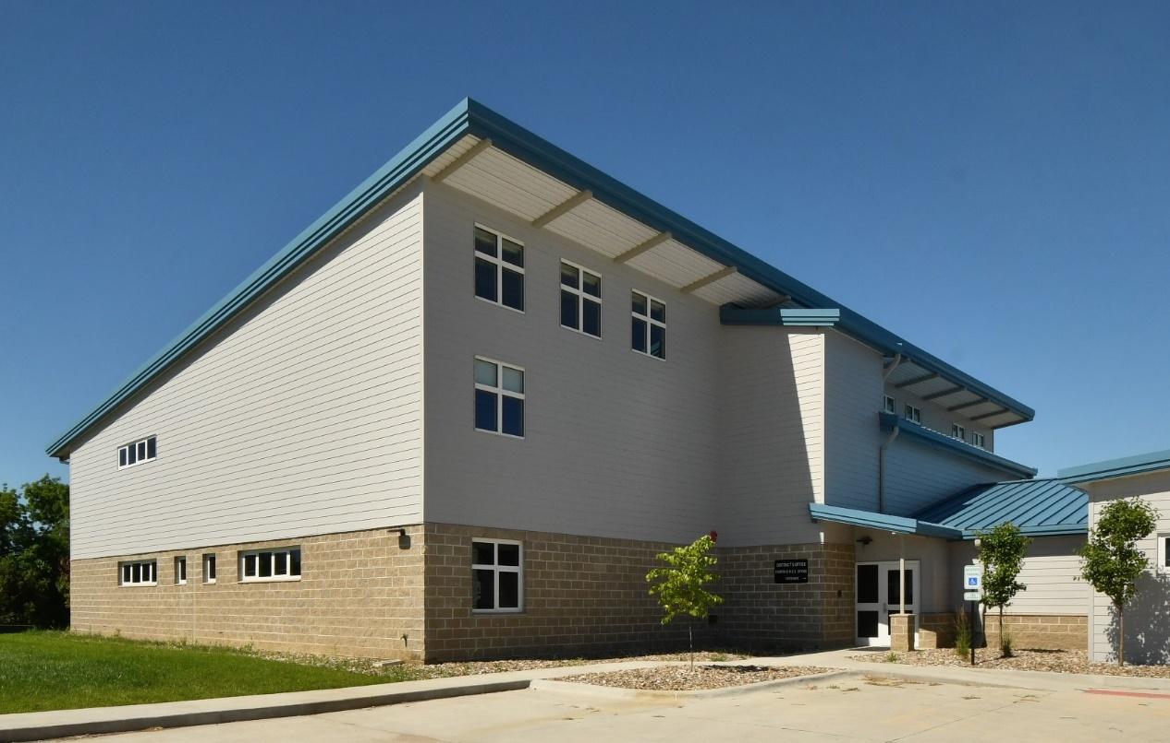
New District 5 Office
205 E. 227th Street
Fairfield, Iowa, 52556
Building Total Square Footage: 21,710 SF
New Material Lab: 4,872 SF
(original building + east addition)
Building is 100% heated/cooled by Geothermal
Building Occupancy:
Employees: 74
1st level Training Room: 23
2nd level Large Conference Room: 79
Bid: $4.2 million original contract.

Slide 4
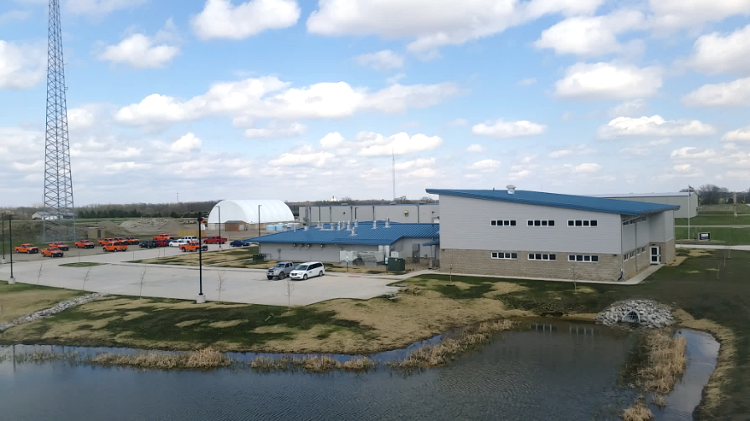
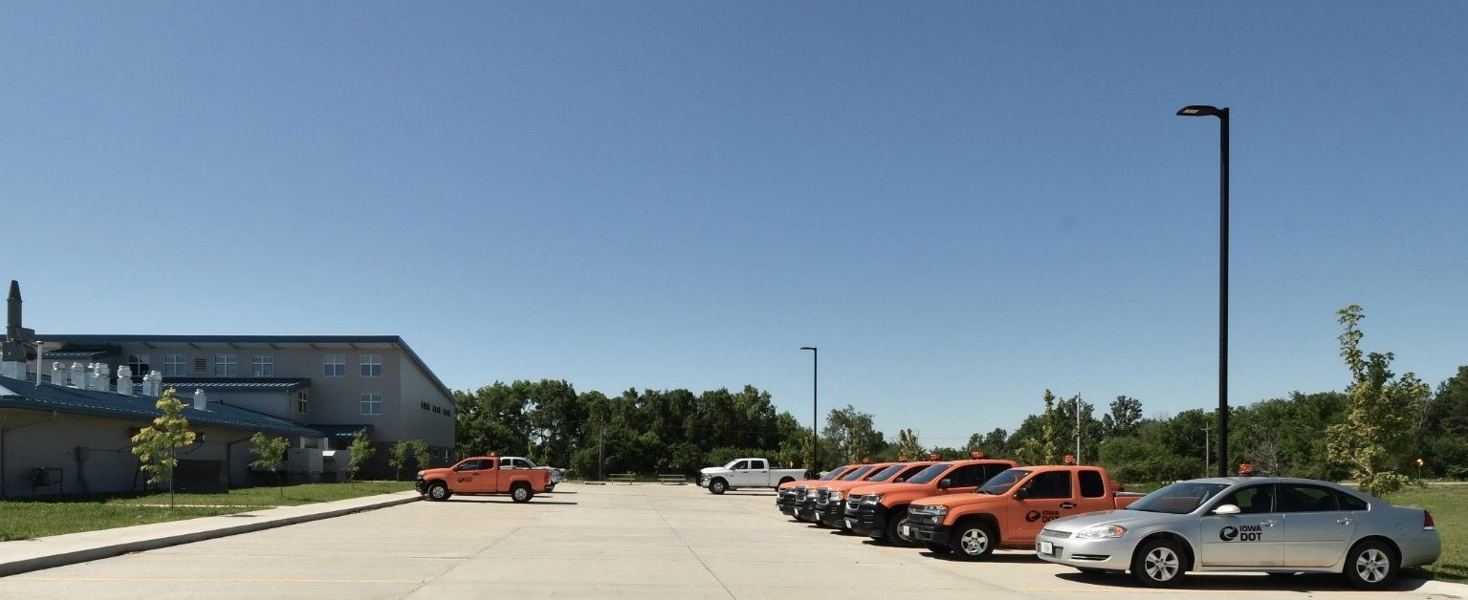
Retention pond to catch rain water from the new building and maintenance building
149 parking stalls

Slide 5
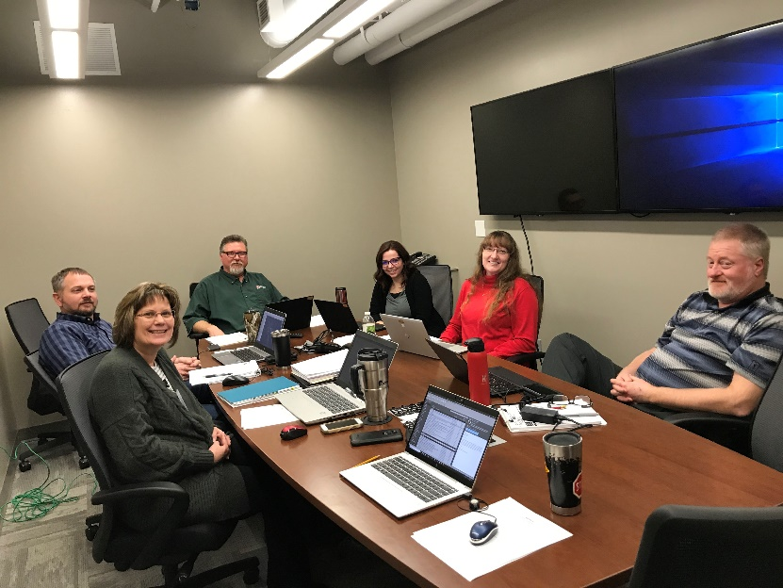
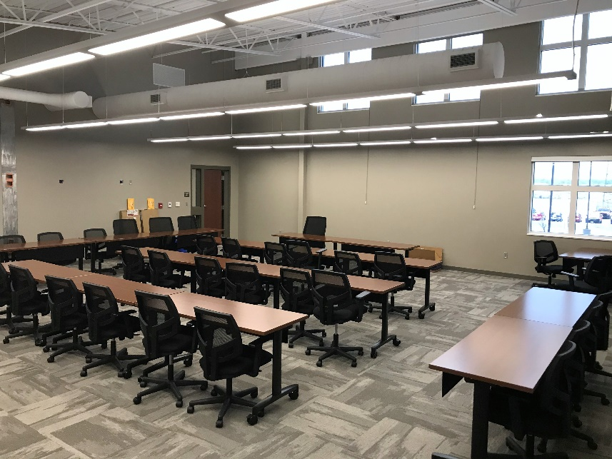
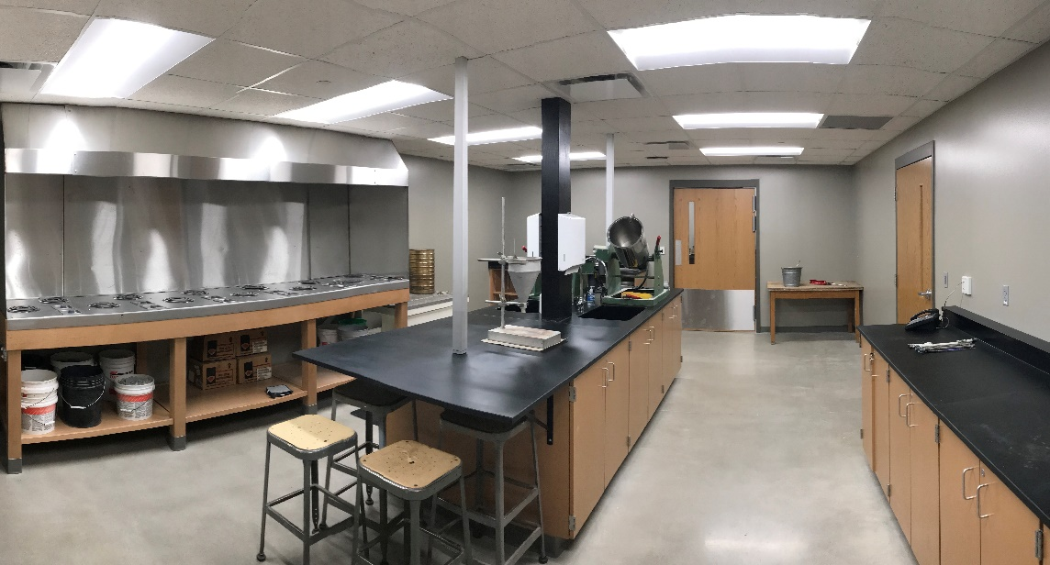
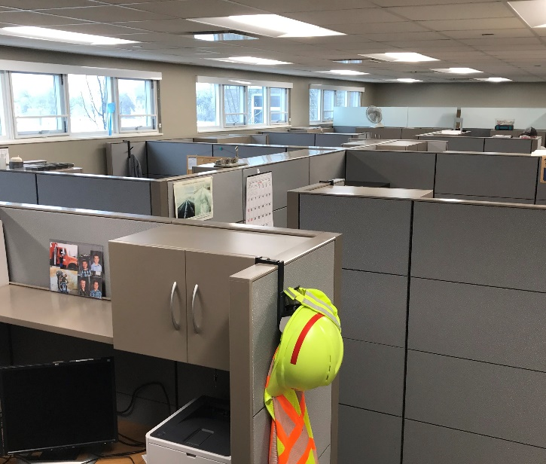

Slide 6

U.S. 63 NW Oskaloosa Bypass
South Central Regional Airport site
U.S .63 Corridor from Mahaska County line to I-80
IA 21 Corridor S. of I-80 to IA-149
IA 92 & U.S. 63 Corridors (in Oskaloosa)
IA 23 Corridor
IA 149 Des Moines River Bridge to W. Woodland Ave in Ottumwa (Not Programmed)
U.S. 34 Corridor in Ottumwa
(Not Programmed)

Slide 7
U.S. 63 NW Oskaloosa Bypass
NHSX-063-3(93)3H-62
Program Year Estimate AADT 3,000 – 10% Truck
Project Description
The project consists of a new two-lane highway northwest of the City of Oskaloosa from IA 163 to U.S. 63. An interchange will be added on IA 163 at a realigned 235th St. with an intersection at U.S. 63 near 210th St. – approx. 4 miles
Need for Project
To help improve the safety and operations of U.S. 63 by re-routing truck traffic around Oskaloosa instead of through the city.
2021-2025 Iowa Highway Program
$25.75 million
• Right of Way $5.90 million in FY-2023
• Grading $14.15 million in FY-2024
• Wetland/stream mitigation $500,000
in FY-24
• RCB Culvert-New $2.03 million in FY24
• Bridge New-PPCB $3.16 million in FY25
• Pavement anticipated FY-26
(with opening possible Fall 2026)
John Doe
John Doe
John Doe
manager
manager
manager
manager

Slide 8
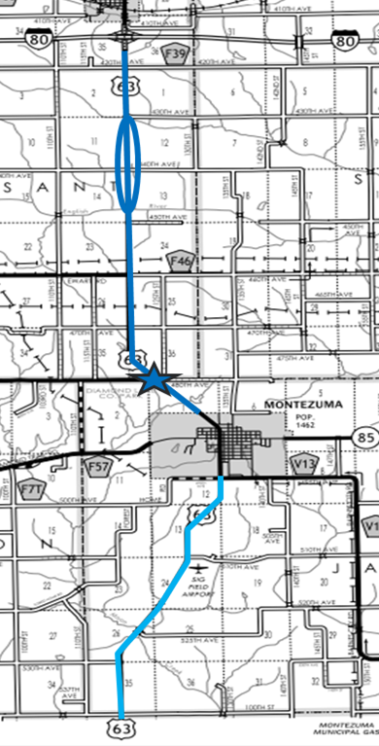
U.S .63 from Mahaska County line to I-80
Poweshiek County – District 1
2015 $5.3M (2018 AADT 3500): 5” PCC overlay (3R funds)
4’ paved shoulders
Rumble strips - shoulder and center line
RCB extensions
Right turn lane (star)
Climbing/passing lane (oval area) in the northbound and southbound directions
Snow borrows to address drifting areas
2017 $3.2M (2018 AADT 1420): 3” CIPR and 3” HMA (3R funds)
4’ paved shoulders
Rumble strips - shoulder and center line
RCB extensions
Snow borrows to address drifting areas
John Doe
John Doe
John Doe
manager
manager
manager
manager

Slide 9
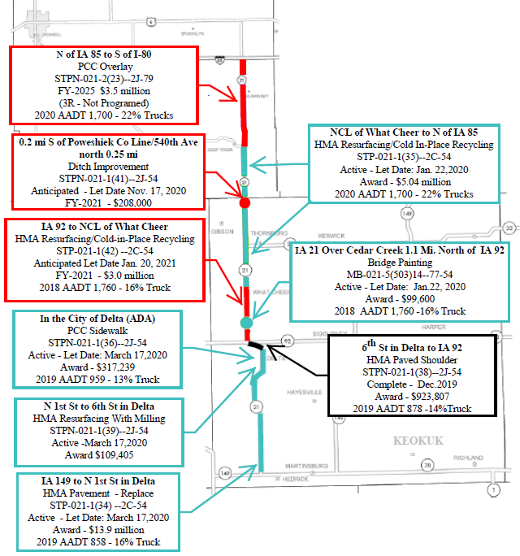
POWESHIEK
Counties of Poweshiek & Keokuk
Iowa 21 Corridor South of 1-80 to IA 149
Approx. 37 miles
Since Calendar Year 2019
$27.1 Million Investment

Slide 10
Counties Of Mahaska & Keokuk
IA 92, IA 23, & U.S. 63 Corridors (approx. 51.6 miles)
Since Calendar Year 2017 – $31.8 million Investment
MAHASKA
KEOKUK

Slide 11
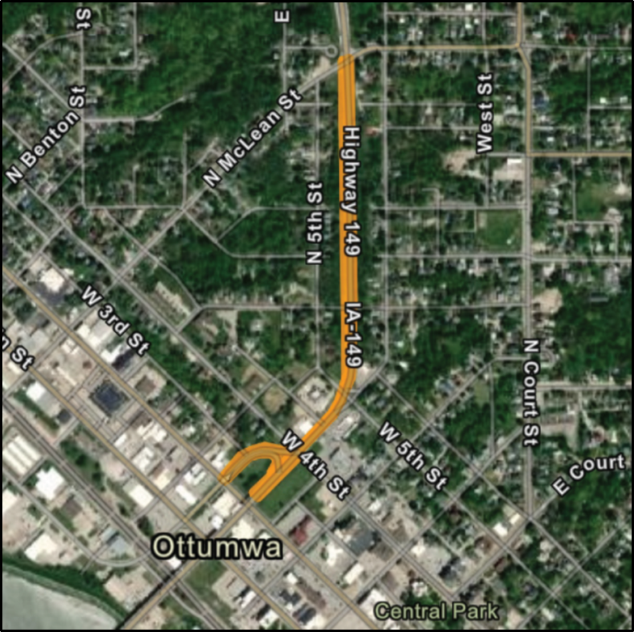
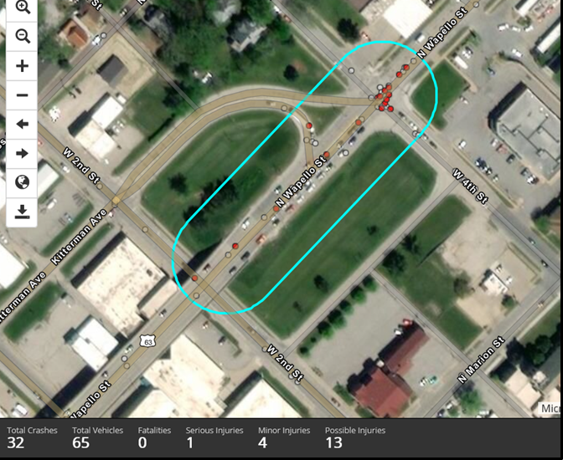
Des Moines River Bridge to W. Woodland Ave. in Ottumwa
STP-149-1(88)--2C-90
(Not Programmed)
Replace existing pavement due to condition; reconfigure intersections (roundabout considered as an option) and remove ramps.
Approximate Project Length: 3/4 Miles
We are considering a PCC reconstruction, or an HMA overlay of the existing PCC.
Intersection of IA-149 and 4th is identified in the District Road Safety Plan, and scored 85 on the top 200 in the Iowa DOT SICL.
Traffic Information | ADT | Truck Percent
2019 Year Traffic: | 19,987 | 4%
Total 20 Year Traffic Is: | 23,168 | 4%
Total 30 Year Traffic Is: | 25,040 | 5%

Slide 12
US 34 from Wildwood Dr to W Jct US 63 in Ottumwa
NHSX-034-7(151)--3H-90
(Not Programmed)

Slide 13
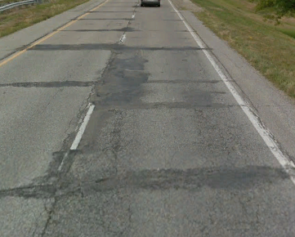
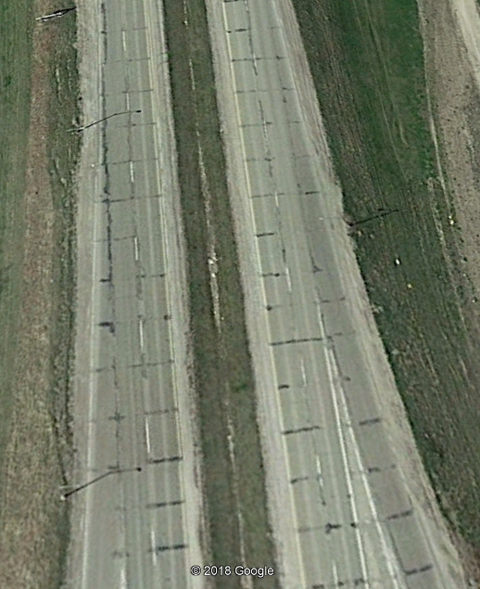
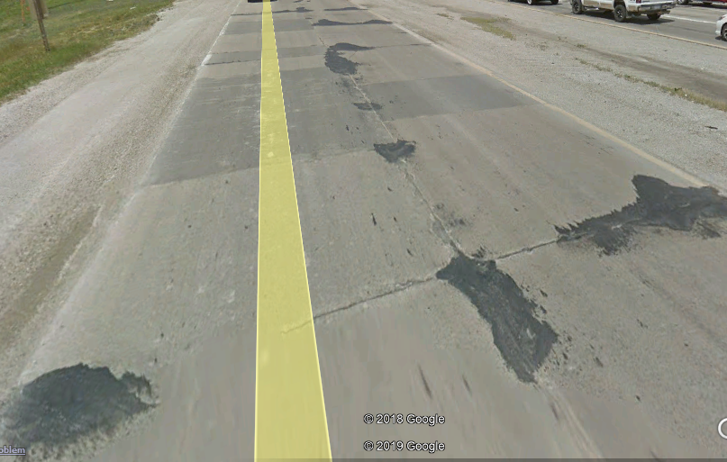
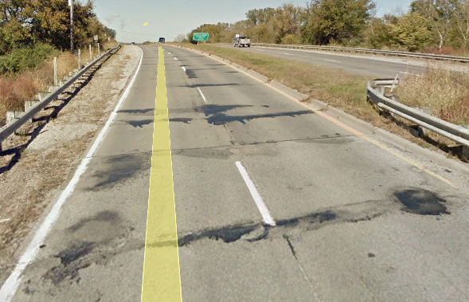
Existing Conditions - Pavement
Commission - August 2020
WB West of Church
EB East of Quincy
WB West of Church
EB West of Vine
Road Constructed in mid-1960’s
Pavement Showing Severe Distress

Slide 14
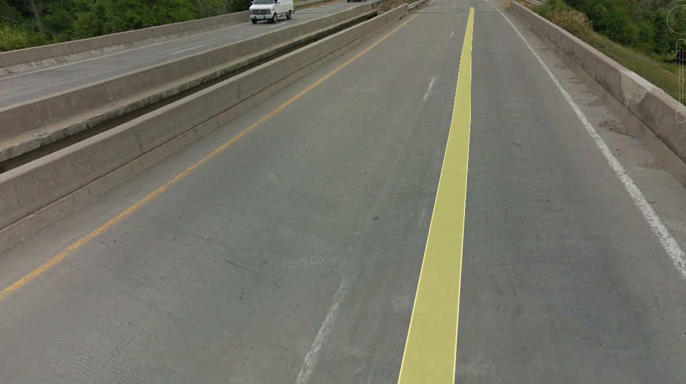
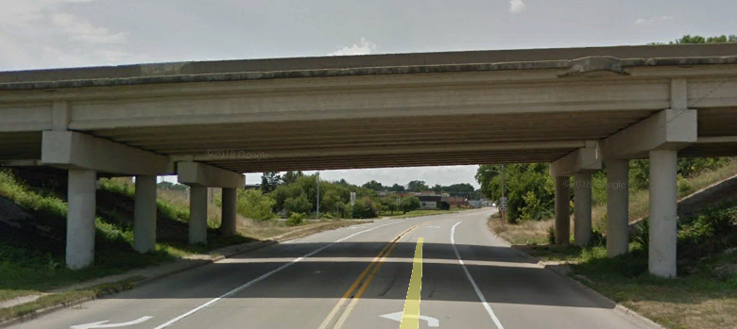
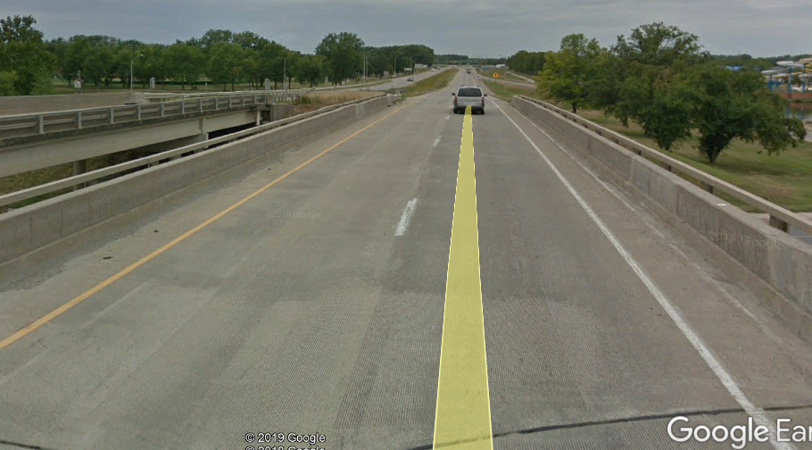
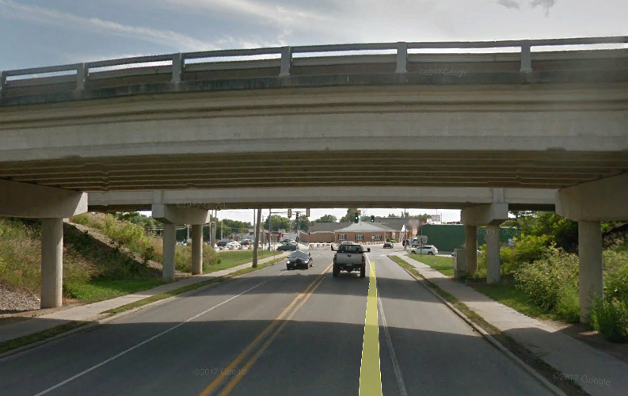
Existing Conditions - Bridge
Commission - August 2020
Bridges Approaching Significant Maintenance/Replacement Conditions
WB Vine St. Bridge
Vine St. Bridge
WB Church St. Bridge
Church St. Bridge

Slide 15
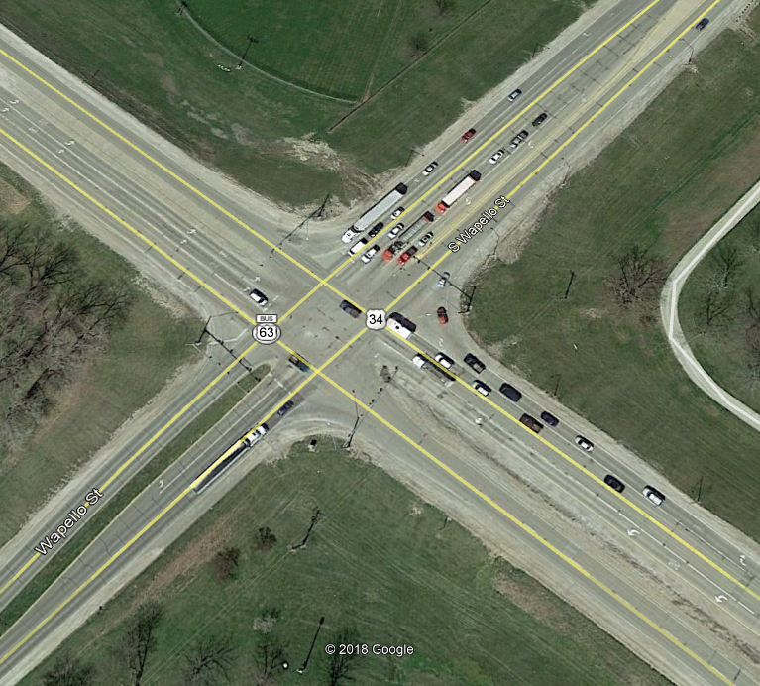
U.S. 34 and Iowa 149 Intersection
Commission - August 2020

Slide 16
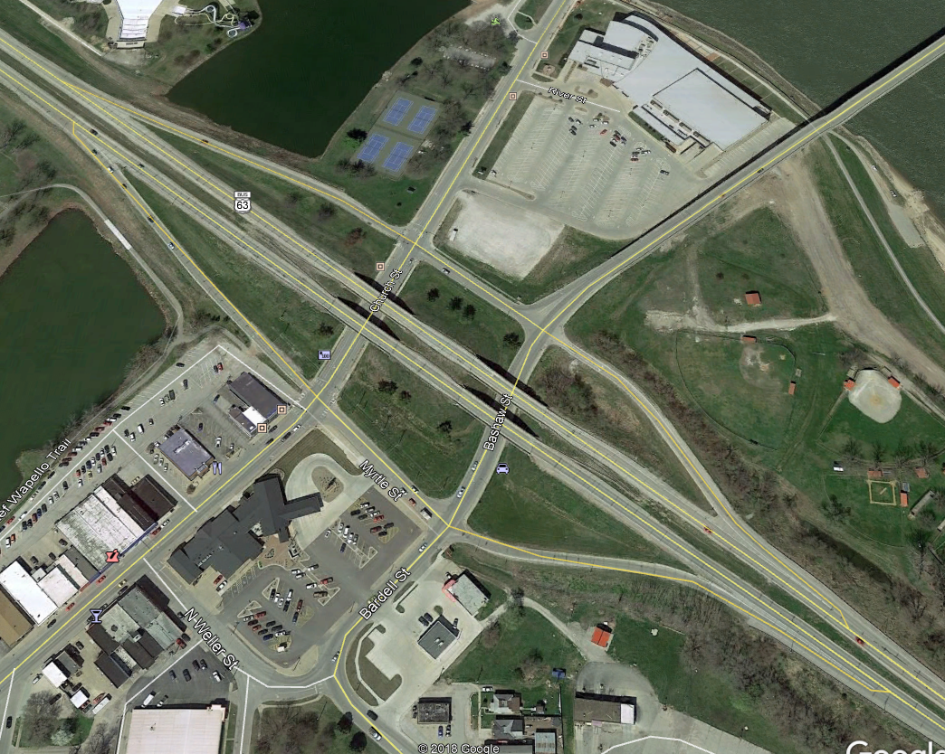
Split Diamond Interchange Church and Jefferson
Commission - August 2020
Potential
Future Hotel

Slide 17
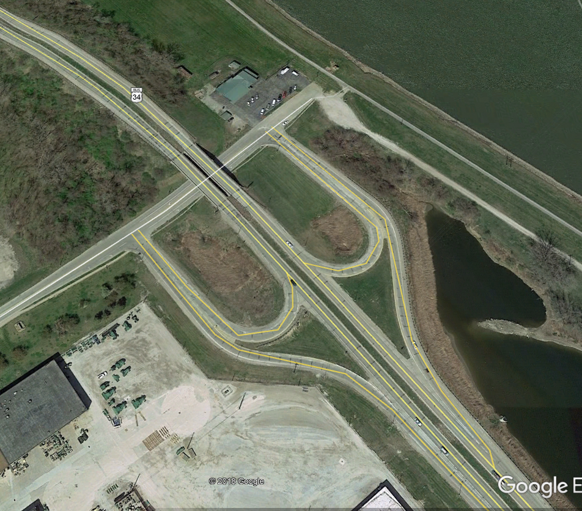
Vine St. Interchange
Commission - August 2020
John Deere Works

Slide 18
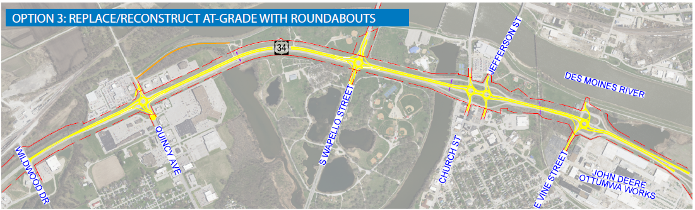
US 34 from Wildwood Dr to W Jct US 63 in Ottumwa
NHSX-034-7(151)--3H-90
(Not Programmed)

Slide 19
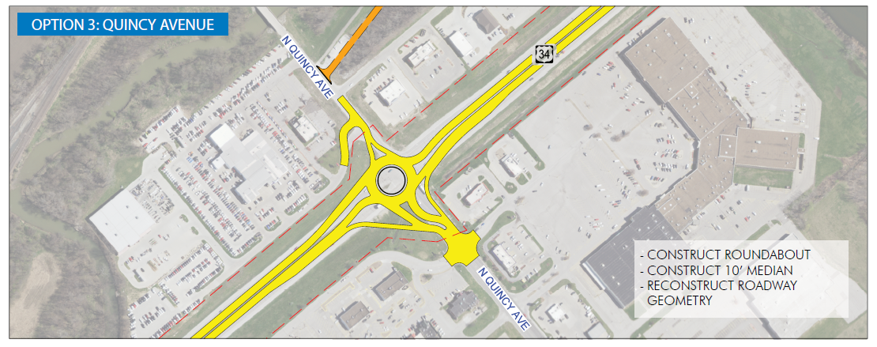
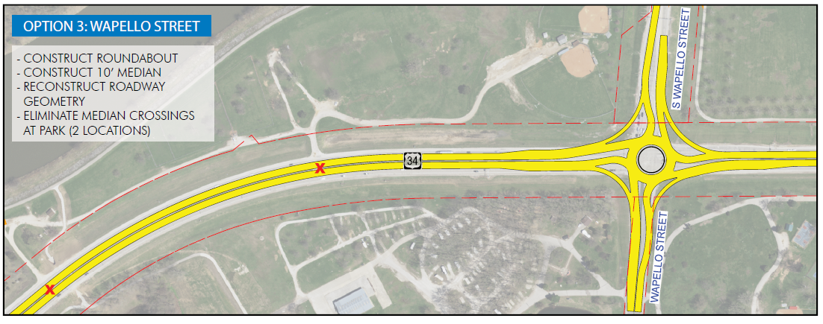
US 34 from Wildwood Dr to W Jct US 63 in Ottumwa
(Not Programmed)

Slide 20
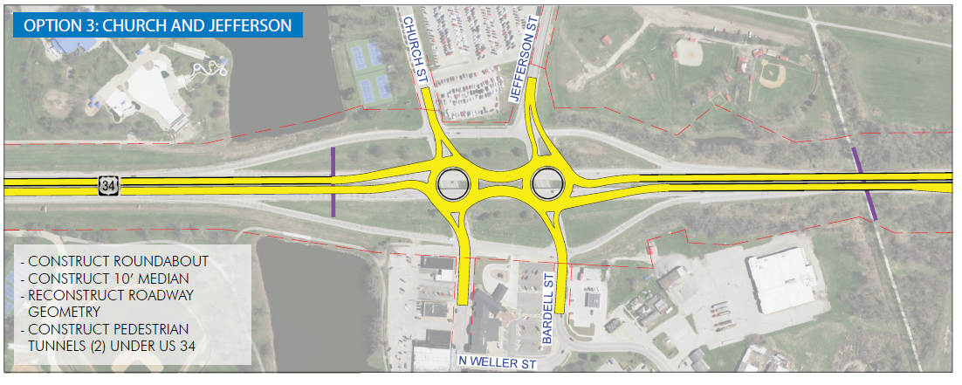
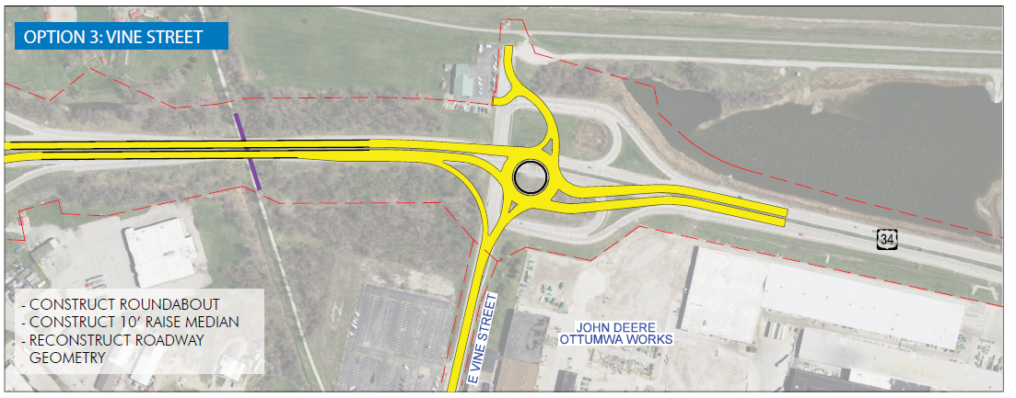

Slide 21

THANK YOU FOR YOUR TIME AND ATTENTION

