Slide 1
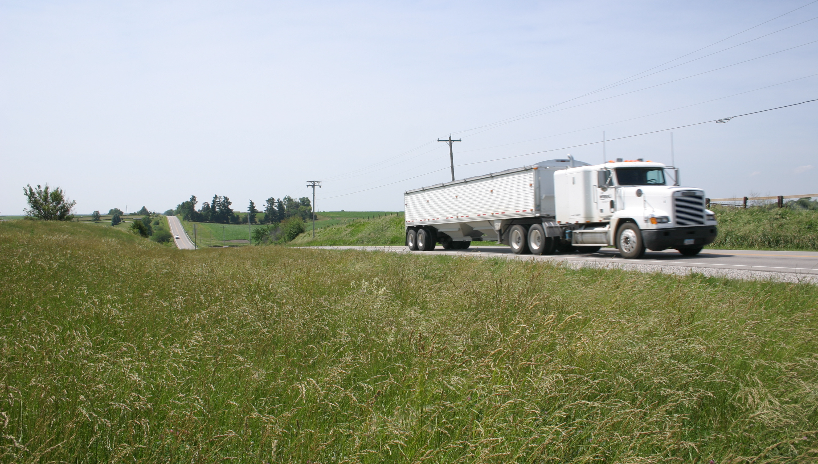

East Central Iowa Transportation Coalition
Iowa DOT Commission August 11, 2020

Slide 2
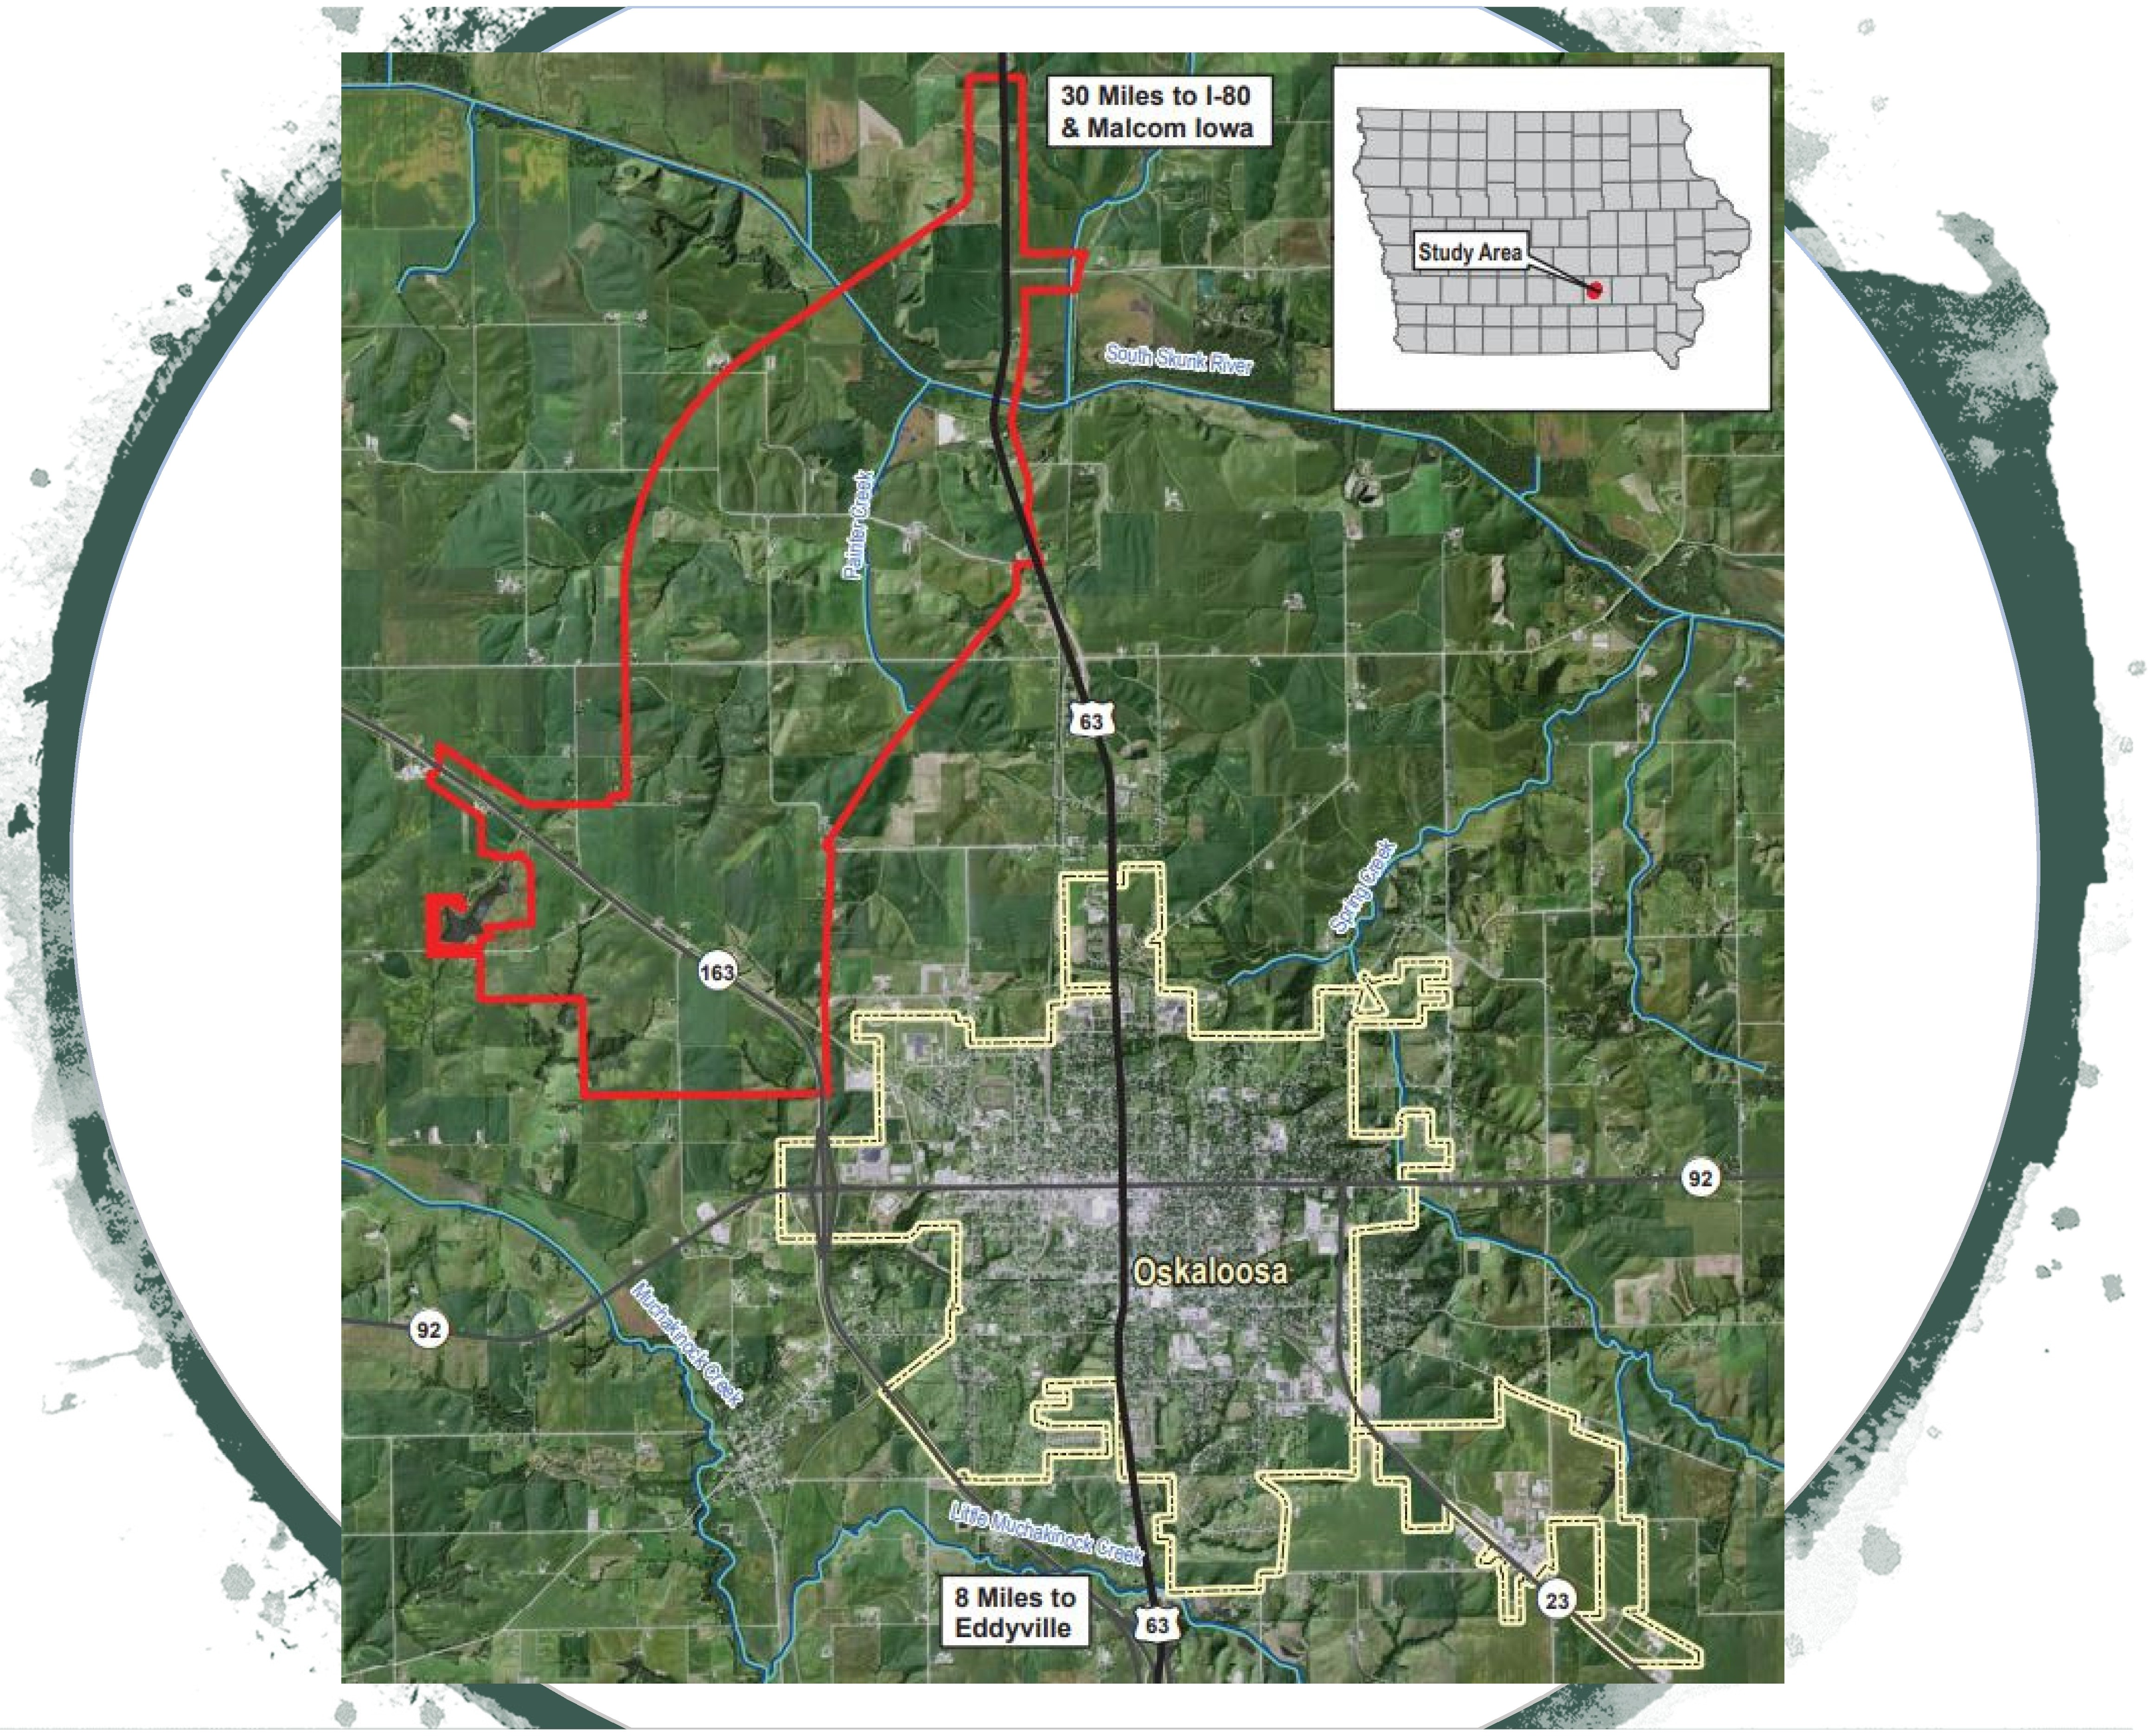
l
•
•

Slide 3
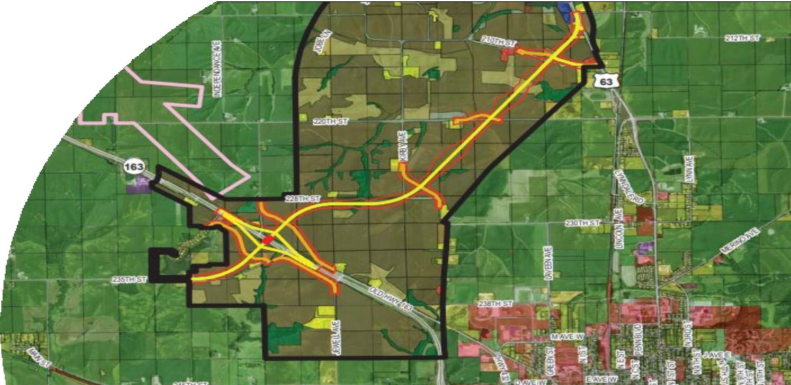

Slide 4

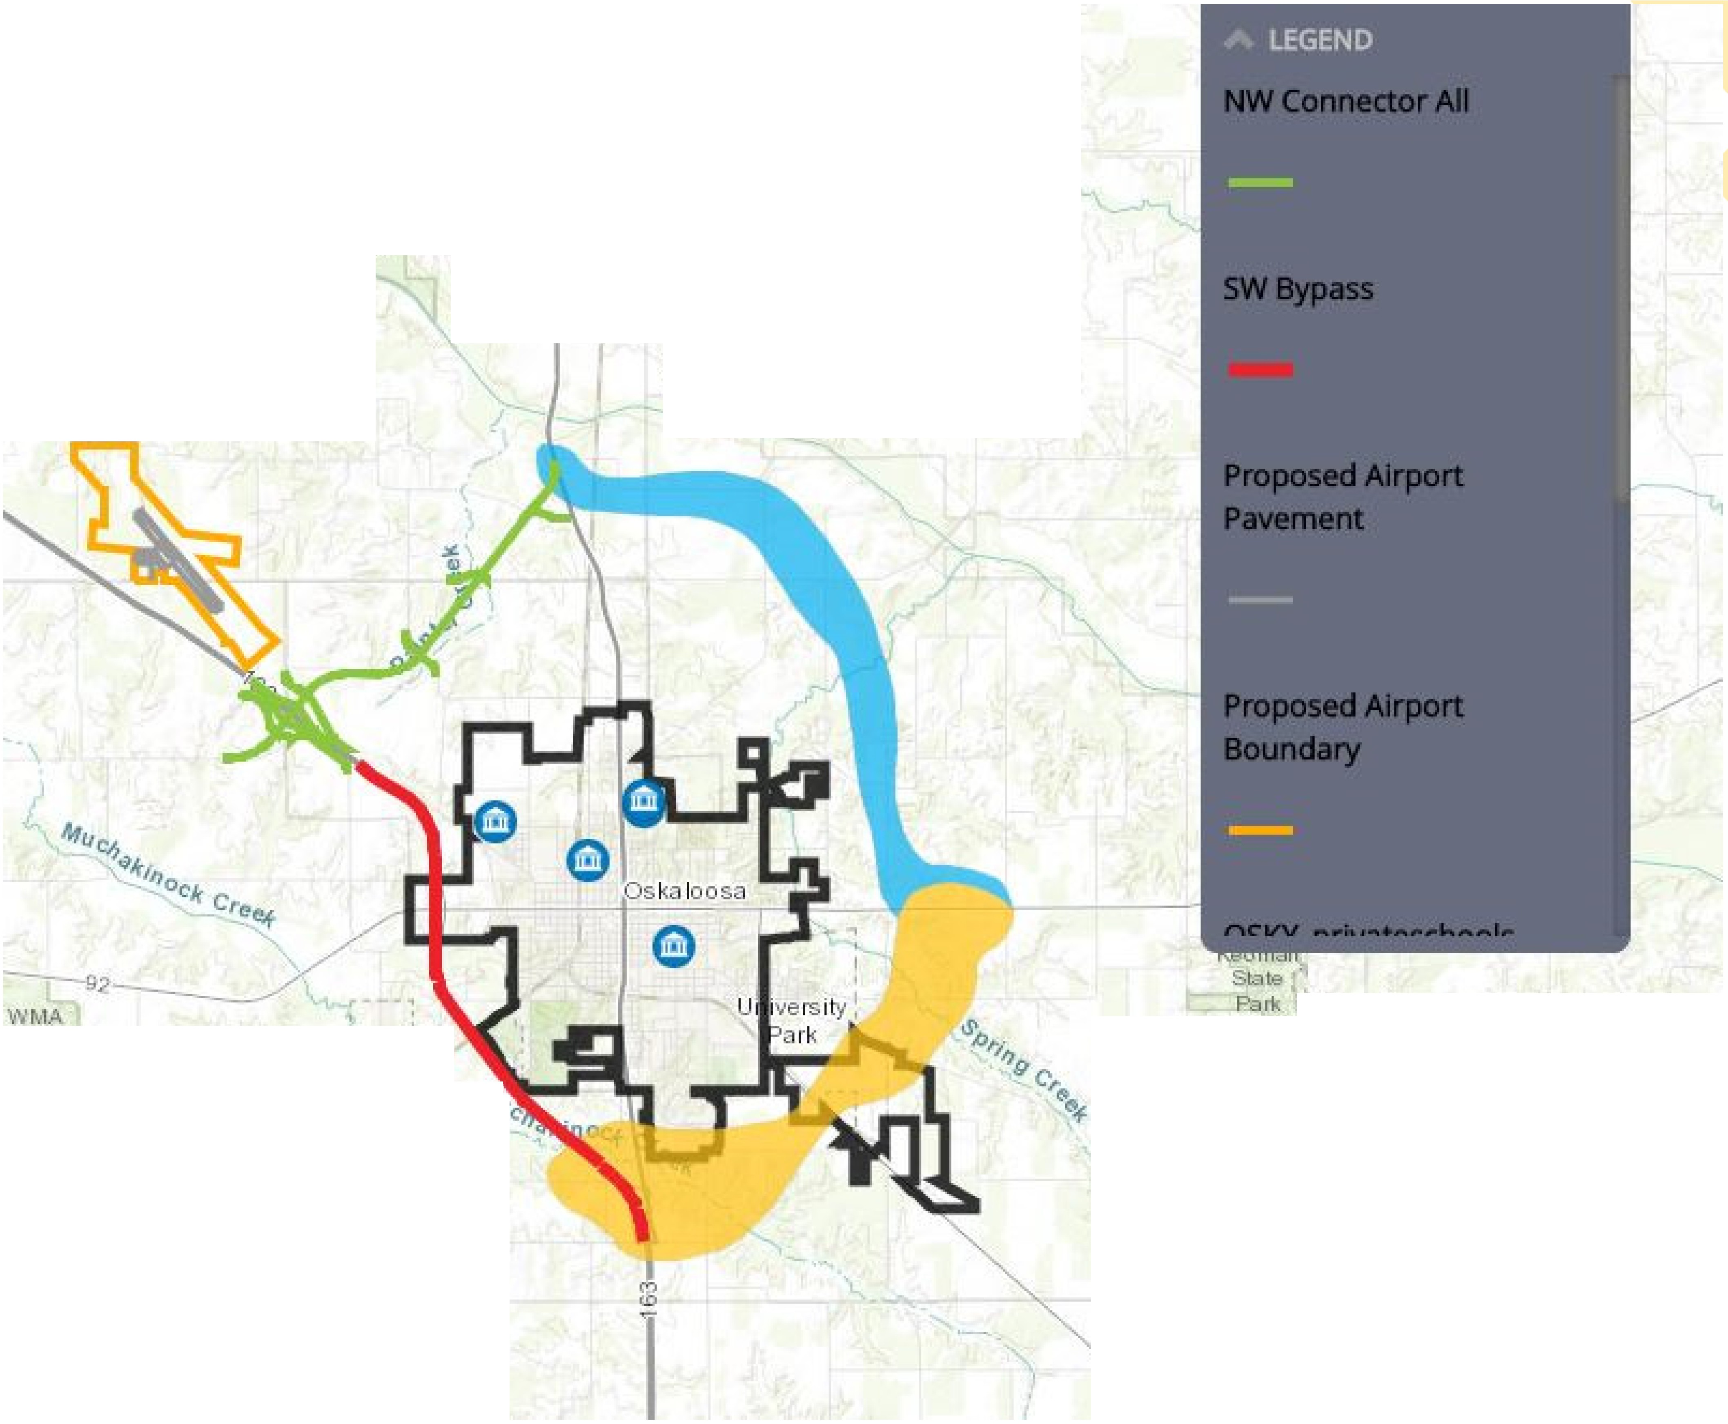



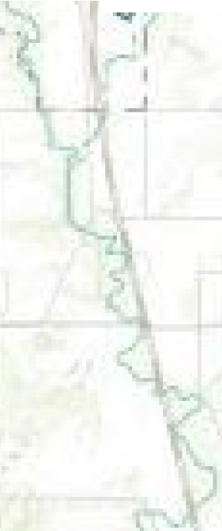



W in fold
WMA
Russell
w , 1;1e
A re.:1
(
Keo mah
Vill age
eaco n 1
, \'le Mt,
.....,1 , C:
_I

Slide 5
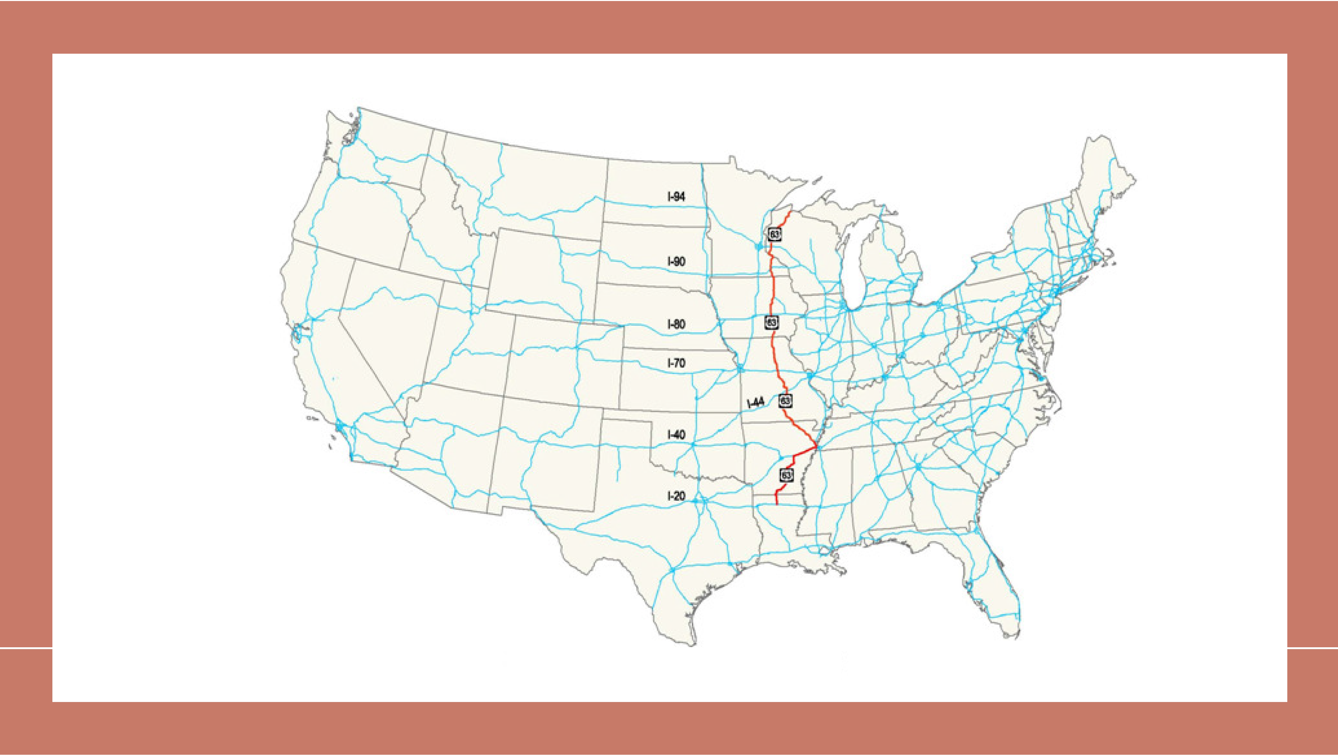
US 63 - ENTIIRE R¹ 0 UTIE (1.286 MILES)

Slide 6
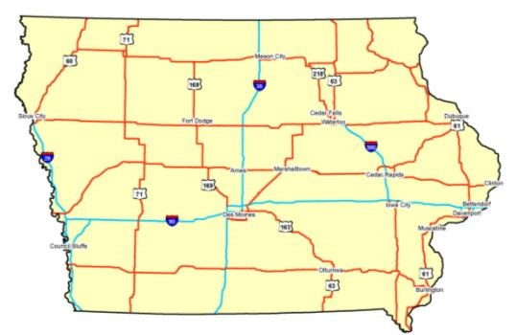
100-mile gap

Slide 7
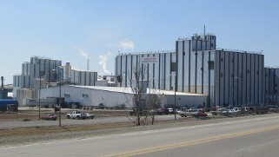

Slide 8

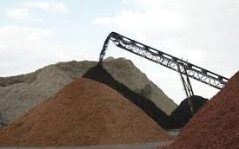


Slide 9
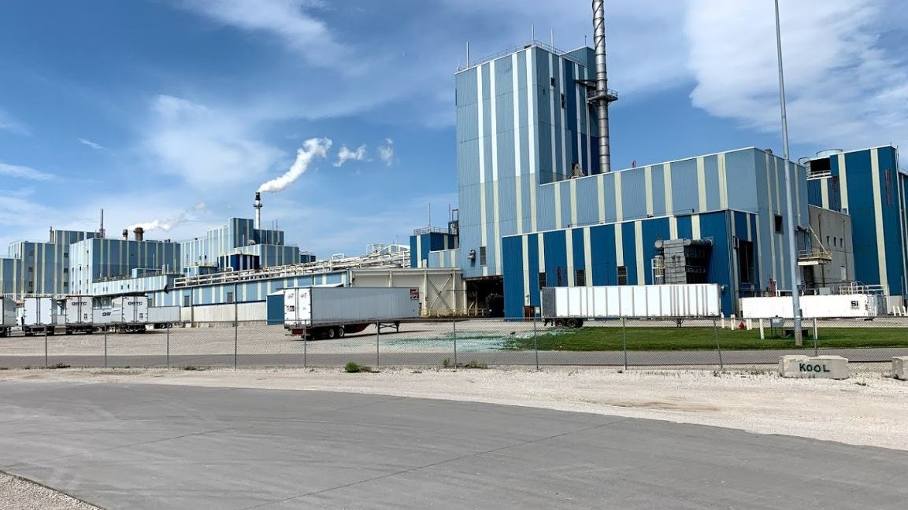

Slide 10
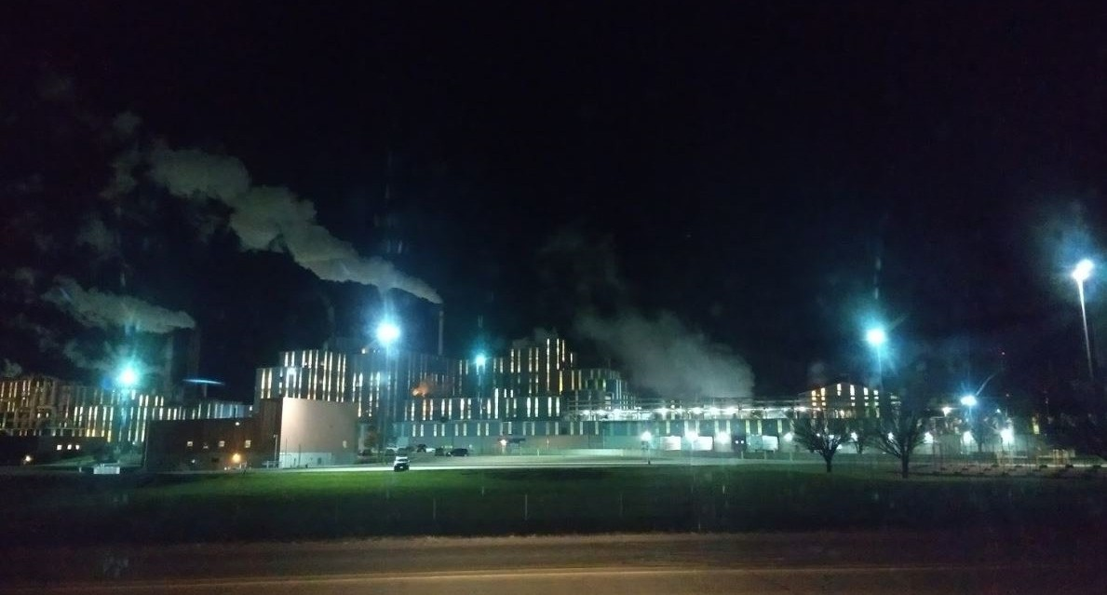

Slide 11

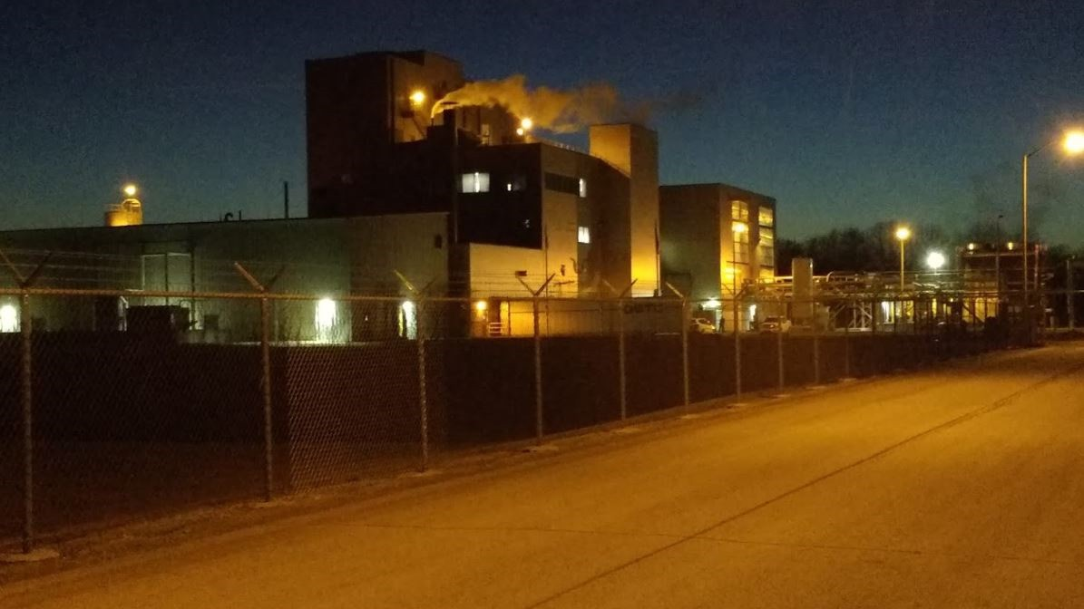


Slide 12

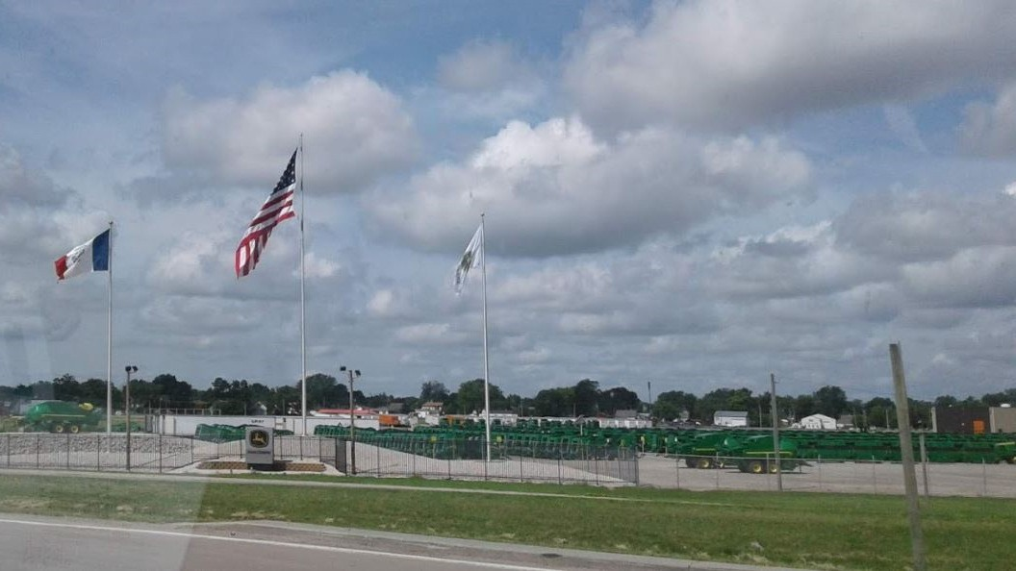


Slide 13


Slide 14
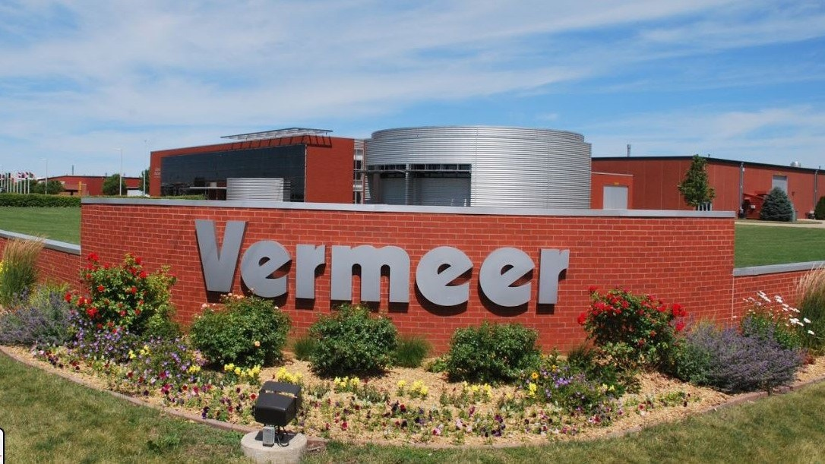

Slide 15
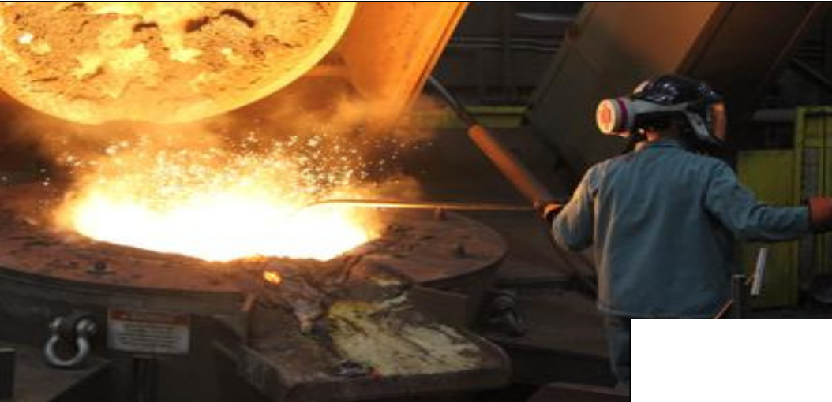




Slide 16




Slide 17
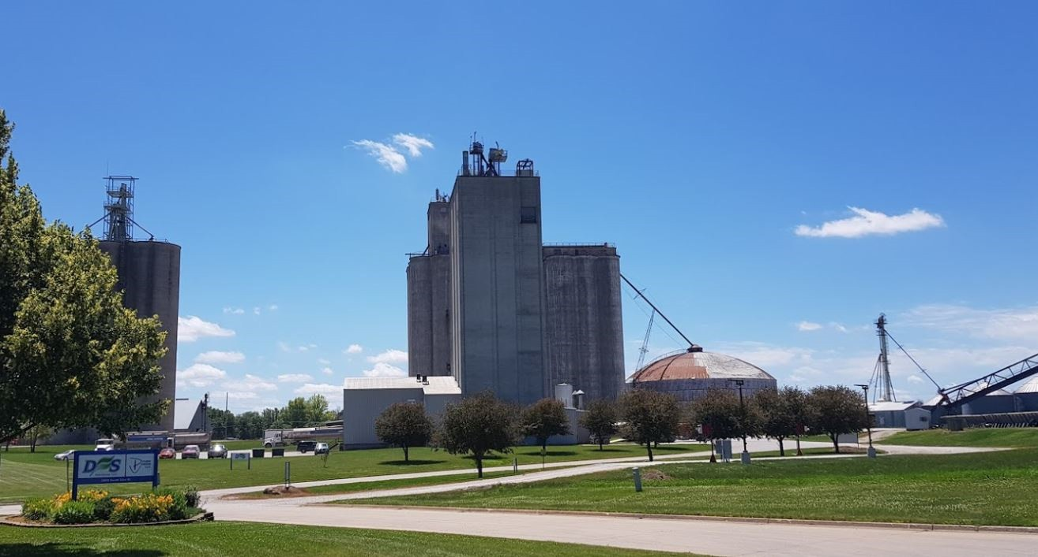

Slide 18
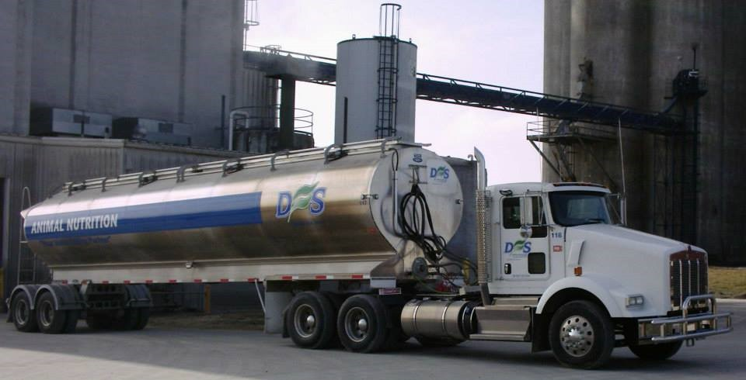

Slide 19
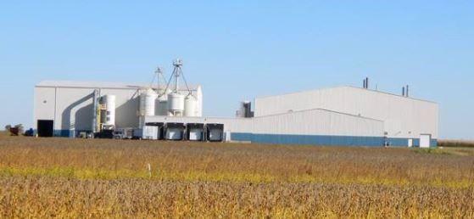

Slide 20
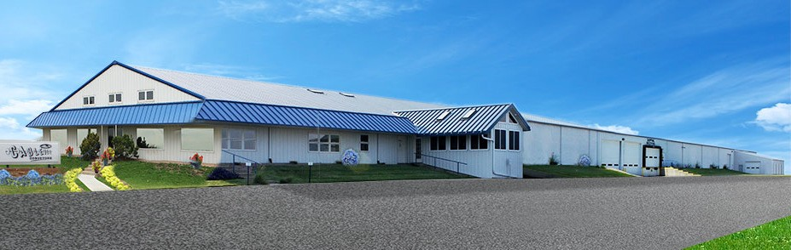

Slide 21
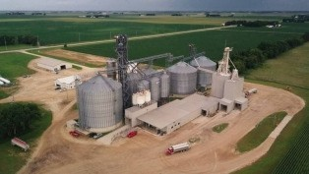

Slide 22




Slide 23

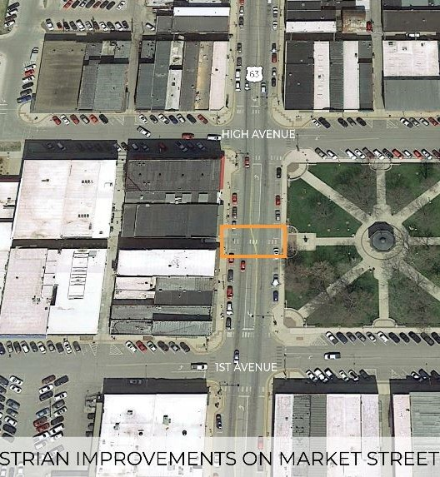
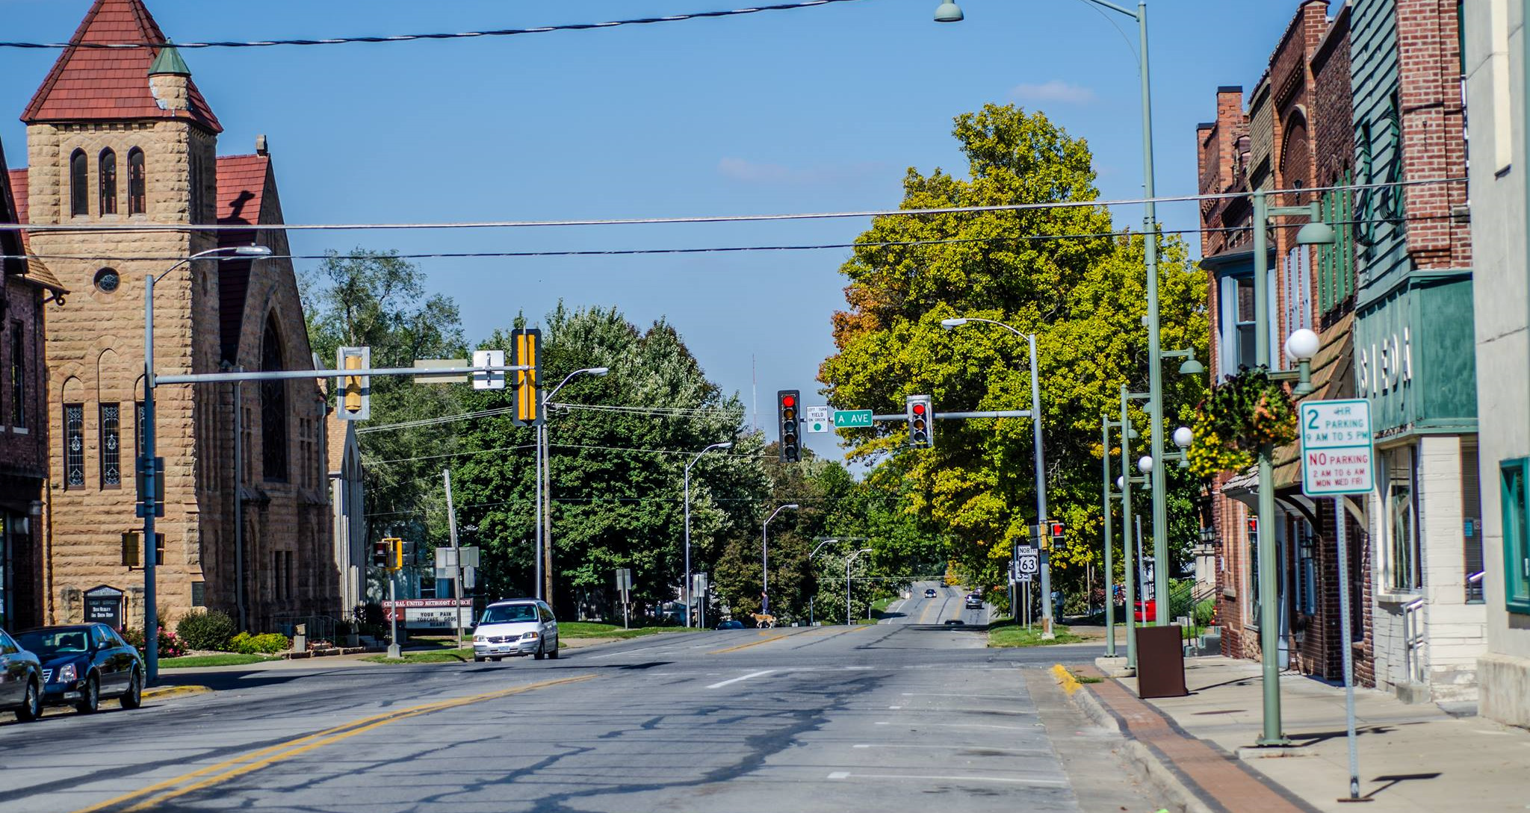

Slide 24
US 63 NW Bypass
Safety Efficiency
Economic Impact Manufacturing Export
Quality of Life
Intermodal Opportunity

Slide 25


You’re Invited Iowa DOT Commission
Tour 2021
Oskaloosa, Iowa

