Slide 1
Iowa Transportation Commission Update
August 2020
Mahaska/Oskaloosa Driving Economic Success Planning Study

Slide 2
City of Oskaloosa, Mahaska County, Mahaska Chamber & Development Group
Joint Applicants/Private Partner
Notes:
Mahaska County is a rural county located in southeast Iowa. As of the 2010 census, the population was 22,335.
The county seat is City of Oskaloosa. As of the census of 2010, there were 11,463 people, 4,715 households, and 2,842 families residing in the city.
Beth: The Mahaska Chamber and Development Group is a private non-profit committed to help fund a portion of MODES.
Beth: Highlight 2 to 3 wow factors.
Relevance of our industries.
The City of Oskaloosa is the lead applicant

Slide 3
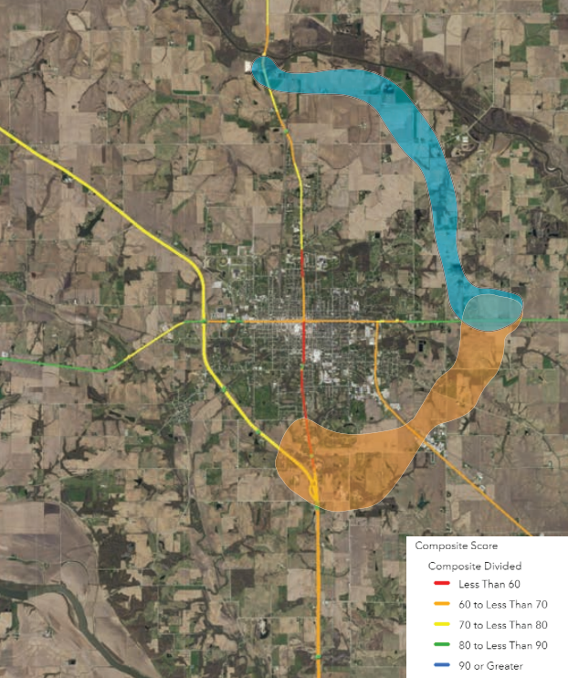
MODES Need
USDOT ROUTES initiative
Large volume of heavy vehicles
Improve regional access to better accommodate freight needs;
Spur additional economic development in the region;
Improve quality of life for Oskaloosa residents by removing heavy freight loads away from residential areas; and,
Expand the agricultural production of east central Iowa.

Slide 4
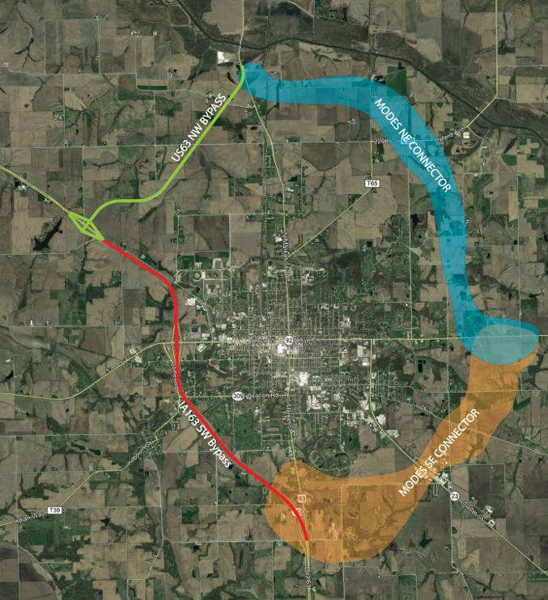
What is MODES?​
Mahaska Oskaloosa Delivering Economic Success (MODES)
Rural Planning Grant
Eastern Connectors
MODES Southeast
MODES Northeast
Project Budget : $950,000
Applicant Match: $100,000
BUILD Request: $850,000

Slide 5
Partners/Supporters
Notes:
Talk about companies. Highlight a few companies, expansion plans, jobs, University
Cargill: Billion-dollar facility and growing, second largest facility in the world.

Slide 6
Project History
Notes:
Every Partner has worked on advancing the project.
This project provides an opportunity to take a comprehensive look at the needs of the region.

Slide 7
Merit Criteria
Improved Safety
477 crashes between 2015-2019, 98% higher than State Average
State of Good Repair
Existing highways constructed between 1927 and 1973 are nearing end of useful life
Environmental Sustainability
Reduction in greenhouse gases
Cleaner air for residents due to heavy traffic being bypassed
Overall less emissions due to efficient movement of heavy traffic without needing to slow down and stop at multiple signals in the downtown areas
Additional benefits
Planning study will consider benefits of using sustainable and energy efficient systems in alternative analyses.
Economic Competitiveness
Exporting to more than 80 countries
Local Goods Global Reach

Slide 8
Merit Criteria
Quality of Life
Downtown Revitalization
Dining and Socializing
Arts and Entertainment
Improved Connectivity
Pedestrian Spaces and Trails
Shared Streets
Connection to University
Quality of Life
Housing
Beautification and Wayfinding
Innovation and Partnership
Innovative Technologies
Integrate V2X technology
Consider future ready infrastructure such as autonomous freight transportation
Innovative Project Delivery
Continuous public involvement through online and virtual meetings
Use of virtual story telling
Partnership
Oskaloosa, Mahaska County and Mahaska Chamber are contributing 10.5% of the project cost. Iowa DOT and Area 15 RPC are committing in-kind support

Slide 9
MODES Recap/Highlights
Planning study for approximately 14 miles of new roadway infrastructure
BUILD Project website: www.modesiowa.com
Need was identified in 1999 (21 years ago)
Public-private partnership project

Slide 10
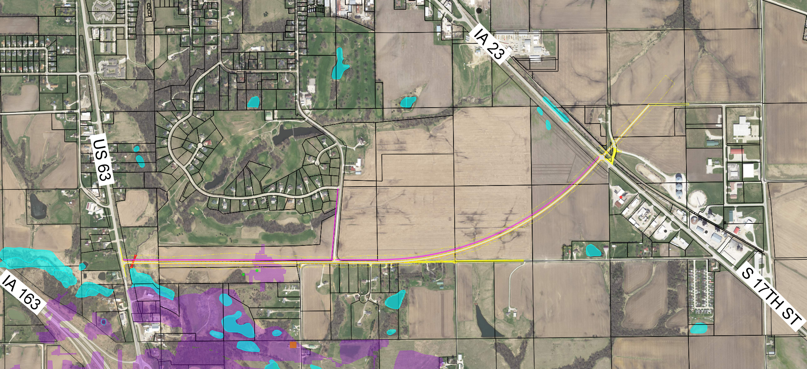
Local Update​
Local US63-IA 23 Connection

Slide 11
Questions/Contact
Lead Applicant
Michael Schrock Jr.​
City Manager​
City of Oskaloosa​
220 S. Market Street​
Oskaloosa, IA 52577​
641.673.9431​
Michael.Schrock@oskaloosaiowa.org
Joint Applicant
Andrew McGuire​, PE
Mahaska County Engineer​
Mahaska County​
2074 Old Hwy 163​
Oskaloosa, IA 52577​
641.672.2897​
McGuire@mahaskacounty.org
Private Partner
Beth Danowsky​
Chair, Business Development Committee​
Mahaska Chamber & Development Group​
222 First Avenue East​
Oskaloosa, IA 52577​
641.673.2058​
Beth.Danowsky@musco.com
Technical Questions Bhooshan Karnik, PE, PMP Senior Project Manager McClure 1740 Lininger Lane North Liberty, IA 52317 319.626.9090
bkarnik@mecresults.com

