Slide 1
RPA 15 Presentation to the Iowa Department of Transportation Commission Public Input Meeting and Tour
Tuesday August 11th, 2020

Slide 2
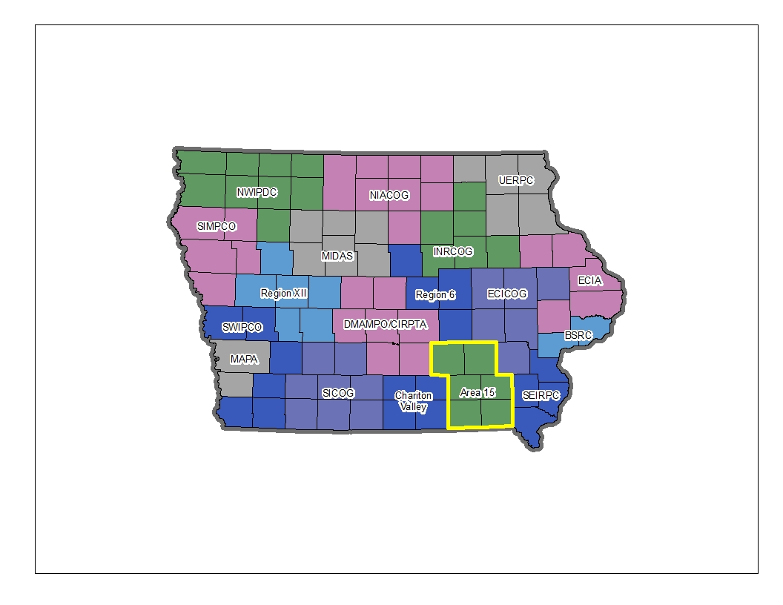
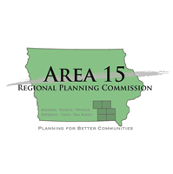
Area 15 Regional Planning Commission
Formed in 1974.
Consists of 6 counties: Davis, Jefferson, Keokuk, Mahaska, Van Buren, and Wapello and 50 cities in southeast Iowa.
Region population: 101,649.
RPC is a designated Economic Development District organization.
Oversees several organizations/funding opportunities including the RPA.
Provides assistance in the areas of: economic development, community development, transportation planning, business assistance and housing assistance.

Slide 3
Regional Planning Affiliation 15
Formed in 1994.
Consists of 5 counties: Jefferson, Keokuk, Mahaska, Van Buren and Wapello and 46 cities.
Region population: 92,649.
Assists local jurisdictions with transportation projects related to:
Economic Development.
Infrastructure Improvement.
Quality of Life Improvement.

Slide 4
Jefferson County RISE – Nutmeg Avenue
Funded July 8th, 2014.
Received $140,625 in RISE funding.
Paved 1,000 feet of Nutmeg Avenue north from U.S. 34 to improve access to a new grain elevator.
Resulted in the creation of 6 new jobs with an average wage of $21.66 /hr.
Non-RISE total-capital investment: $27,300,000.

Slide 5
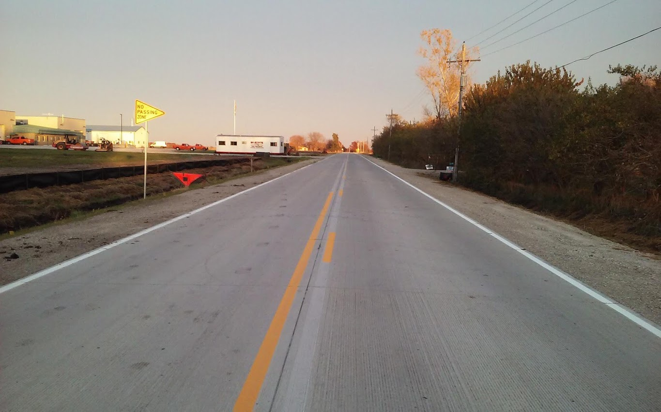
Jefferson County RISE – 227th Street
Funded December 8th, 2015.
Received $476,342 in RISE funding.
Paved 2,680 feet of 227th Street and constructed a left turn lane on Highway 1.
Provided improved access to the new 50-acre South Fairfield Industrial Park.
Non-RISE total capital investment: $1,060,093.

Slide 6
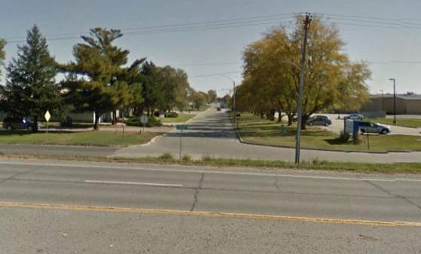
City of Ottumwa RBDG – Fox-Sauk Road
Funded May 14th, 2020.
Received $142,347 in USDA Rural Business Development Grant funds.
Widens the curve by 50’ at the intersection of N Court Street and Fox-Sauk Road.
Provides improved access and safety for large vehicles to the industrial park.
Park includes an 80-acre addition, area is site certified and targeted to transportation & logistics.

Slide 7
Trails
Five communities have trail systems: Eldon, Fairfield, Keosauqua, Oskaloosa and Ottumwa.
Interest in developing a regional or inter-region trail between communities.
RPA assists communities by:
Maintaining a regional trails plan.
Allocating flex funds to Transportation Alternative type projects.
Assisting with local plans, project development and applications.

Slide 8
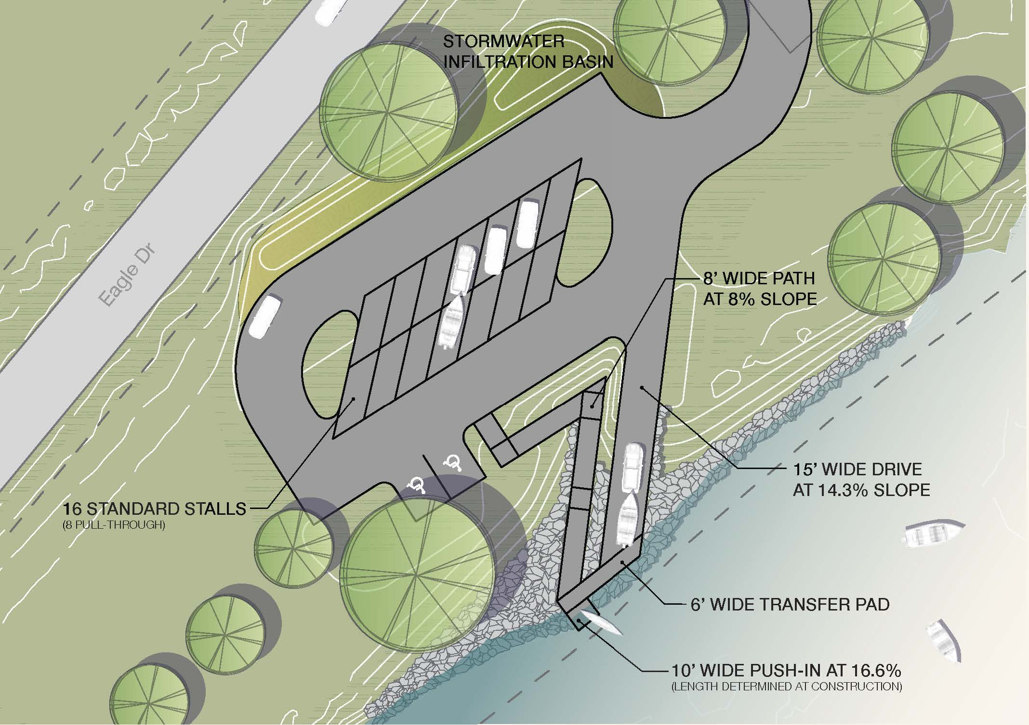
Keosauqua Riverfront Trail and Austin Park Boat Ramp
Keosauqua has expanded its trail system, adding three segments over the past five years.
Awarded $240,000 in Transportation Alternatives funding for the Riverfront Trail segment.
Assisting with approval for a signed pedestrian crossing on Highway 1.
Lower Des Moines River Water Trail runs from the NW to SE for 41 miles in Van Buren county, and there are 8 access points.
Assisting with a Resource Enhancement and Protection grant to construct a new ramp at Austin Park.
Incorporates universal design, allows use by all people to the greatest extent possible.
According to the Iowa DNR, this will be the first segment in the state with universal design access.

Slide 9
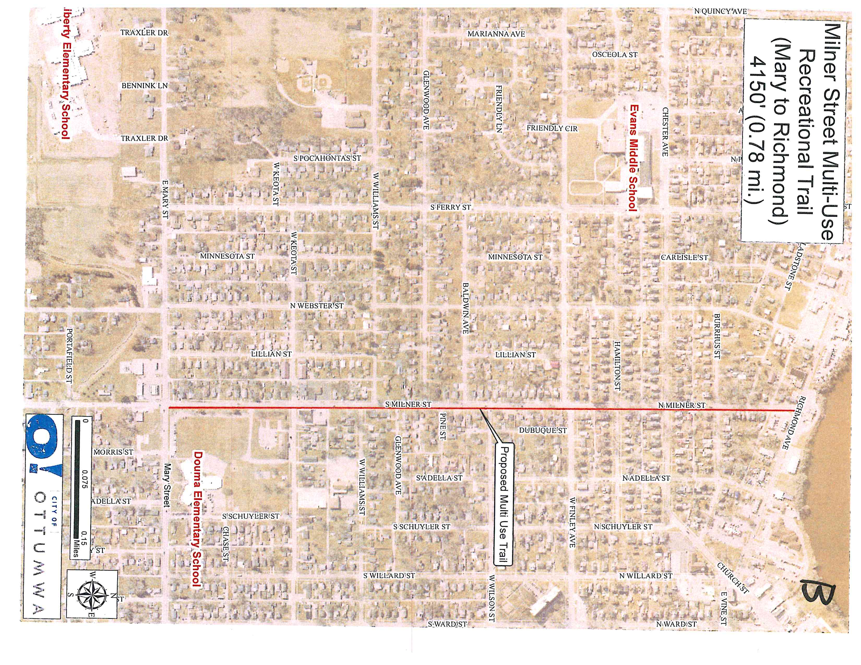
Ottumwa Bicycle and Pedestrian Plan and Milner Neighborhood Trail
Ottumwa has developed a trail system along the Des Moines River.
Assisted City and trails council to develop a bicycle and pedestrian plan for the city.
Awarded $301,735 in Transportation Alternative funds for the Milner Neighborhood Trail the first project in implementing the plan.
City and trails council preparing a REAP application for the Oxbow trail that will connect to the Milner Trail and Greater Ottumwa Park.

Slide 10
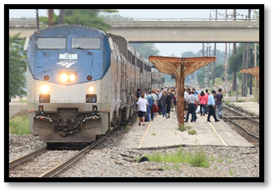
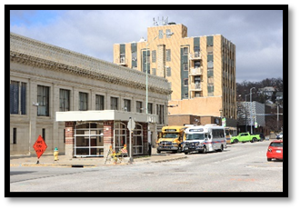
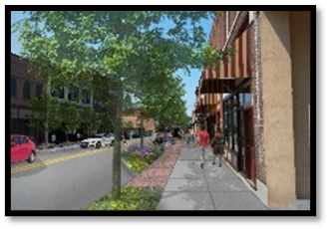
Ottumwa BUILD Grant – West Main Multimodal Corridor Revitalization Project

Slide 11
Ottumwa’s BUILD Grant Project Activities

Slide 12
Project Activities, Cost Estimates, Cost Share

Slide 13
How did we get here?
This project represents the natural progression of a decade of improvements throughout both downtown and the greater Main Street corridor:
Street & Utility Infrastructure Reconstruction
Large and Small-scale Façade/Building Improvements
Public, Private, and Public-Private Partnerships
Ottumwa has been very proactive in public planning processes—especially in the last decade.
City Comprehensive Plans (2001, 2014 update, 2020 update)
Riverfront Renaissance Plan (2014)
Downtown Streetscape Plan (2015)
Opportunity Analysis & Implementation Strategy (2019)

Slide 14
Main Street Corridor Street & Utility Enhancements

Slide 15
Chris Kukla, Transportation Director
Area 15 Regional Planning Commission
Ottumwa, IA 52501
641-684-6551
Chris.Kukla@area15rpc.com
www.area15rpc.com

