Slide 1
FY 2022 Highway-Railroad Crossing Safety Program
September 8, 2020

Slide 2
Program
FHWA Funding available for states to improve warning devices at railroad crossings. (23 USC Section 130)
Amount of appropriation funded by FHWA is determined by the number of public crossings in the state.
Iowa currently has 4,951 public railroad crossings.

Slide 3
Project Evaluation Criteria
Benefit-Cost Ratio
Formula includes:
Number of accidents
Exposure Index, (number of trains x number of vehicles)
Train traffic
Vehicle traffic
Predicted Accidents, (train speed, roadway speed, number of traffic lanes, number of tracks)
Existing warning devices vs. possible upgrades
On-site safety diagnostic review
An application must be filed with the department

Slide 4
Available Funding and Application Summary
90% Federal Funds from FHWA
10% match by Highway Authority or Railroad
Applicant can be either Roadway Authority or Railroad, or combination of the two
Number of projects: 17 (15 & 2 closure incentives)
Total project costs: $5,715,000
Total FHWA project costs: $5,143,500
Annual Apportionment: $5,195,890

Slide 5
List of Applications Recommended
PROJECT NAME | SPONSOR | SCORE | TOTAL PROJECT COST | REQUESTED AMOUNT (% of Total Project Cost) | RECOMMENDED AMOUNT (% of Total Project Cost)
US 18, City of Spencer 385716S | DME Railroad Iowa DOT | 7.0 | $325,000 | $292,500 (90%) | $292,500 (90%)
Jones Street, 911770M | CCP Railroad City of Dubuque | 4.3 | $175,000 | $157,500 (90%) | $157,500 (90%)
30th Ave. North, 376043H | DME Railroad City of Clinton | 1.5 | $400,000 | $360,000 (90%) | $360,000 (90%)
Spruce Avenue, 380021P | DME Railroad Cerro Gordo County | 1.3 | $325,000 | $292,500 (90%) | $292,500 (90%)
IA 39, City of Odebolt 190945U | CCP Railroad Iowa DOT | 0.8 | $280,000 | $252,000 (90%) | $252,000 (90%)

Slide 6
List of Applications Recommended
PROJECT NAME | SPONSOR | SCORE | TOTAL PROJECT COST | REQUESTED AMOUNT (% of Total Project Cost) | RECOMMENDED AMOUNT (% of Total Project Cost)
Ortho Way, 078050W | BNSF Railroad Lee County | 0.7 | $300,000 | $270,000 (90%) | $270,000 (90%)
155th Street, 074970K | BNSF Railroad Fremont County | 0.7 | $410,000 | $369,000 (90%) | $369,000 (90%)
23rd Ave. North, 376039T | DME Railroad City of Clinton | 0.7 | $410,000 | $369,000 (90%) | $369,000 (90%)
IA 110, City of Storm Lake 307518K | CCP Railroad Iowa DOT | 0.6 | $300,000 | $270,000 (90%) | $270,000 (90%)
4th Street, 097445U | BNSF Railroad Sioux County | 0.6 | $315,000 | $283,500 (90%) | $283,500 (90%)

Slide 7
List of Applications Recommended
PROJECT NAME | SPONSOR | SCORE | TOTAL PROJECT COST | REQUESTED AMOUNT (% of Total Project Cost) | RECOMMENDED AMOUNT (% of Total Project Cost)
32nd Ave. North, 376045W | DME Railroad City of Clinton | 0.7 | $475,000 | $427,500 (90%) | $427,500 (90%)
County Road C-16, 097429K | BNSF Railroad Plymouth County | 0.5 | $350,000 | $315,000 (90%) | $315,000 (90%)
9th Ave. North, 376027Y | DME Railroad City of Clinton | 0.7 | $500,000 | $450,000 (90%) | $450,000 (90%)
Washington Street, 074503X | BNSF Railroad Fremont County | 0.5 | $350,000 | $315,000 (90%) | $315,000 (90%)
220th Street, 074962T | BNSF Railroad Fremont County | 0.4 | $410,000 | $369,000 (90%) | $369,000 (90%)

Slide 8
List of Applications Recommended
PROJECT NAME | SPONSOR | SCORE | TOTAL PROJECT COST | REQUESTED AMOUNT (% of Total Project Cost) | RECOMMENDED AMOUNT (% of Total Project Cost)
Main Street, 074504E | BNSF Railroad Fremont County | 0.4 | $410,000 | $369,000 (90%) | $369,000 (90%)
US 69, City of Osceola 074046T | Iowa DOT | 0.0* | $55,000 | $49,500 (90%) | $49,500 (90%)
2 projected closure incentive payments at various locations ($7,500 each location) | TBD | N/A | $15,000 | $15,000 (100%) | $15,000 (100%)
* Fencing project designed to keep pedestrians on the sidewalks and out of the railroad right-of-way and off of the
AMTRAK station platforms. This is being incorporated into a multi-faceted project in Osceola at US 69
and the AMTRAK station.

Slide 9
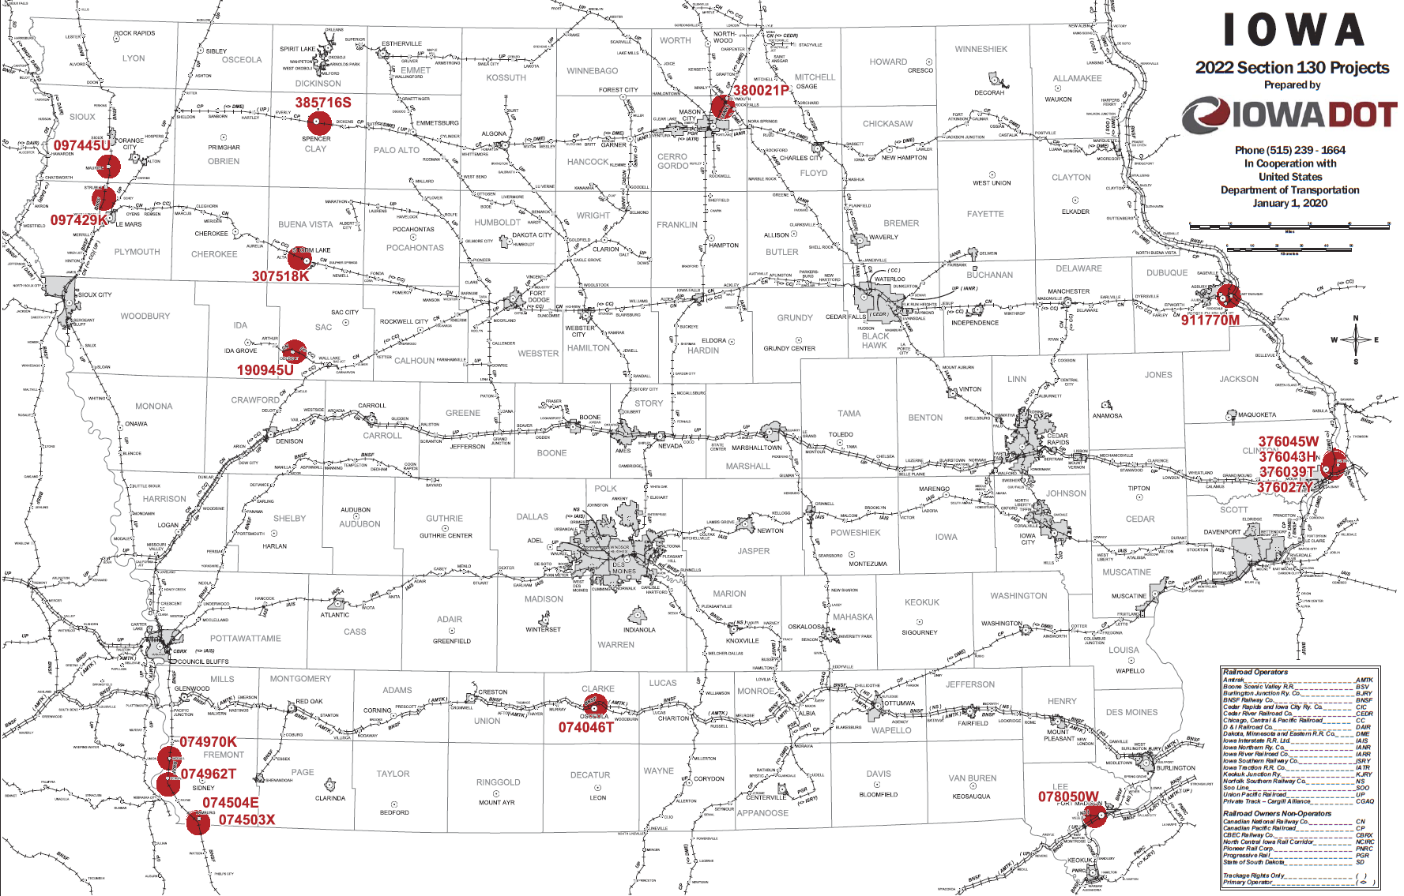
Map of Recommended Awards

Slide 10
QUESTIONS?
Kristopher Klop
Manager, Highway-Rail Crossing Programs
kristopher.klop@iowadot.us

