Slide 1
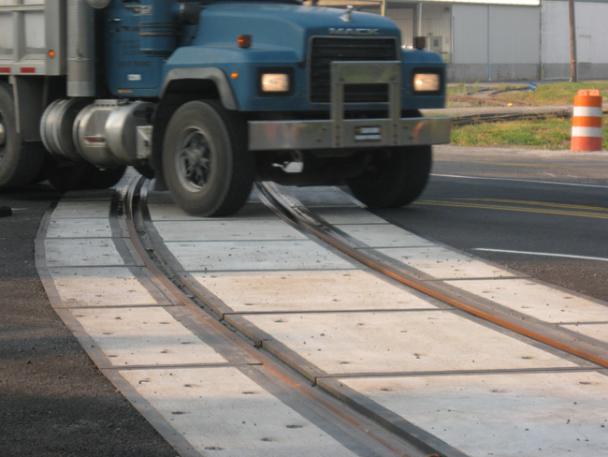
FY 2022 Highway-Railroad Crossing
Surface Repair Program
September 8, 2020

Slide 2
Program
Highway-Railroad crossing surface repair program incentivizes railroads and roadway authorities to participate in the cooperative repair of crossing surfaces.
Project funding breakdown:
60% State
20% Roadway authority
20% Railroad
Responsibilities:
Railroad: Replacement of rock (ballast), ties, track, underlayment, and crossing panels
Roadway Authority: Replacement of crossing approaches and existing sidewalks (ADA compliant), road closures and detours

Slide 3
Project Evaluation Criteria
Projects are funded in the order the applications are received, except that up to 50% of the program allocation can be used in a discretionary manner.
All 43 crossings currently in the program queue were scored according to the following criteria:
Type of route the crossing is on, (crude oil, ethanol, passenger)
Average daily vehicle traffic / train traffic
Exposure index, (number of trains x number of cars)
Predicted Accidents, (train speed, roadway speed, number of traffic lanes, number of tracks)
Planned concurrent roadway projects
On-site inspection
Maximum score possible: 30 points
Final Projects
The six highest scored crossings were brought forward to be funded in addition to those already scheduled to be funded for FY 2022 for a total of 14 projects.
Associated railroads and roadway authorities were contacted and confirmed they were able to participate with funding and repairs.

Slide 4
Available Funding and Application Summary
Crossing Surface Repair Program receives an annual statutory appropriation of $900,000 (off-the-top of the Road Use Tax Fund)
Program funding queue currently has 43 applications submitted.
Number of projects:
8 - in order received
6 - with scoring
14 - total
Total program funding request: $1,103,957
In order received: $704,648 / 64%
Scored: $399,309 / 36%

Slide 5
List of Applications Recommended
PROJECT NAME | SPONSORS | SCORE | TOTAL PROJECT COST | REQUESTED AMOUNT (% of Total Project Cost) | RECOMMENDED AMOUNT (% of Total Project Cost)
Ontario Street, 307447R | CCP Railroad City of Pomeroy | N/A Order Received | $227,000 | $136,200 (60%) | $136,200 (60%)
Buddy Holly Place, 385516H | DME Railroad City of Clear Lake | N/A Order Received | $122,000 | $73,200 (60%) | $73,200 (60%)
Underwood Avenue (T-66), 385422G | DME Railroad Floyd County | N/A Order Received | $70,000 | $42,000 (60%) | $42,000 (60%)
Roosevelt Avenue (B-20), 385762T | DME Railroad O’Brien County | N/A Order Received | $94,600 | $56,760 (60%) | $56,760 (60%)

Slide 6
List of Applications Recommended
PROJECT NAME | SPONSOR | SCORE | TOTAL PROJECT COST | REQUESTED AMOUNT (% of Total Project Cost) | RECOMMENDED AMOUNT (% of Total Project Cost)
220th Street (B-57), 385301J | DME Railroad Chickasaw County | N/A Order Received | $123,000 | $73,800 (60%) | $73,800 (60%)
19th Street SW, 874095Y | Iowa Traction Railroad City of Mason City | N/A Order Received | $132,333 | $79,400 (60%) | $79,400 (60%)
19th Street SW, 874104V | Iowa Traction Railroad City of Mason City | N/A Order Received | $168,814 | $101,288 (60%) | $101,288 (60%)
Washington Street, 307615U | Farmer’s Cooperative City of Remsen | N/A Order Received | $236,665 | $141,999 (60%) | $141,999 (60%)

Slide 7
List of Applications Recommended
PROJECT NAME | SPONSOR | SCORE | TOTAL PROJECT COST | REQUESTED AMOUNT (% of Total Project Cost) | RECOMMENDED AMOUNT (% of Total Project Cost)
Twin Rivers Drive, 072519M | Keokuk Junction Railway City of Keokuk | 29 | $82,200 | $49,320 (60%) | $49,320 (60%)
2nd Street, 095331A | BNSF Railroad Adams County | 27 | $194,871 | $116,923 (60%) | $116,923 (60%)
490th Avenue, 385645X | DME Railroad Palo Alto County | 25 | $66,000 | $39,600 (60%) | $39,600 (60%)
South Gilbert Street, 607299C | CRANDIC Railroad City of Iowa City | 25 | $70,400 | $42,240 (60%) | $42,240 (60%)

Slide 8
List of Applications Recommended
PROJECT NAME | SPONSOR | SCORE | TOTAL PROJECT COST | REQUESTED AMOUNT (% of Total Project Cost) | RECOMMENDED AMOUNT (% of Total Project Cost)
Oasis Avenue, 079161S | BNSF Railroad Henry County | 24 | $144,000 | $86,400 (60%) | $86,400 (60%)
McPherson Street, 603291J | IAIS Railroad Guthrie County | 23 | $108,045 | $64,826 (60%) | $64,826 (60%)

Slide 9
Map of Recommended Awards

Slide 10
QUESTIONS?
Kristopher Klop
Manager, Highway-Rail Crossing Programs
kristopher.klop@iowadot.us

