Slide 1
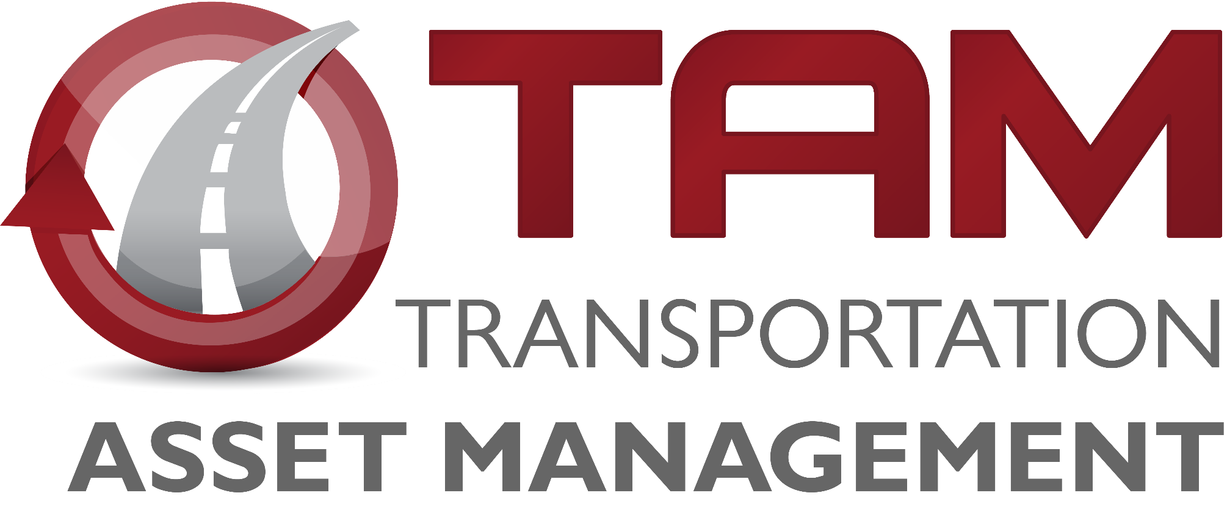

Transportation Asset Management (TAM) Overview
Matt Haubrich
Transportation Commission Workshop
September 8, 2020

Slide 2

Topics for Today:
What is TAM?
Why is it important?
What are we doing to implementing it?
How can we improve our TAM presentations?

Slide 3
What is TAM?

Slide 4

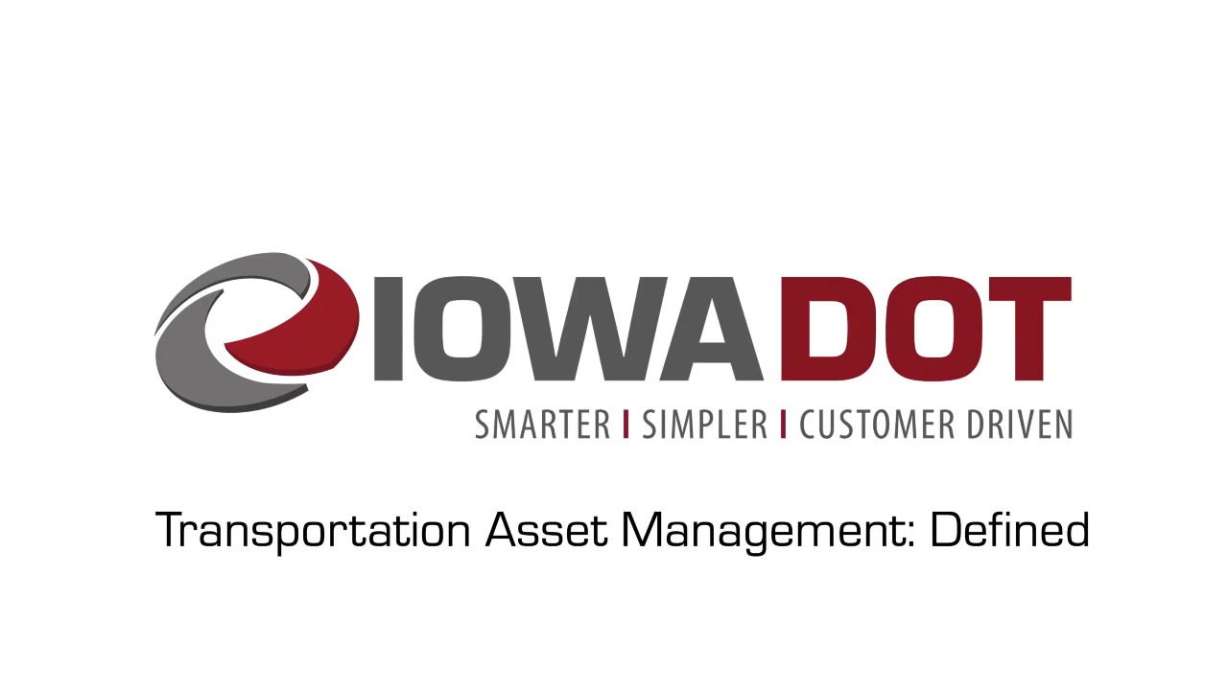

Slide 5
Why is TAM important?

Slide 6
TAM helps us
Build, preserve, operate, maintain, upgrade, and expand the transportation system more cost-effectively throughout its whole life.
Improve performance of the transportation system.
Deliver to Iowa DOT’s customers the best value for every dollar spent
Enhance Iowa DOT’s credibility and accountability in its stewardship of transportation assets

Slide 7
TAM saves money

Slide 8
What are we doing to implement TAM?

Slide 9
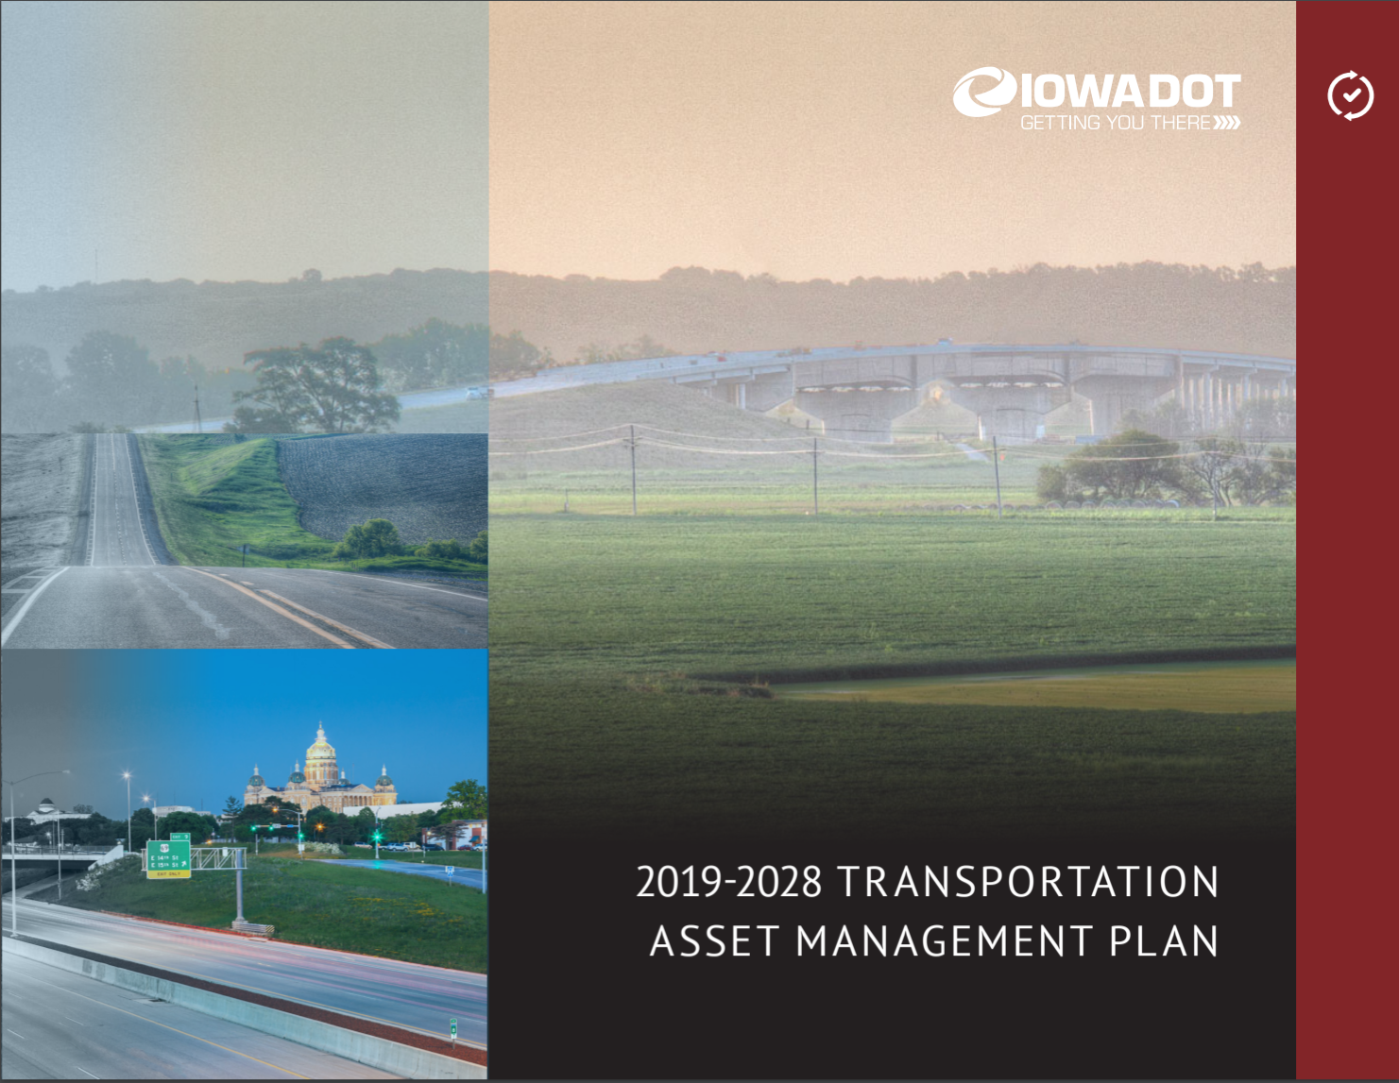
We have a plan
(we call it our TAMP)
TAMP Objectives
Defines clear links among agency goals, objectives, and decisions
Defines the relationship between proposed funding levels and expected results
Develops a long-term outlook for asset performance
Documents how decisions are supported by sound information
Develops a feedback loop from observed performance to subsequent planning and programming decisions
Improves accountability for decision making
Unifies existing data, business practices, and divisions to achieve Iowa DOT’s asset management goals

Slide 10
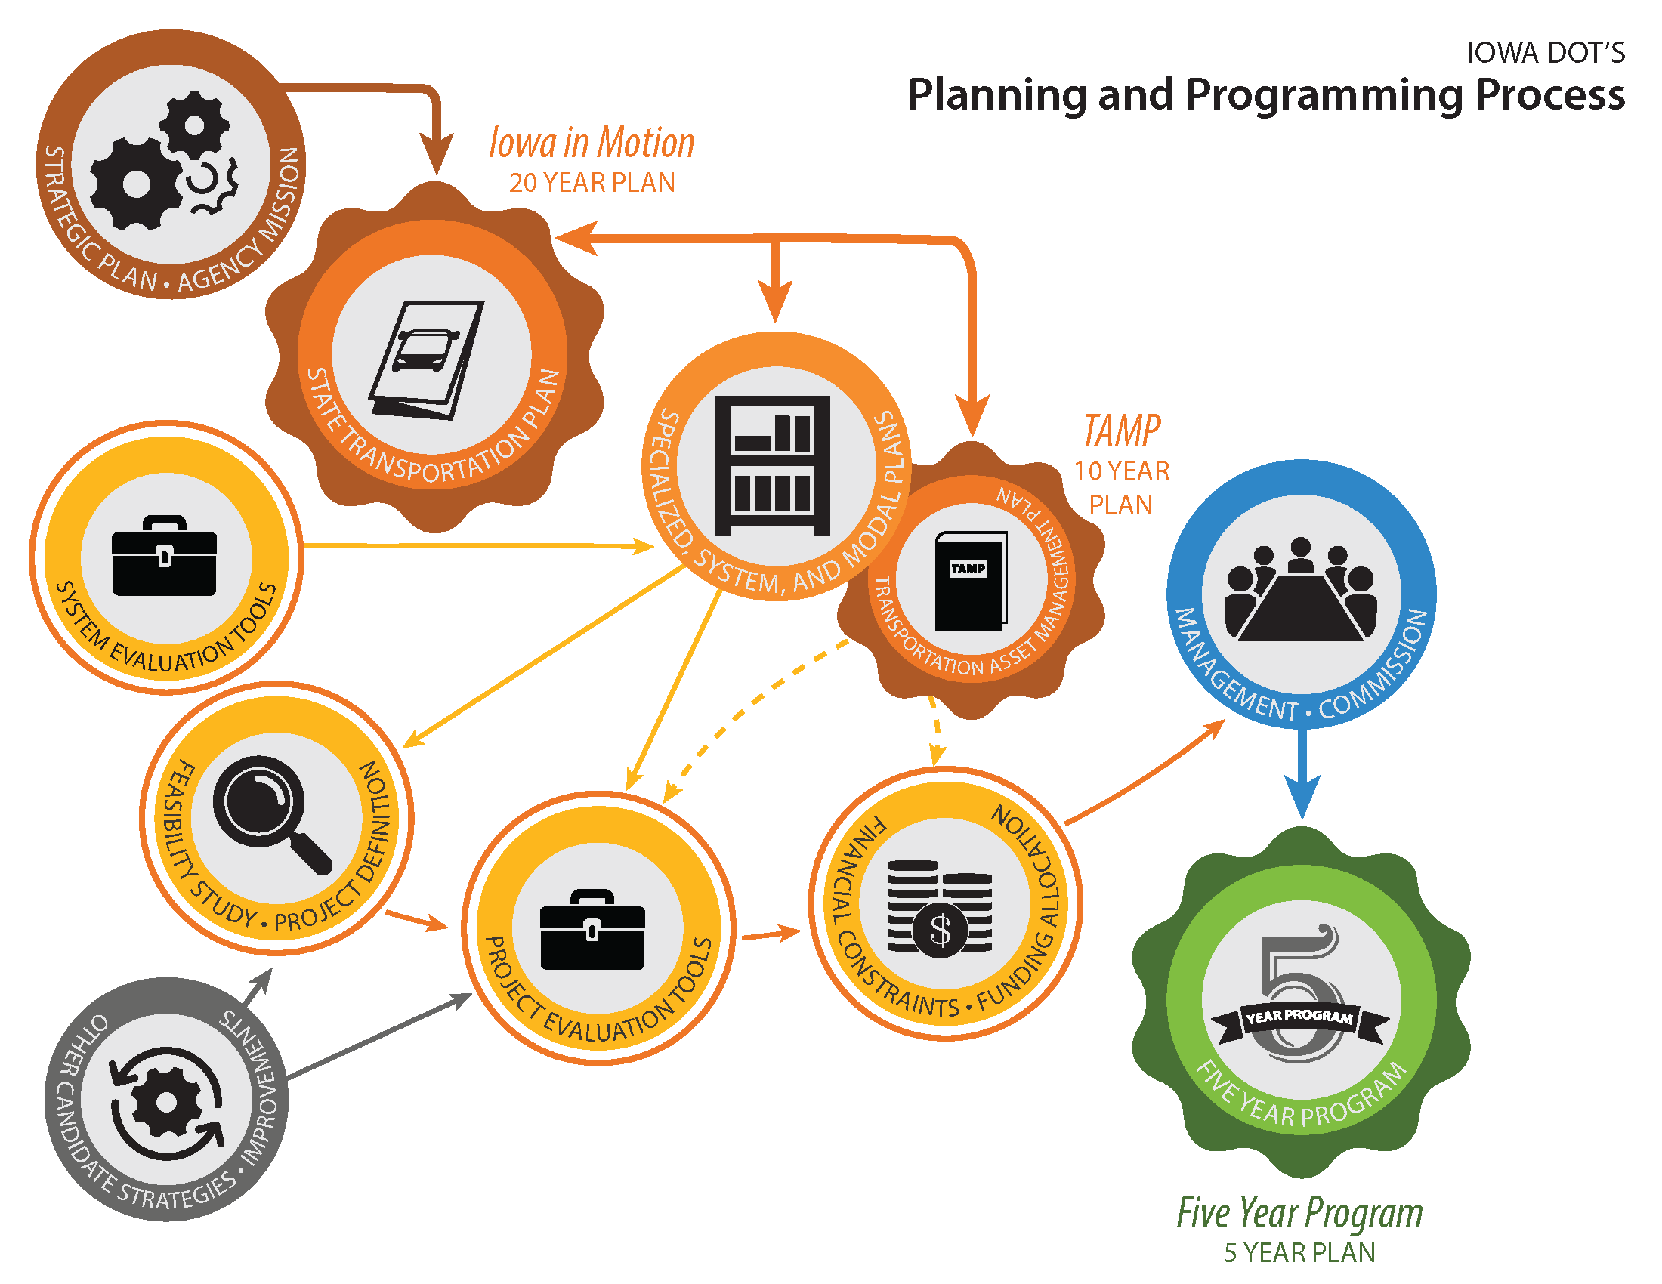
How does the TAMP fit in the planning and programming process?

Slide 11
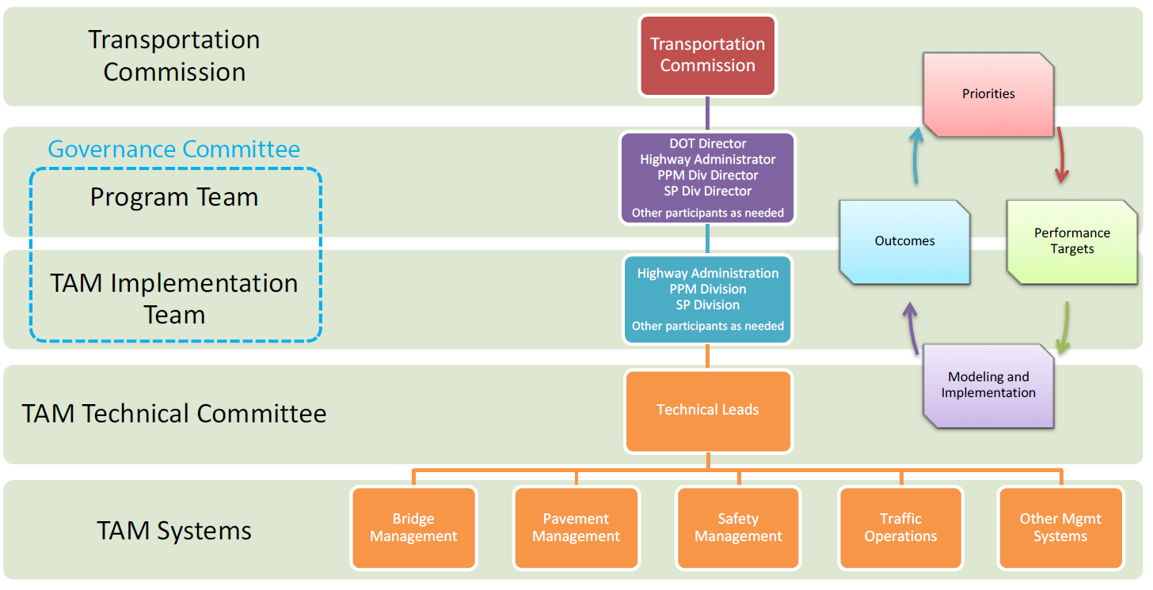
TAM Governance Structure

Slide 12
How can we improve our TAM presentations?

Slide 13
TAM Presentation Feedback
Start
  What is missing that should be added?
  What kind information would be most helpful?
Stop
  What parts are not helpful and should be discontinued?
Continue
  What parts should we keep doing?

Slide 14
Proposed TAM Presentations
Presentation | Objectives
Project prioritization refresher | Explain how we developed the prioritization system and how we’re using it in project selection Review current prioritization factors and explain the process we used to determine the weighting Highlight how prioritization factors relate to our long range plan
Integrated Corridor Management (ICM) Updates | Refresher of the purpose and approach of ICM Update on status of the Des Moines Metro ICM Provide recommendations / considerations for programming future ICM implementation strategies

Slide 15
Proposed TAM Presentations
Presentation | Objectives
Interstate Investment Plan | Present updated recommendations for timing and location of future capacity and stewardship investments Request input on proposed schedule and funding level Include a “preview” of revisions to the options list for Interstate projects
Bridge management | Review of current bridge conditions Present different investment scenarios and resulting conditions
Pavement management | Review of current pavement conditions Present different investment scenarios and resulting conditions
Trade-off analysis | Present recommendations for investment levels (pavement vs. bridge, capacity vs. stewardship) Receive feedback on proposed investment levels

Slide 16
TAM Presentation Feedback
Start
  What is missing that should be added?
  What kind information would be most helpful?
Stop
  What parts are not helpful and should be discontinued?
Continue
  What parts should we keep doing?

