Slide 1
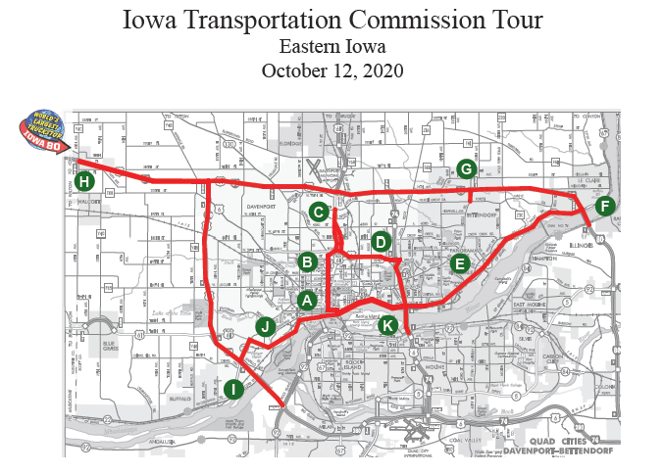

Slide 2
Bus Option 1 56 Passenger Executive Coach Bus

Slide 3
Bus Option 2 35 Passenger Prevost Entertainer Coach

Slide 4
Bus Option 3 27 Passenger Executive Mini Bus

