Slide 1
State Recreational Trails Program
Funding Recommendation

Slide 2
State Recreational Trail Program
Created in 1988
Available to cities, counties, state agencies, local governments, or non-profit organizations through an application program
Purpose is to establish recreational trails in Iowa for the use, enjoyment and participation of the public.

Slide 3
Project Evaluation Criteria
Need in terms of population to be served and existing trails in the area (25 points)
Compatibility with local, areawide, regional or statewide plans (15 points)
Benefits of multiple uses and recreational opportunities (20 points)
Quality of the site (25 points)
Economic benefits to the local area (10 points)
Special facilities for disabled users (5 points)
Project is "shovel ready“ and will be completed by 6-30-2023 (25 points)
Projects with cash match (5 points)

Slide 4
Available Funding and Application Summary
Available Funding:
FY 2021 Legislative appropriation from the Rebuild Iowa Infrastructure Fund: $1,000,000
Application Summary:
Total number of projects: 24
Total project costs: $24,214,380
Total amount requested: $7,219,414

Slide 5
List of Applications Recommended
PROJECT NAME | SPONSOR | SCORE | TOTAL PROJECT COST | REQUESTED AMOUNT (% of Total Project Cost) | RECOMMENDED AMOUNT (% of Total Project Cost)
Raccoon River Valley Trail to High Trestle Trail Connector Phase IV Construction | Dallas County Conservation | 113 | $669,300 | $201,618 (30%) | $201,618 (30%)
High Trestle Trail Extension to Oralabor Road (Ankeny) | Ankeny | 112 | $2,231,700 | $400,000 (17%) | $295,060 (13%)
Tatonka Ska Trace Rail Trail Phase III(c) | Dickinson County | 111 | $867,022 | $176,522 (20%) | $176,522 (20%)
Jump to applications not recommended for funding

Slide 6
List of Applications Recommended
PROJECT NAME | SPONSOR | SCORE | TOTAL PROJECT COST | REQUESTED AMOUNT (% of Total Project Cost) | RECOMMENDED AMOUNT (% of Total Project Cost)
Flint River Trail-Bluff Road Connector | Burlington | 106 | $515,000 | $165,000 (32%) | $165,000 (32%)
Little River Scenic Pathway – Phase 1 | Decatur County Conservation | 104 | $631,800 | $161,800 (25%) | $161,800 (25%)
Jump to applications not recommended for funding

Slide 7
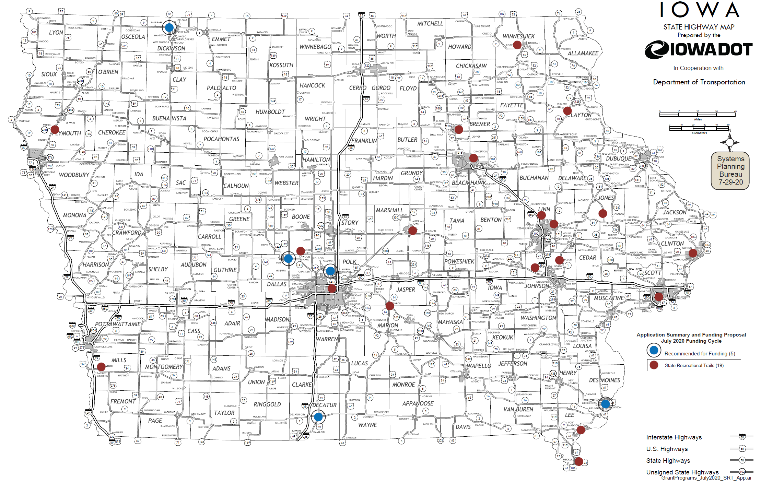
Map of Applications Received

Slide 8
QUESTIONS?
Craig Markley, Systems Planning Bureau
craig.markley@iowadot.us
515-239-1027

Slide 9
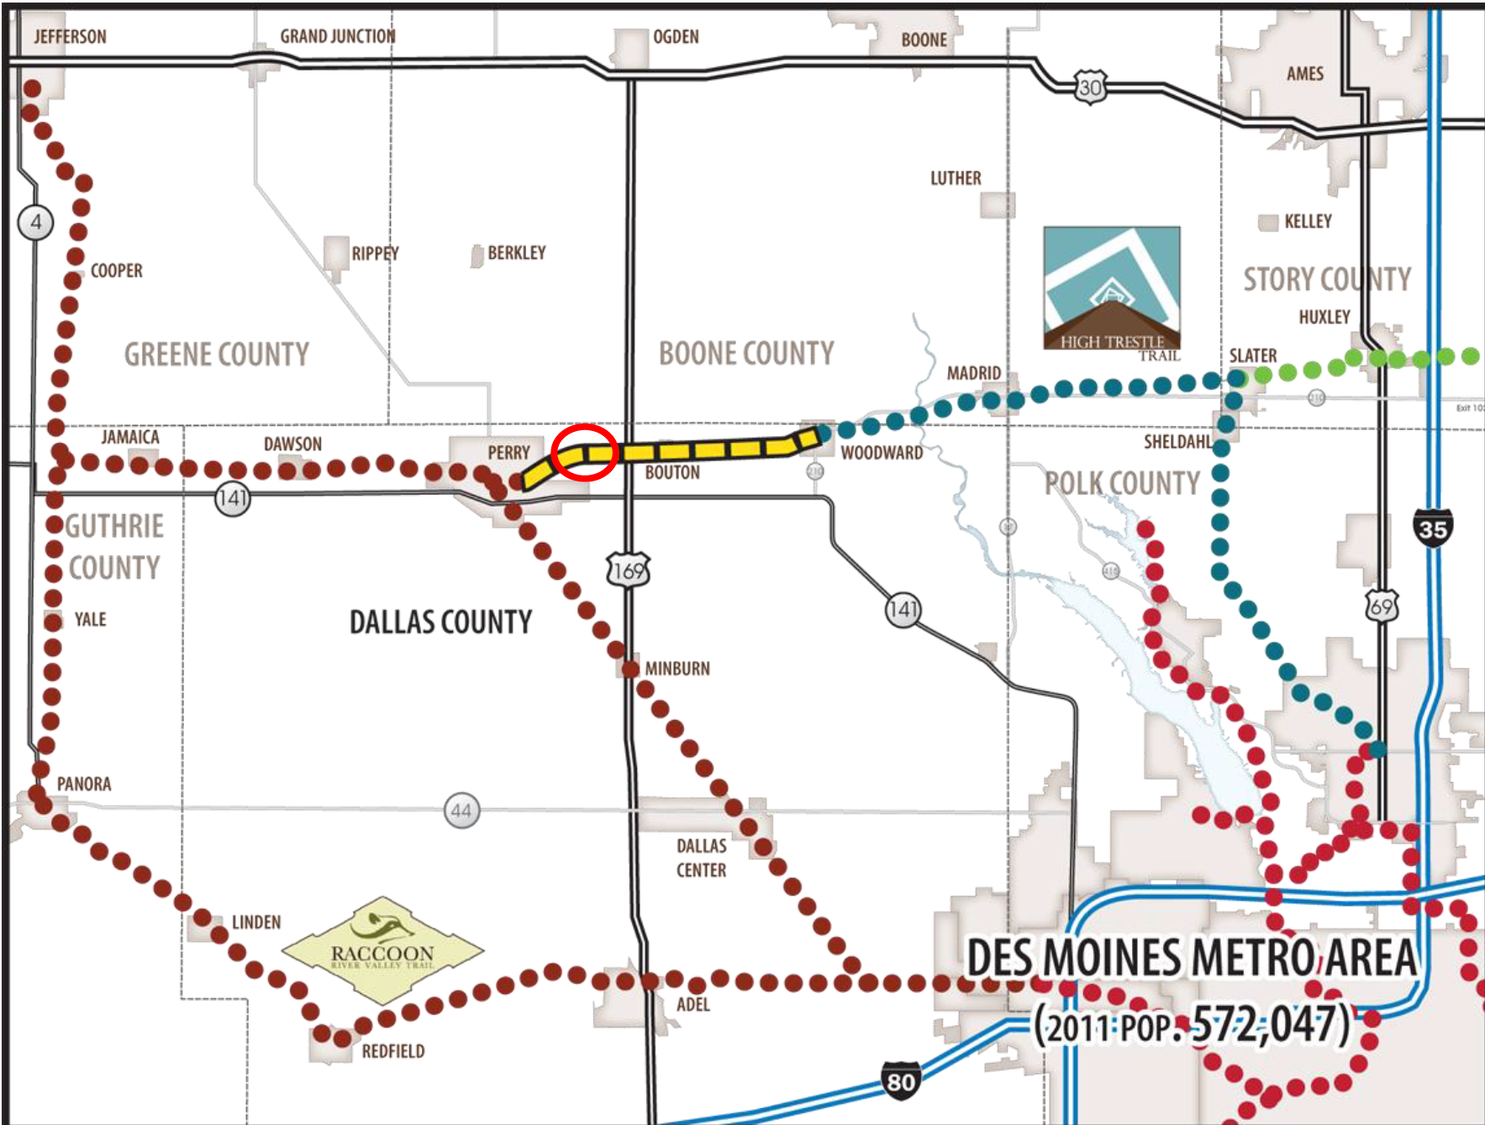
Raccoon River Valley Trail to High Trestle Trail Connector Phase III Construction (Dallas County Conservation Board)
This project is a 0.34-mile paved segment of the connector trail from 130th Street to M Avenue in Dallas County. Upon completion of all phases of construction, the 9-mile connector trail will link the Raccoon River Valley Trail and the High Trestle Trail between Perry and Woodward.
Total Cost: $669,000
Requested: $201,618 (30%)
Return to List of Applications Recommended

Slide 10
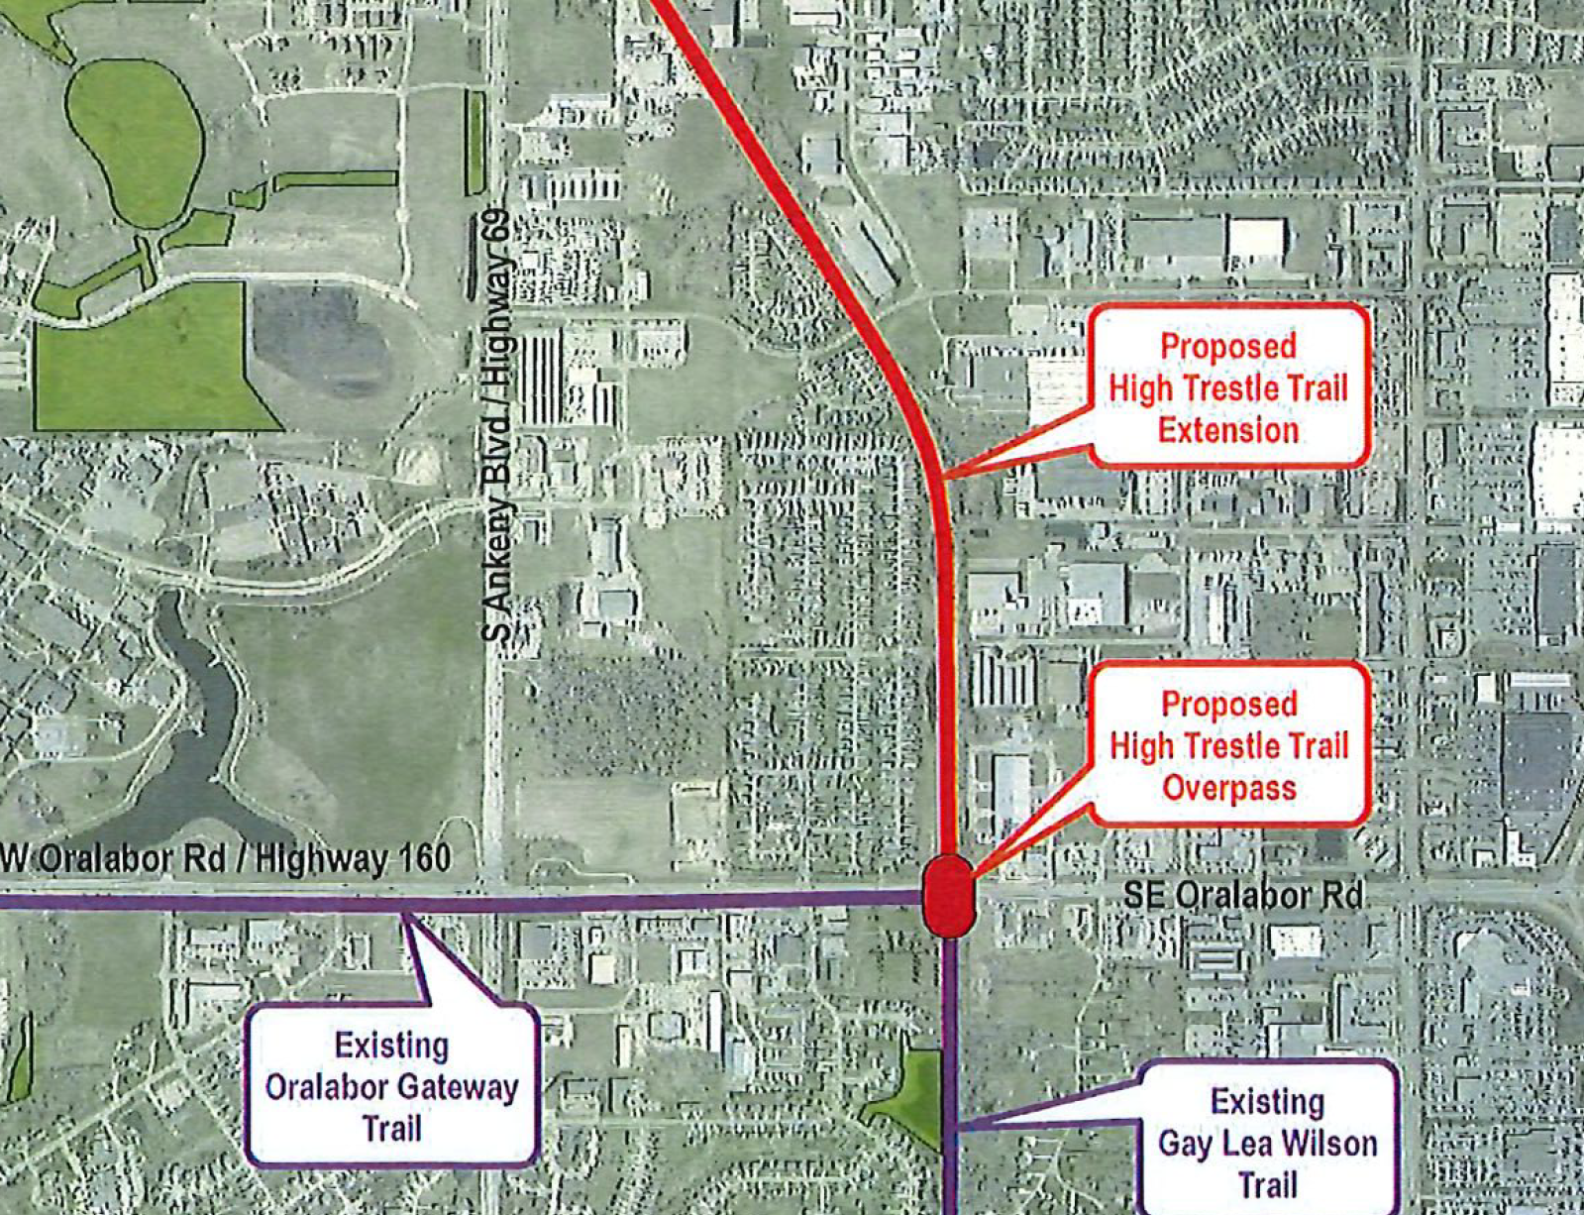
High Trestle Trail Extension to Oralabor Road Project(Ankeny)
This project extends the High Trestle Trail 1.15 miles from SE Magazine Road to a direct connection with the Gay Lea Wilson and Oralabor Gateway Regional Trails, located on the south side of SE Oralabor/Iowa 150. The project will include a trail bridge at SE Oralabor/Iowa 150.
Total Cost: $2,231,700
Requested: $ 400,000 (17%)
Recommended: $ 295,060 (13%)
Return to List of Applications Recommended

Slide 11
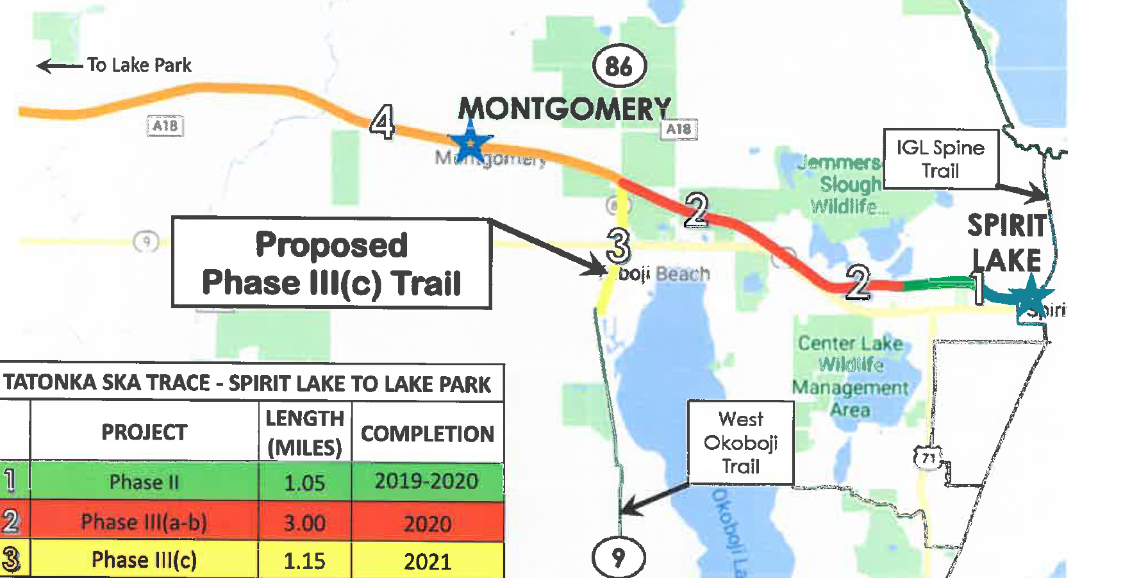
Tatonka Ska Trace Rail Trail Phase III(c) (Dickinson County)
This project starts at the North Harbor Tunnel (West Okoboji Trail) at the junction of Iowa 86 and 155th Street. It then travels 1.15 miles north where it connects with Tatonka Ska Trace –Phase III(b), approximately 0.55 miles north of Jct. Hwy 86 and Hwy 9. This project connects West Okoboji Trail and Spine Trail. Over 35 miles of trail.
Total Cost: $867,022
Requested: $176,522 (20%)
Return to List of Applications Recommended

Slide 12
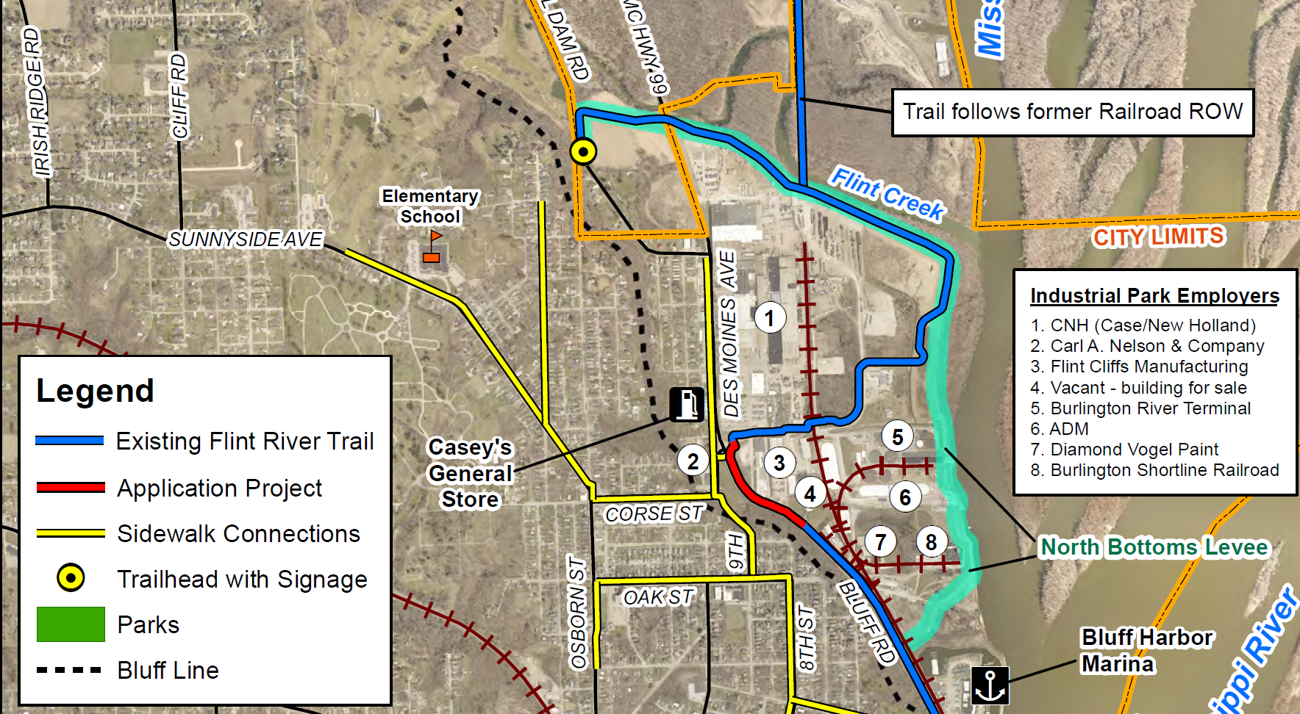
Flint River Trail-Bluff Road/North Bottoms Connector (Burlington)
This project will construct 0.23 mile of paved trail parallel to Bluff Road. Bluff Road is the designated route of the Mississippi River Trail. This segment will finalize the Flint River Trail within the city of Burlington and create a continuous 3.0 mile trail connecting 2.25 miles of existing trail from the north city limits with 0.80 mile of existing trail to the Burlington Riverfront in the south.
Total Cost: $ 515,000
Requested: $ 165,000 (32%)
Return to List of Applications Recommended

Slide 13
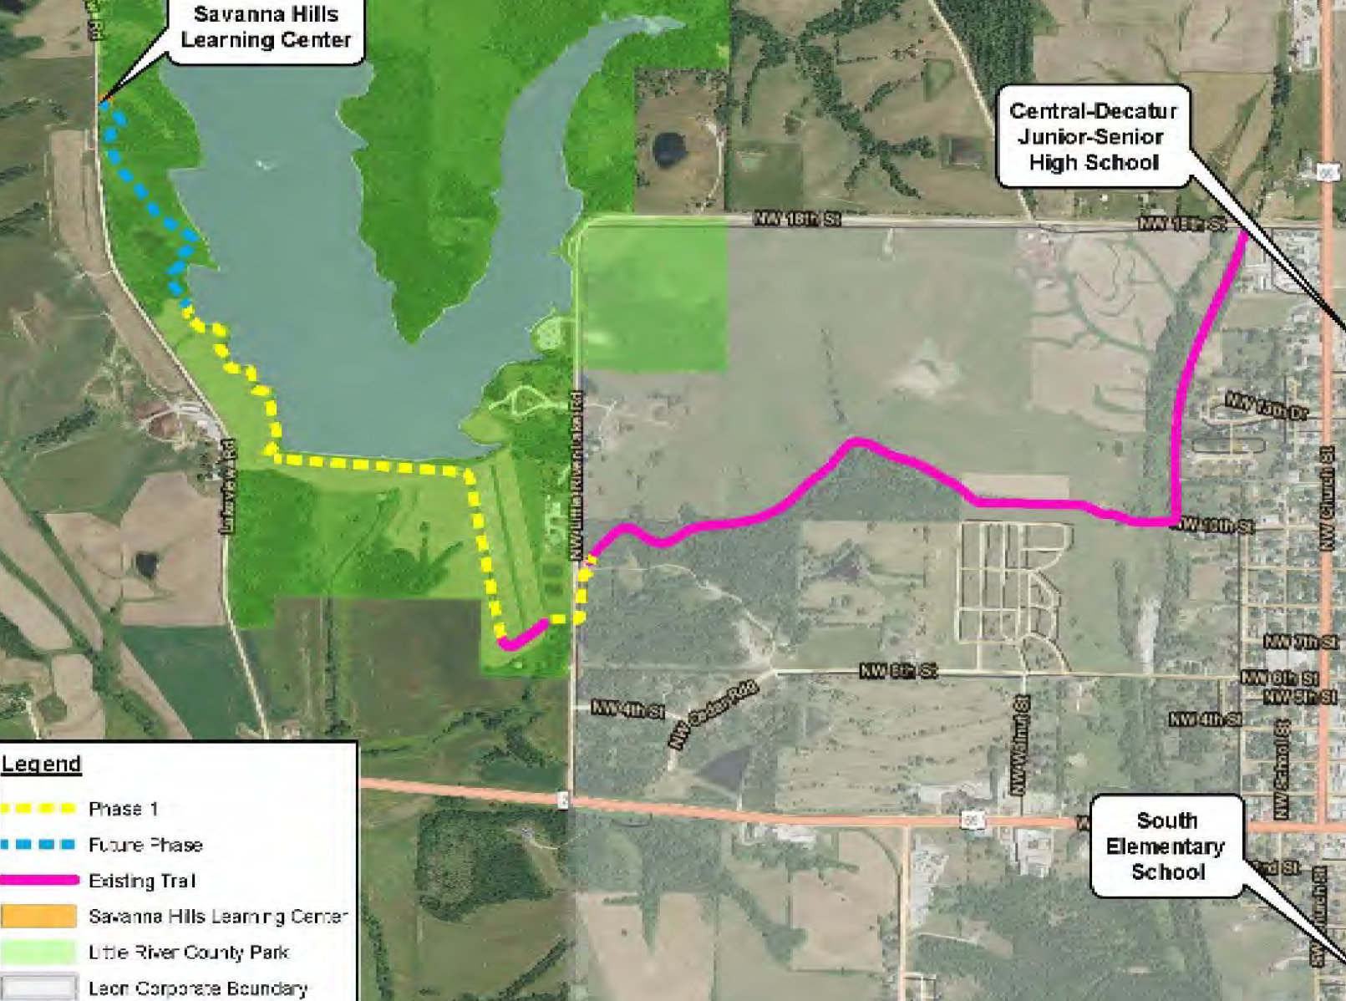
Little River Scenic Pathway Phase 1 (Decatur County Conservation Board)
This project extends the Little River Scenic Pathway (which connects to the city of Leon) 1.2 miles from the current trailhead east of Little River Recreation Area, crossing NW Little River Lake Road into the park, along the dam on the south side of the lake and to the north along the lake’s shoreline.
Total Cost: $631,800
Requested: $161,800 (25%)
Return to List of Applications Recommended

Slide 14
List of Applications Not Recommended for Award
PROJECT NAME | SPONSOR | SCORE | TOTAL PROJECT COST | REQUESTED AMOUNT (% of Total Project Cost) | RECOMMENDED AMOUNT (% of Total Project Cost)
Rolling Prairie Trail Extension | Waverly | 101 | $294,000 | $220,000 (75%) | $0
Pony Hollow Trail Extension - Phase 1 | Clayton County Conservation Board | 99 | $854,233 | $640,400 (74%) | $0
Connecting Fort Madison! Phase 4 - 48th Street Trail Connection | Fort Madison | 97 | $440,840 | $300,000 (68%) | $0
Red Rock Prairie Trail | Jasper County Conservation Board | 96 | $3,398,000 | $312,249 (9%) | $0
Let’s Konnect! Riverfront Trail | Keokuk | 95 | $1,058,316 | $334,072 (31%) | $0
Return to List of Applications Recommended

Slide 15
List of Applications Not Recommended for Award
PROJECT NAME | SPONSOR | SCORE | TOTAL PROJECT COST | REQUESTED AMOUNT (% of Total Project Cost) | RECOMMENDED AMOUNT (% of Total Project Cost)
Plywood Trail Phase 1A | Le Mars | 94 | $1,279,973 | $350,000 (27%) | $0
Wapsipinicon Trail Phase 2 | Jones County Conservation Board | 92 | $513,240 | $170,000 (32%) | $0
Grant Wood Trail Gap Connection | Linn County Conservation Board | 92 | $1,271,000 | $200,000 (15%) | $0
Cedar Valley Nature Trail Bridge C1 Repairs | Black Hawk County Conservation Board | 91 | $208,800 | $156,600 (75%) | $0
Return to List of Applications Recommended

Slide 16
List of Applications Not Recommended for Award
PROJECT NAME | SPONSOR | SCORE | TOTAL PROJECT COST | REQUESTED AMOUNT (% of Total Project Cost) | RECOMMENDED AMOUNT (% of Total Project Cost)
High Trestle Trail to City of Boone Trail Phase I | Boone County Conservation Board | 87 | $929,000 | $350,000 (37%) | $0
13th Avenue North Recreational Trail | Clinton | 87 | $740,653 | $340,653 (45%) | $0
Glenwood Trail Project | Glenwood | 86 | $723,000 | $143,000 (19%) | $0
Clear Creek Trail Half Moon Avenue to F. W. Kent Park | Johnson County Conservation Board | 86 | $1,015,000 | $350,000 (34%) | $0
Grant Wood Trail Paving – Waldo’s Rock to Oxley Road | Linn County Conservation Board | 83 | $790,000 | $400,000 (50%) | $0
Return to List of Applications Recommended

Slide 17
List of Applications Not Recommended for Award
PROJECT NAME | SPONSOR | SCORE | TOTAL PROJECT COST | REQUESTED AMOUNT (% of Total Project Cost) | RECOMMENDED AMOUNT (% of Total Project Cost)
Solon Recreation and Nature Area (SRNA)/Hoover Trailhead Restroom and Shelter | Solon | 80 | $107,620 | $80,715 (75%) | $0
Dry Run Trail Segment 1 Connection to the Greenbelt | Winneshiek County Conservation Board | 77 | $1,106,600 | $500,000 (45%) | $0
Neal Smith Rehabilitation Phase 2 | Des Moines | 74 | $900,000 | $450,000 (50%) | $0
Iowa’s River Edge Trail Paving Towards Iowa River | Marshalltown | 72 | $950,000 | $300,000 (31%) | $0
Return to List of Applications Recommended

Slide 18
List of Applications Not Recommended for Award
PROJECT NAME | SPONSOR | SCORE | TOTAL PROJECT COST | REQUESTED AMOUNT (% of Total Project Cost) | RECOMMENDED AMOUNT (% of Total Project Cost)
First Bridge | River Action | 69 | $2,696,903 | $500,000 (18%) | $0
Return to List of Applications Recommended

