Slide 1
Railroad Revolving Loan and Grant Program FY 2021 Funding Cycle

Slide 2
Railroad Revolving Loan and Grant Program
Created by legislation in 2005
Purpose: To provide loans and grants for railroad related improvement projects to benefit Iowa.
Funded by loan repayments and appropriations by the Iowa Legislature. Funding is available to cities, counties, economic development organizations and other non-profit organizations through an application program.

Slide 3
Available Funding and Application Summary
Available Funding:
FY 2021 Legislative appropriation (RIIF): $500,000
Loan repayment: $1,674,650
Previous Balance: $475,398
Rescinded funds $1,449,952
Total: $4,100,000
Application Summary:
Total number of projects: 7
Total rail project costs: $15,171,664
Total amount requested: $7,242,907
Notes:
Rescinded funds are:
Agritrade FY ’20 Project: $1,298,027
KJRY FY ‘19 Project: $151,925

Slide 4
Project Evaluation Criteria
Targeted Job Creation Projects:
Hourly wage rates must meet 100% of the average county wage criteria:
Job leverage: 40 pts
Wage quality: 20 pts
Capital investment: 20 pts
Loan leverage: 20 pts
Rail Network Improvement Projects:
Project readiness
Rail network impact
Economic impact
Financial readiness
Rail Port Planning and Development Studies:
Existing/potential site information
Goals of the study
Organizational structure and capacity to complete the study
Notes:
An application is required in order to submit for RRLG funding. Once applications are received, an evaluation team is identified and we review each application and then score and evaluate them based on the project type….

Slide 5
Applications Received & Recommended Awards
TOTAL PROJECT COST
REQUESTED AMOUNT
(% of Total Project Cost)
RECOMMENDED AMOUNT
(% of Total Project Cost)
PROJECT NAME
SPONSOR
SCORE
CRANDIC – AW 2235 | CRANDIC | 44.46 (Grant Only) | $5,400,000 | Grant: $2,700,000 (50%) | Grant: $2,700,000 (50%)
BJRY Passing Track | BJRY | NA (Loan Only) | $285,259 | Loan: $228,207 (80%) | Loan: $228,207 (80%)
IANR Bridge Replacement | IANR | NA (Loan Only) | $1,300,000 | Loan: $487,500 (37.5%) | Loan: $487,500 (37.5%)
Western Iowa Energy Rail Expansion | Western Iowa Energy LLC | NA (Loan Only) | $4,677,405 | Loan: $1,000,000 (21.3%) | Loan: $500,000 (10.6%)
Jump to applications not recommended for funding
Notes:
First Project: Is a Targeted Job Creation project known as CRANDIC – AW 2235 Rail Project:
The applicant is the Cedar Rapids and Iowa City Railway (CRANDIC). The proposed project is for construction of industry lead tracks and industry tracks to support the competitive shipment of their product in the Cedar Rapids area. Rail service will be for one of the largest economic development prospects in the history of the state. The project will create approximately 385 new jobs.
Total Project Cost: $5,400,000
Applicant has requested a grant of $2,700,000 (385 jobs) (50%)
Staff recommends a full grant award of $2,700,000
2nd Project: Is a Rail Network work Improvement project known as the BJRY Passing Track -
The project will construct 1,300 feet of rail that will serve as a relocated passing track on the BJRY mainline. This project will increase efficiency and capacity of BJRY’s operations.
Total Cost: $285,259
Requested loan: $228,207 (80%)
Staff recommends a full loan award of $228,207
The third project recommended for funding is a Rail Network Improvement project known as the IANR Bridge Replacement Project
IANR is the applicant. IANR recently entered into a long term operation and maintenance agreement with the Union Pacific Railroad (April 2019). IANR has assumed all maintenance of the line. One of the main areas of focus on the line is the Railroad bridge in Waterloo, Iowa. This bridge can no longer hold 286# railcars, and is in need of replacement.
Total Cost: $1,300,000
Requested: $487,500 (37.5%)
Staff recommends a full loan award of $487,500
The fourth project recommendation is a Rail Network Improvement project known as the Western Iowa Energy Rail Expansion
This project is adding track capacity and track infrastructure to Western Iowa Energy’s existing facility in Wall Lake, IA. The rail expansion involves a series of storage tracks at the end of the current spur. The existing spur is currently inadequate for outbound product.
Total Cost: $4,677,405
Requested: $1,000,000 (21.3%)
Due to limited funding, Staff recommends a partial loan award of $500,000 (applicant has accepted)

Slide 6
Applications Received & Recommended Awards Contd.
TOTAL PROJECT COST
REQUESTED AMOUNT
(% of Total Project Cost)
RECOMMENDED AMOUNT
(% of Total Project Cost)
PROJECT NAME
SPONSOR
SCORE
River Cities Business Park Rail Spur | River Cities Management | NA (Planning Grant) | $100,000 | Grant: $80,000 (80%) | Grant: $80,000 (80%)
Dallas County/ Dexter Railport Development Study | Ten D/Merchants Distribution Co. | NA (Planning Grant) | $125,000 | Grant: $100,000 (80%) | Grant: $100,000 (80%)
Total Awards: $4,095,707
Jump to applications not recommended for funding
Notes:
The fifth project recommendation is for a Railport Planning and Development Study award. Known as the River Cities Business Park Rail Spur Study
This planning study will evaluate the need and ability to create a rail spur that will connect River City Management’s properties from Davenport to neighboring Eldridge, Iowa. At one point, CP served the site, however mainline connections were disconnected. River Cities is again interested in connecting these two properties via a rail spur and want to conduct a study to see if the two properties can accommodate additional rail spurs and again be served by CP.
Total Cost: $100,000
Requested: $80,000 (80%)
Staff recommends a full planning grant award of $80,000
The final project recommendation also a Railport Planning and Development Study known as the Dallas County/Dexter Railport Development Study
The proposed study is to plan for future rail service on a site known as the Gerdau site as a railport in Dallas County, Iowa. This study will determine potential developmental and startup costs, spur expansion and addition options, site design and engineering as well as determine options for future direction of rail yard services and capabilities of expansion and property acquisition. Site currently has a rail spur that connects to the IAIS mainline.
Total Cost: $125,000
Requested: $100,000 (80%)
Staff recommends a full planning grant award of $100,000

Slide 7
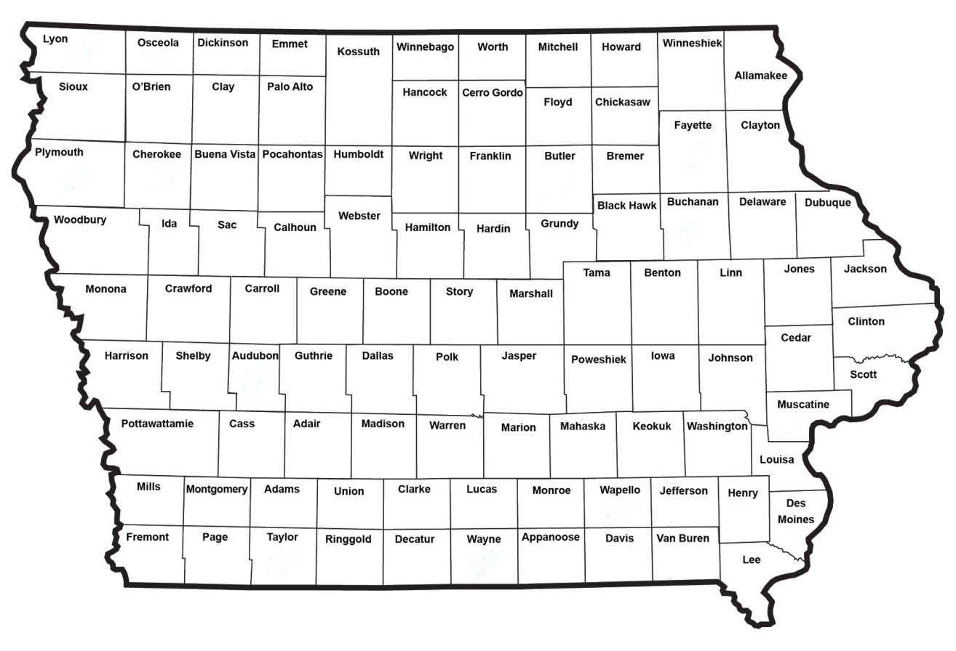
Map of Applications Received

Slide 8
QUESTIONS?
Laura Hutzell, Rail Transportation Bureau
Laura.Hutzell@iowadot.us
515-239-1066

Slide 9
CRANDIC – AW 2235
The proposed project is for construction of industry lead tracks and industry tracks to support the competitive shipment of product in the Cedar Rapids area. Rail service will be for one of the largest economic development prospects in the history of the state. The project will create approximately 385 new jobs.
Total Cost: $5,400,000
Requested: $2,700,000 (50%)
Return to Recommendation Summary

Slide 10
BJRY Passing Track
The project will construct 1,300 feet of rail that will serve as a relocated passing track on the BJRY mainline. This project will increase efficiency and capacity of BJRY’s operations.
Total Cost: $285,259
Requested: $228,207 (80%)
Return to Recommendation Summary

Slide 11
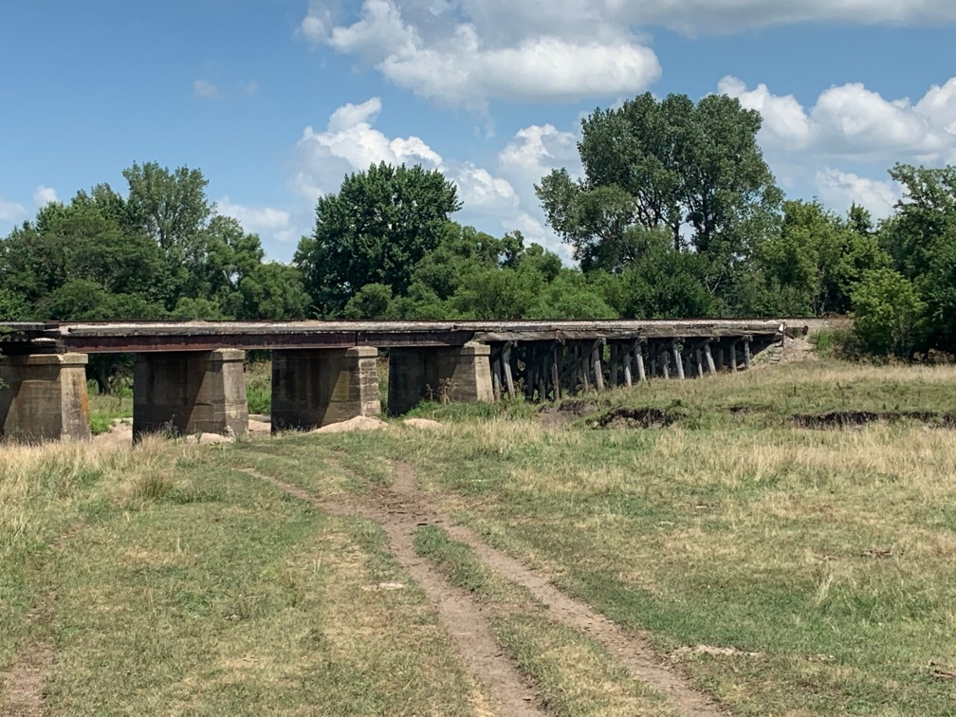
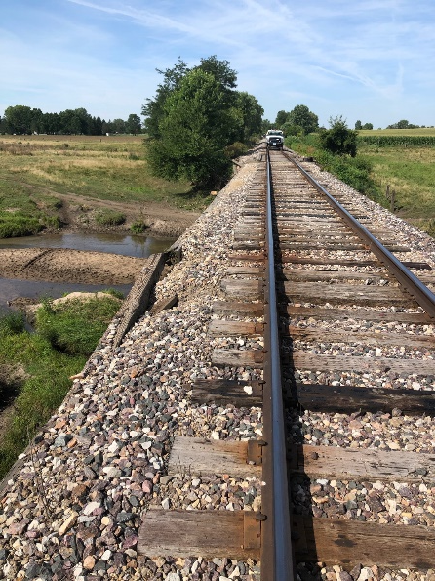
IANR Bridge Replacement Project
IANR recently entered into a long term operation and maintenance agreement with the Union Pacific Railroad (April 2019). IANR has assumed all maintenance of the line. One of the main areas of focus on the line is the Railroad bridge in Waterloo, Iowa. This bridge can no longer hold 286# railcars, and is in need of replacement.
Total Cost: $1,300,000
Requested: $487,500 (37.5%)
Return to Recommendation Summary

Slide 12
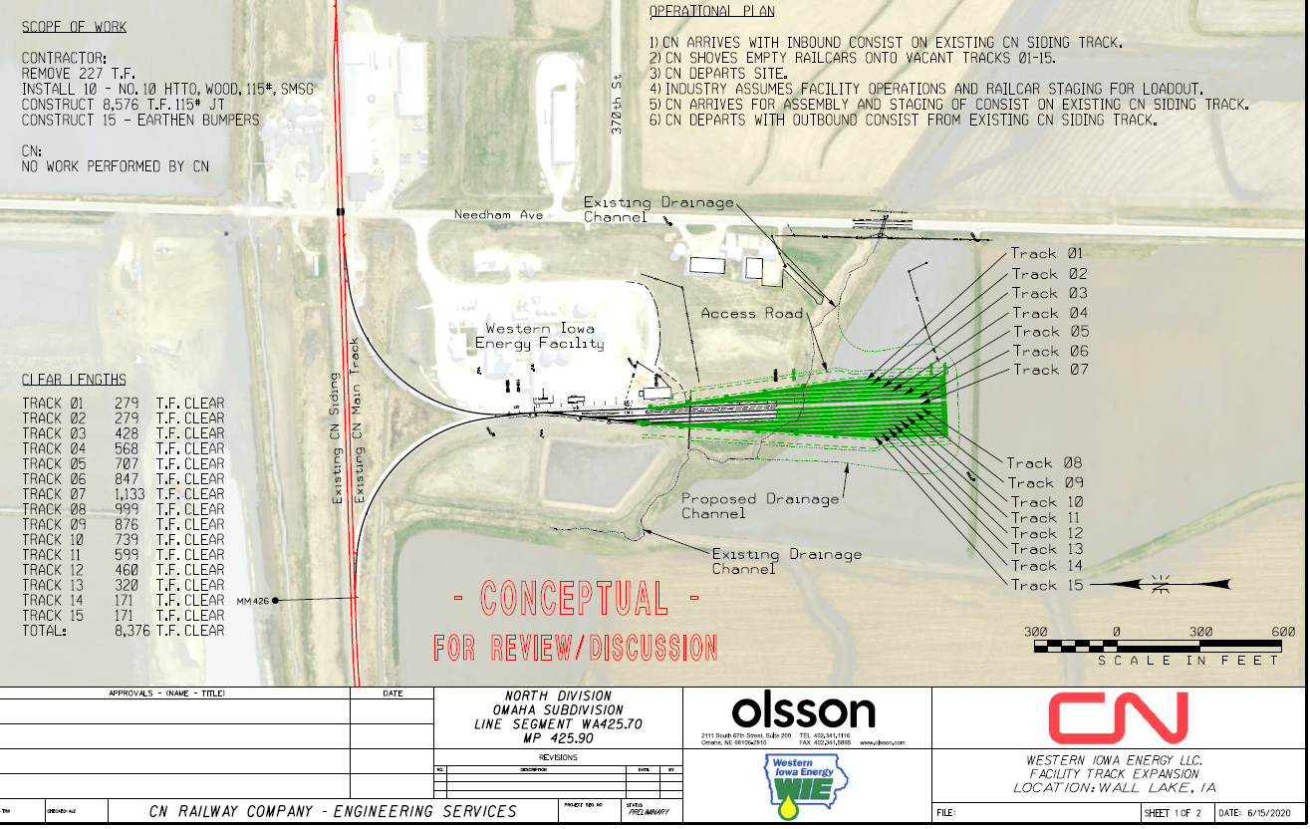
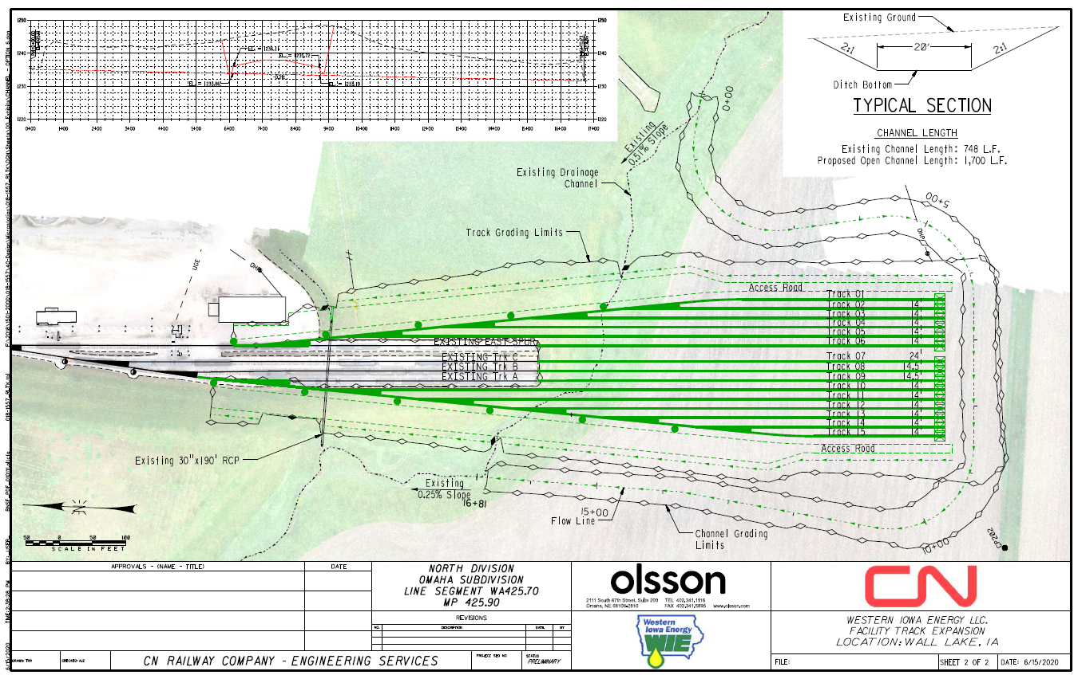
Western Iowa Energy Rail Expansion
This project is adding track capacity and track infrastructure to Western Iowa Energy’s existing facility in Wall Lake, IA. The rail expansion involves a series of storage tracks at the end of the current spur. The existing spur is currently inadequate for outbound product.
Total Cost: $4,677,405
Requested: $1,000,000 (21.3%)
Return to Recommendation Summary

Slide 13
River Cities Business Park Rail Study
This planning study will evaluate the need and ability to create a rail spur that will connect River City Management’s properties from Davenport to neighboring Eldridge, Iowa. At one point, CP served the site, however mainline connections were disconnected. River Cities is again interested in connecting these two properties via a rail spur and want to conduct a study to see if the two properties can accommodate additional rail spurs and again be served by CP.
Total Cost: $100,000
Requested: $80,000 (80%)
Return to Recommendation Summary

Slide 14
Dallas County/Dexter Railport Development Study
The proposed study is to plan for future rail service on a site known as the Gerdau site as a railport in Dallas County, Iowa. This study will determine potential developmental and startup costs, spur expansion and addition options, site design and engineering as well as determine options for future direction of rail yard services and capabilities of expansion and property acquisition. Site currently has a rail spur that connects to the IAIS mainline.
Total Cost: $125,000
Requested: $100,000 (80%)
IEDA Certified—West Metro Rail Park
Return to Recommendation Summary
Proposed site

Slide 15
List of Applications Not Recommended for Award
REQUESTED AMOUNT
(% of Total Project Cost)
RECOMMENDED AMOUNT
(% of Total Project Cost)
PROJECT NAME
SPONSOR
SCORE
TOTAL PROJECT COST
Pattison Sand Phase IV | Pattison Sand Company | NA (Loan only) | $3,284,000 | Loan: 2,627,200 (80%) | Loan: $0
Return to Recommendation Summary
Notes:
Due to limited funding for FY ‘21, and large amounts of previously dedicated funding for this multi phase project, Pattison Sand is not being recommended for funding in FY ‘21.

