Slide 1
COVID-19 Transportation Funding Impact Update
Transportation Commission Workshop
September 8, 2020

Slide 2
Update
Travel trends
  US total rail carloads
  Commercial air service passenger counts
  Vehicular traffic
  Vehicle sales
Funding
  State Road Use Tax Fund
  Federal funding update

Slide 5
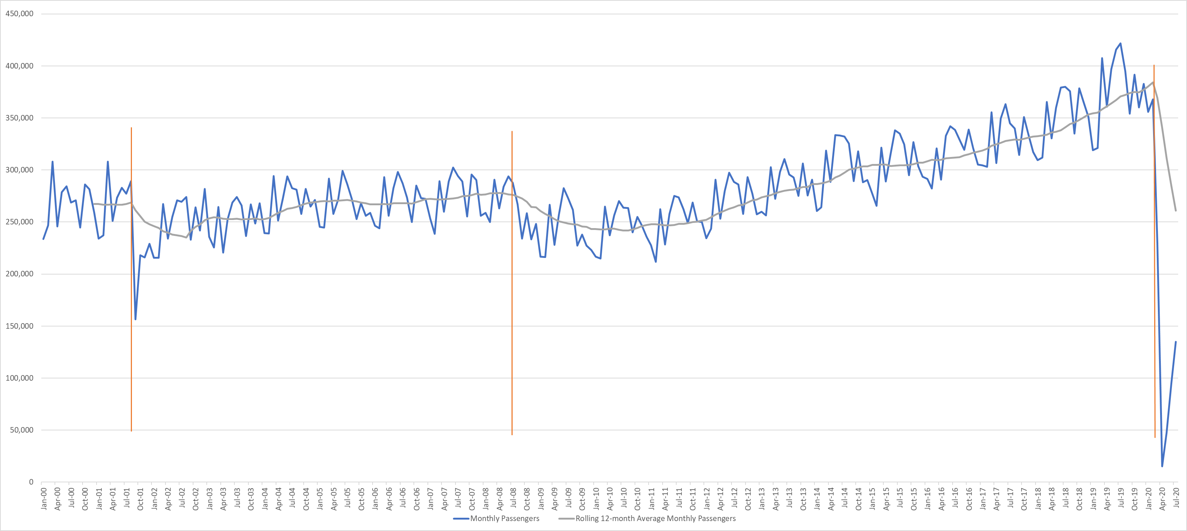
Monthly Passenger Counts at Iowa’s Eight Commercial Service Airports
(through July 2020)
9/11
2008 Recession
COVID-19

Slide 6
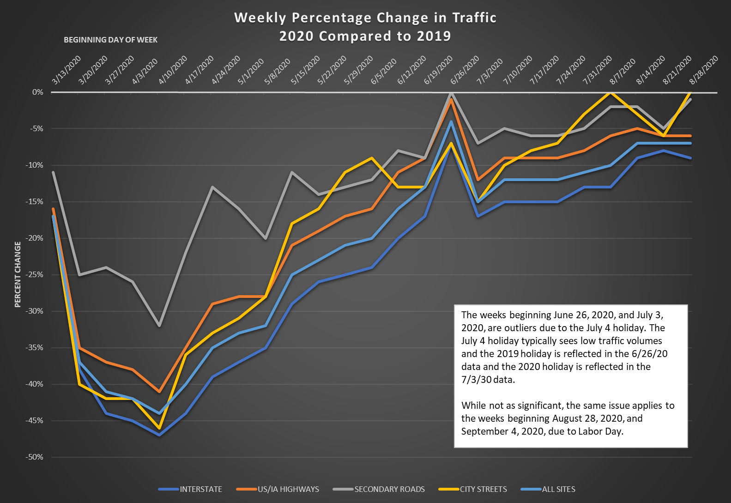

Slide 7
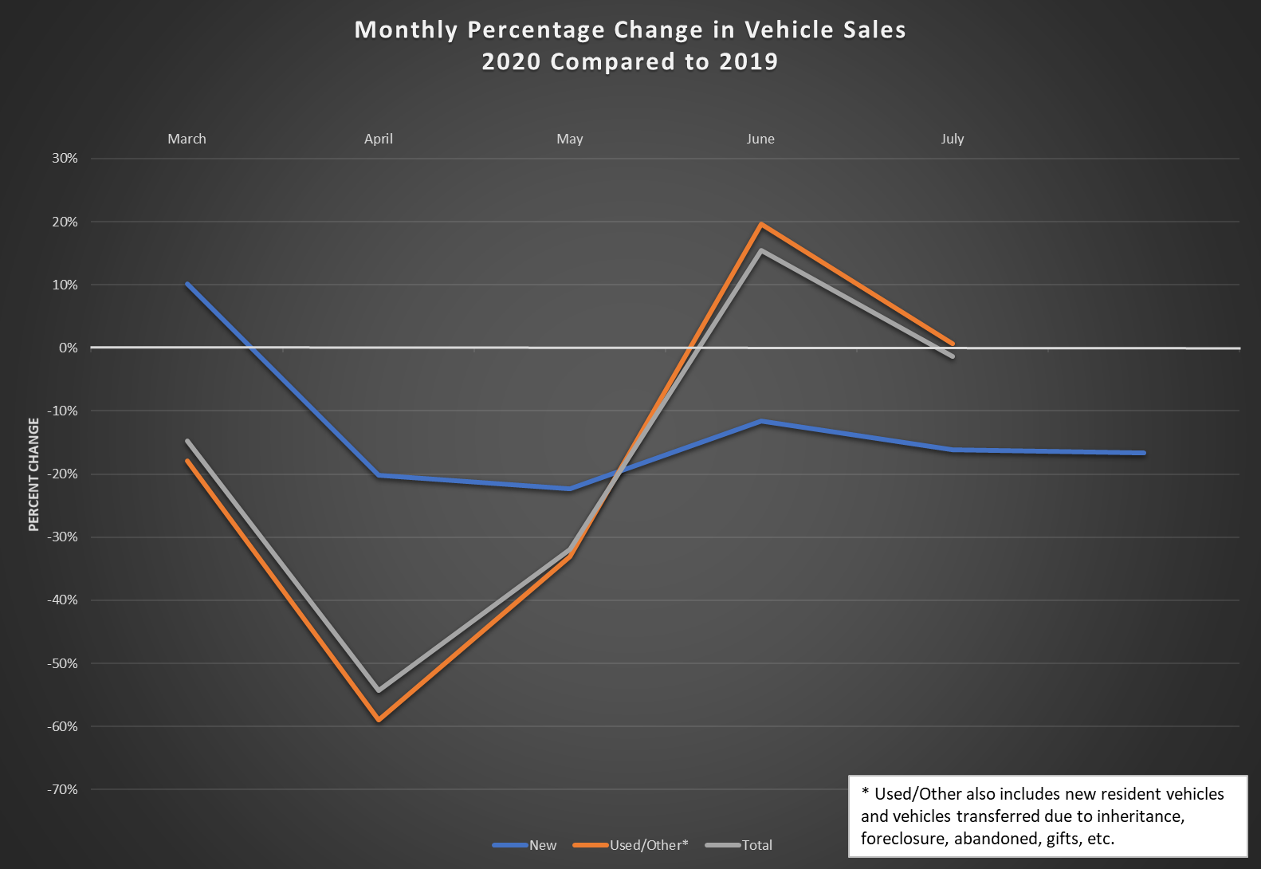

Slide 8
Road Use Tax Fund
Funding sources
  Fuel tax revenue down with reduced travel
  Fee for New Registration revenue down with reduced vehicle sales
  Annual vehicle registration revenue down slightly

Slide 9
Road Use Tax Fund (cont.)
Monthly Funding Impacts
  June allocation of RUTF (actual): -$25 million
    Generally reflective of April collections
  July allocation of RUTF (actual): +$18 million (had estimated -$1 million)
    COVID-19 impact is offset by a fuel tax deposit timing situation.
  August allocation of RUTF (actual): -$6 million (had estimated -$28 million)
  September allocation of RUTF (actual): -$2 million (had estimated -$19 million)
  October allocation of RUTF (est.): -$17 million (had estimated -$20 million)

Slide 10
Road Use Tax Fund (cont.)
Long-Term Estimated Impacts (not updated since August)
  June 2020 through Oct. 2020 Impact: -$50 million (had estimated -$100 million)
  Nov. 2020 through June 2021 Impact: -$96 million (had estimated -$118 million)
Reasons for Changes
  Vehicle sales did not drop as significantly as data originally showed. Much of the drop was due to delayed processing as a result of COVID-19 office closures.
  Fuel tax
    Diesel tax is helping offset lower gasoline tax
    Fuel tax receipts may still not fully reflect lower travel trends

Slide 11
Federal Funding Update
Reauthorization – no additional action
FFY 2021 Appropriation – discussion of continuing resolution that extends into December
COVID-19 Relief Package
  House passed bill on May 15, 2020
  Senate proposal released July 27, 2020
  Negotiations failed by self-imposed August 7, 2020 deadline
  Primary issue: whether to provide financial aid to state and local governments

Slide 12
Questions?

