Slide 1
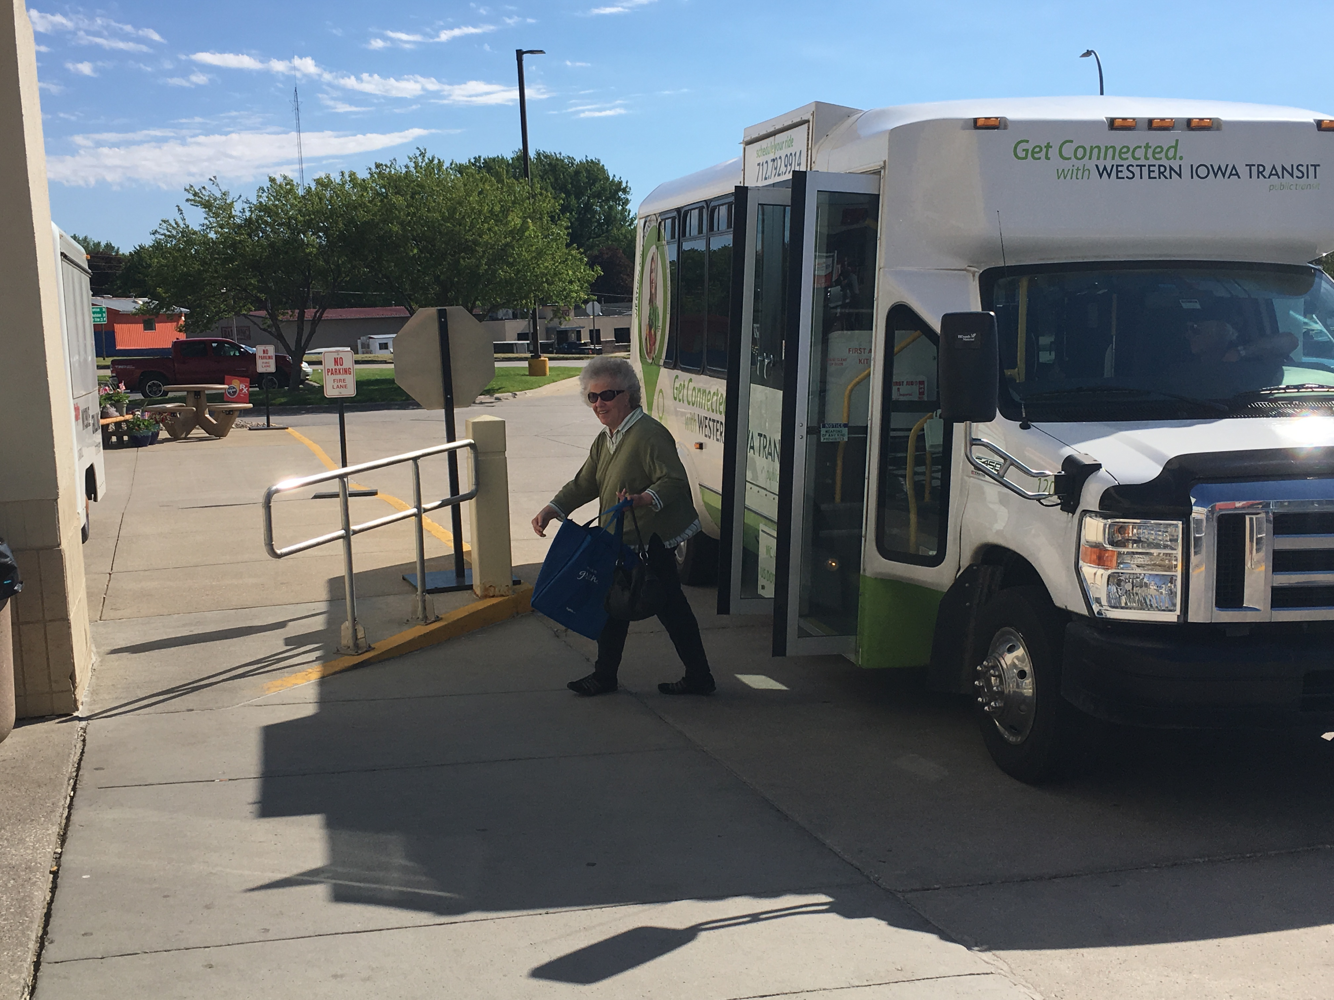

FFY 2020 Federal Bus Replacement Discretionary Funding

Slide 2

Grants for Buses and Bus Facilities Program
Purpose: Federal Transit Administration (FTA) program to assist in the financing of buses and bus facility capital projects, including replacing, rehabilitating, purchasing or leasing buses or related equipment, and rehabilitating, purchasing, constructing or leasing bus-related facilities
Eligible Applicants: Designated recipients that allocate funds to fixed route bus operators, states, local governmental authorities that operate fixed route bus service, Native American tribes

Slide 3
Project Evaluation Criteria
Demonstration of need for capital investment in bus vehicles and/or supporting facilities
Demonstration of benefit for how the project will improve transit system condition, service reliability, and enhance access and mobility
Demonstration of how the project is consistent with transit priorities identified in the long range plan
Local financial commitment
Project implementation strategy
Demonstration of technical, legal and financial capacity to undertake the project

Slide 4
Available Funding and Funding Recommendation
Available funding
  $464 million offered in FFY 2020
  282 project submitted nationwide totaling approximately $1.8 billion in funding requests
  96 projects funded nationwide averaging $4.8 million each
  Iowa DOT awarded $5.54 million
Funding recommendation
  Replace 26 old vehicles operating beyond their federal useful life at 8 public transit agencies
  Utilized Public Transit Management System process
    Points awarded based on age and mileage
    Prioritize highest points down

Slide 5
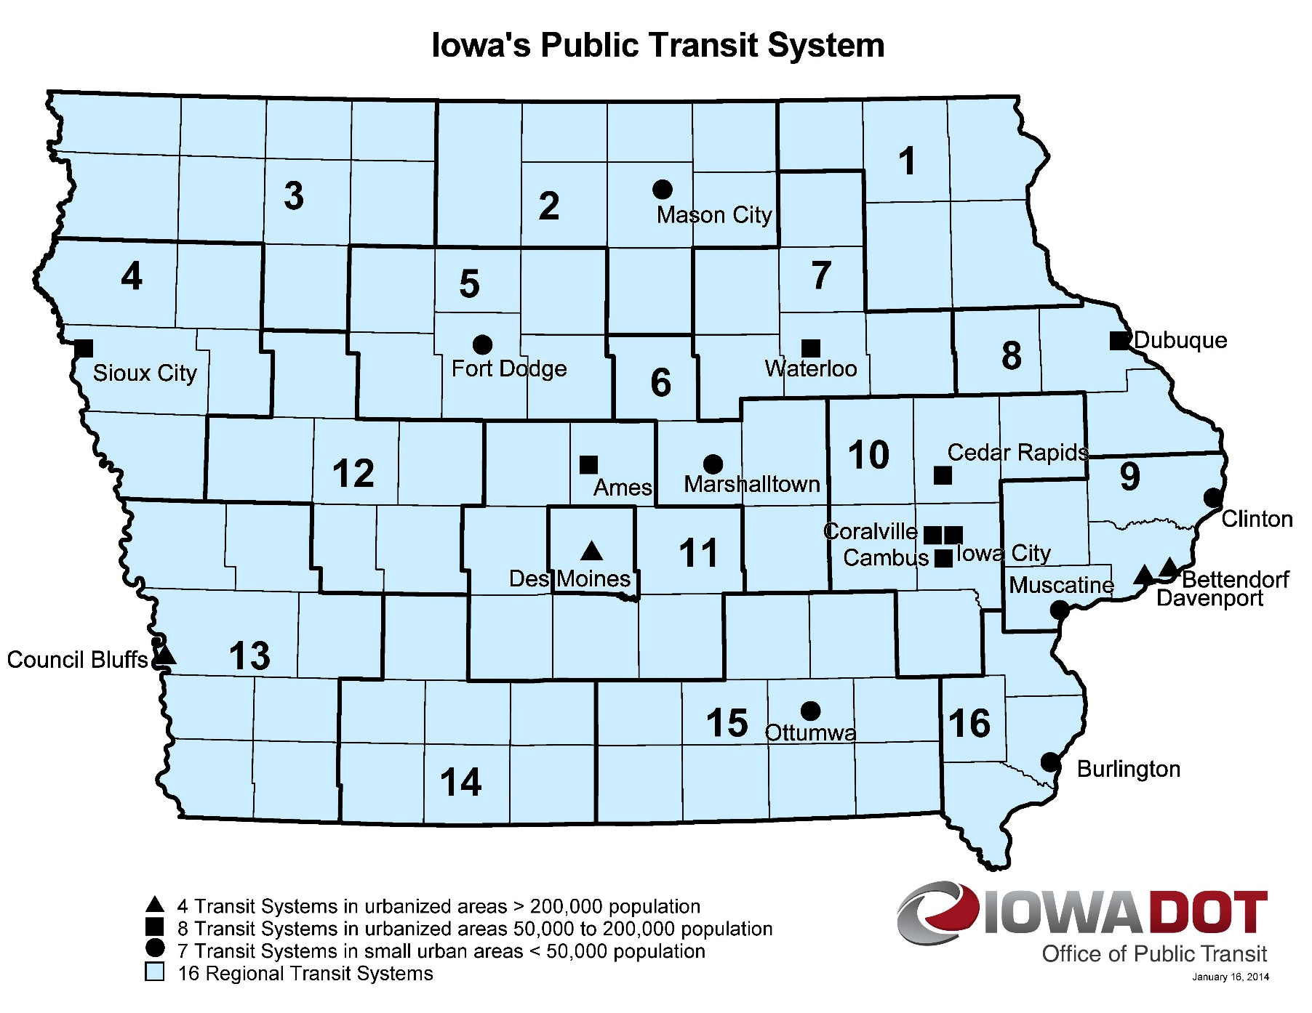
Transit System Vehicle Replacements
Notes:
21 Public Transit Agencies Awarded

Slide 6

QUESTIONS?
Sree Mitra
Transit Program Manger
Sreeparna.mitra@iowadot.us
For more information on Iowa’s public transit and intercity bus programs, visit
www.iowadot.gov/transit

