Slide 1
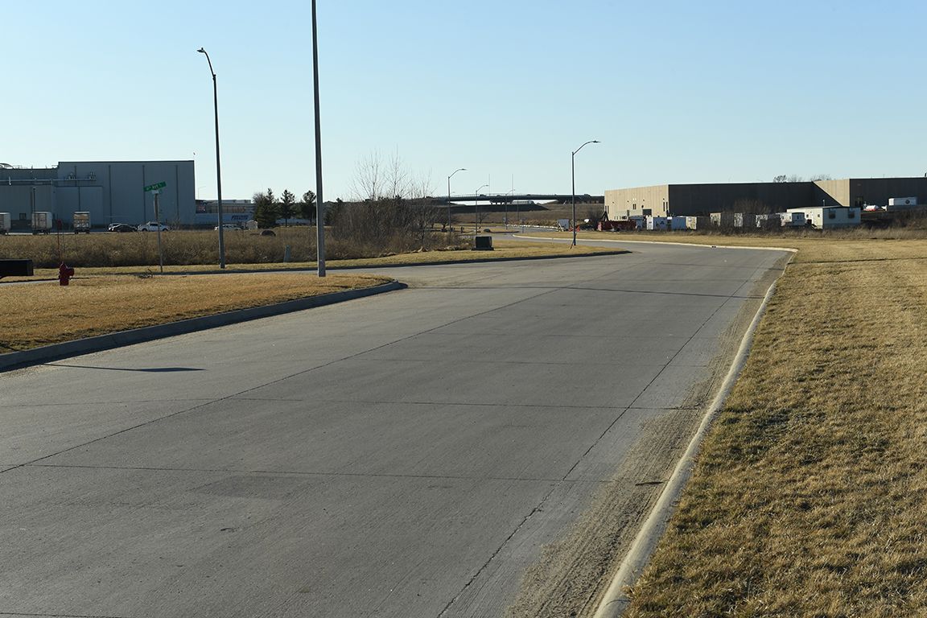
Revitalize Iowa’s Sound Economy Program
Iowa Transportation Commission Workshop
Workforce Housing Element RISE Policy
September 14, 2021

Slide 2
Summary of Potential Projects in RPA 12
Site #1:
Population approximately 500;
16 proposed lots (8 – 0.35 acres each and 8 – 0.71 acres each);
Projected development cost is $870,000 of which $325,000 is related to city street expenses;
Street construction bidding possibly early in 2022.
Site #2:
Population approximately 1,100;
15 proposed lots;
Projected development cost is $800,000 of which $550,000 is related to city street expenses;
Street construction bidding possibly early in 2022.

Slide 3
Summary of a Recently Completed Project in an RPA 12 city of about 4,500
Two homes built by a local contractor:
2 bedroom/2 bath – 1,000 square feet – 20’ x 20’ attached garage – full unfinished basement – 1 egress window – plumbing stubbed in basement for future bathroom;
Sold for $175,000 each;
City provided free lots, all funding for sidewalks, utility hookups and waived all construction permit fees.
Two homes from “Homes for Iowa”:
3 bedroom/2 bath – 1,200 square feet – 24’ x 24’ attached garage - full unfinished basement – two egress windows – plumbing stubbed in the basement for future bathroom;
Sold for $190,000 each;
City provided all funding for sidewalks, utility hookups and lot maintenance.

Slide 4
Interim Workforce Housing Element RISE Policy Requirements
Support rural/small city workforce housing;
Priority for in-fill workforce housing in areas with a housing shortage but also allow applications for new subdivision development;
Must provide sidewalks, water/sewer/other utility hookups;
Leverage local funding including their use of TIF/CDBG/etc;
Collaborate with Iowa Economic Development Authority and Regional Planning Affiliations to identify a small number of pilot communities to submit funding applications for future Transportation Commission approval at a maximum 70% RISE participation rate;

Slide 5
Recommended Next Steps
Set-aside a maximum of $2,000,000 in RISE funding for all initial pilot projects;
Applications due early spring of 2022;
Review applications with Transportation Commission late spring or early summer;
Following this review, seek Transportation Commission approval of any applications meeting intent of the new Workforce Housing policy.

Slide 6
QUESTIONS?
Craig Markley, Systems Planning Bureau
craig.markley@iowadot.us
515-239-1027

