Slide 1
State Recreational Trails Program
Funding Recommendation

Slide 2
State Recreational Trail Program
Created in 1988
Available to cities, counties, state agencies, local governments, or non-profit organizations through an application program
Purpose is to establish recreational trails in Iowa for the use, enjoyment and participation of the public.

Slide 3
Project Evaluation Criteria
Need in terms of population to be served and existing trails in the area (25 points)
Compatibility with local, areawide, regional or statewide plans (15 points)
Benefits of multiple uses and recreational opportunities (20 points)
Quality of the site (25 points)
Economic benefits to the local area (10 points)
Special facilities for disabled users (5 points)
Project is "shovel ready“ and will be completed by 6-30-2024 (25 points)
Projects with cash match (5 points)

Slide 4
Available Funding and Application Summary
Available Funding:
FY 2022 Legislative appropriation from the Rebuild Iowa Infrastructure Fund: $1,500,000
Application Summary:
Total number of projects: 37
Total project costs: $36,588,196
Total amount requested: $14,525,462

Slide 5
List of Applications Recommended
PROJECT NAME | SPONSOR | SCORE | TOTAL PROJECT COST | REQUESTED AMOUNT (% of Total Project Cost) | RECOMMENDED AMOUNT (% of Total Project Cost)
Heart of Iowa Nature Trail: Paving Skunk River Bridge to 610th Avenue | Story County Conservation Board | 108 | $674,000 | $384,000 (57%) | $384,000 (57%)
Raccoon River Valley Trail to High Trestle Trail Connector: S Avenue to Iowa 210 | Woodward | 107 | $393,000 | $220,080 (56%) | $220,080 (56%)
Grant Wood Trail: Paving Waldo’s Rock to Oxley Road | Linn County Conservation Board | 100 | $735,000 | $400,000 (54%) | $400,000 (54%)
Jump to applications not recommended for funding

Slide 6
List of Applications Recommended
PROJECT NAME | SPONSOR | SCORE | TOTAL PROJECT COST | REQUESTED AMOUNT (% of Total Project Cost) | RECOMMENDED AMOUNT (% of Total Project Cost)
Keokuk Riverfront Trail | Keokuk | 100 | $1,182,371 | $493,595 (42%) | $493,595 (42%)
Jump to applications not recommended for funding

Slide 7
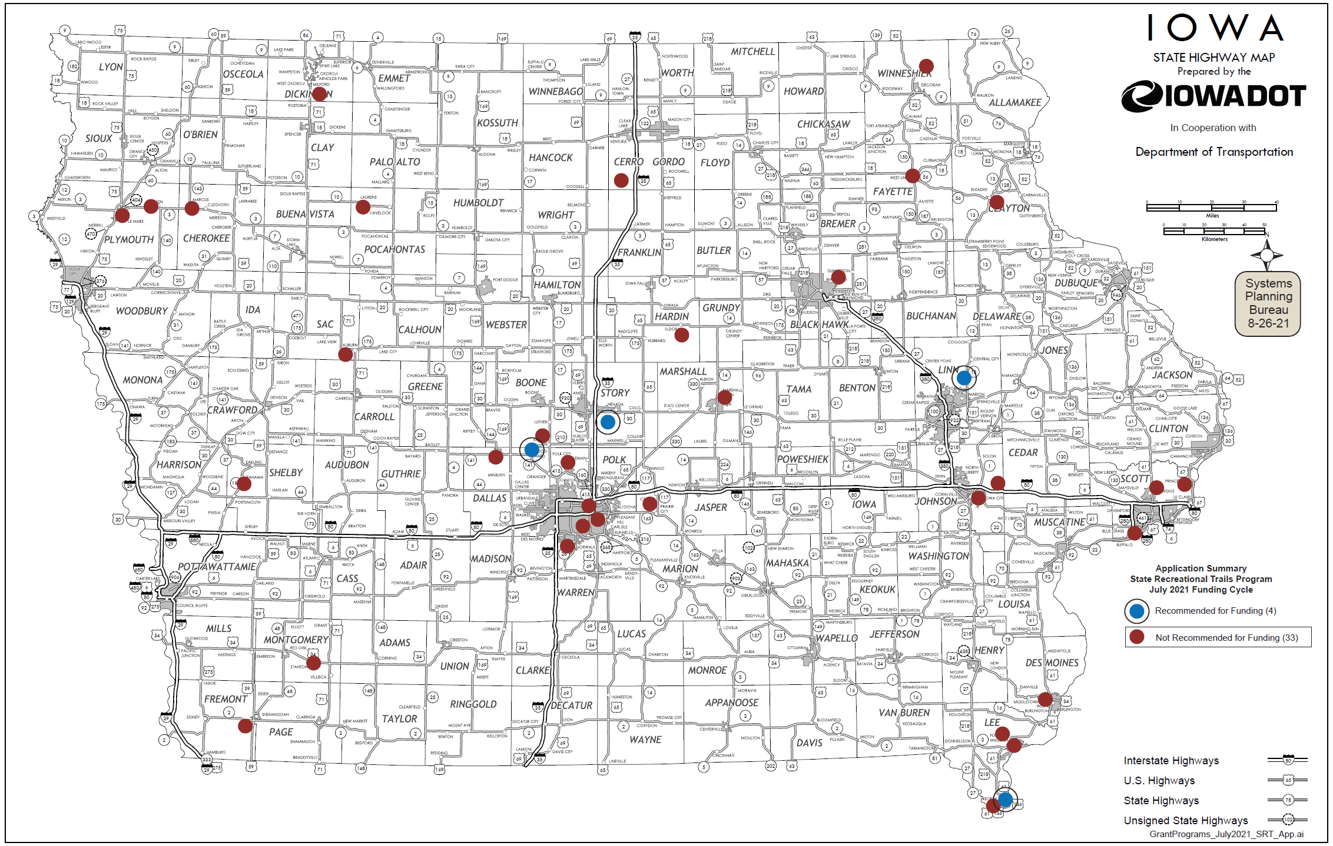
Map of Applications Received

Slide 8
QUESTIONS?
Craig Markley, Systems Planning Bureau
craig.markley@iowadot.us
515-239-1027

Slide 9
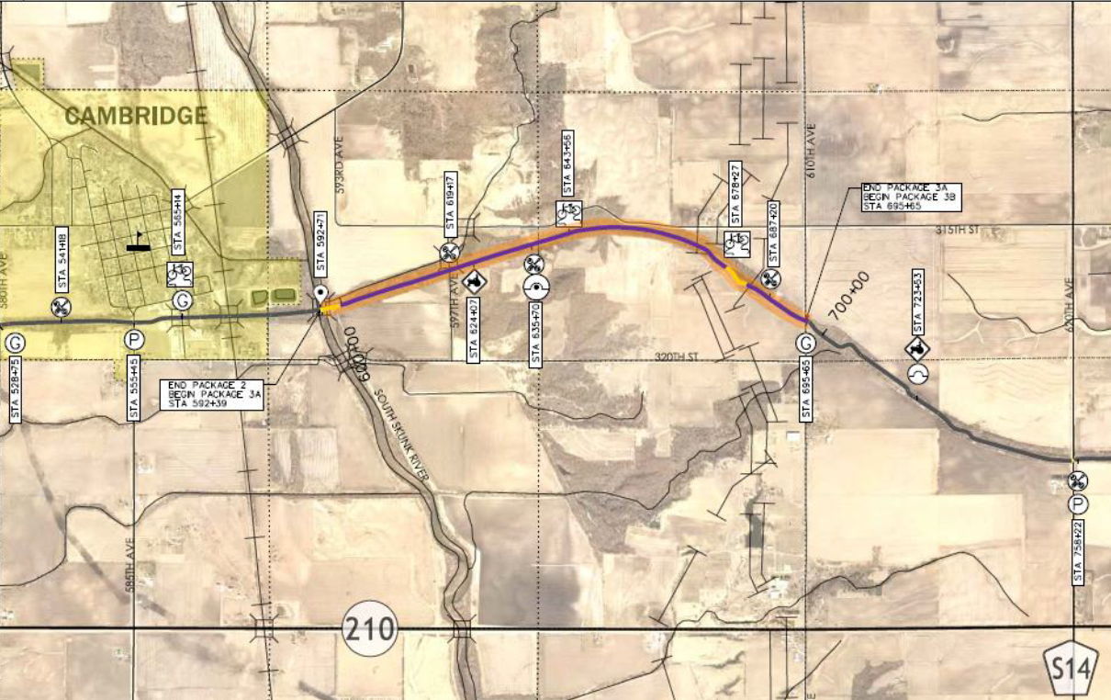
Heart of Iowa Nature Trail: Paving Skunk River Bridge to 610th Avenue
(Story County Conservation Board)
This project includes improvements and hard surfacing of 1.9 miles of existing limestone trail beginning at the east end of South Skunk River Scenic Bridge and ending at 610th Avenue.
Total Cost: $674,000
Requested: $384,000 (57%)
Return to List of Applications Recommended

Slide 10
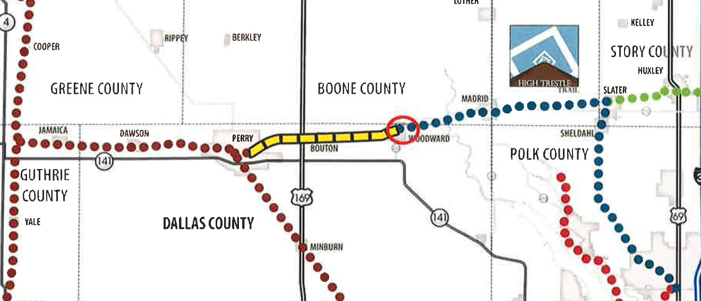
Raccoon River Valley Trail to High Trestle Trail Connector: S Avenue to Iowa 210
(Woodward)
This phase connects to the existing High Trestle Trailhead along Iowa 210. The connection begins at S Avenue and travels east ending at the trailhead entrance on Iowa 210.
Total Cost: $393,000
Requested: $220,080 (56%)
Return to List of Applications Recommended

Slide 11
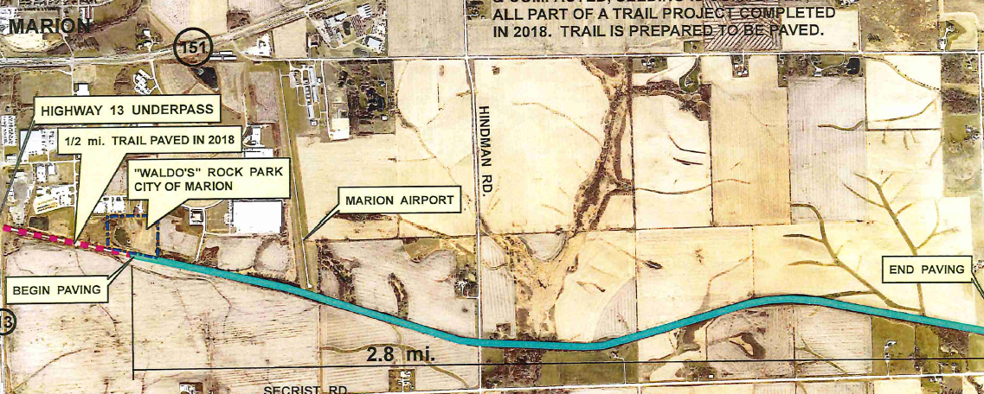
Grant Wood Trail: Paving Waldo’s Rock Park to Oxley Road
(Linn County Conservation Board)
This project applies a hard surface to 2.8 miles of existing limestone trail. Beginning at Waldo’s Rock Park travelling east and ending at Oxley Road. Project is an extension of previous 2.4 miles of hard surfacing on the east end of Marion. Trail provides both a grassed, soft surface for runners and horseback riders and a hard surface for bikes, wheelchairs and strollers.
Total Cost: $735,000
Requested: $400,000 (54%)
Return to List of Applications Recommended

Slide 12
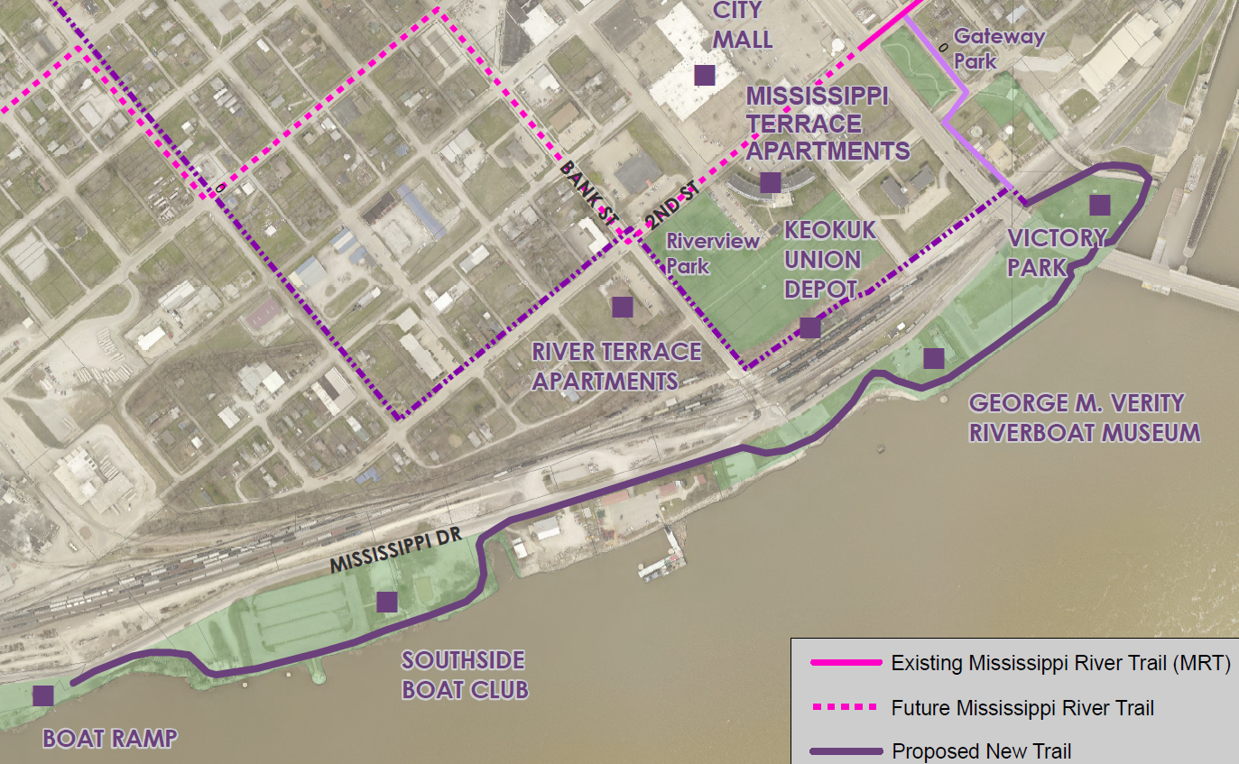
Keokuk Riverfront Trail
(Keokuk)
This project will construct a 1.0-mile trail along Keokuk’s riverfront. Beginning at Victory Park and heading southwest ending at the Boat Ramp.
Total Cost: $ 1,182,371
Requested: $ 493,595 (42%)
Return to List of Applications Recommended

Slide 13
List of Applications Not Recommended for Award
PROJECT NAME | SPONSOR | SCORE | TOTAL PROJECT COST | REQUESTED AMOUNT (% of Total Project Cost) | RECOMMENDED AMOUNT (% of Total Project Cost)
Connecting Fort Madison! Phase 4 | Fort Madison | 98 | $625,477 | $440,000 (70%) | $0
Prairie Land Trail: Grouse Avenue to 100th Street | Cerro Gordo County Conservation Board | 97 | $1,742,500 | $300,000 (17%) | $0
Great Western Trail Rehabilitation Phase 1 | Warren County Conservation Board | 96 | $752,000 | $115,000 (15%) | $0
Plywood Trail Phase 1B | Le Mars | 96 | $1,599,775 | $350,000 (22%) | $0
Stanton Greenbelt Trail Phases 1, 2 and 3 | Stanton | 96 | $1,250,000 | $890,000 (71%) | $0
Iowa River’s Edge Trail: Paving Iowa 175 to 260th Street | Hardin County | 95 | $1,000,000 | $300,000 (30%) | $0
Return to List of Applications Recommended

Slide 14
List of Applications Not Recommended for Award
PROJECT NAME | SPONSOR | SCORE | TOTAL PROJECT COST | REQUESTED AMOUNT (% of Total Project Cost) | RECOMMENDED AMOUNT (% of Total Project Cost)
Riverview Connection Trail | Des Moines | 94 | $650,000 | $400,000 (62%) | $0
Clear Creek Trail: Half Moon Avenue to F.W. Kent Park | Johnson County Conservation Board | 94 | $2,988,000 | $388,000 (13%) | $0
Bee Branch Creek Trail: Phase 2 | Dubuque | 94 | $825,254 | $502,329 (61%) | $0
Pony Hollow Trail Phase 1 | Clayton County Conservation Board | 93 | $898,227 | $206,227 (23%) | $0
Dry Run Trail | Winneshiek County Conservation Board | 93 | $1,727,419 | $200,000 (12%) | $0
Grant Park Trail Phase 2 | Auburn | 93 | $690,000 | $415,000 (60%) | $0
Return to List of Applications Recommended

Slide 15
List of Applications Not Recommended for Award
PROJECT NAME | SPONSOR | SCORE | TOTAL PROJECT COST | REQUESTED AMOUNT (% of Total Project Cost) | RECOMMENDED AMOUNT (% of Total Project Cost)
Cedar Valley Nature Trail: Miller Creek Bridge Repairs | Black Hawk County Conservation Board | 93 | $339,425 | $254,568 (75%) | $0
Gear Avenue Trail Extension Phase 2 | West Burlington | 92 | $890,496 | $415,104 (47%) | $0
High Trestle Trail to Swede Point Park Trail | Boone County Conservation Board | 91 | $444,300 | $200,000 (45%) | $0
Iowa River’s Edge Trail: Paving Radio Tower Road to Iowa River | Marshalltown | 91 | $1,025,000 | $450,000 (44%) | $0
Pollmiller Trail Project | Lee County Conservation Board | 89 | $420,000 | $100,000 (24%) | $0
Marcus Trail Phase 1 | Marcus | 87 | $749,410 | $339,000 (45%) | $0
Return to List of Applications Recommended

Slide 16
List of Applications Not Recommended for Award
PROJECT NAME | SPONSOR | SCORE | TOTAL PROJECT COST | REQUESTED AMOUNT (% of Total Project Cost) | RECOMMENDED AMOUNT (% of Total Project Cost)
Copper Creek Mountain Bike Park | Central Iowa Trails Association | 86 | $640,500 | $50,000 (8%) | $0
Nahant Marsh Trail | Nahant Marsh | 85 | $309,625 | $212,624 (69%) | $0
Perry Trail: Perkins Park to Pattee Park | Perry | 85 | $1,198,135 | $898,601 (75%) | $0
Clay County Connection Phase 1 | Dickinson County | 85 | $712,670 | $234,480 (33%) | $0
Polk City Trail Phase 1B | Polk City | 85 | $712,000 | $534,000 (75%) | $0
Hoover Trail Bridge #2 | Cedar County Conservation Board | 84 | $260,000 | $195,000 (75%) | $0
Gateway to Recreation: West Union to Echo Valley State Park | West Union | 83 | $1,263,489 | $945,284 (75%) | $0
Return to List of Applications Recommended

Slide 17
List of Applications Not Recommended for Award
PROJECT NAME | SPONSOR | SCORE | TOTAL PROJECT COST | REQUESTED AMOUNT (% of Total Project Cost) | RECOMMENDED AMOUNT (% of Total Project Cost)
Mississippi River Trail Phase 1 | Princeton | 80 | $712,000 | $534,000 (75%) | $0
East Lincoln Road Trail | Eldridge | 78 | $1,274,138 | $955,603 (75%) | $0
Red Rock Prairie Trail Phase 2 | Jasper County Conservation Board | 78 | $1,993,700 | $330,000 (17%) | $0
Admiral Trail Phase 2 | Farragut | 76 | $1,497,000 | $300,000 (20%) | $0
Shelby County Trail Phase 2 | Shelby County | 76 | $1,007,310 | $755,485 (75%) | $0
Return to List of Applications Recommended

Slide 18
List of Applications Not Recommended for Award
PROJECT NAME | SPONSOR | SCORE | TOTAL PROJECT COST | REQUESTED AMOUNT (% of Total Project Cost) | RECOMMENDED AMOUNT (% of Total Project Cost)
Broadway Avenue Trail: NW 2nd Avenue to the Neal Smith Trail | Polk County Conservation Board | 76 | $2,151,000 | $400,000 (19%) | $0
Prairie Park Trail | Laurens | 69 | $1,165,000 | $350,000 (30%) | $0
Walking Trail Resurfacing | Remsen | 57 | $89,975 | $67,481 (75%) | $0
Return to List of Applications Recommended

