Slide 1
FY 2023 Highway-Railroad Crossing Safety Program
September 14, 2021

Slide 2
Program
FHWA Funding available for states to improve warning devices at railroad crossings. (23 USC Section 130)
Amount of appropriation funded by FHWA is determined by the number of public crossings in the state.
Iowa currently has 4,950 public railroad crossings.

Slide 3
Project Evaluation Criteria
Benefit-Cost Ratio
Formula includes:
Number of accidents
Exposure Index, (number of trains x number of vehicles)
Train traffic
Vehicle traffic
Predicted Accidents, (train speed, roadway speed, number of traffic lanes, number of tracks)
Existing warning devices vs. possible upgrades
On-site safety diagnostic review
An application must be filed with the department

Slide 4
Available Funding and Application Summary
90% Federal Funds from FHWA
10% match by Highway Authority or Railroad
Applicant can be either Roadway Authority or Railroad, or combination of the two
Number of projects: 18 (16 & 2 closure incentives)
Total project costs: $5,700,556
Total FHWA project costs: $5,130,500
Annual Apportionment: $5,051,497

Slide 5
List of Applications Recommended
PROJECT NAME | SPONSOR | SCORE | TOTAL PROJECT COST | REQUESTED AMOUNT (% of Total Project Cost) | RECOMMENDED AMOUNT (% of Total Project Cost)
NE Broadway 876012P | Polk County | N/A * | $555,555.56 | $500,000 (90%) | $500,000 (90%)
IA 3, 067357C | BNSF Railroad Iowa DOT | 4.46 | $35,000 | $31,500 | $31,500 (90%)
115th Street, 190461F | UP Railroad Cedar County | 3.35 | $375,000 | $337,500 (90%) | $337,500 (90%)
185th Avenue, 608572K | UP Railroad Kossuth County | 1.35 | $325,000 | $292,500 (90%) | $292,500 (90%)
E Street 385427R | DME Railroad City of Charles City | 1.47 | $475,000 | $427,500 (90%) | $427,500 (90%)
* There is no modeling for a grade separation, (elimination of a railroad crossing via a bridge) within the project
selection formulas. Polk County has a $5 million project to replace the at-grade railroad crossing with a
roadway-under bridge. This funding request will make the project possible.

Slide 6
List of Applications Recommended
PROJECT NAME | SPONSOR | SCORE | TOTAL PROJECT COST | REQUESTED AMOUNT (% of Total Project Cost) | RECOMMENDED AMOUNT (% of Total Project Cost)
440th Street, 608579H | UP Railroad Kossuth County | 1.35 | $325,000 | $292,500 (90%) | $292,500 (90%)
8th Avenue SE, 190501B | UP Railroad City of Cedar Rapids | 1.24 | $375,000 | $337,500 (90%) | $337,500 (90%)
42nd Street, 607858A | IANR Railroad City of Cedar Rapids | 1.22 | $225,000 | $202,500 (90%) | $202,500 (90%)
Linwood Avenue 190734X | UP Railroad Greene County | 1.19 | $375,000 | $337,500 (90%) | $337,500 (90%)
Wilson Avenue SW, 376730N | CRANDIC Railroad City of Cedar Rapids | 1.0 | $325,000 | $283,500 (90%) | $292,500 (90%)

Slide 7
List of Applications Recommended
PROJECT NAME | SPONSOR | SCORE | TOTAL PROJECT COST | REQUESTED AMOUNT (% of Total Project Cost) | RECOMMENDED AMOUNT (% of Total Project Cost)
32nd Avenue, 190547P | UP Railroad Benton County | 0.97 | $375,000 | $337,500 (90%) | $337,500 (90%)
Tombstone Trail, 607175J | DME Railroad Muscatine County | 0.75 | $475,000 | $427,500 (90%) | $427,500 (90%)
22nd Avenue, 922467W | UP Railroad Benton County | 0.67 | $375,000 | $337,500 (90%) | $337,500 (90%)
William Street, 380054C | DME Railroad City of Carpenter | 0.66 | $475,000 | $427,500 (90%) | $427,500 (90%)
US 6, 606843G | IAIS Railroad Iowa DOT | 0.61 | $375,000 | $337,500 (90%) | $337,500 (90%)

Slide 8
List of Applications Recommended
PROJECT NAME | SPONSOR | SCORE | TOTAL PROJECT COST | REQUESTED AMOUNT (% of Total Project Cost) | RECOMMENDED AMOUNT (% of Total Project Cost)
220th Street 607399G | IANR Railroad Butler County | 0.14 ** | $220,000 | $198,000 (90%) | $198,000 (90%)
2 projected closure incentive payments at various locations ($7,500 each location) | TBD | N/A | $15,000 | $15,000 (100%) | $15,000 (100%)
** Shell Rock Soy Processing announced that they would be opening a new soybean processing facility
immediately to the west of the IANR main track and south of 220th Street. The plant location is directly south of
new projects: Trinity Rail Maintenance Services, Butler Intermodal Terminal, Zinpro Corporation, and American
Colloid Company, due west of Flint Hills Resources ethanol plant. There is significant industrial and job
growth in this area.
The current roadway average daily traffic factored into the project selection formula does not represent the
anticipated growth in this area, nor the number of vehicles anticipated to traverse this railroad crossing.

Slide 9
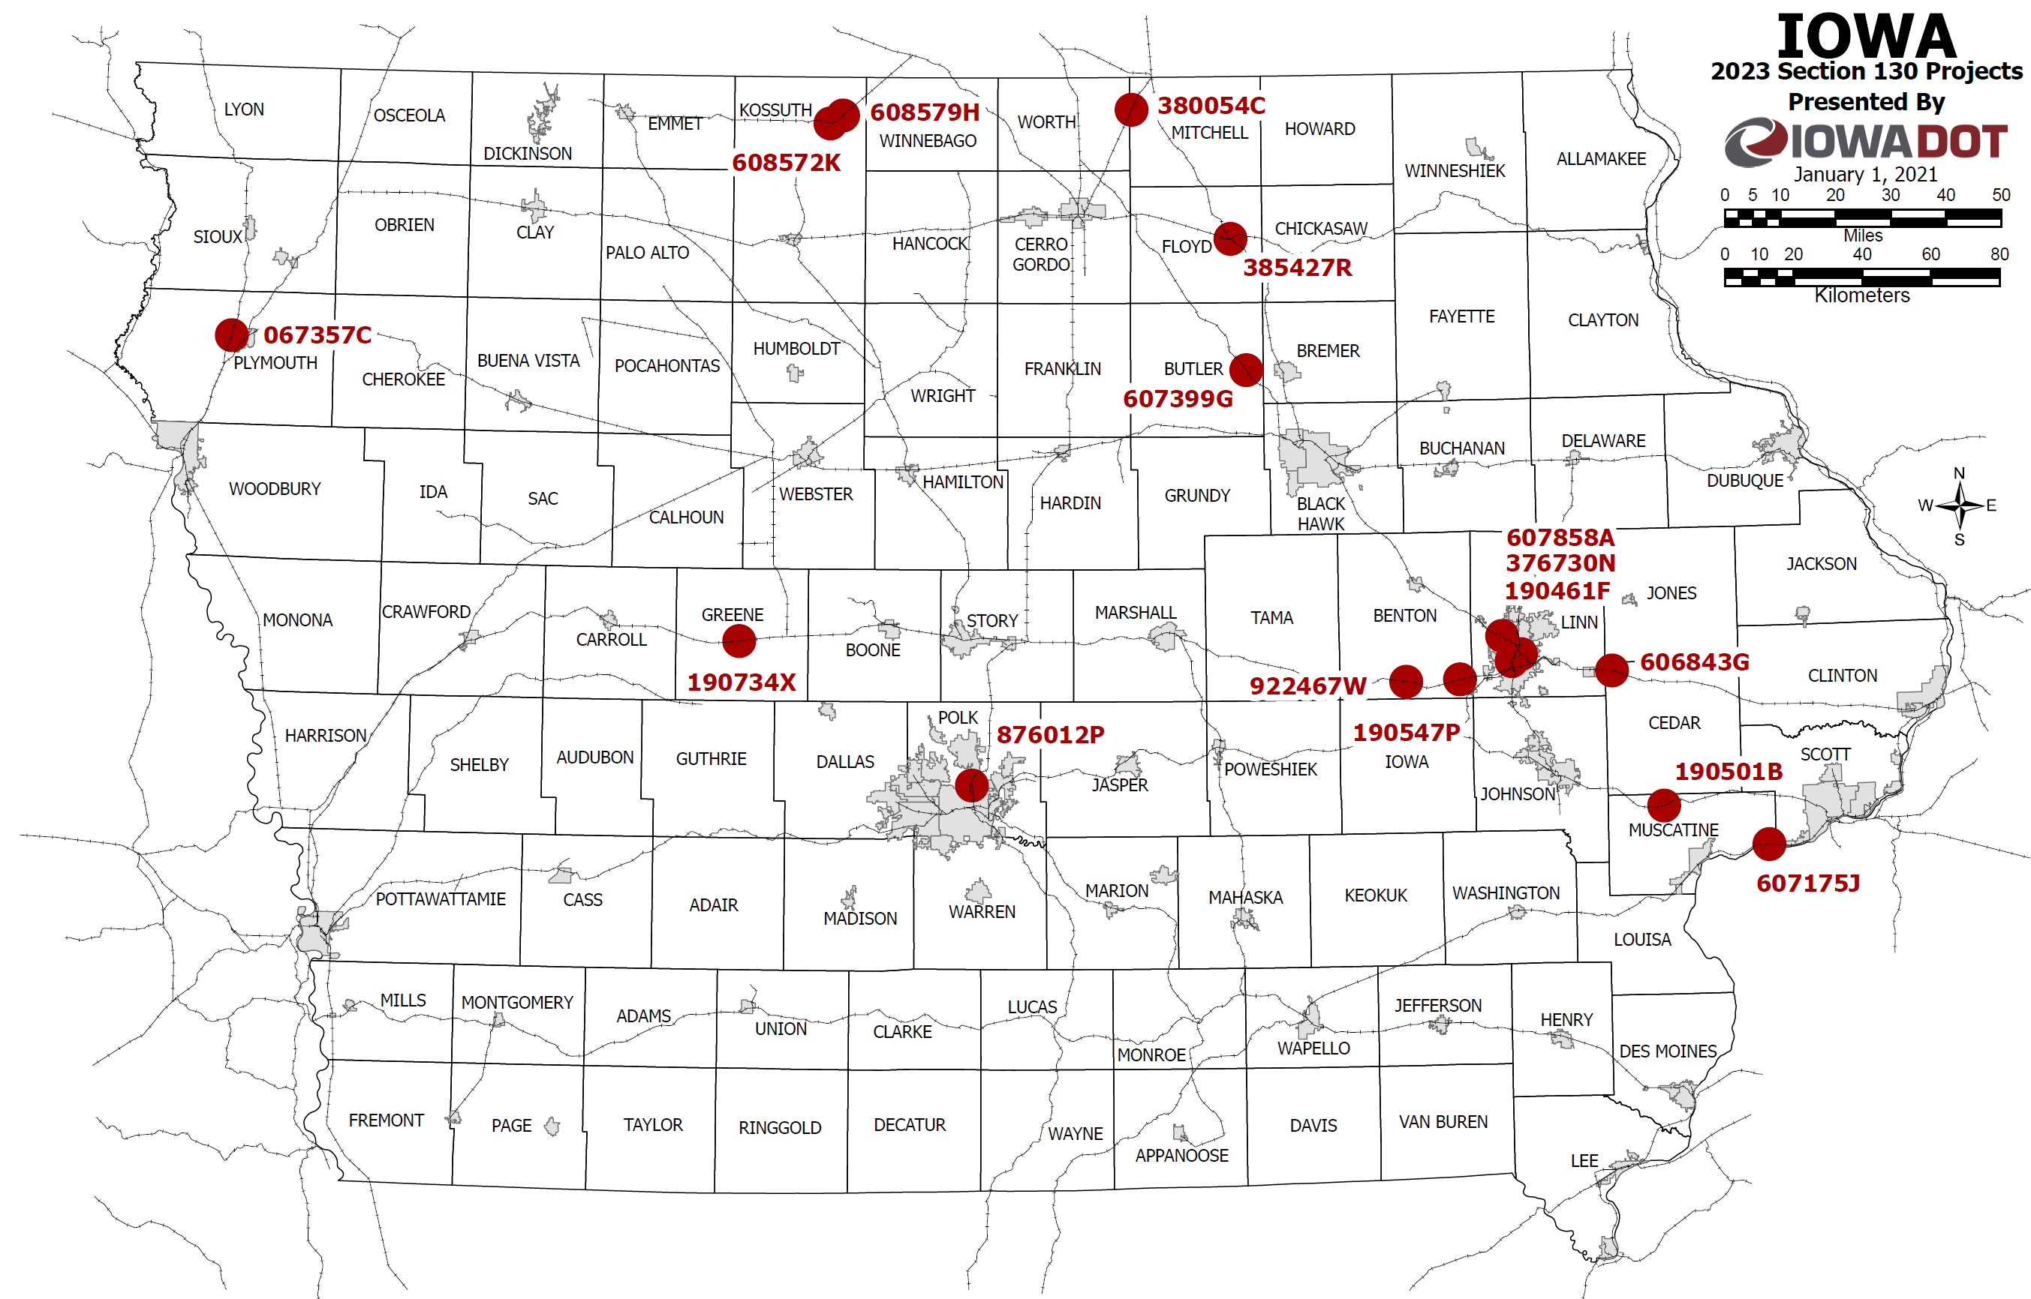
Map of Recommended Awards

Slide 10
QUESTIONS?
Kristopher Klop
Manager, Highway-Rail Crossing Programs
kristopher.klop@iowadot.us

