Slide 1
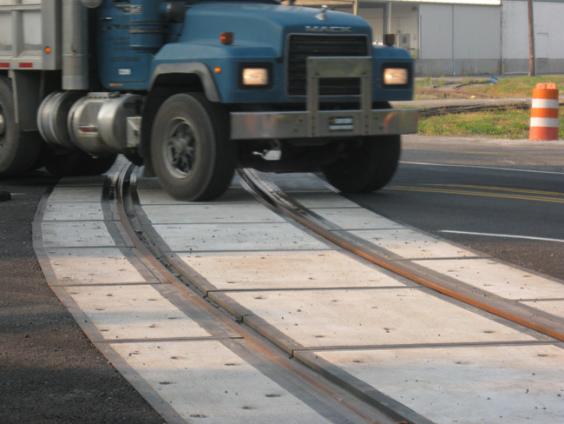
FY 2023 Highway-Railroad Crossing
Surface Repair Program
September 14, 2021

Slide 2
Program
Highway-Railroad crossing surface repair program incentivizes railroads and roadway authorities to participate in the cooperative repair of crossing surfaces.
Project funding breakdown:
60% State
20% Roadway authority
20% Railroad
Responsibilities:
Railroad: Replacement of rock (ballast), ties, track, underlayment, and crossing panels
Roadway Authority: Replacement of crossing approaches and existing sidewalks (ADA compliant), road closures and detours

Slide 3
Project Evaluation Criteria
Projects are funded in the order the applications are received, except that up to 50% of the program allocation can be used in a discretionary manner.
All 36 crossings currently in the program queue were scored according to the following criteria:
Type of route the crossing is on, (crude oil, ethanol, passenger)
Average daily vehicle traffic / train traffic
Exposure index, (number of trains x number of cars)
Predicted Accidents, (train speed, roadway speed, number of traffic lanes, number of tracks)
Planned concurrent roadway projects
On-site inspection
Maximum score possible: 30 points
Final Projects
The six highest scored crossings were brought forward to be funded in addition to those already scheduled to be funded for FY 2022 for a total of 13 projects.
Associated railroads and roadway authorities were contacted and confirmed they were able to participate with funding and repairs.

Slide 4
Available Funding and Application Summary
Crossing Surface Repair Program receives an annual statutory appropriation of $900,000 (off-the-top of the Road Use Tax Fund)
Program funding queue currently has 36 submitted applications.
Number of projects:
7 - in order received
6 - with scoring
13 - total
Total program funding request: $1,052,001
In order received: $570,727 / 54%
Scored: $481,274 / 46%
Annual appropriation $900,000
Four cancelled projects last year: + $507,275
Available funding for FY 2023: $1,407,275

Slide 5
List of Applications Recommended
PROJECT NAME | SPONSORS | SCORE | TOTAL PROJECT COST | REQUESTED AMOUNT (% of Total Project Cost) | RECOMMENDED AMOUNT (% of Total Project Cost)
5th Avenue, 607878L | IAIS Railroad City of Altoona | N/A Order Received | $127,701 | $76,621 (60%) | $76,621 (60%)
9th Ave./ 5th Ave., 607880M | IAIS Railroad City of Altoona | N/A Order Received | $136,562 | $81,937 (60%) | $81,937 (60%)
Smith Street 607937L | IANR Railroad City of Shellsburg | N/A Order Received | $57,600 | $34,560 (60%) | $34,560 (60%)
9th Street SW 840212W | CRANDIC Railroad City of Cedar Rapids | N/A Order Received | $63,850 | $38,310 (60%) | $38,310 (60%)

Slide 6
List of Applications Recommended
PROJECT NAME | SPONSORS | SCORE | TOTAL PROJECT COST | REQUESTED AMOUNT (% of Total Project Cost) | RECOMMENDED AMOUNT (% of Total Project Cost)
305th Street, 608544G | DME Railroad Cerro Gordo County | N/A Order Received | $79,500 | $47,700 (60%) | $47,700 (60%)
W. Cedar Street, 307576F | CCP Railroad City of Cherokee | N/A Order Received | $142,000 | $85,200 (60%) | $85,200 (60%)
9th Street SW., 376726Y | CRANDIC Railroad City of Cedar Rapids | N/A Order Received | $344,000 | $206,400 (60%) | $206,400 (60%)

Slide 7
List of Applications Recommended
PROJECT NAME | SPONSORS | SCORE | TOTAL PROJECT COST | REQUESTED AMOUNT (% of Total Project Cost) | RECOMMENDED AMOUNT (% of Total Project Cost)
86th Street, 377207A | IAIS Railroad City of Clive | 35 | $286,123 | $171,674 (60%) | $171,674 (60%)
20th Street NW, 067362Y | BNSF Railroad City of Sioux Center | 28 | $138,000 | $82,800 (60%) | $82,800 (60%)
4th St. NW, 067359R | BNSF Railroad City of Sioux Center | 27 | $113,000 | $67,800 (60%) | $67,800 (60%)
3rd St. NW 067358J | BNSF Railroad City of Sioux Center | 26 | $117,000 | $70,200 (60%) | $70,200 (60%)

Slide 8
List of Applications Recommended
PROJECT NAME | SPONSOR | SCORE | TOTAL PROJECT COST | REQUESTED AMOUNT (% of Total Project Cost) | RECOMMENDED AMOUNT (% of Total Project Cost)
3rd St. NW, 067358J | Farmer’s Co-op City of Sioux Center | 26 | $74,000 | $44,400 (60%) | $44,400 (60%)
4th St. NW, 067359R | Farmer’s Co-op City of Sioux Center | 25 | $74,000 | $44,400 (60%) | $44,400 (60%)

Slide 9
Map of Recommended Awards

Slide 10
QUESTIONS?
Kristopher Klop
Manager, Highway-Rail Crossing Programs
kristopher.klop@iowadot.us

