Slide 1
Transportation Commission Update #4
September 14, 2021

Slide 2
Project Background
Develop a system plan to advance an already outstanding airport system
10 years since last system plan
Assistance provided by Project Advisory Committee (PAC)

Slide 3
Iowa’s Recommended System
Built on 2010 SASP
Upgrade three airports
Shenandoah Municipal (Basic Service to General Service)
Lamoni Municipal (Local Service to Basic Service)
Waverly Municipal (Local Service to Basic Service)
Two additional airports
Sioux Regional (new)
Peltz Field
South Central Airport – Will replace Pella and Oskaloosa during the planning period

Slide 4
Technical Document
Introduction – Goals of the Plan
Inventory – Airport Survey
Forecast – What activity is expected in the system in the future
System Evaluation – How are the system airports meeting user needs
Airport System Roles – How are the system airports divided
Facility and Service Objective Evaluation – How system airports meet established criteria
Cost Estimates – Review of system costs
Recommendations – Areas to focus on moving forward

Slide 5
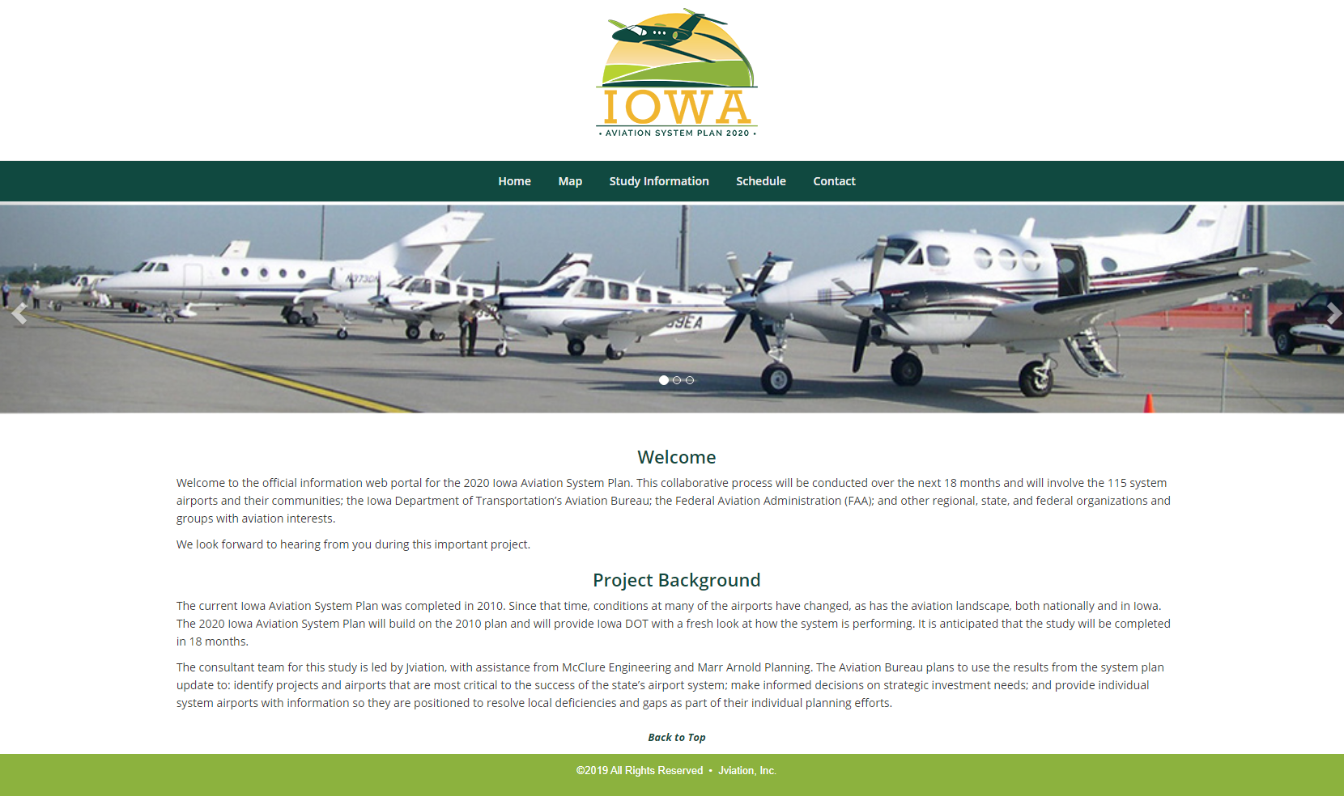
Public Involvement and Comment
Public Comment Period was open from June 1 – July 16, 2021
- Notices sent out via DOT press release, direct email to stakeholders and aviation users
- Two comments received and responded to
Public Information Webinar
- July 1, 2021
- No Comments Received All draft Technical Document chapters and Advisory Committee meeting presentations available on the website throughout the development

Slide 6
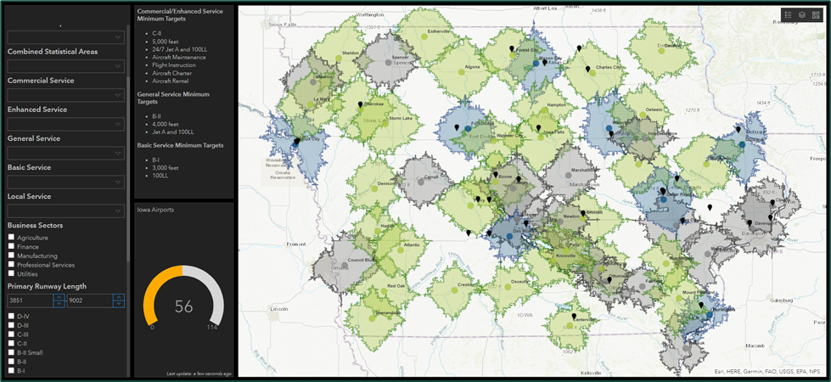
Continuation of the System Planning Process
ArcGIS Dashboard
Economic Impact Study – started this summer
ArcGIS System Assessment Tool and Dashboard will allow for updating and future assessment of changing conditions

Slide 7
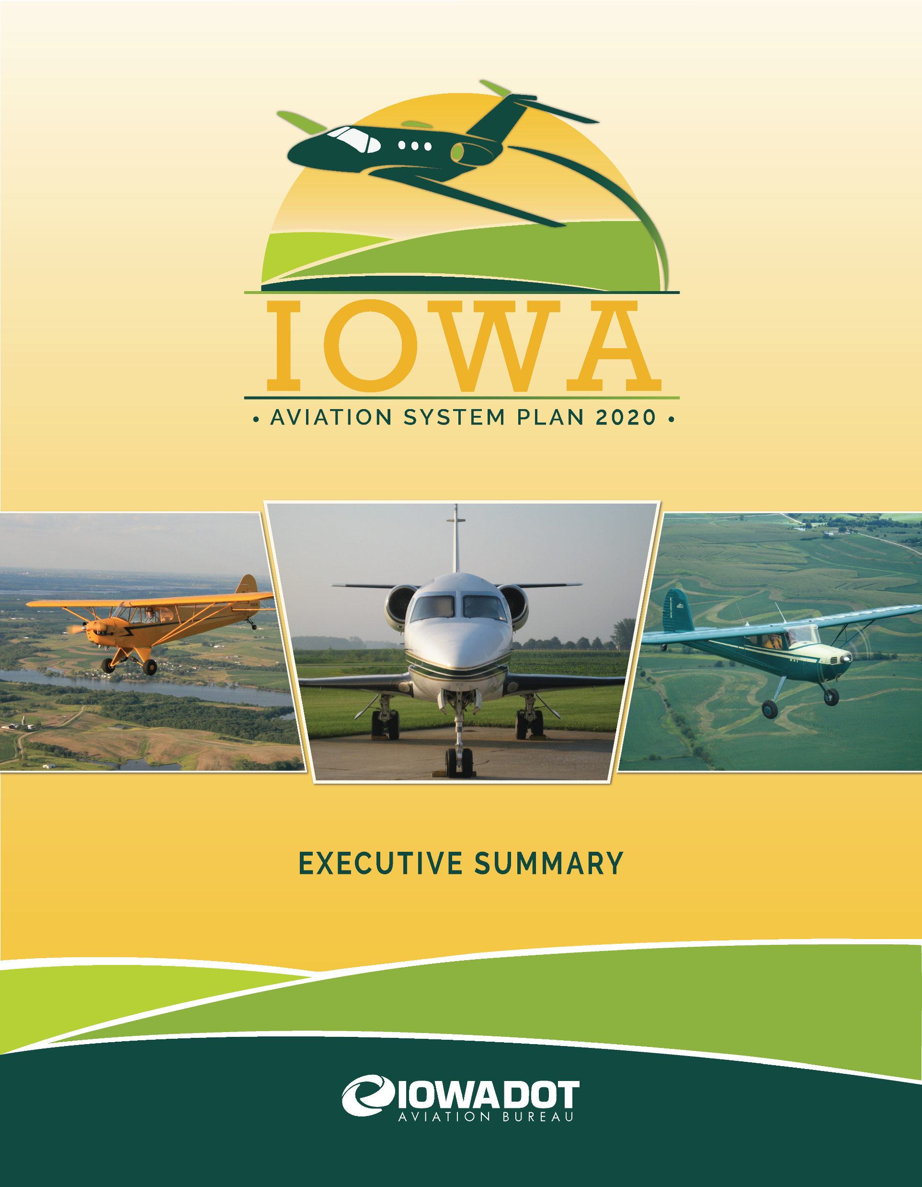
Deliverables: Executive Summary

Slide 8
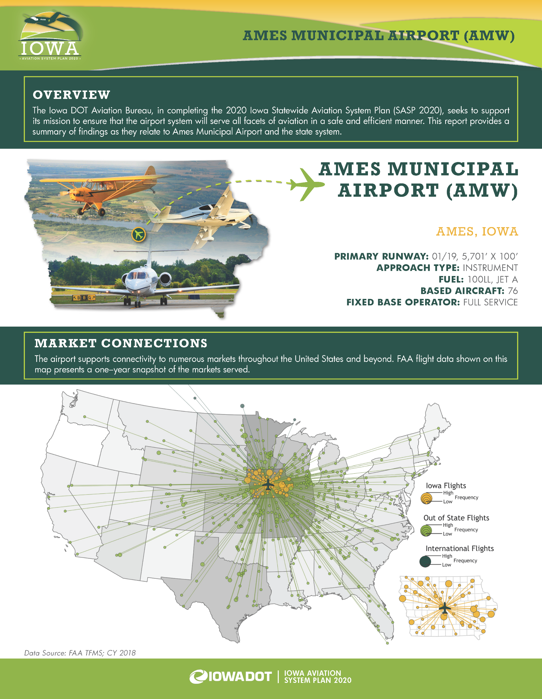
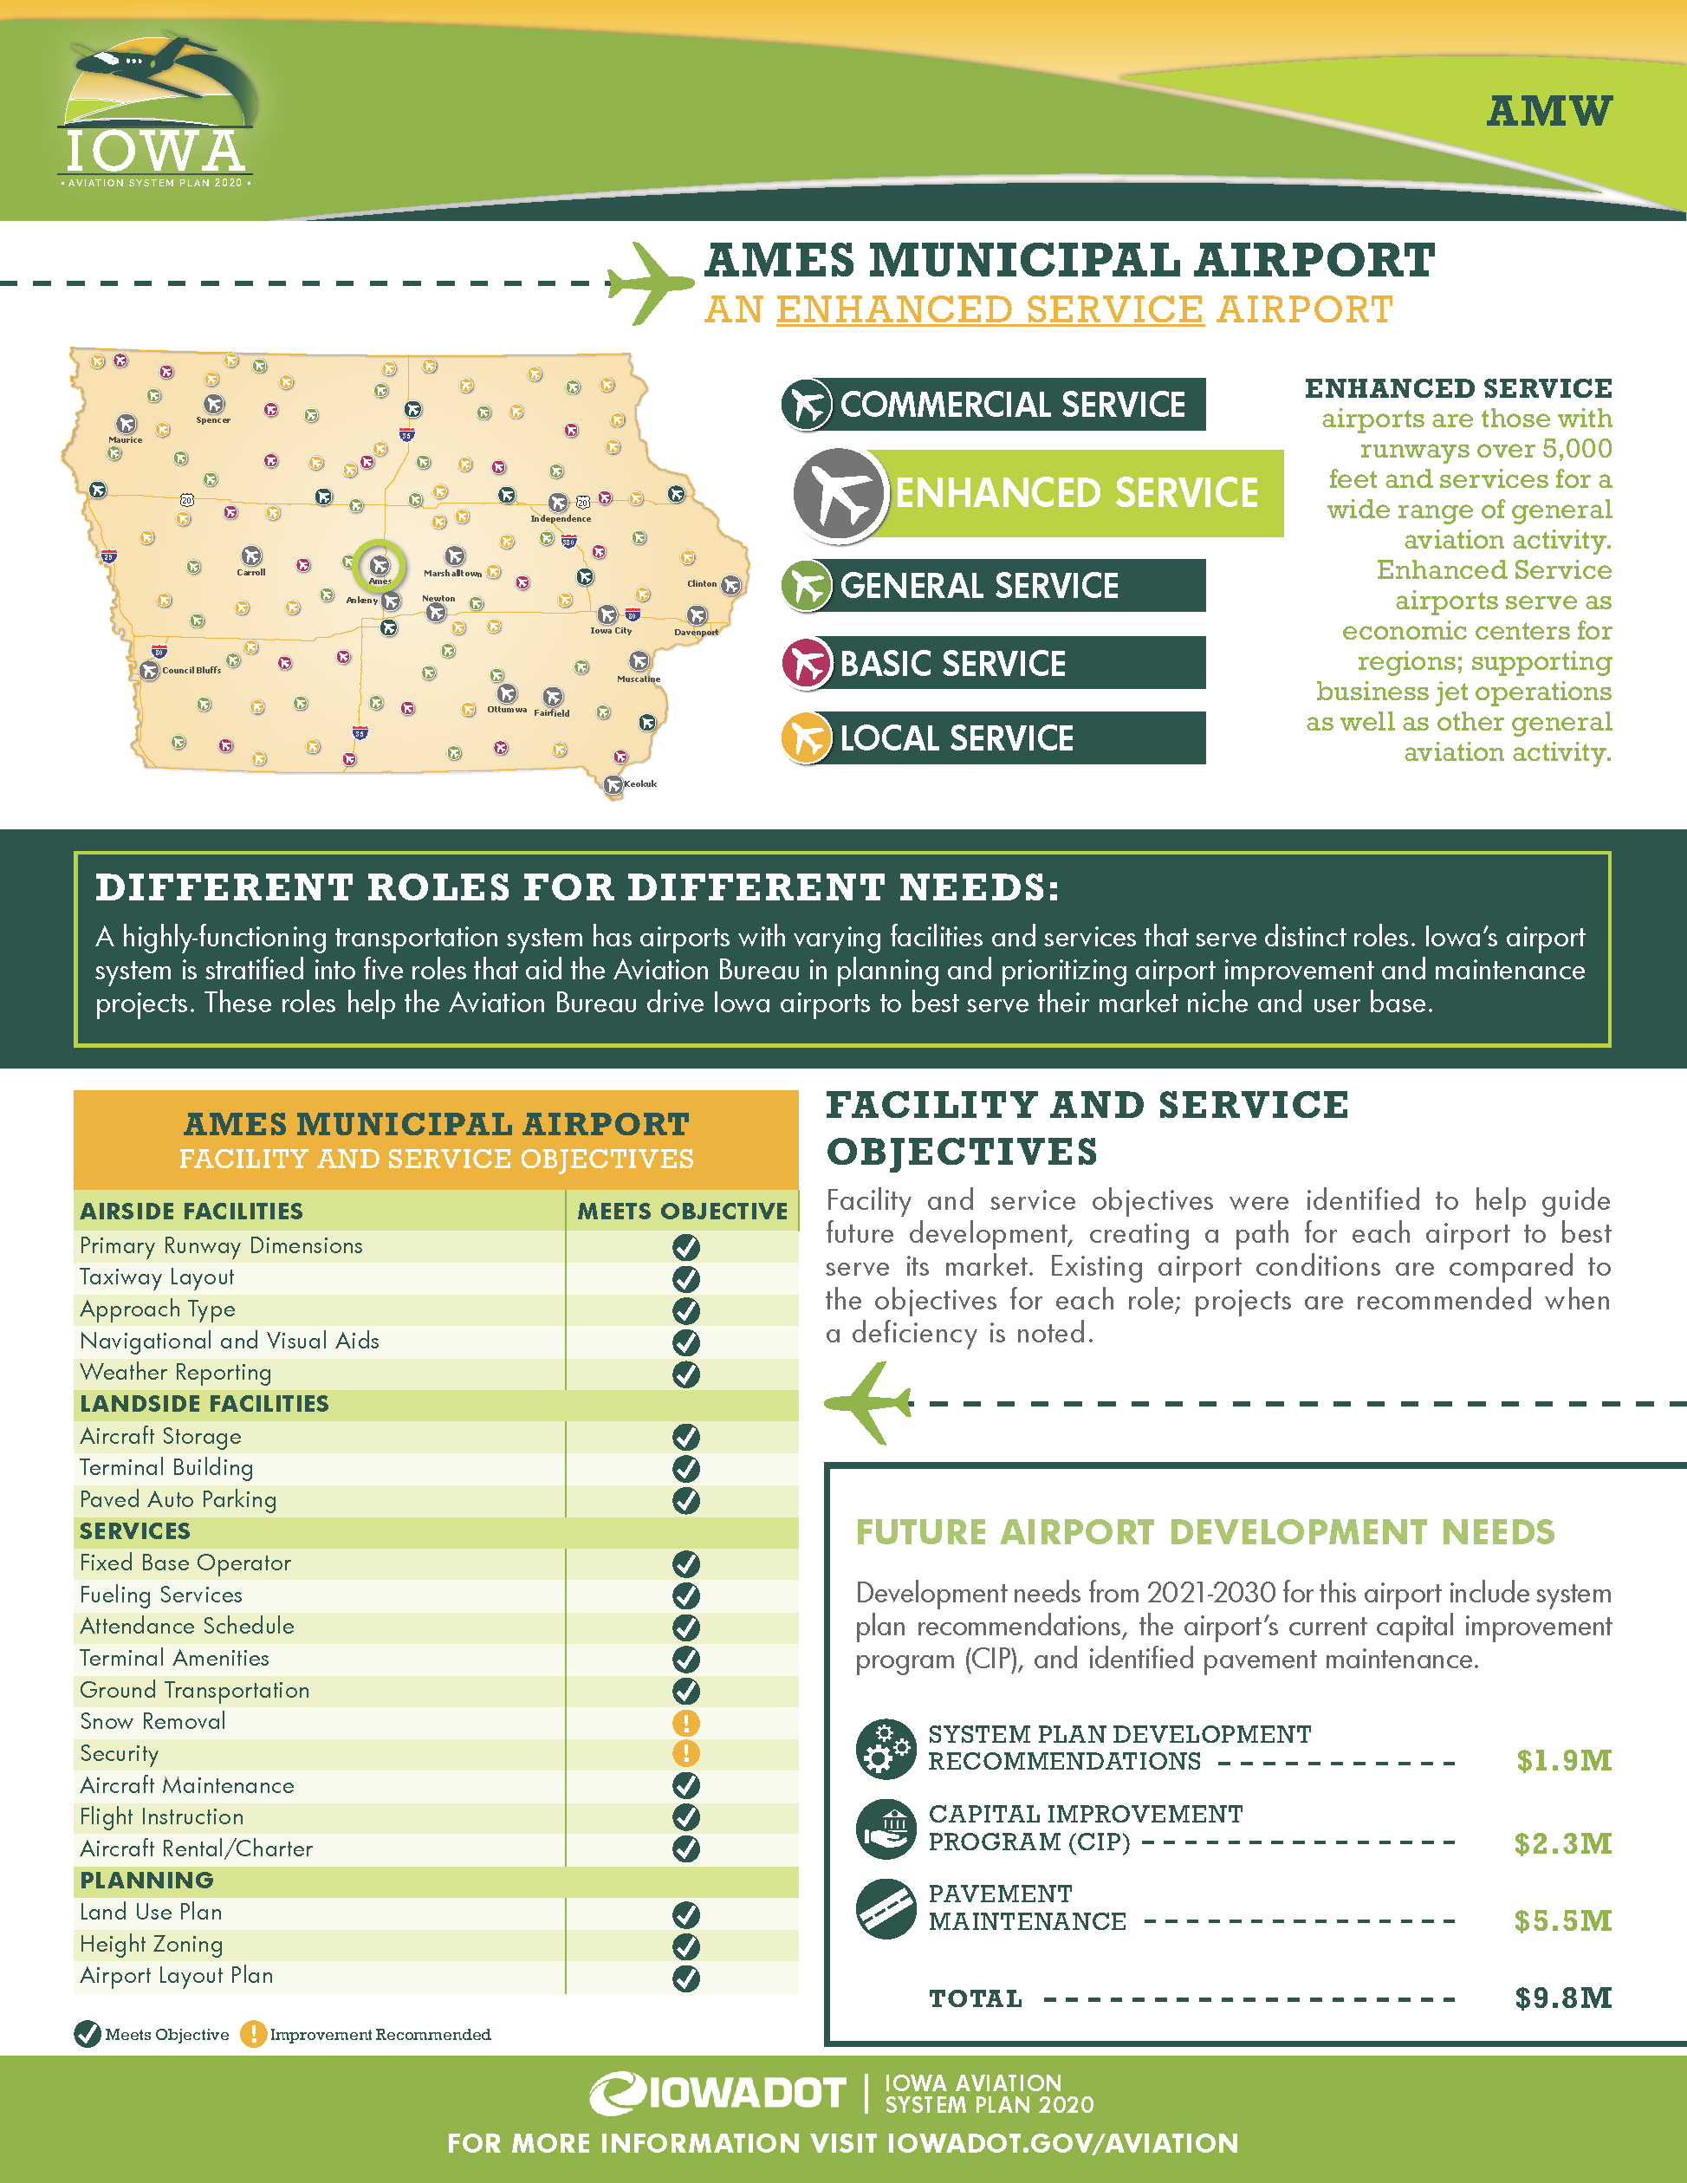
Deliverables: Individual Airport Summary

Slide 9
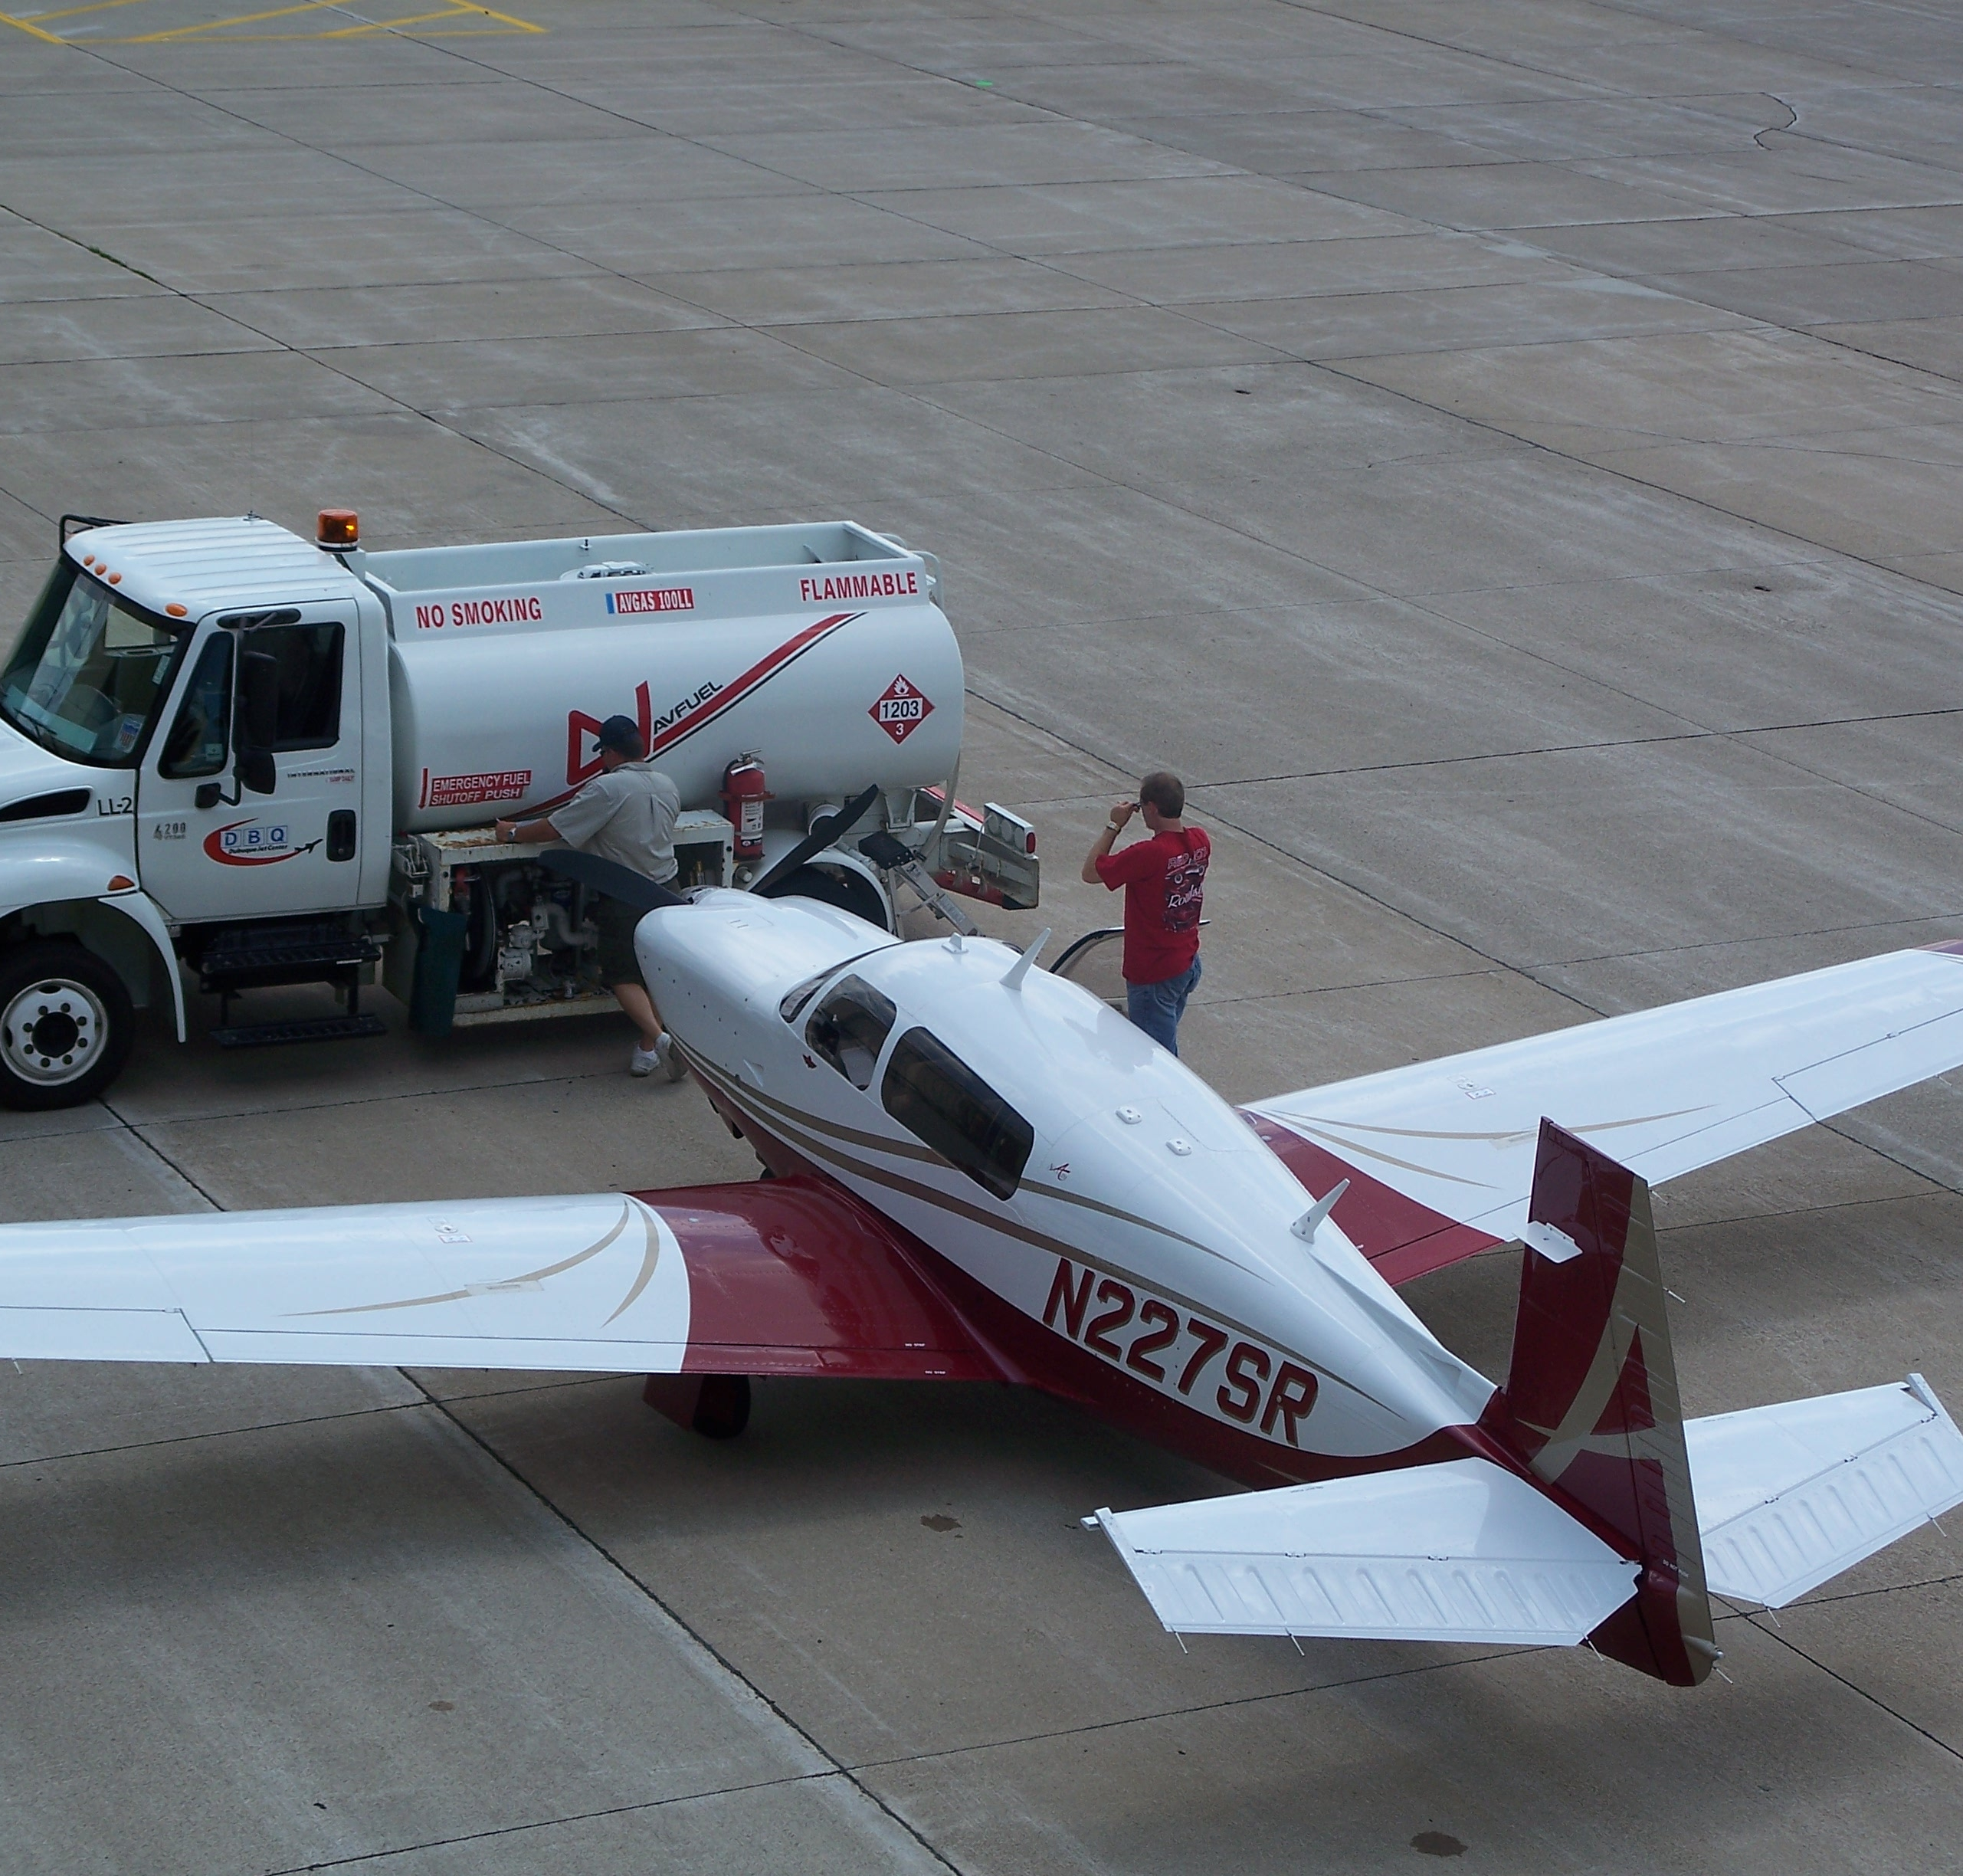
Next Steps
Finalize Executive Summary and Individual Reports
Distribute Information to Sponsors
Evaluate internal programming
Monitor and Update progress
ArcGIS Tool

Slide 10
Thank You – Any questions?

